Slide 1
Oklahoma Swimming
Administrative Official Clinic

Slide 2
102.14 ADMINISTRATIVE OFFICIAL/REFEREE
.1 Shall be responsible to the Referee for the supervision of the following:
The entry and registration process
Clerk of Course
Timing Equipment Operator
Hy-Tek Operator
Other administrative personnel

Slide 3
102.14 ADMINISTATIVE OFFICIAL/REFEREE
.2 Shall be responsible to the Referee for:
The accurate processing of entries and scratches.
Accurate seeding of preliminary, semi-final and final heats.
Determination and recording of official time.
Receiving and reviewing the automatic and/or semi-automatic timing results from the Timing Equipment Operator and comparing primary timing results with the back-up timing results to determine their validity.
Receiving the times recorded by the Head Lane Timers from the Chief Timer and the order of finish data from the Place Judges and using that data to the extent needed to determine the official time for each swimmer.
Unless otherwise directed, notifying the Referee whenever a time obtained by the primary timing system cannot be used as the Official Time.
Recording disqualifications approved by the Referee.
Determination of the Official Results
Publication and posting of results and scores.
.3 Shall perform other duties assigned by the Referee

Slide 4
THE ADMINISTRATIVE OFFICIAL MUST:
Know the administrative rules of USA Swimming.
Ensure those rules are followed and that all swimmers have their results fairly and accurately recorded.
Supervise the administrative aspects (“dry side”) of swimming competition

Slide 5
THE ADMINISTRATIVE OFFICIAL MUST:
Consult with Meet Referee on specific duties and responsibilities for that meet.
Work with the Meet Director to ensure smooth operation of that meet.
Ensure that all the administrative positions of that meet are properly being fulfilled.

Slide 6
THE ADMINISTRATIVE OFFICIAL CAN:
Be a Hy-Tek Operator or Timing Judge.
Each LSC is different, Oklahoma Swimming and USAS says that an Administrative Official cannot be a Meet Director.
The Administrative Official CANNOT also fill a “wet deck” position:
This includes Meet Referee and Deck Referee

Slide 7
How To Become an OKS Administrative Official
Must be 18 years or older.
Register as a Non-Athlete Member of USA Swimming
Complete a Level II Background Check
Complete and Pass Athlete Protection Training
Complete and Pass the Administrative Official Test with a score of 80%.
Attend an OKS conducted Administrative Officials Clinic.
Complete 4 Apprentice Sessions with an Administrative Official.

Slide 8
AS AN ADMINISTRATIVE OFFICIAL:
READ, REREAD AND REREAD, THEN HIGHLIGHT THE MEET INFORMATION!!!!!!!!
The Meet Information provides specific administrative details such as:
Details about the type of meet (timed finals or prelim/finals)
Swimmer Eligibility
Entry Requirements
Deadlines (positive check-ins, scratches)
Scoring and Awards
Deck Entries
Time Trials

Slide 9
WORK FLOW AND PRIORITIES
As an AO, you are required to balance priorities and deadlines while maintaining quality and accuracy.
“What’s the most important thing I need to be doing right now?”
This may change on a moment’s notice
You can’t sacrifice quality and accuracy, but you also can’t ignore deadlines.
Example 1: Positive Check – In
Make sure you have enough time to do all that needs to be done.
If you have multiple events, do them in batches rather than all at once.
Heat Sheets for coaches, then timer sheets, then heat sheets for officials.
Example 2: Prioritize Tasks
At a prelim/final meet, processing prelim results are very high priority.
At a timed final meet, processing results have no time pressure and may be a lower priority.

Slide 11
Forms can also be found on OKS.org. Another great resource is Midwestmeetman.com

Slide 12
RELAYS
When are relay cards due?
Have they all been turned in? Check meet manager, run a heat sheet with relay names to see who is missing.
It is important to get all the relay names in the database correctly.
Can’t check eligibility without the names.
A relay without names will not load into SWIMS
The lead-off split will not automatically load into SWIMS
Relay Cards with name and order are usually due 30 minutes prior to the event.
Coaches can change the names and/or order before the event.
A team can report an order change to the lane timers before they swim.

Slide 15
Lets talk about seeding……
Is your Meet a Timed Finals Meet?
Is it seeded slow to fast or fast to slow? Is the meet alternating heats of women and men in the same event or is the meet swimming all women and then all men per event.
Is your meet a Prelim/Finals Meet?
Is each event circle seeded for the fastest 3 heats?
Who knows the circle seeding rule that went into effect on May 8, 2017?
How are we seeding non-conforming times? What are non-conforming times?
Deck Seeding (positive check-ins):
When is the deadline? Is there a penalty if a swimmer checks-in and does not swim?

Slide 16
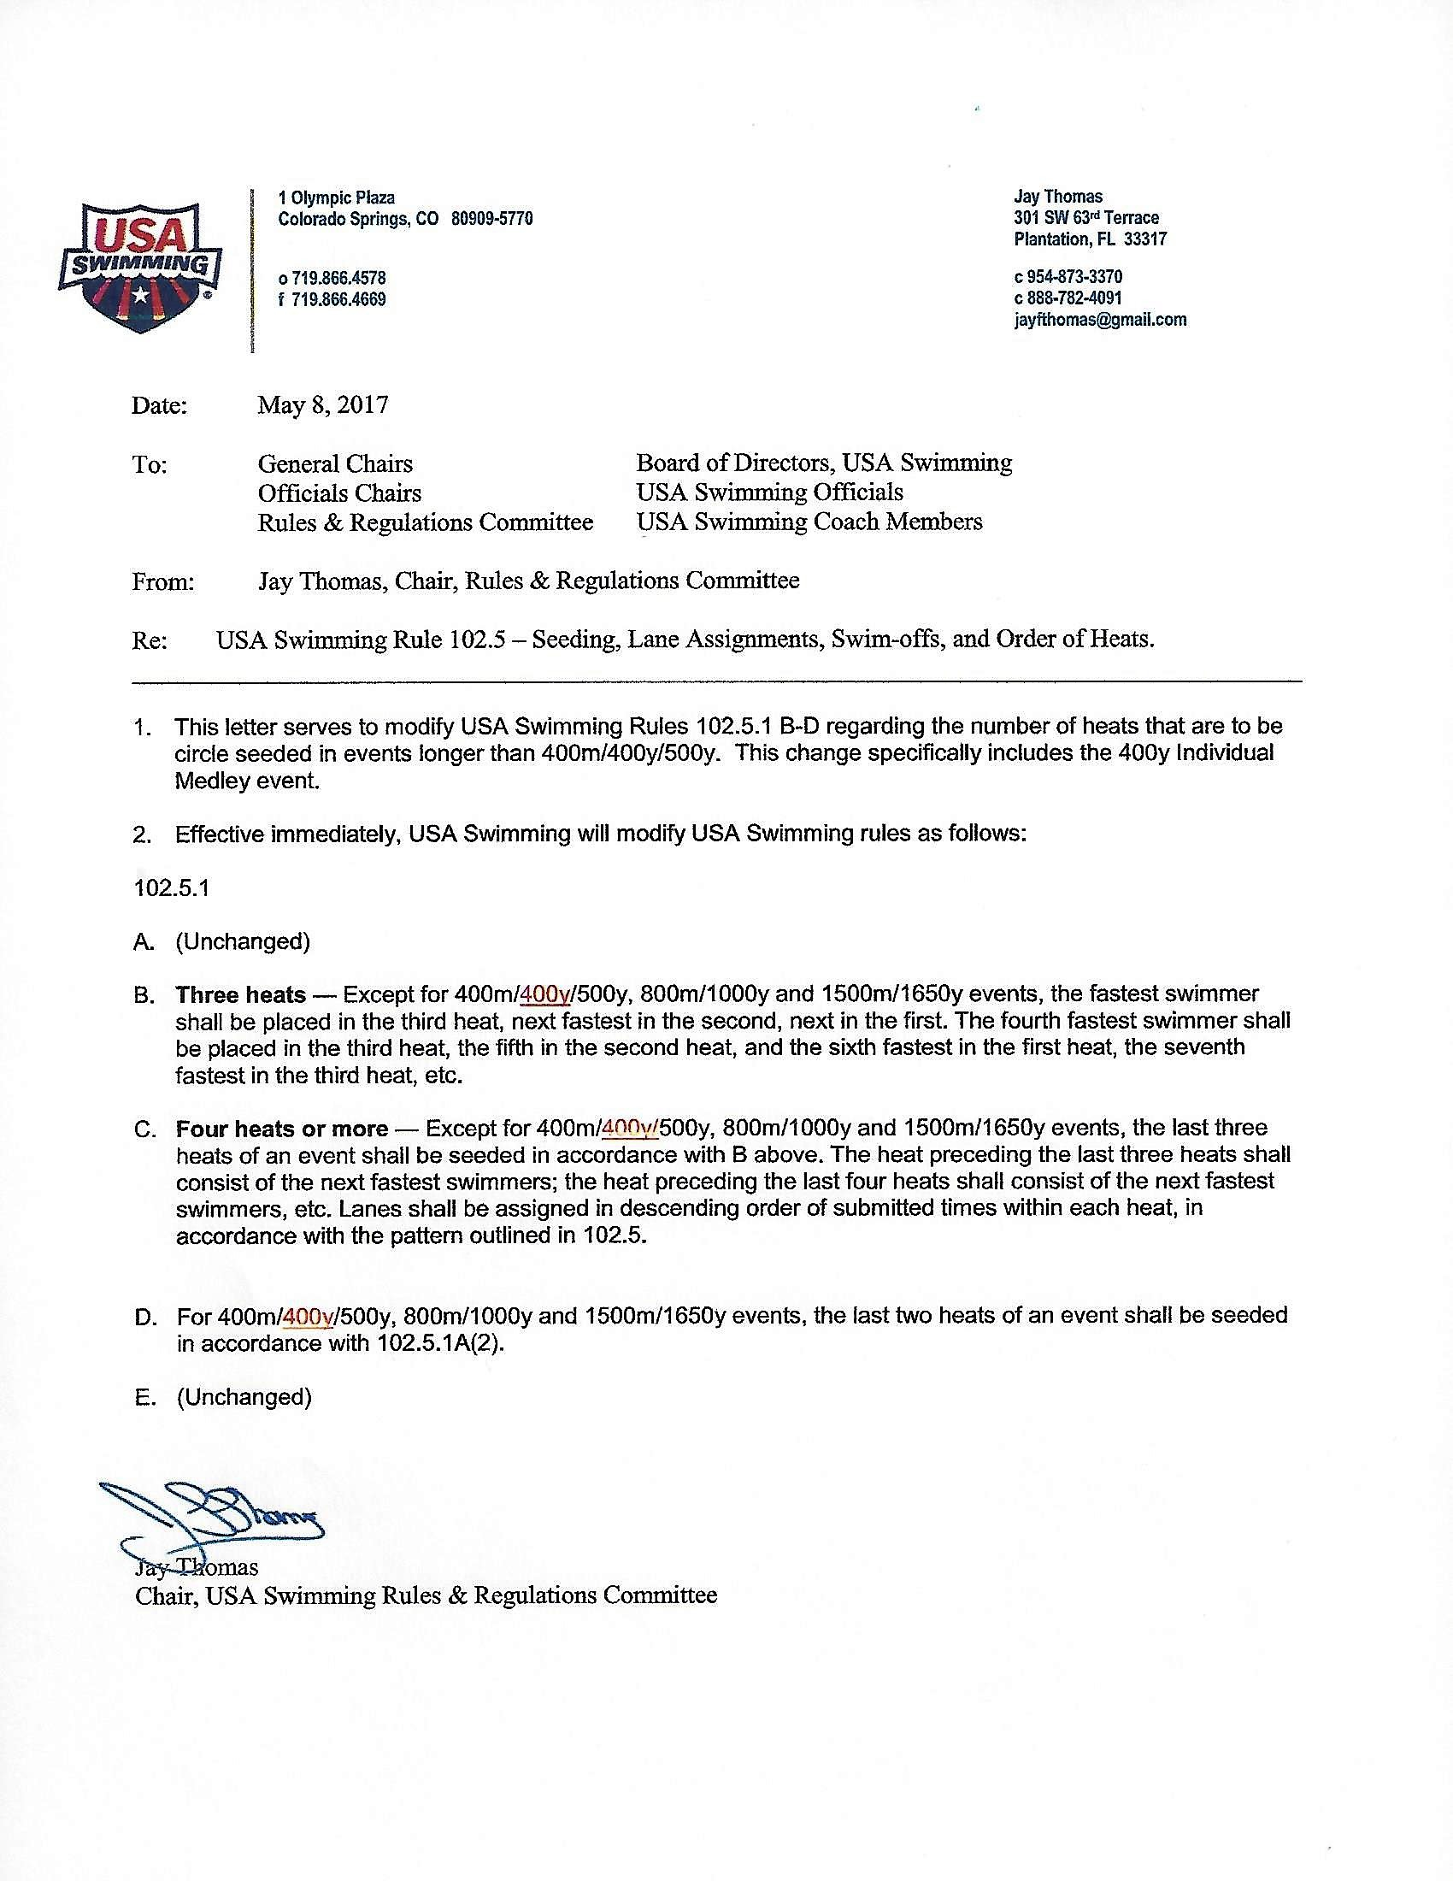

Slide 17
USING RADIOS
Listening on the radio provides the Admin. Official a picture of what is happening on deck.
Such as… DQ’s, No-Shows, Declared False Starts or Reseeds
Knows to expect paperwork for these items.
Can reconcile their counts with the deck referees.
ACKNOWLEDGE ALL RADIO CALLS MADE TO YOU!!!!!!!!
A simple “thank you” is sufficient for the caller to know you received their call.

Slide 18
Timing Systems
Know what type of timing system is being used at the meet….
The timing system should be listed in the meet information, if its not upon arrival at the pool, check it out. See what is being used. Is it working properly?
There are 3 types of systems:
Automatic Timing
Primary – touchpads, secondary – buttons, tertiary – watches
Semi-Automatic Timing
Primary – two buttons per lane, secondary – watches
Manual Timing
Primary – Three Watches per lane

Slide 19
AUTOMATIC TIMING
This is the most common type of timing system.
The touchpad is activated by the swimmer, the buttons and watches are activated by timers; 2 per lane each operating a watch and a button. One timer is designated as the scribe and writes the watch times on a lane timer sheet. They also note soft touches and verify the swimmers name.
SEMI-AUTOMATIC SYSTEM
This system relies on the buttons with back up watches. A minimum of two timers per lane is needed for this system and each timer has a button and a watch. Again, one timer is designated as the scribe and writes the watch times on a lane timer sheet. They also note soft touches and verify the swimmers name.
MANUAL TIMING
This type of system uses stop watches only. When using a manual system three stop watches are required, each operated by a separate timer.

Slide 20
TIMING JUDGE
Determining the OFFICIAL TIME is the MOST IMPORTANT job of the Administrative Official.
Read USAS Rule 102.24 – Timing Rules
Understand the use of primary and backup timing systems
Understand how to apply the rules for using a back up time when you have determined a primary system malfunction
Order of Finish is another piece of information that can come in handy.
Don’t get wrapped up in procedures and make a good primary time into a bad time.
102.24.4A: Automatic Timing – When recorded by properly operating automatic equipment, the pad time shall be the official time.
You MUST prove the pad time is incorrect.
Use button times, watch times and order of finish
Talk to the timers: Was there a timer error? Was there a late or soft touch?
How confident is the starter in the order of finish?

Slide 21
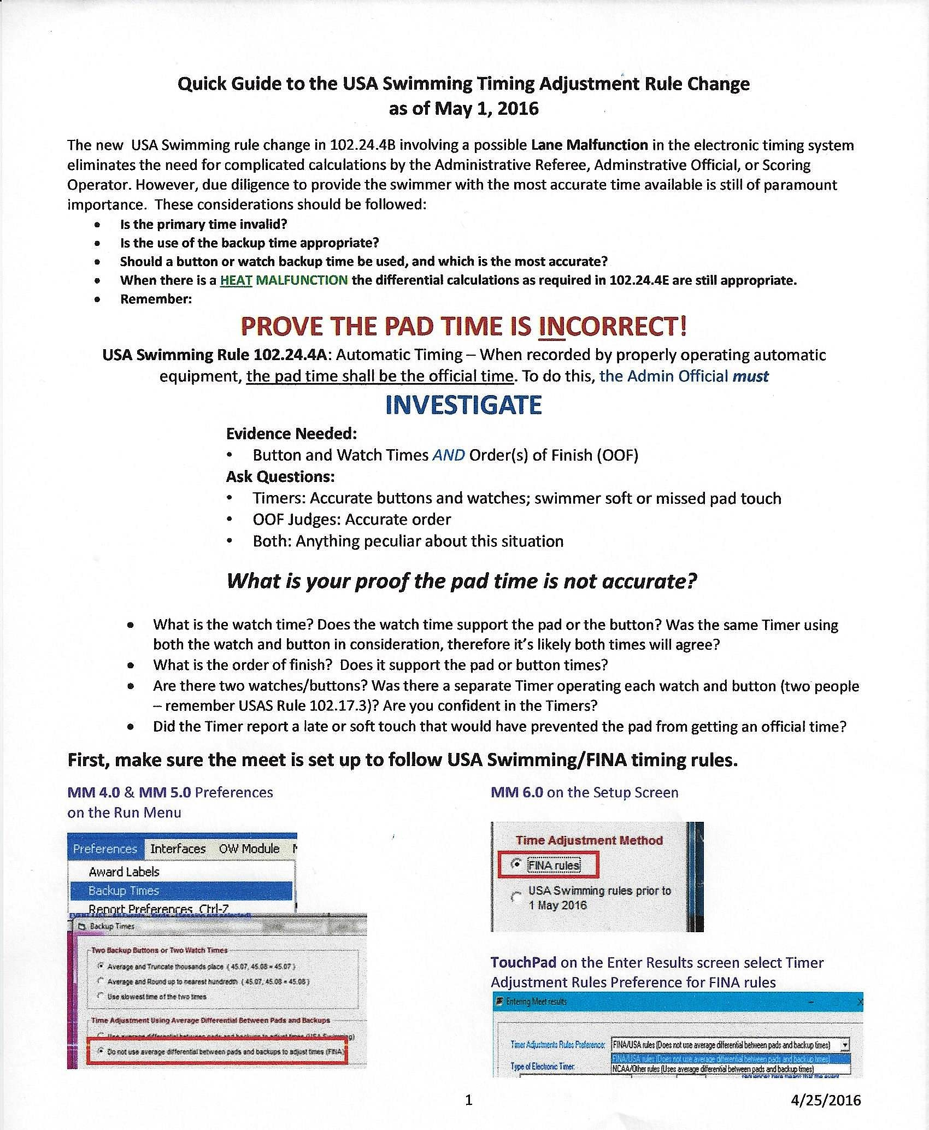
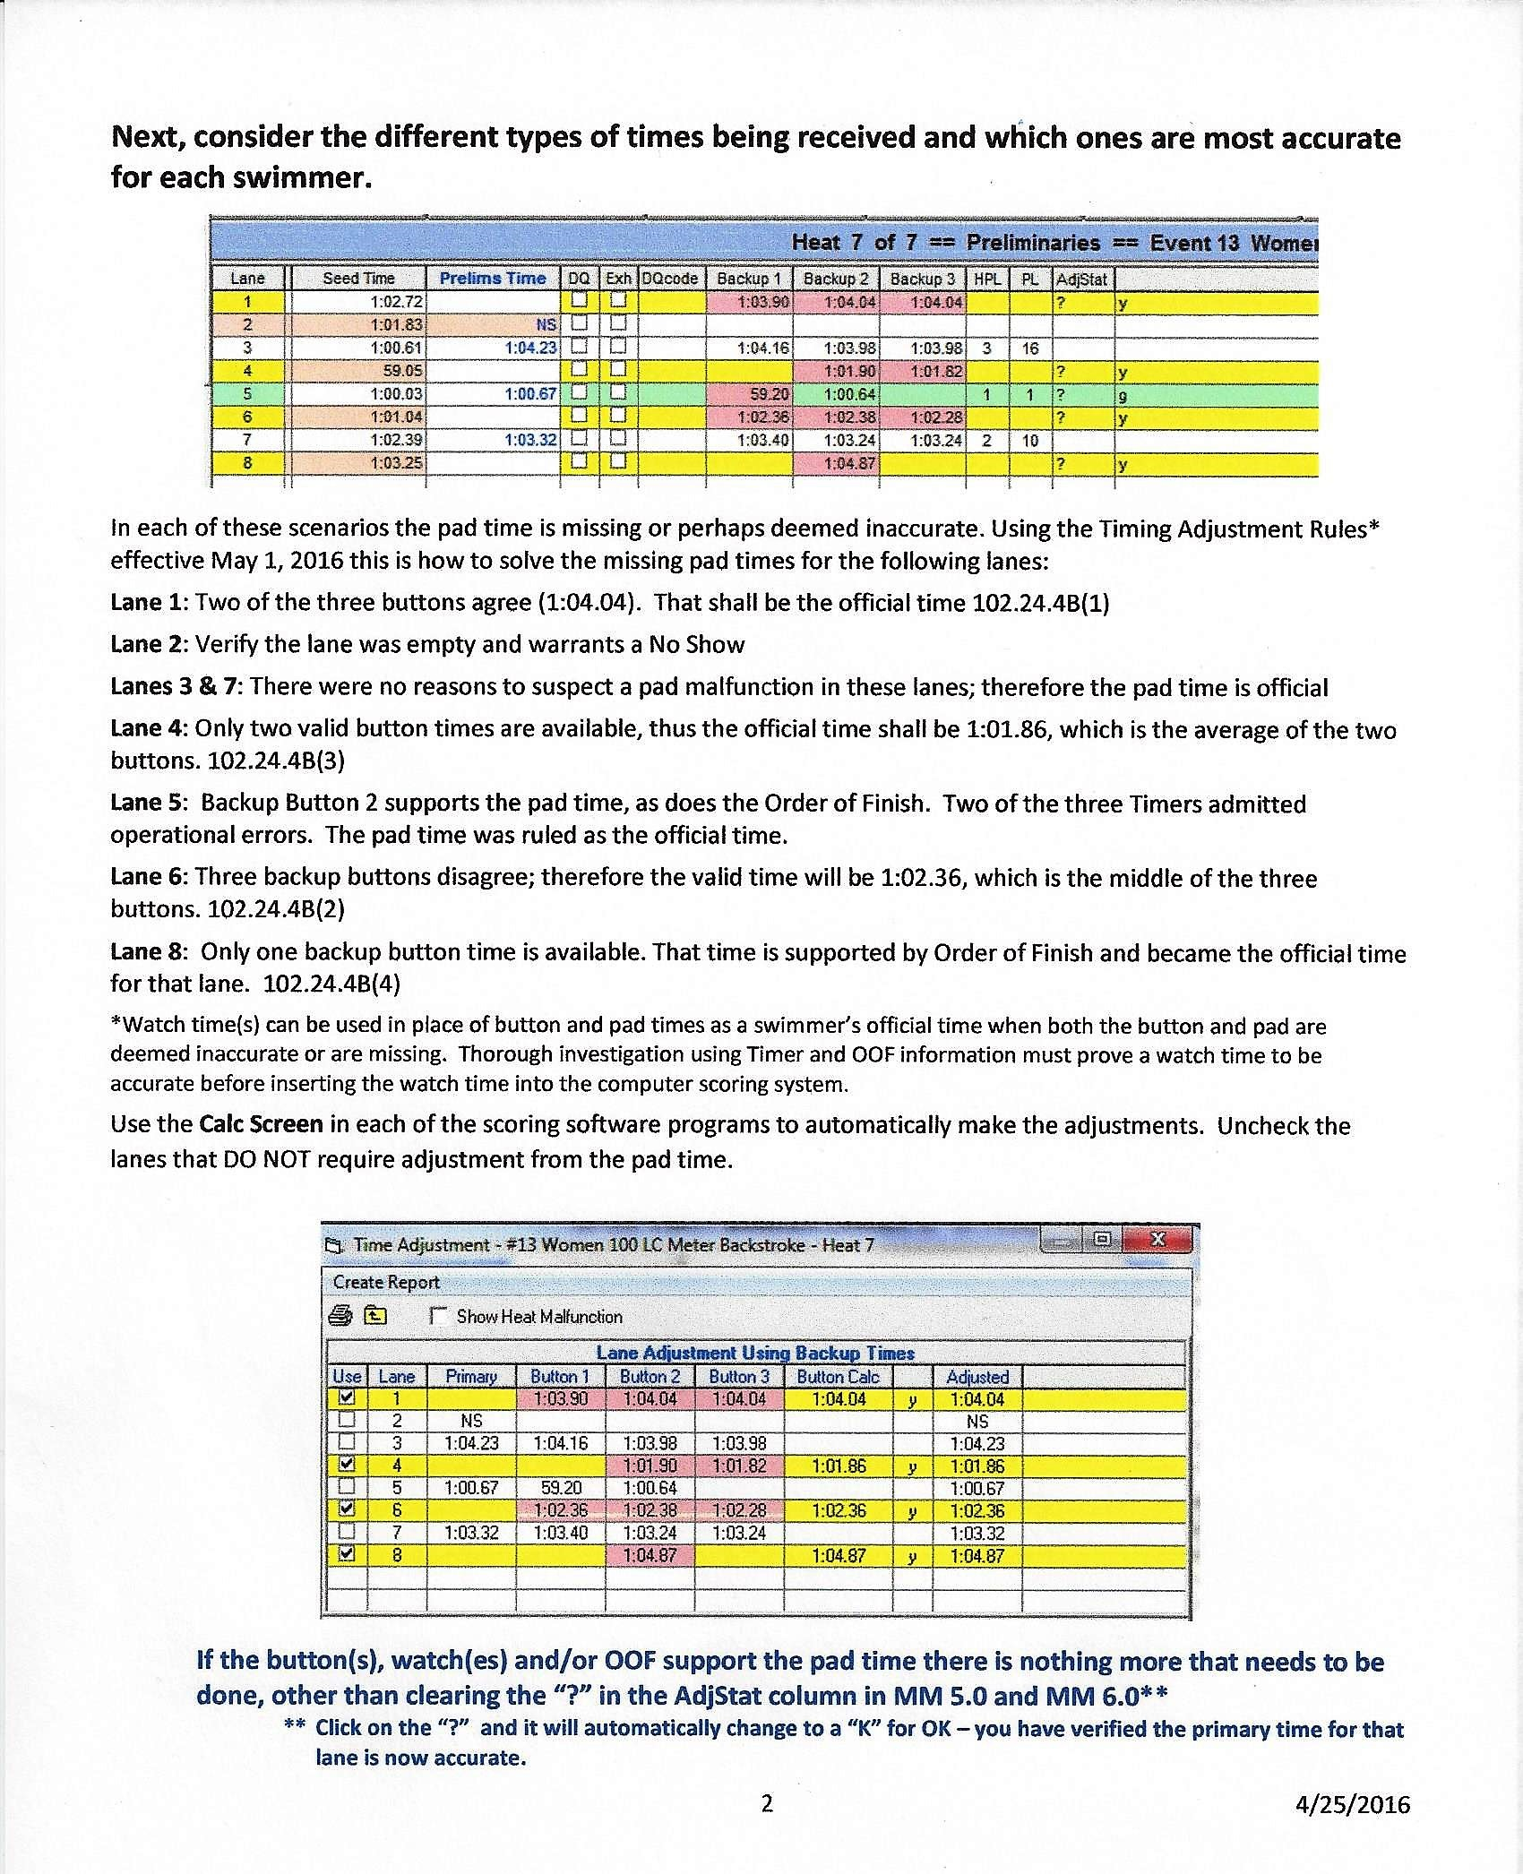
TIMING JUDGE
USA SWIMMING GUIDELINES

Slide 24
TIMING JUDGE
The following scenarios assume that touchpads are the primary timing system, two buttons are the secondary system, and at least one stopwatch is the tertiary system (automatic timing)
Later we will look at some scenarios for when two buttons are the primary timing system (semi-automatic timing)

Slide 36
TIMING JUDGE
No Pad Time. No Back Up Buttons. No Back Up Stopwatch time.
Get order of finish to know where the swimmer places in the heat.
Use any time you can get!!!!
For example, a coach’s time
Whenever you use a back up time….
Document what you did for the file.
The easiest way is to write it on the timing system printout.
Include the watch times, order of finish, and any other information you used to determine the time (include the final time)
Anyone looking at the paperwork later should be able to tell what you did and why you did it.

Slide 37
TIMING JUDGE
The following scenarios assume two buttons are the primary timing system and one stopwatch is the back up (semi-automatic timing).

Slide 41
TIMING JUDGE
No Buttons:
Verify the back up watch time with the order of finish to determine the official time.
The back up watch time is the official time.

Slide 42
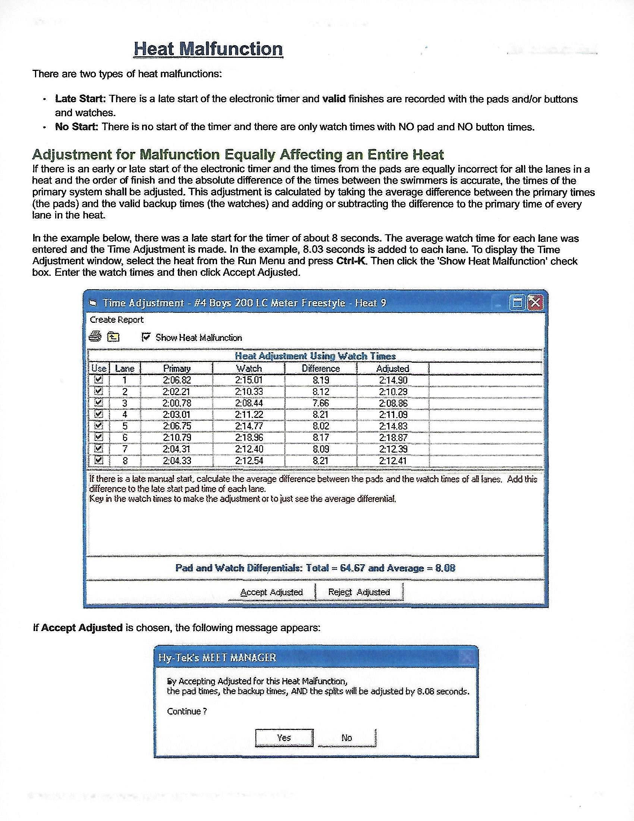
HEAT MALFUNCTION

Slide 43
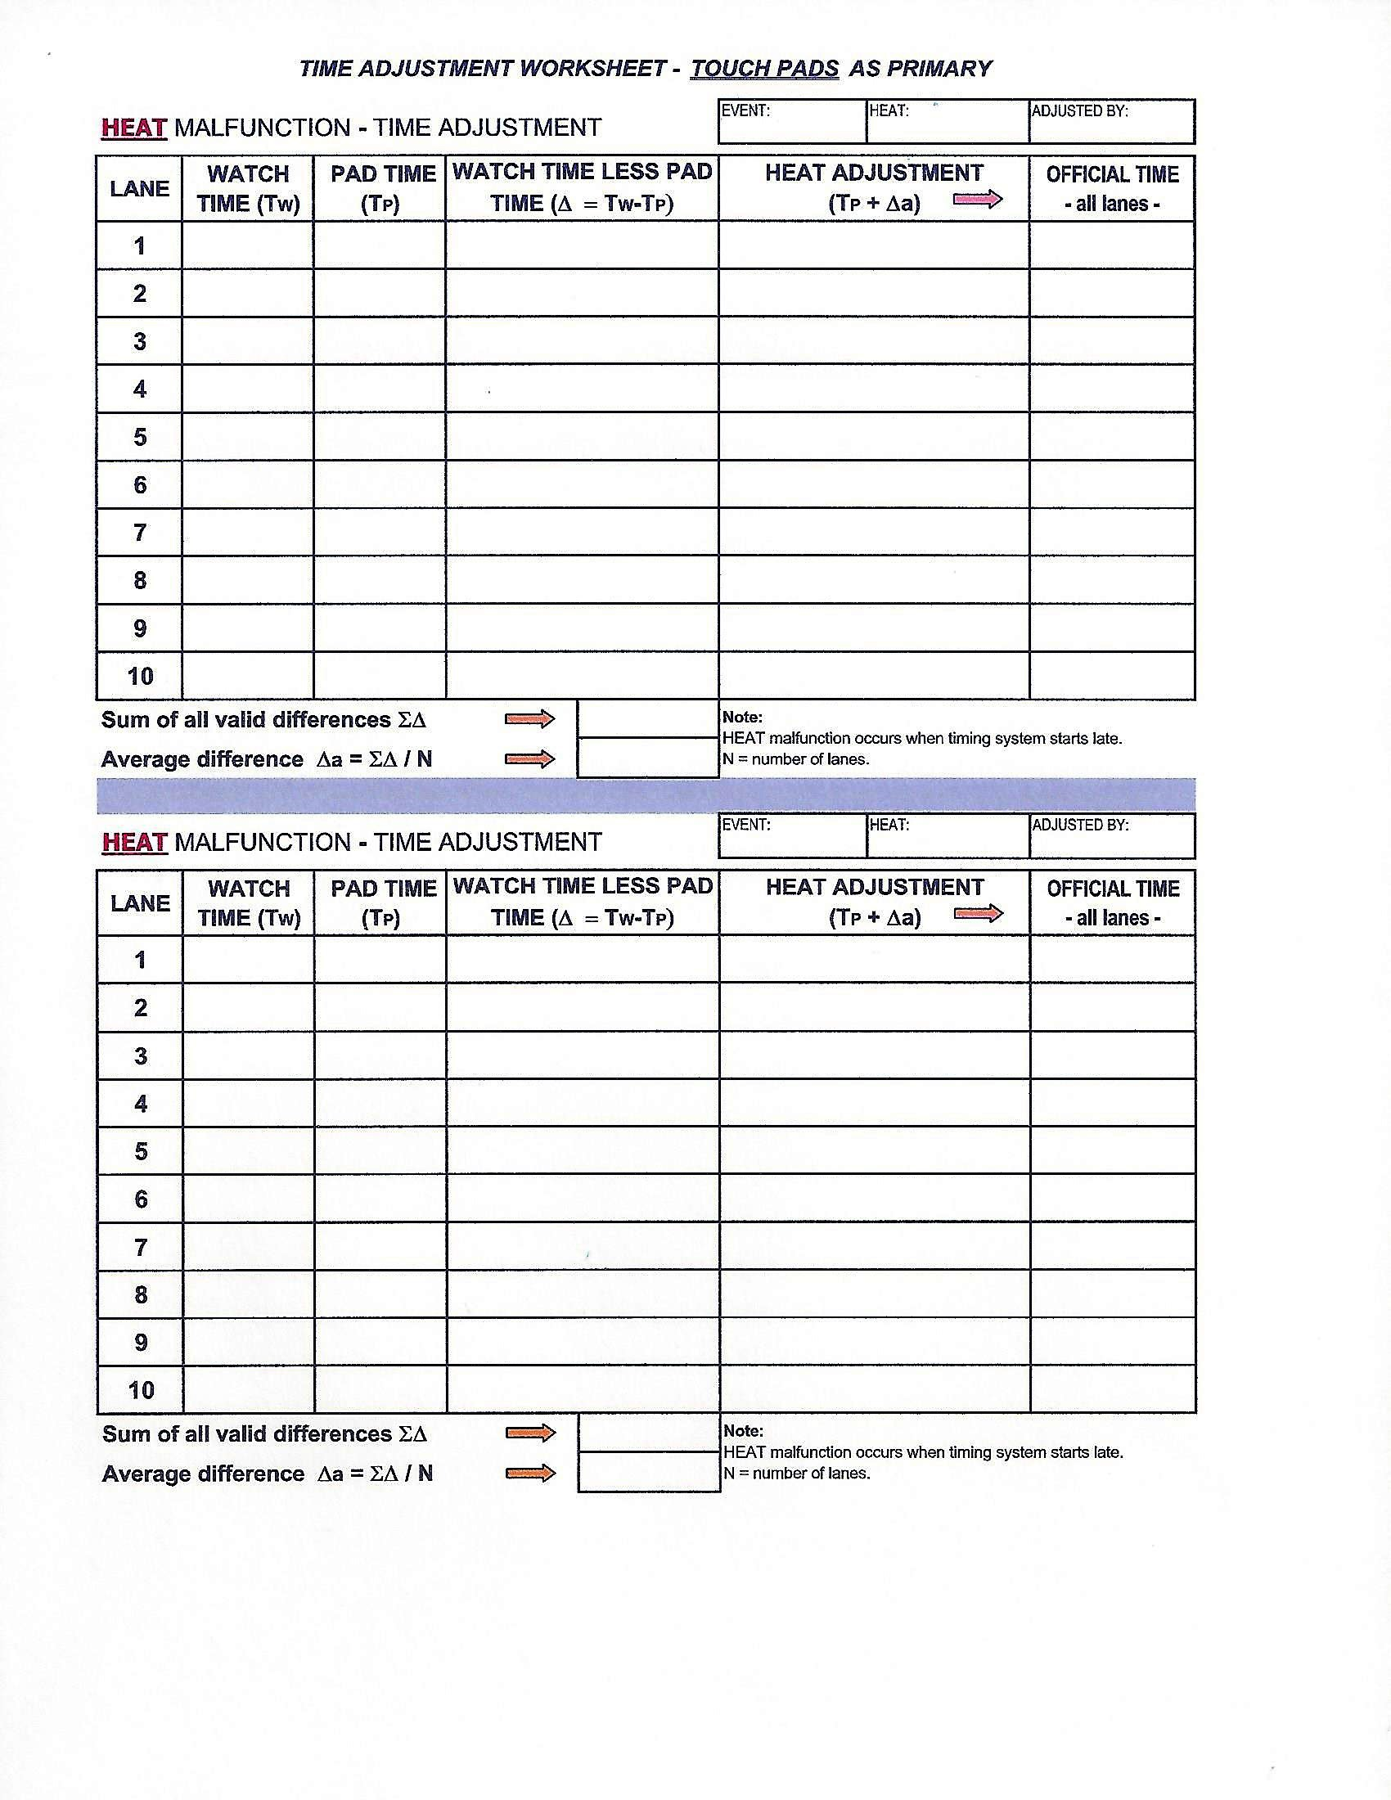

Slide 44
VERIFY RESULTS
Before publishing event results, review them.
Did all the timing adjustments get made?
Is there color or questions marks?
Are there any times that are unreasonably fast?
Did the Hy-Tek Operator verify the NS with the lane timer sheets?
Were there any notes on the lane timer sheets?
Were all the DQ’s recorded?
In a prelim/finals meet, are there any potential swim-offs?

Slide 45
Remember the Administrative Official and their staff are the face of the meet. You should be user friendly, customer service oriented and accommodating. Our response to can we, is “absolutely, as long as it falls within the confines of the meet information and the meet referee has no problem with it.”
Be sure to thank everyone for their help, it takes a village to be a GREAT Admin.
Finally….. Thank you all for giving me the opportunity to share this information with you.
See you at the pool!!

