Slide 1
SVSC
New Member Meeting
Thursday, September 13, 2018
6:15-7:30pm

Slide 2
SVSC New Member Meeting Agenda
Welcome & Introduction
Vision & Mission
Team Unify SVSC Website
Parent Expectations
Equipment
Key Dates
Mentors
Q&A

Slide 3
SVSC Board Members
Tammy Wilson, President
Tom Donaldson, Vice President
Gary Dietz, Treasurer
Robert Kling, Secretary
Trent Wilson, Registrar
John Stefanowicz, Board member/AMS treasurer
Brock Seeley, Board member/New Family Mentorship

Slide 4
SVSC Coaches
Brian Blackwell, Head Coach & Senior Coach
Jeff Gavin, Head Age Group Coach
Lisa Wilson, Age Group Coach
Nicole Rogos, Dryland Coach

Slide 5
If I could go back in time,
I wish I had known…
What a B, BB, A time was?
What does IMX mean?
What is the Deck Pass app?
What a yellow slip was before the first meet?
Why is it not always important that my child comes in first place?
IM Ready Events (IMR)
9-10 year olds: 100 Free, 50 Back, 50 Breast, 50 Fly, 100 IM
11-12 year olds: 200 Free, 50 Back, 50 Breast, 50 Fly, 100 IM
13-18 year olds: 200 Free, 100 Back, 100 Breast, 100 Fly, 200 IM
IM Xtreme Events (IMX)
9-10 year olds: 200 Free, 100 Back, 100 Breast, 100 Fly, 200 IM
11-12-year olds: 500 Free, 100 Back, 100 Breast, 100 Fly, 200 IM
13-18-year olds: 500 Free, 200 Back, 200 Breast, 200 Fly, 200 IM, 400 IM

Slide 6
Vision and Mission of SVSC
Mission—To develop competitive swimming skills and good sportsmanship in children of all ages and ability levels.
Vision—To be western Pennsylvania’s premier swim club through the physical, mental, and emotional development of our swimmers.

Slide 7
Team Unify Site www.swimsvsc.org
Events Tab
  Meet information section
    Forms/Documents
Calendar Tab
Coaches Corner
Documents

Slide 8
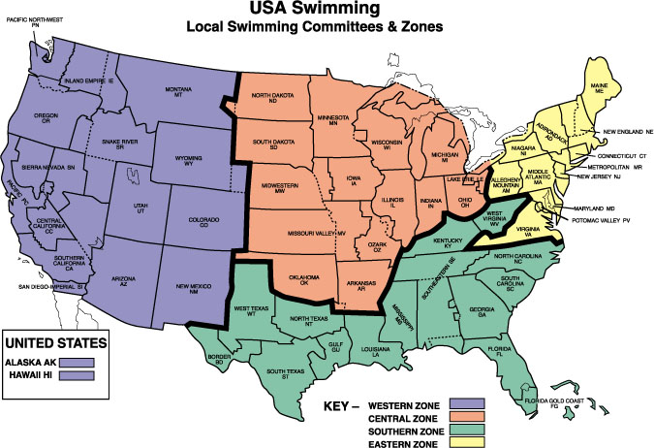
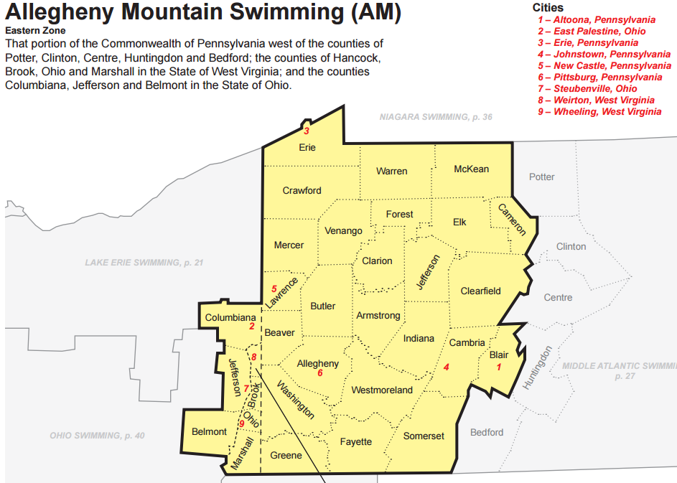
What’s the difference?
USA Swimming
Allegheny Mountain Swimming (AMS)
Seneca Valley Swim Club (SVSC)
There are 12 Local Swimming Committees (LSCs) in the Eastern Zone.
Our Local Swim Committee (LSC), Allegheny Mountain Swimming (AMS), includes approximately:
  51 Swim Clubs
  279 Coaches
  3,400 Age Group Swimmers

Slide 9
Parent Expectations
Communications with Board & Coaches
Meets/IMX
  Types
  Swimmer Prep
  Parent Prep
Goals/Development of Swimmers
Membership Meetings – open to members, 1x per month
Technology Apps – USA Swimming Deck Pass, OnDeck Parent, MeetMobile

Slide 10
Equipment Needed
Fins
Kickboard
Pull Buoy
Mesh bag to carry equipment
Team Suit for meets
These items are available to borrow at our pool, however, there aren’t a lot of small fin sizes.
Visit our team store through Swimmers Network for the suits and more!

Slide 11

SWIM SUITS, APPAREL & EQUIPMENT
Visit our team store through Swimmers Network for the suits and more!

Slide 12
Speedo Team Suits
Suits will be black and blue without logo. Boys will have choice of jammers or briefs. Visit our team store through Swimmers Network for the suits and more!
Racing in style !

Slide 13
Key Dates
September 4th - Kickoff Meeting (6:30pm)
September 13th - New Member meeting (6:15pm)
September 18th – Swimsuit fittings (4pm)
September 29th – Blue Black Meet (12pm)
October 2nd – Safe Sport (7:30pm)
October 9th - Team Photo day (mandatory 4:45pm)
October 13th – 14th - First Splash
October 20th – 21st – Hosting Mini-Distance Meet

Slide 14
2018 Short Course (SC)
Meet Schedule
Sept 29 Black & Blue Meet (SVSC)
Oct 13-14 First Splash
Oct 20-21 Mini/Distance Meet (SVSC)
Nov 3-4 BB & Faster (Moon)
Nov 10-11 B & Slower (MLAC)
Nov 16-18 Braun Travel Meet
Dec 1-2 BB & Faster/Dist (BPR)
Dec 5-9 USA Jr. Nationals (NC)
Dec 8-9 B & Slower/Mini (SFAC)
Dec 13-16 Christmas Meet (TPIT)

Slide 15
2019 Short Course (SC)
Meet Schedule
Jan 12-13 Open Meet (BPR)
Jan 19-20 Mini/Distance (NHA)
Jan 25-27 IMX Games (University of Maryland)
Feb 9-10 Single Age Meet (ANSC)
Feb 16-17 Mini Champs (10 and under)
Feb 22-24 Silver Champs (WAAC)
Mar 7-9 AMS Junior Olympic Champs (TPIT)
Mar 23-24 Last Splash (PRA)

Slide 16
Coach Contact info
Email is the best
  Briandavidblackwell@yahoo.com
  All Coaches can be reached by email
  Link by Name on the Coach Page on our website
  Please allow at least 72 hours for a response

Slide 17
Survival Handbook
Available on SVSC website

Slide 18

Mentors

Slide 19
Leaving this meeting… your next steps
Register (if not already complete)
Sign up for Blue Black meet (& Mini-Distance Meet)
Add all meets to your family calendar
Review survival handbook
Wait for your mentor to reach out to you over the next week

Slide 20

Q & A

Slide 21

Parting Thought
It’s a marathon not a sprint.
It’s a 1650 not a 50!

Slide 22




COMMUNICATION
Like us on Facebook and our website is swimsvsc.org.
***When in doubt, refer to Event Tab &/or Calendar tab
***School District asks SVSC not to park or drop off in the area in front of the Natatorium (no right turn)

Slide 23
Thank you for coming!
We look forward to having you as part of our swimming family!
Please reach out with any questions.
Brock Seeley
seeleybrock@gmail.com

Slide 24
Practice Times
Practices are canceled on HOME football game nights and Home SV Varsity swim meets – please check the calendar to keep up to date.
Senior Mon-Fri 3:00-5:30 pm Tues/Thurs 5:30-7:00 am
Sat 8:30-11:30 am
Gold Mon-Fri 5:00-7:00 pm & Sat 8:30-10:30 am
Silver Mon-Fri 5:00-6:30 pm
Bronze Mon/Tues/Wed/Friday 6:30-7:30 pm
Novice Tue/Thurs/Fri 6:30 – 7:30 pm
Intro Mon/Wed 6:00 – 6:45 pm

Slide 25
SWIM GROUPS
Senior - 2.5 hours x 6 days + 2 mornings
Gold - 2 hours a day x 6 days
Silver - 1.5 hours x 5 days
Bronze - 1 hour x 4 days
Novice - 1 hour x 3 days
Intro - 40 mins x 2 days
What this allows will be a group based on these principles:
Senior ( in-district/varsity)
***Senior practice after school – into Varsity – no longer offer out of district practice from 5-7:30 for out of district swimmers (swim w/ own varsity team Nov 15-March)
Gold (Advance Age Group - 2 hour practices focus on endurance building, advance level drills and agility/strength development - Highly dedicated only)
Silver (Intermediate Age Group - 1.5 hour practices 5 days a week - technical advancement of strokes, endurance building and race strategies)
Bronze (Beginner Age Group - 1 hour practices 4 days a week - further development of strokes, swimming concepts, drills and race strategies)
Novice (Introduction to Competitive Swimming - Learn to swim program graduates, basic understanding of swimming, starts, turns, intro drills)
Intro (Introduction to Competitive Swimming – Learn to swim program, begin the understanding of swimming, is the bridge to being ready for the club)

Slide 26
Planning
Pen
LCD projector
Laptop
Sign in sheet
Bring copy of:
  Short Course time standards

Slide 27
Letter to Mentors
Good Evening,
We sincerely appreciate everyone volunteering their time to mentor the new families/swimmers joining SVSC this year. Your new family likely attended the new family meeting on Thursday, September 13th from 6:15-7:30pm during Novice practice. As a mentor, we ask that you contact your assigned family by this Monday, September 17th to introduce yourself and welcome them to the club. From there, I recommend meeting with them in person to review the information below.
Items that need to be covered:
1) SVSC Survival Guide (found on the SVSC website)
2) SVSC Website
3) Meet schedule
4) Questions on swim gear both for practice and meets (Team store on Swimmers Network)
The end of everyone's two week trial is this coming in the next few days, so our main goal is to ensure they all feel welcome and all of their questions are answered.
Attached are the mentor assignments. If you have challenges contacting them or if there are questions, contact myself or one of the board members.
Thanks again for your help.
Best regards,
Brock Seeley

