Slide 1
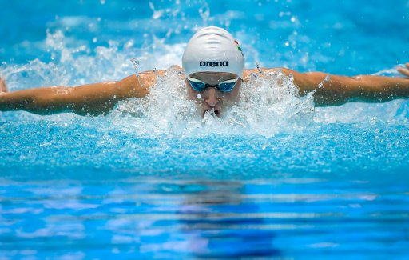
Eating for Optimal Performance: Swimming
By Kim Brown, BS, RDN, CDE
Registered Dietitian Nutritionist, Certified Diabetes Educator
Henry Mayo Fitness and Health

Slide 2
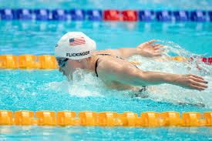
Principles of a Sports Diet
Focus is on Performance:
Strength
Power
Stamina
ALL require ENERGY

Slide 3
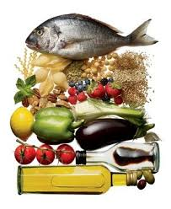
Macronutrients
Carbohydrates (Primary energy source)
Fats (Secondary energy source)
Protein (Muscle building)
…......All are Essential

Slide 4
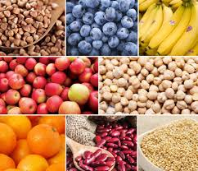
Carbohydrates
PRIMARY fuel source
Stored in the muscle in the
form of glycogen
Sources:
Grains/Starches: bread, cereal, pasta, rice, potatoes, tortillas, pita, bagels, crackers, beans, corn, peas. One serving = 1 slice bread, ½ cup cooked rice/cereal, beans, peas. Goal- 6-12 servings per day.
Fruits: All: One serving = ¾-1 cup berries, small piece of fruit (about the size of a tennis ball), ¼ cup dried fruit.
Vegetables: Non-starchy. One serving = ½ cup broccoli, 1 cup leafy (spinach, lettuce).
Fruit and Vegetable goal- at least 2 servings of fruit and 3 servings of vegetables; variety and color.

Slide 5
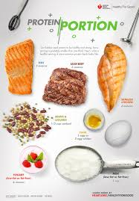
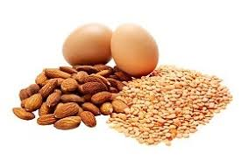
Protein
Building blocks of the body (amino acids); tissues and muscles, hormones, enzymes, immune system, energy (last resort)
Offsets the breakdown of muscle protein; consuming after exercise can help improve protein balance
Sources: MFP (Meat, Fish, Poultry- 3-4 ounces), eggs (1); beans (1/2 c), tofu (1/2 c), nuts (1/4 c), yogurt (6 ounces) and cheese (1 ounce).
Goal- eat protein-rich food at every meal
Protein should not “upstage” carbohydrates. Carbs are still your primary “fuel”

Slide 6
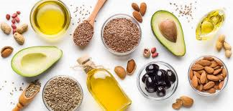
Fats
Back-up energy source
Promotes satiety
Sources of healthy fat: olive oil/canola oil- 1 Tbsp, avocado- 1/5, oily fish (salmon)- 3-4 ounces, nuts- ¼ c, nut butters- 2 Tbsp
Goal- each meal should include a serving of healthy fat
*Limit unhealthy fat such as saturated and trans fat (found in processed/packaged foods, fried foods, fast food)

Slide 7
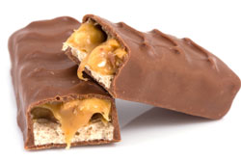
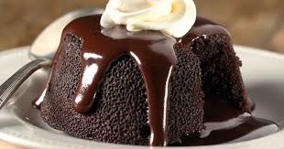
Sweets and Treats ?
Optional....up to 10% of your Calories
Prevent hunger by eating heartier portions of wholesome foods at meals
Diet doesn’t need to be perfect
10% of your Calories can appropriately come from refined sugar
Note- gels and sports drinks count as refined sugar; any product in which sugar is the first or close to the first ingredient on the label (sucrose, glucose, high fructose corn syrup, corn syrup, maple syrup, fructose)
Will get calculated into the carb and fat macro groups

Slide 8
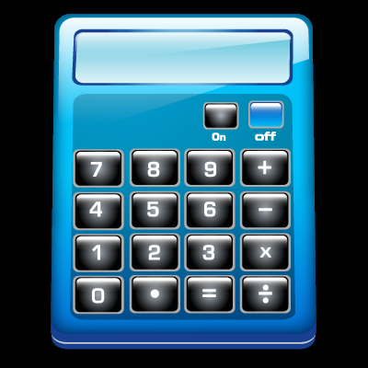
Calculating Your Calorie Needs
Resting Metabolic Rate (most basic needs)
weight in pounds x 10 (Ex. 150 pound person RMR = 1,500 Calories)
Activity Level (daily living):
Sedentary- (sitting, reading) 20-30% (300-450 Cal)
Moderate- (standing, moving around) 40-50% (600-700)
Active- (physically active all day) 60-70% (900-1,000)
Purposeful Exercise
Ex. Swimming Practice for 2 hours +( 1,000-1,500)
Total Calorie needs for weight maintenance = 2,800-3,400

Slide 9
My Fitness Pal
Free phone app
Height, Weight
Activity Level
Weight goal, time line (.5-1.0 pounds per week)
Know your target macro ratios
Good rule of thumb- 50% carb: 25% protein: 25% fat
Barcode feature

Slide 10
Macronutrient Ratios Carbs : Protein : Fat
% of Calories from the 3 Macro groups:
Off Season
(Optional)
50c : 35p : 15f “Lean and Tone”
45c : 35p : 20f “Muscle Builder”
Conditioning/Season
50c : 25p : 25f “Sustained Energy”
60c : 20p : 20f “Athletic Performance”
* My Fitness Pal- has macronutrient “pie graph”

Slide 11
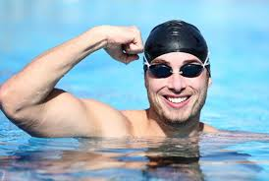
Want to Gain Some Quality Weight?
Add 20% to your total calories
Example: 2,600 Calories (maintenance)
2,600 x .20 = 520 Calories extra per day
3,120 (new total)

Slide 12
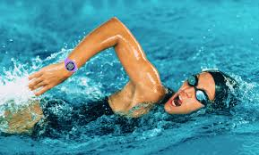
Want to get lean?
Subtract 20% from your total Calories:
Example: 2,500 Calories (maintenance)
2,500 x .20 = 500 calories less per day
2,000 (new total)

Slide 13
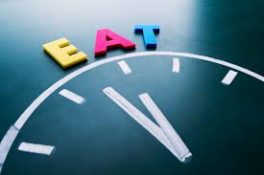
Meal Timing
GOAL: to be well-fueled ALL day
Most of your Calories should be consumed by the late afternoon/early evening
Eat every 3-4 hours
Don’t ignore hunger (have a snack)
Do not skip meals

Slide 14
Sample Eating Plans 2,800 Cal
4 Meals a Day
Breakfast (7 am) 700 Calories
First Lunch (11 am) 700 Calories
Second Lunch (3:00 pm) 700 Calories
Dinner (7:00 pm) 700 Calories
5 Meals a Day
Breakfast (7 am) 700 Calories
Snack (10:00 am) 350 Calories
Lunch (1 pm) 700 Calories
Snack (4 pm) 350 Calories
Dinner (7 pm) 700 Calories

Slide 15
Meal/Snack Sample for 2,800 Cal Plan
Sample menu for 700 Calorie meal
2 tacos (4 corn tortillas, 6 oz chicken, lettuce, tomato)
¼ c shredded cheese
1/2 cup corn salsa
1/5 avocado
1 medium orange
8 ounces fat free milk
Sample menu for 350 Calorie snack
½ pb&j on whole wheat bread
5 oz blueberry Greek yogurt

Slide 16
Sample Eating Plans 2,400
4 Meals a Day
Breakfast (7 am) 600 Calories
First Lunch (11 am) 600 Calories
Second Lunch (3:00 pm) 600 Calories
Dinner (7:00 pm) 600 Calories
5 Meals a Day
Breakfast (7 am) 600 Calories
Snack (10:00 am) 300 Calories
Lunch (1:00 pm) 600 Calories
Snack (4:00 pm) 300 Calories
Dinner (7:00 pm) 600 Calories

Slide 17
Meal/Snack Sample for 2,400 Cal Plan
Sample menu for 600 Calorie meal
Healthy Pasta Dish:
1 cup whole wheat penne (cooked)
4 ounces grilled chicken or turkey sausage
1 cup spinach/kale (portion before cooking)
2 Tbsp parmesan cheese
1-2 tsp olive oil
½ cup fresh fruit
Sample menu for 300 Calorie Snack
½ cup plain hummus
20 baby carrots

Slide 18
Sample Eating Plans 2,000
4 Meals a Day
Breakfast (7 am) 500 Calories
First Lunch (11 am) 500 Calories
Second Lunch (3:00 pm) 500 Calories
Dinner (7:00 pm) 500 Calories
5 Meals a Day
Breakfast (7 am) 500 Calories
Snack (10:00 am) 250 Calories
Lunch (1:00 pm) 500 Calories
Snack (4:00 pm) 250 Calories
Dinner (7:00 pm) 500 Calories

Slide 19
Meal/Snack Sample for 2,000 Cal Plan
Sample menu for 500 Calorie meal
½ cup oatmeal (before cooking)
½ apple (peeled, chopped)
2 Tbsp chopped walnuts
2 tsp honey
cinnamon
½ c low fat milk
Sample menu for 250 Calorie snack
1/3 cup trail mix (almonds, dried fruit)

Slide 20
Nutrient Timing
Pre-Workout
If following 4 or 5 meal plan, you will be well-fueled for practice/training
Meal prior to workout should be eaten 1-2 hours before
Snacks can be eaten 30-60 min before workout but should be low fat
Post Workout
45-minute window for muscle recovery
Optimal recovery ratio- 3:1 of carbs : protein (gram:gram)
8-12 ounces of low fat chocolate milk (cow’s milk) will satisfy this until you can sit down to your next meal
(250-325 Calories, 40-50 g carbs, 12-16 g protein)
Post-workout meal- follow “myplate”

Slide 21
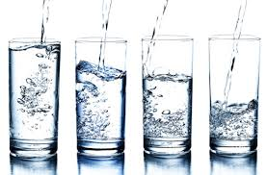
Fluids
Thirst mechanism can be an unreliable signal to drink
Plan to drink before you are thirsty
Not a one-size-fits-all recommendation (varying sweat rates)
30-35 cc/kg
Example: 150# athlete
150 divided by 2.2 = 68kg
68 x 30 = 2,040 cc = 8 8-ounce glasses= 64 ounces)
68 x 35 = 2,380 cc (10 8-ounce glasses= 80 ounces)
+ replenish/prevent fluid loss through sweat during exercise-
8 oz water every 15 minutes (8 big gulps)
All fluids contribute to hydration (juice, tea)

Slide 22
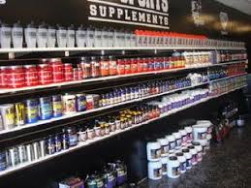
Supplements
Supplements are poorly regulated; read ingredients and know what you are putting into your body
Caffeine stimulates the brain and make effort seem easier allowing you to work harder for longer

Slide 23
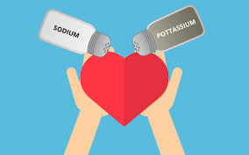
Sodium and Potassium
Who needs more sodium? Athletes who train in hot weather
Foods that contain sodium:
tomato sauce, pizza, turkey and cheese sub, salad dressings,
pickles, olives, soup, salted nuts, pretzels
Sodium and Potassium need to stay in balance; incorporate foods high in Potassium into your diet:
Banana (450 mg), raisins (1/4 c 300 mg), potato (800 mg),
orange juice (1 c 475 mg), milk (1 c 380 mg)

Slide 24
Sleep
Poor sleep can lead to decreases in performance and recovery for athletes
Adequate duration, quality and timing of sleep
Kids ages 6-13 should be getting 9-11 hours of sleep
Teenagers ages 14-17 need 8-10 hours of sleep
Younger adults and adults ages 18-65 need need 7-9 hours of sleep
“Healthy Sleep Habits for Children and Teens”
Bedtime Calculator
For more information, go to www.sleepfoundation.org

Slide 25
Take Away Message
Know what your goals are
Eat for high energy
Carbs, protein and fat are ALL necessary
Variety
Eat at regular intervals
Enjoy treats sometimes
Recover properly (proper nutrition and sleep)

