Slide 1
Williston Sea Lions
Parents Meeting
October 29, 2019

Slide 2
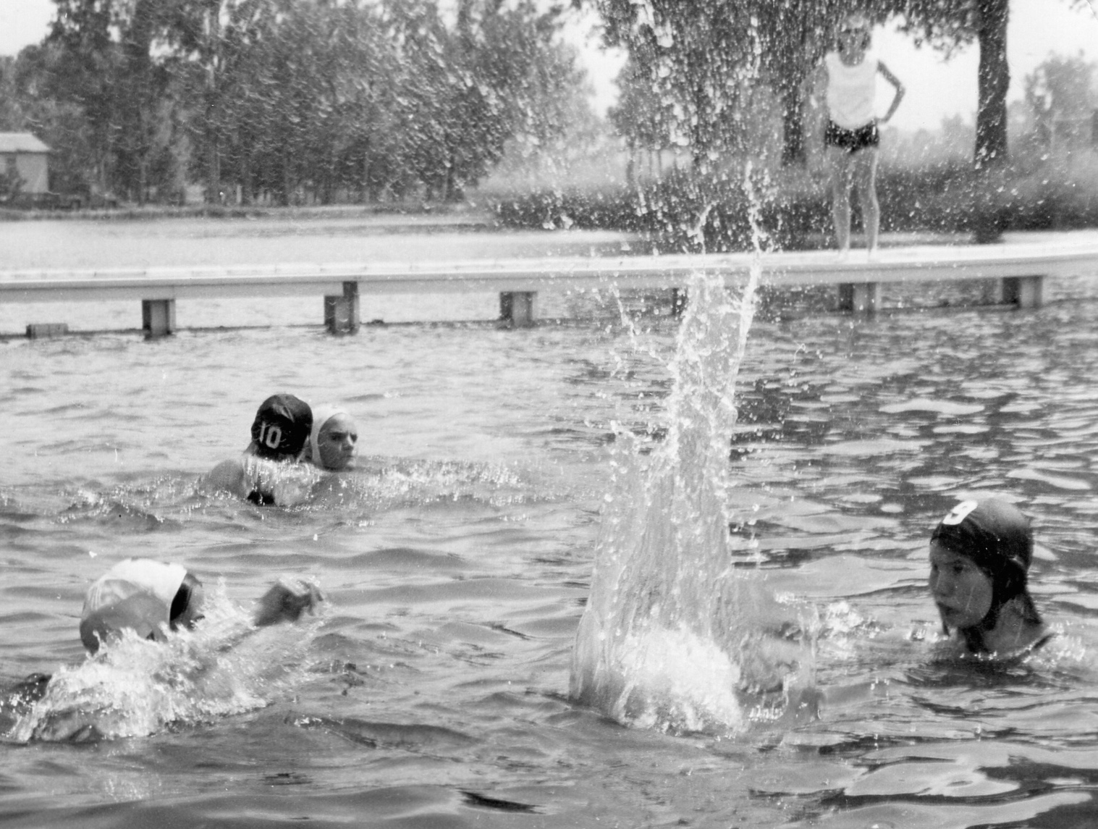
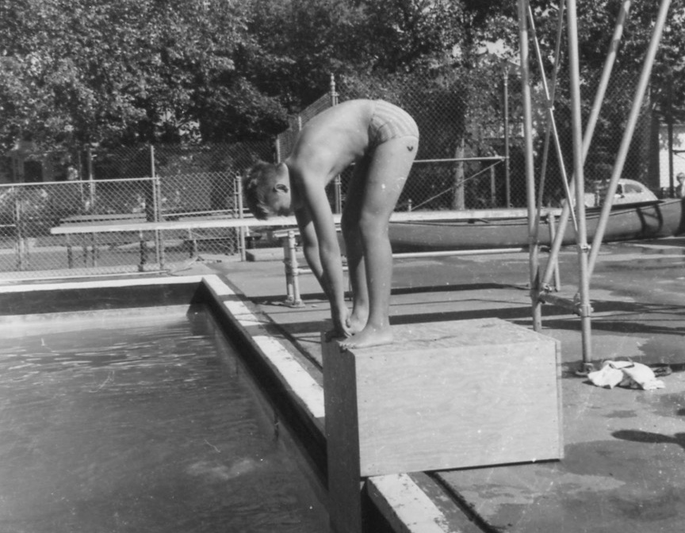
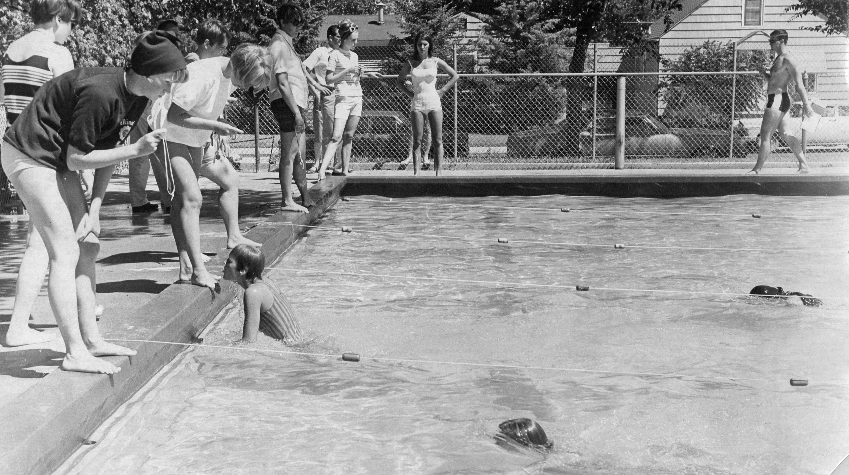
Beginnings
Swimming in Williston has a long history dating back to at least 1967.
Practice and Swim meets were held at the outdoor pool, no heat and lane lines were made out of rope.

Slide 3
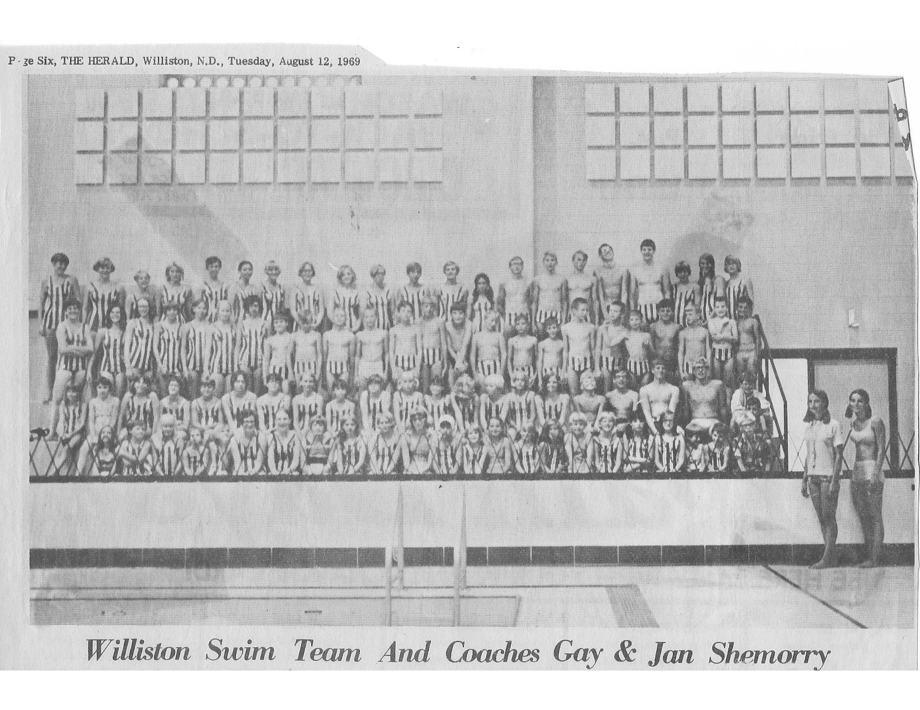
EJ Hagan Pool
The EJ Hagan Pool was completed in 1969
EJ Hagan was a Doctor and also president of the Park Board
EJ was passionate about swimming and was instrumental in getting the indoor pool built
EJ was also the driving force behind all school age children being required to take swimming lessons, as he felt it was a safety issue
The Williston Swim Team was funded by donations and the Williston School District until 1989

Slide 4
Williston Swim Team to Williston Sea Lions
Williston Sea Lions adopted their name from the Lions Club whom gave generous donations to the club for many years.
The team has a deep connection to excellence in swimming and continues to strive and excel.
EJ Hagan’s granddaughter is Katie Ledecky. A 5 time Olympic Gold Medalist and 15 time World Champion.
On March 28, 2014, the ARC opened. The pool was named the E.J. Hagan Natatorium. Katie Ledecky swam the first lap, the Sea Lions followed behind to a packed house of cheering fans.

Slide 5
Club Accomplishments Since 2016
Sea Lions in the Community
Holiday Lights
United Way
Moose
Bingo
Yearly Team Building Event with ARC staff
Parent Education Classes
Technology and Equipment
The Club raised $150,000 to buy new scoreboards for the E.J. Hagan Natatorium
Underwater camera training and video recording
Coaches iPad for training
Yearly budget purchase new
equipment

Slide 6
Club Business Achievements
Online Registration
Updated Website
Developed Standing Committees
Restated By Laws in 2017
Adopted USA Swimming Club Recognition
Achieved Level 1
Resulted in adopting 4 Standard Operating Procedures
Adopted 7 New Policies
Adopted Yearly Budget Process
Head Coach Agreement
Developed new Mission and Vision Statements
Achieved Yearly Fundraising Goals

Slide 7
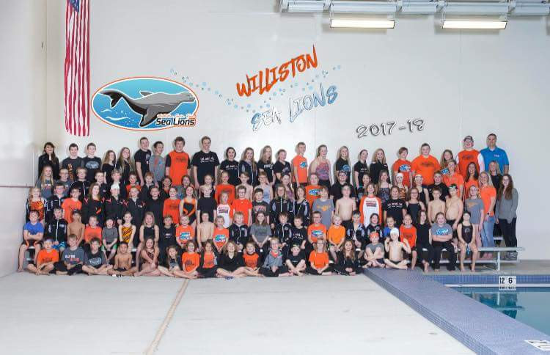
Athlete Success

Slide 8
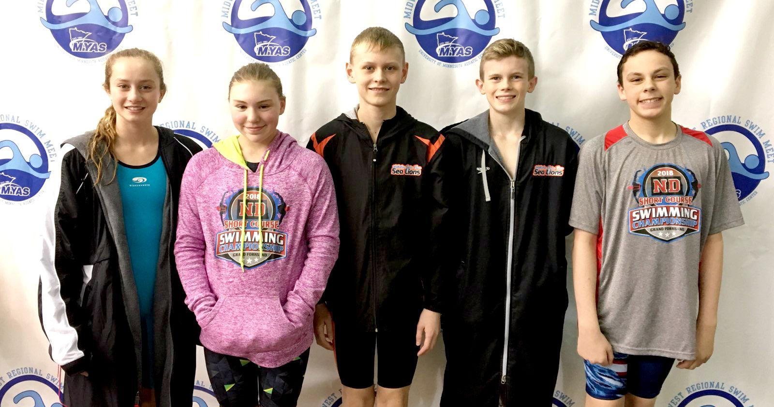
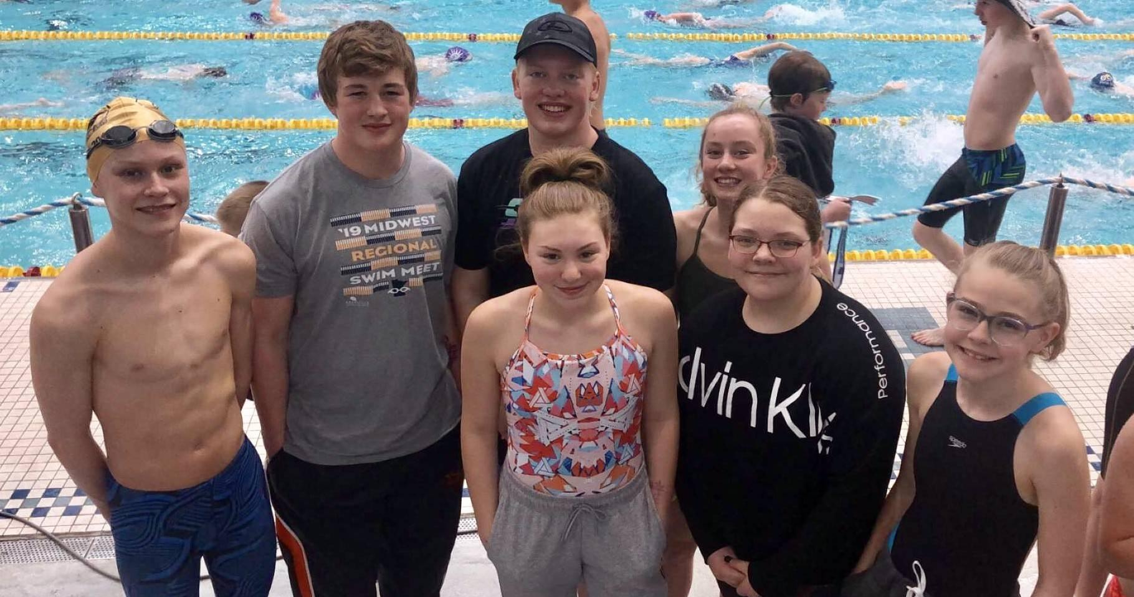
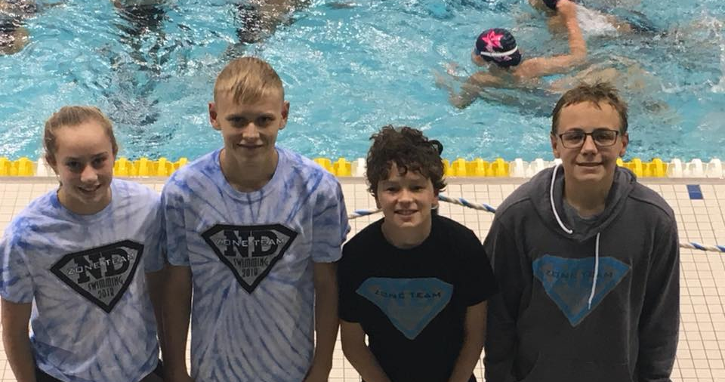
Championship Meets
Midwest Regional Meet
  2018 – Marissa Branham, Savannah Goehring, Kolden Kringen, Caleb Osborn, Reese Holder, Dru Zander, Breklyn Hauge, Maleah Ramsey
  2019 – Savannah Goehring, Kearyn Woodward, Lola Senderhauf, Kolden Kringen, Noah Begley, David Luthy, Marissa Branham, Trevin Lounsbury
Zones
  2018 – Marissa Branham, Gavin Baltes, Camden Ekblad-Lundby, Kolden Kringen
  2019 – Trevor Baltes, Kambree Draper, Kolden Kringen

Slide 9
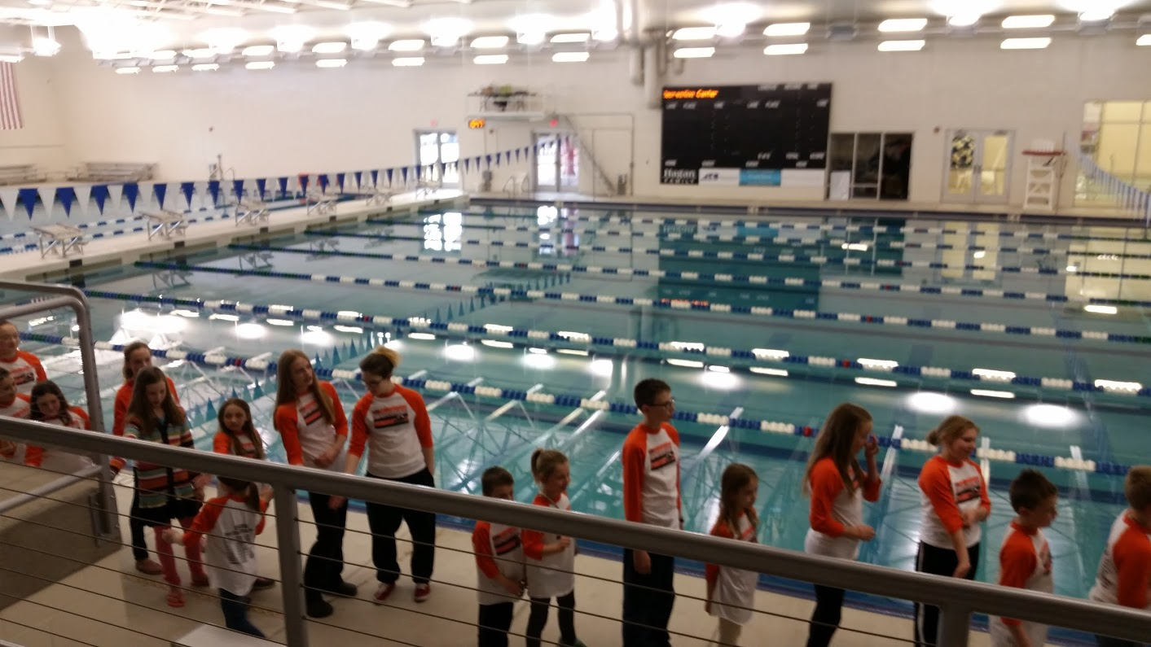

Future Goals and Strategic Objectives
Achieve Level 2 Club Recognition
Full-Time Head Coach
Develop the Dryland Program
Develop the Mentor Program
Official Recruiting

Slide 10
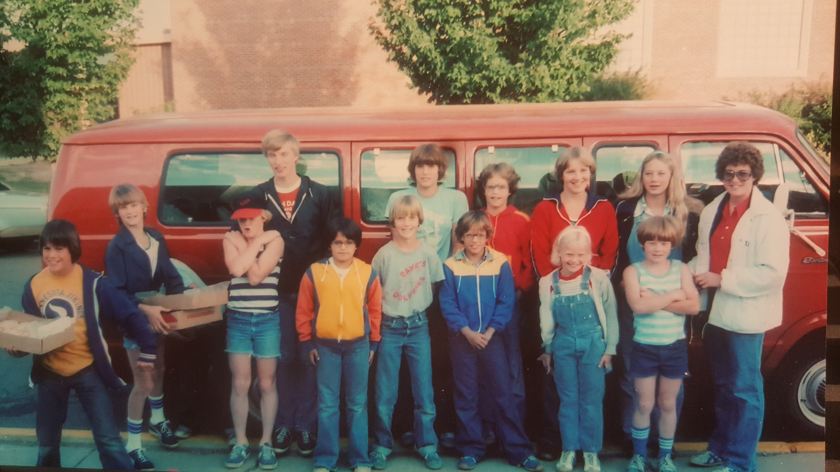
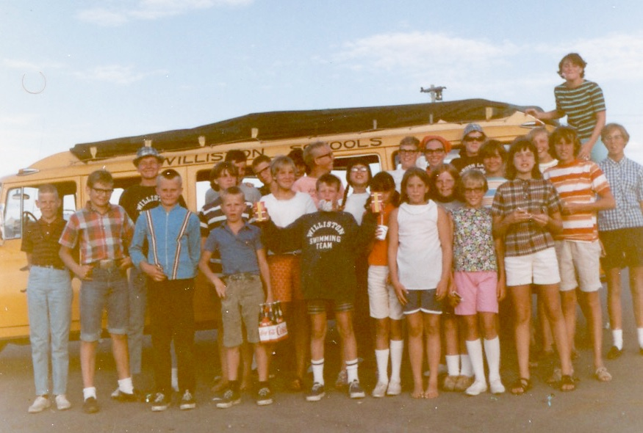
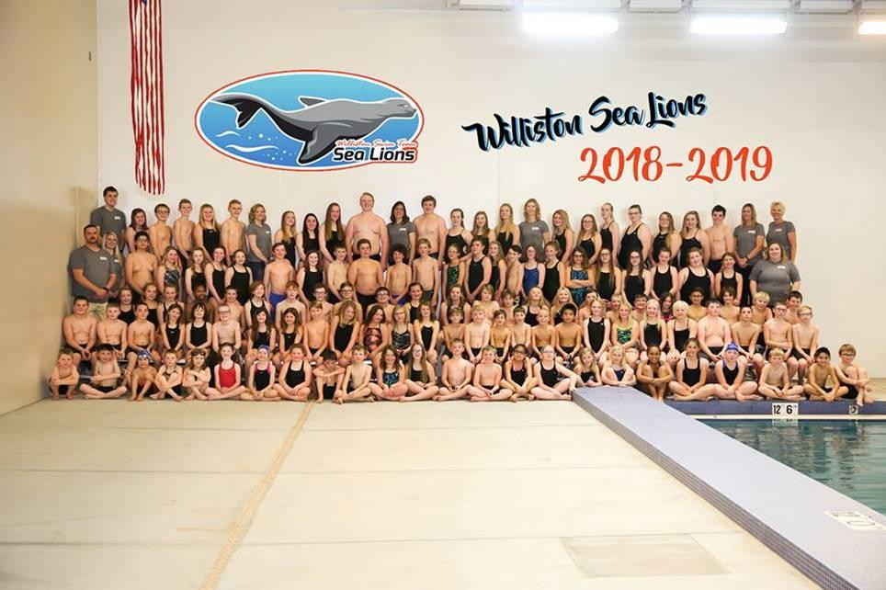
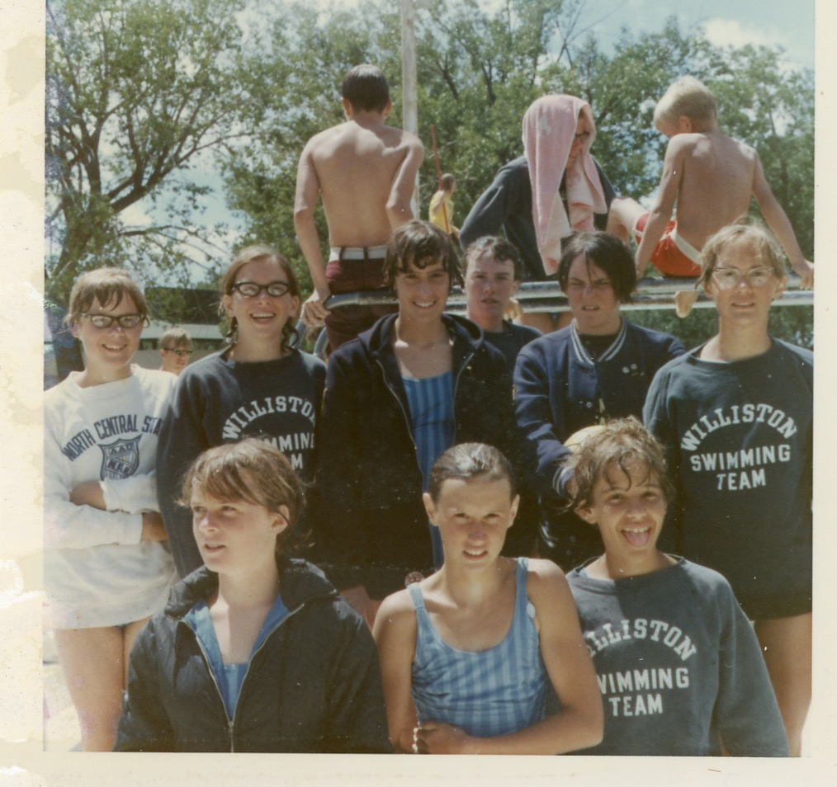
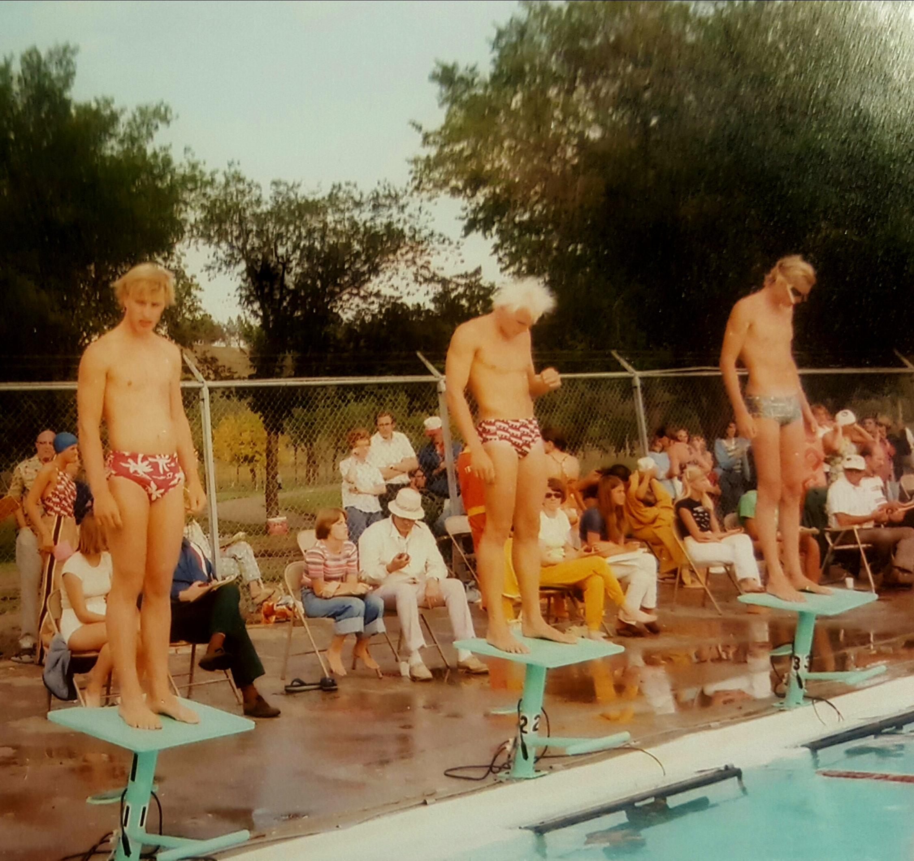
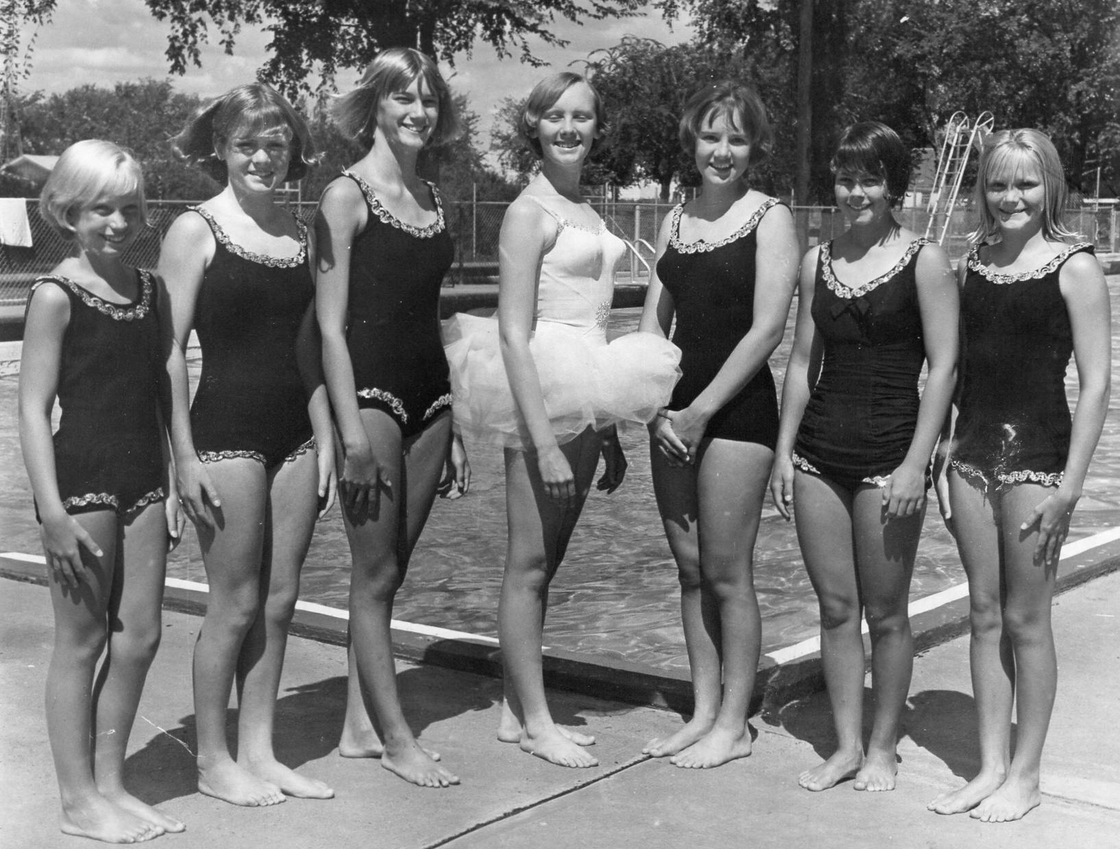
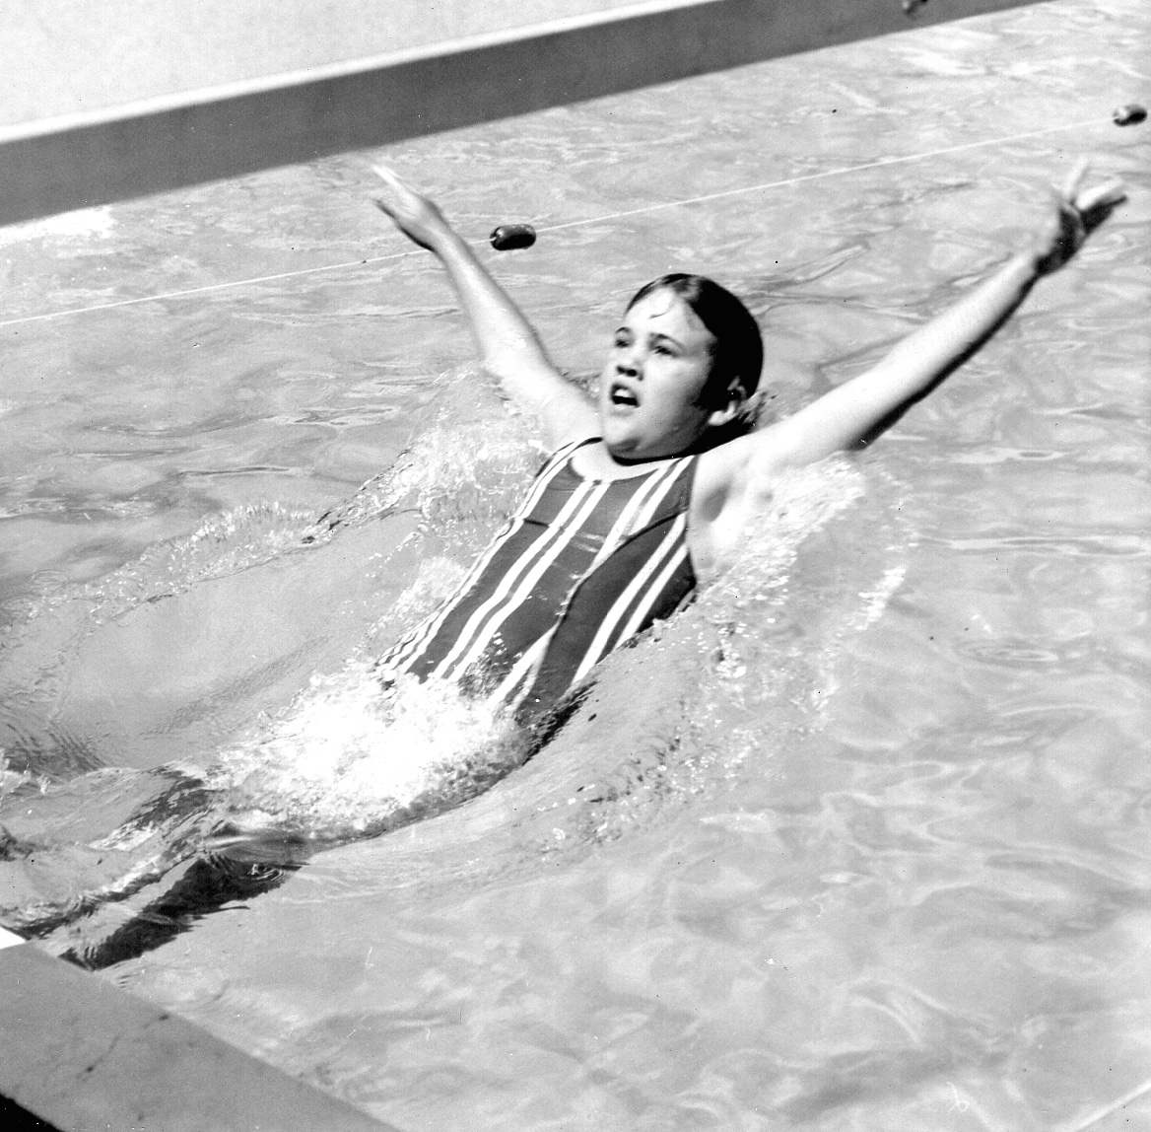
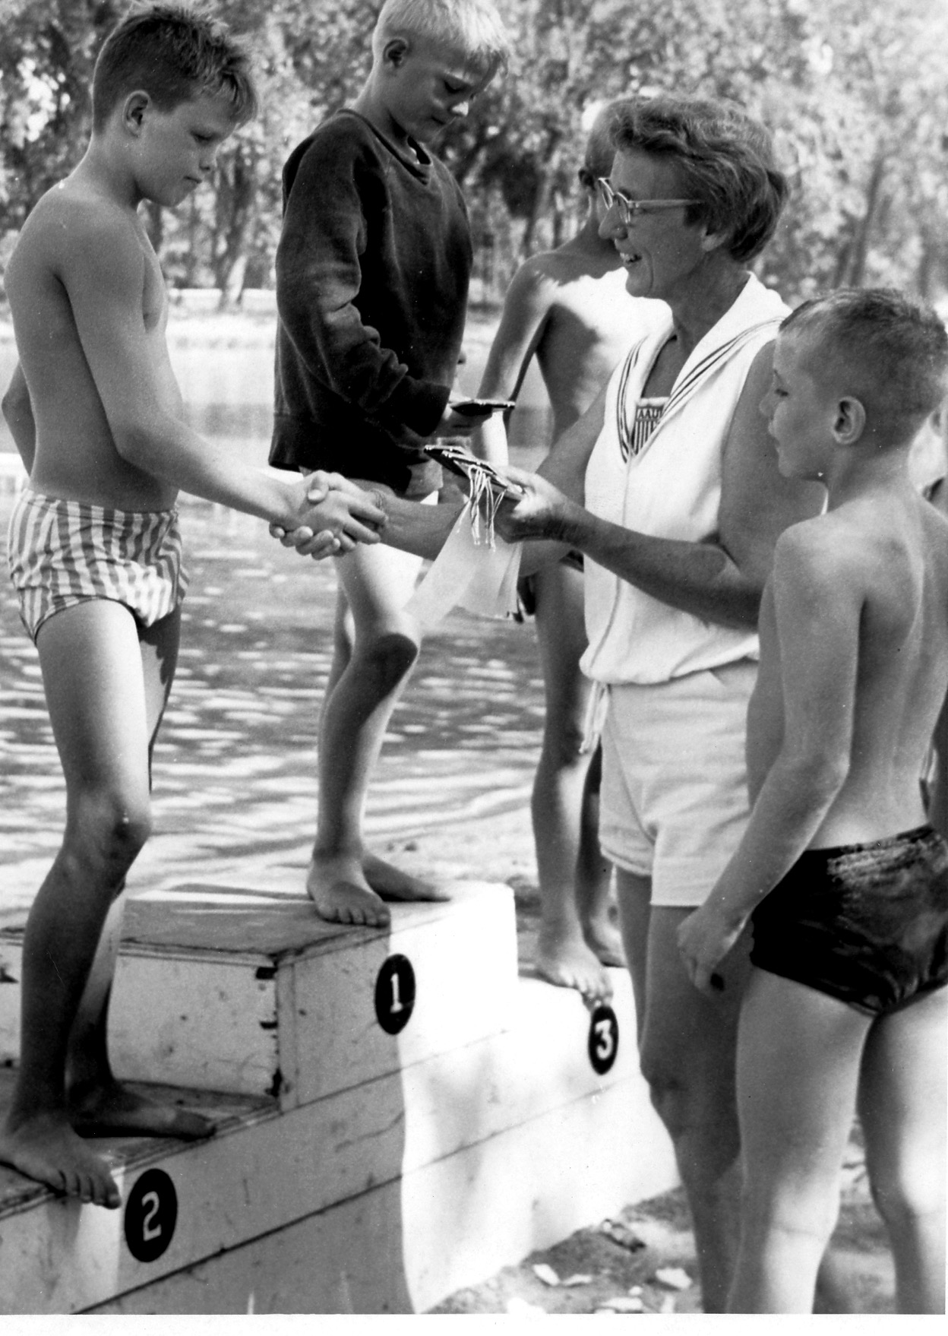
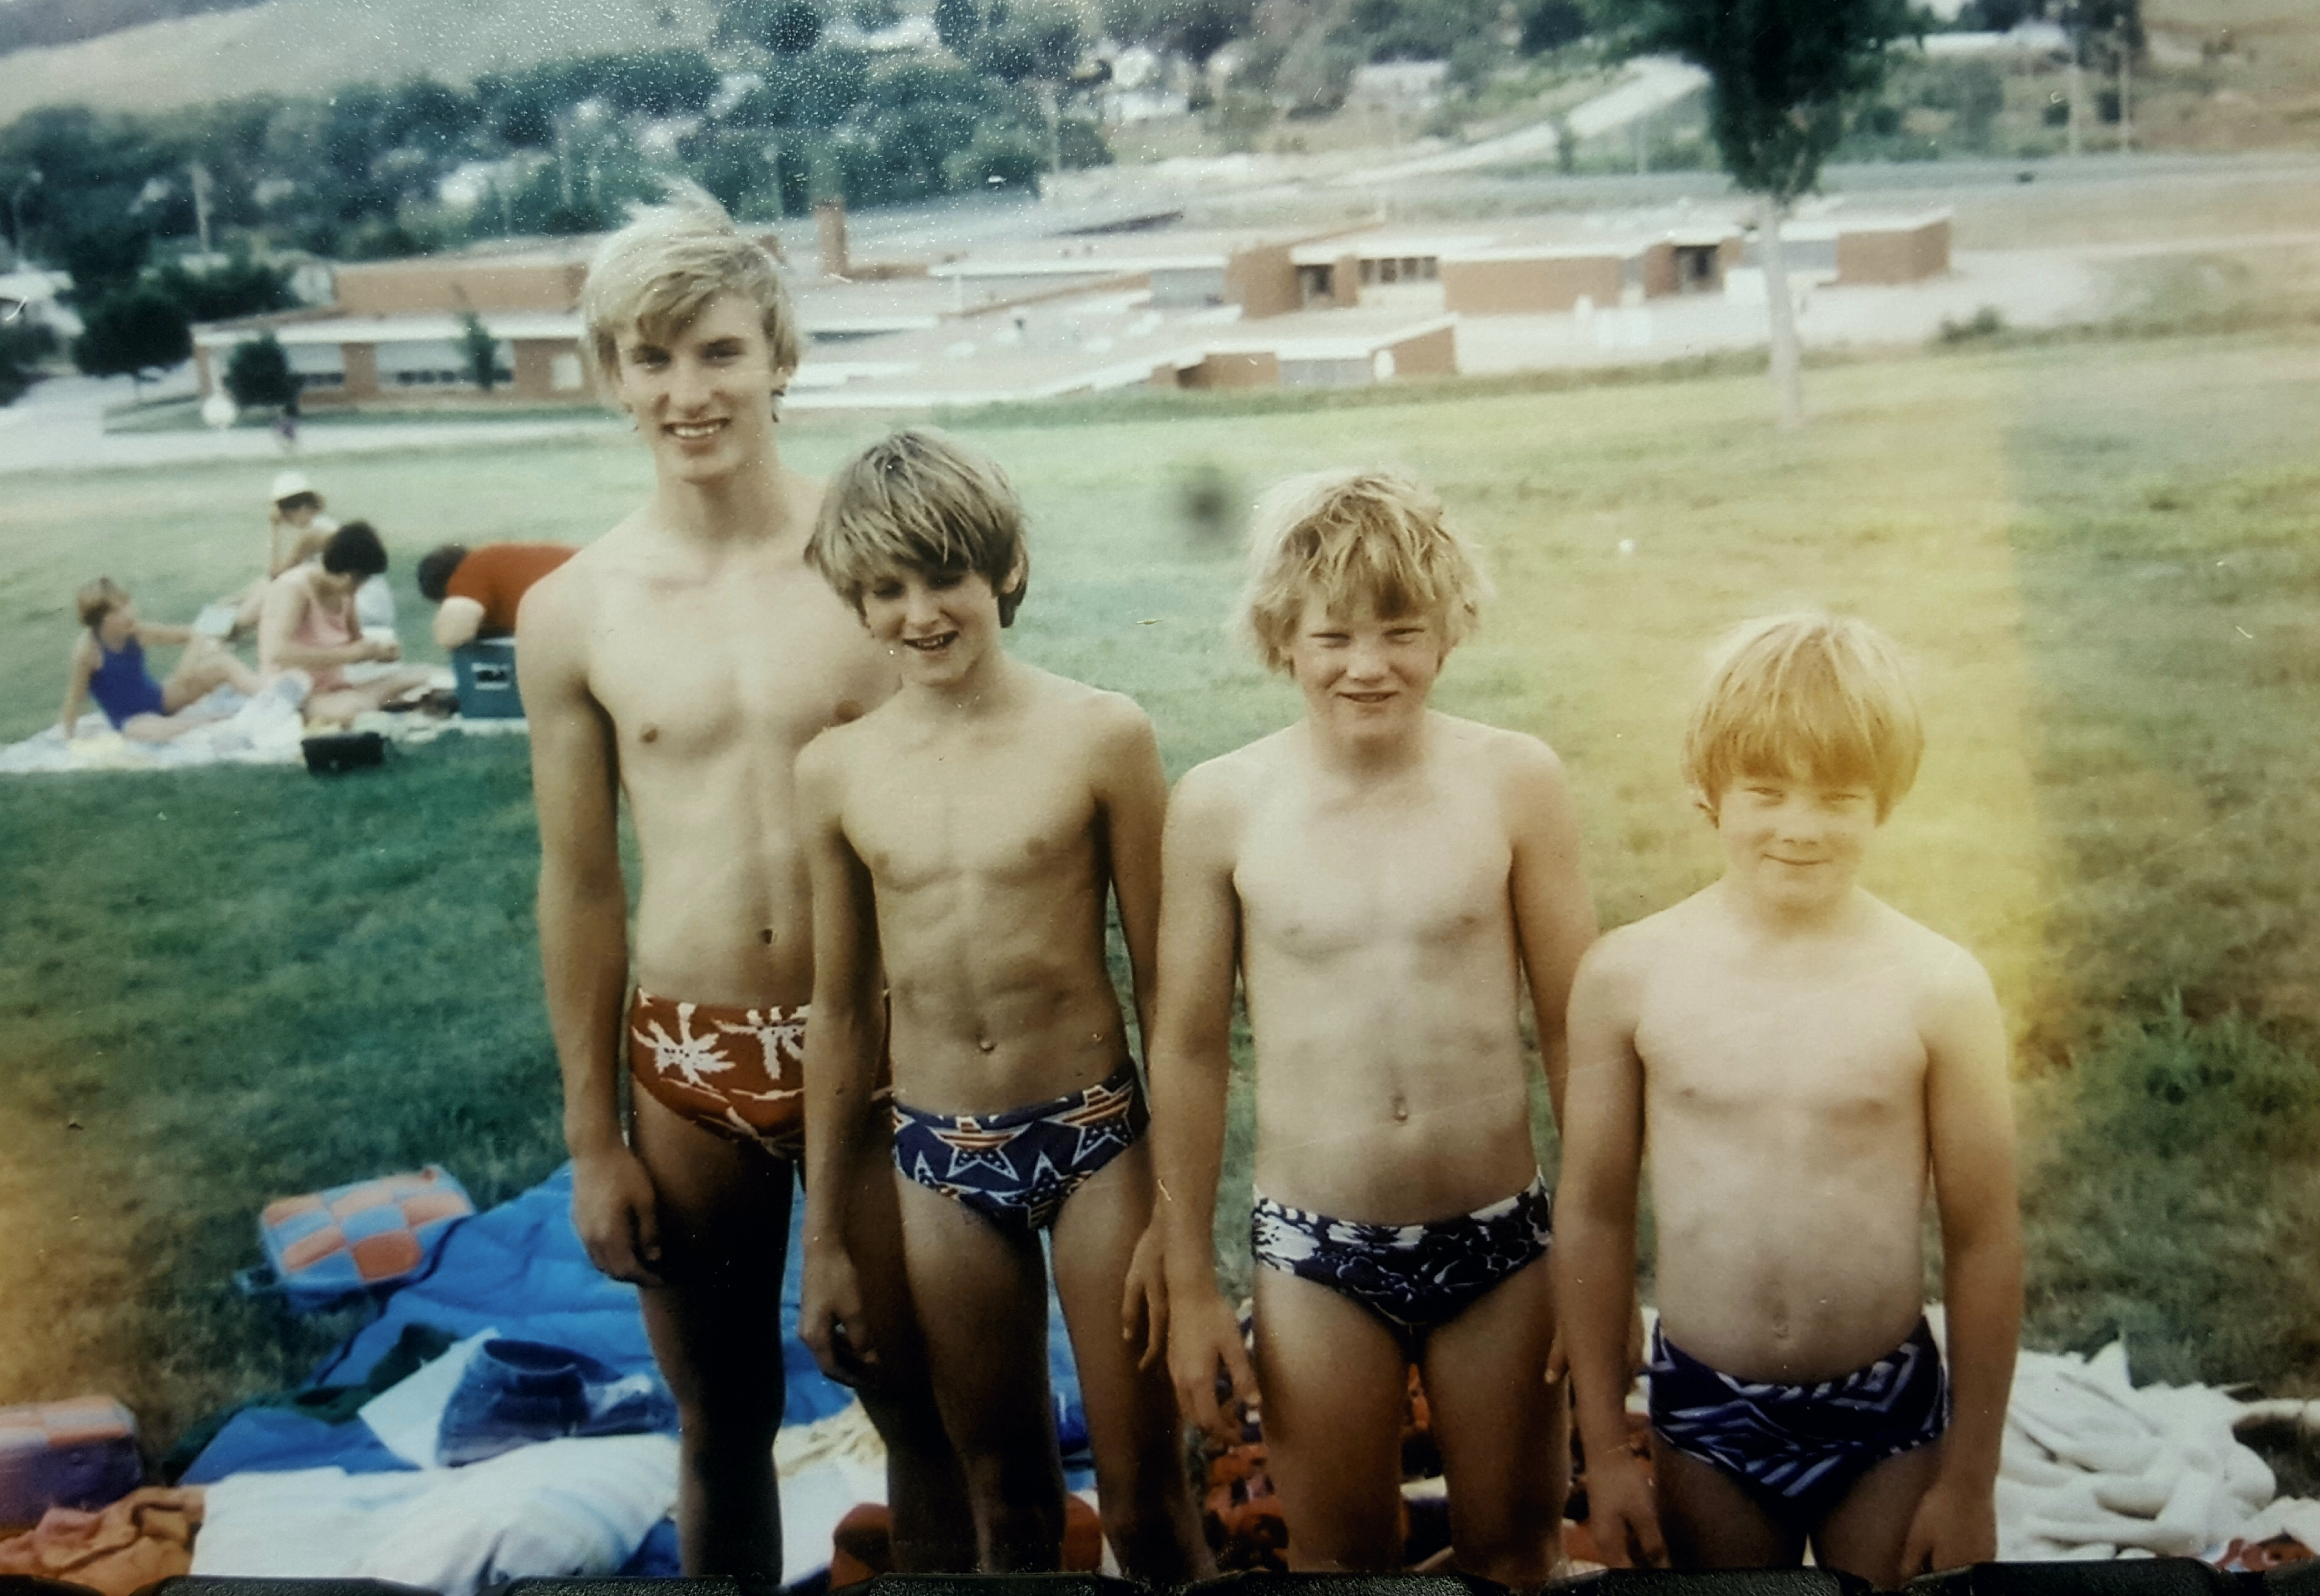
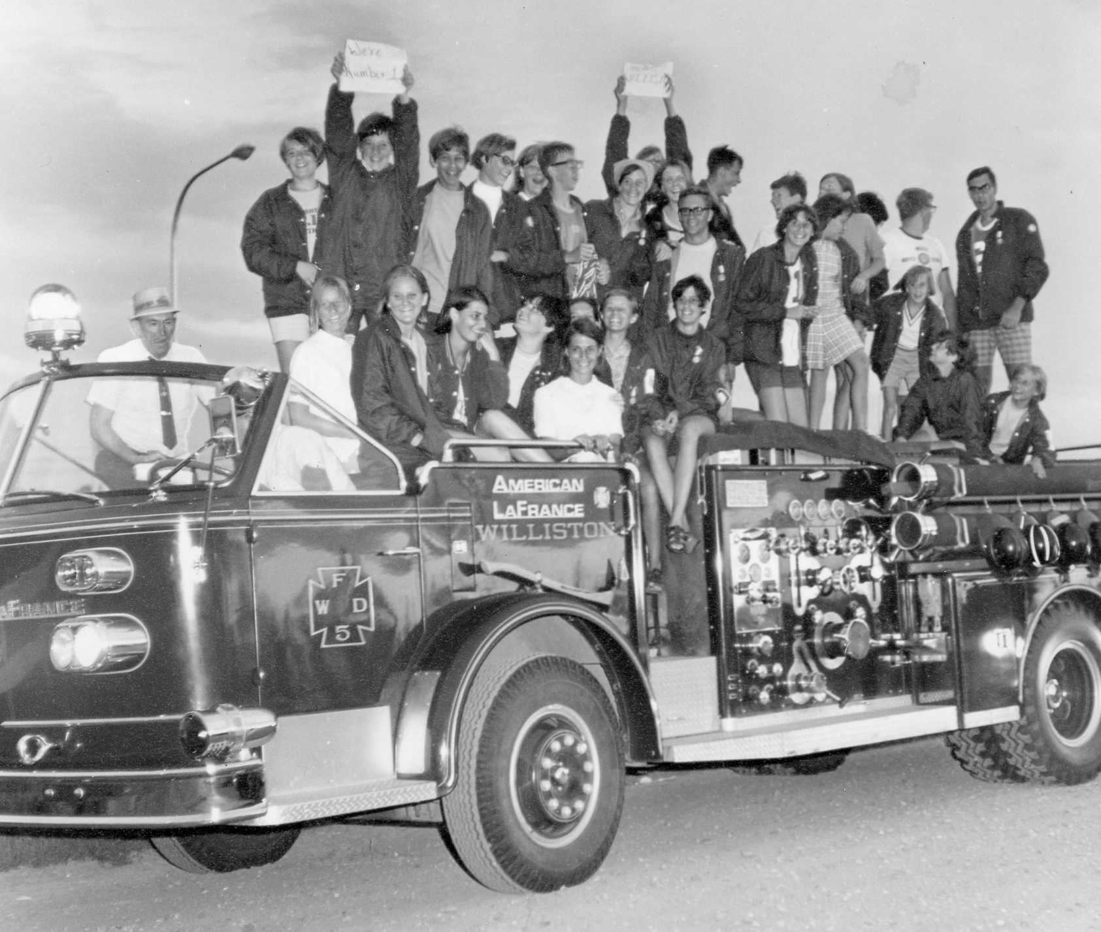
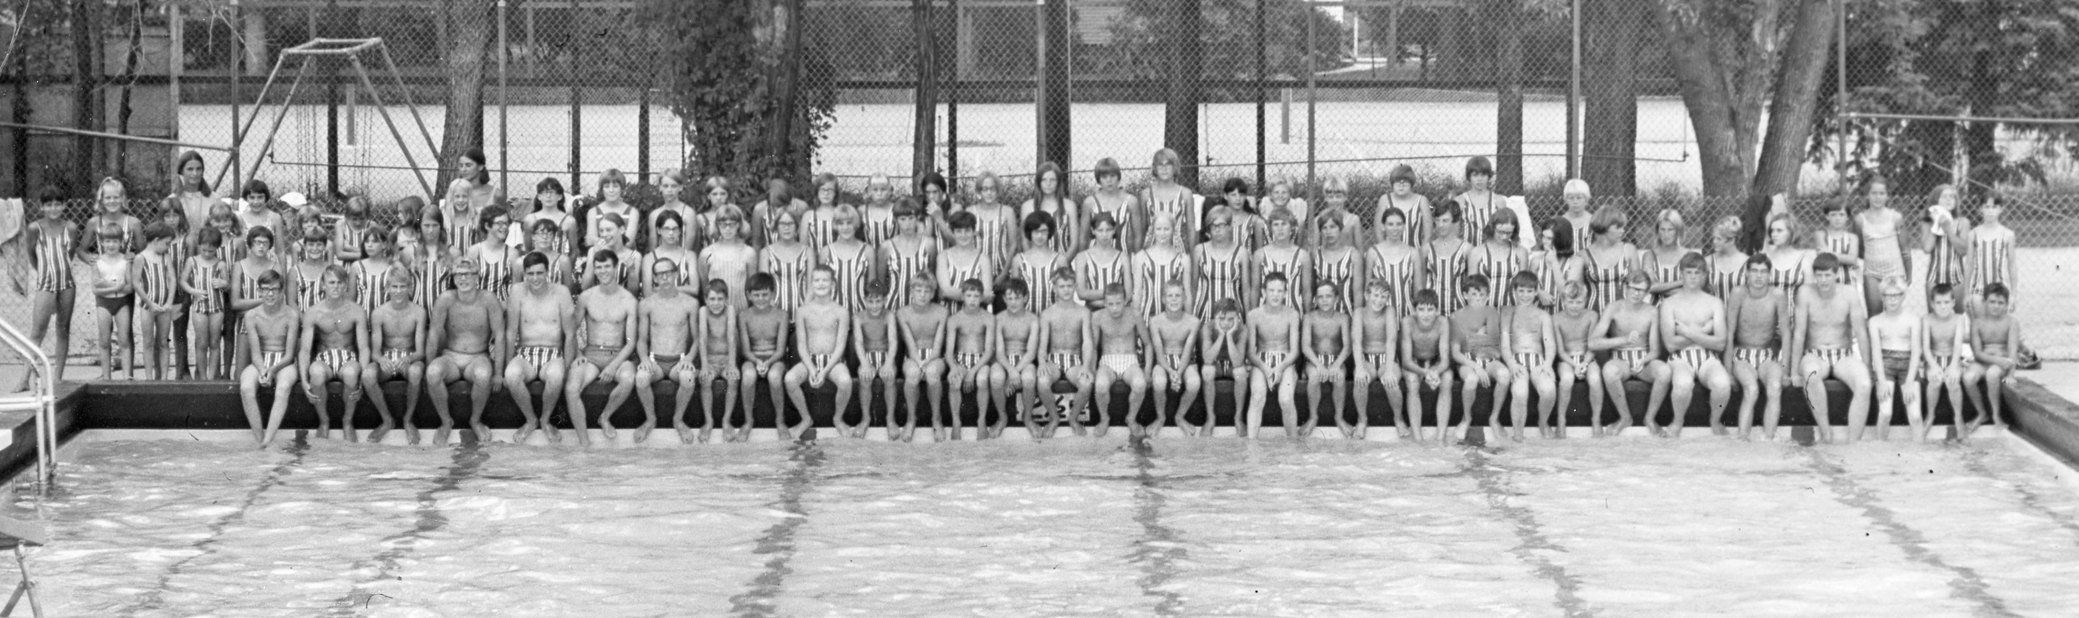
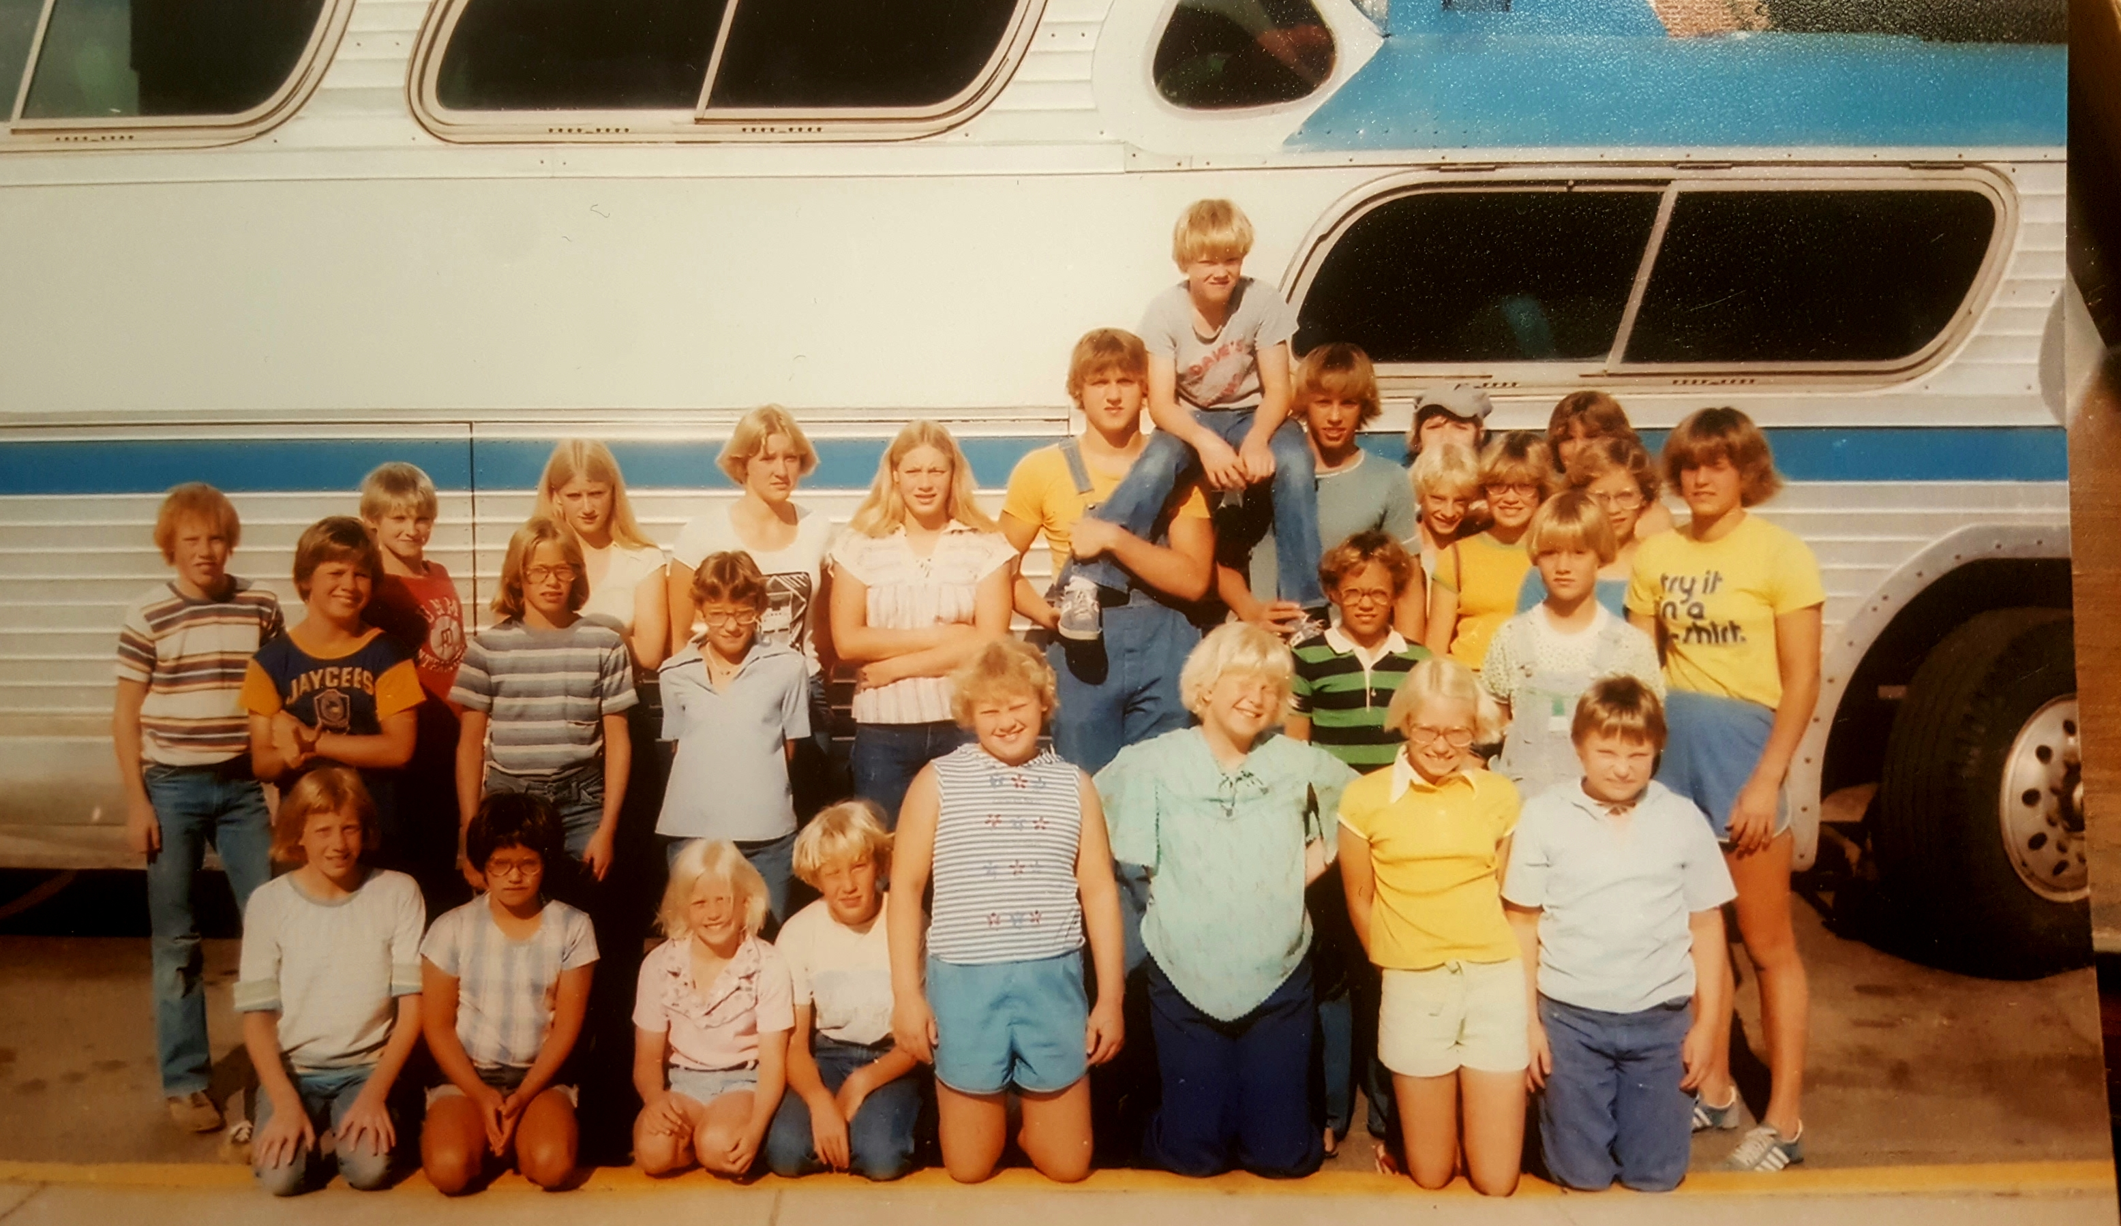
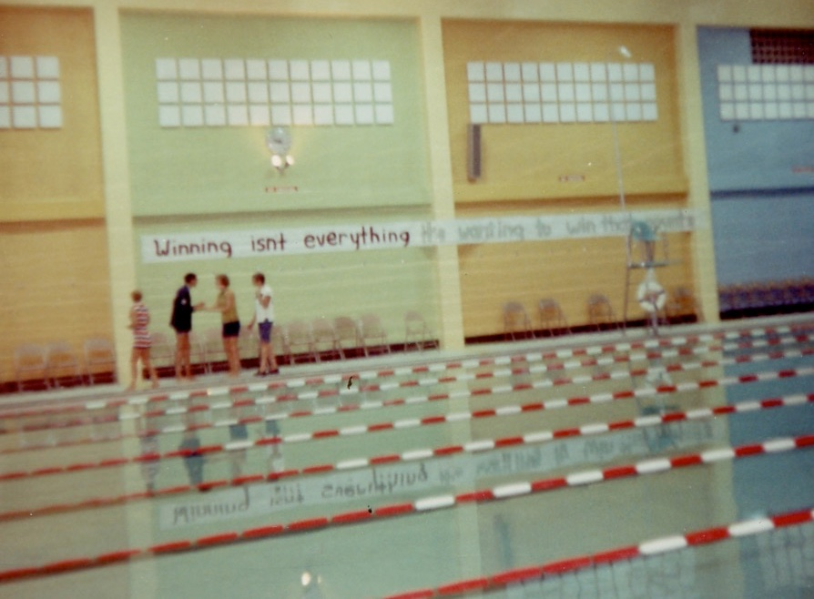
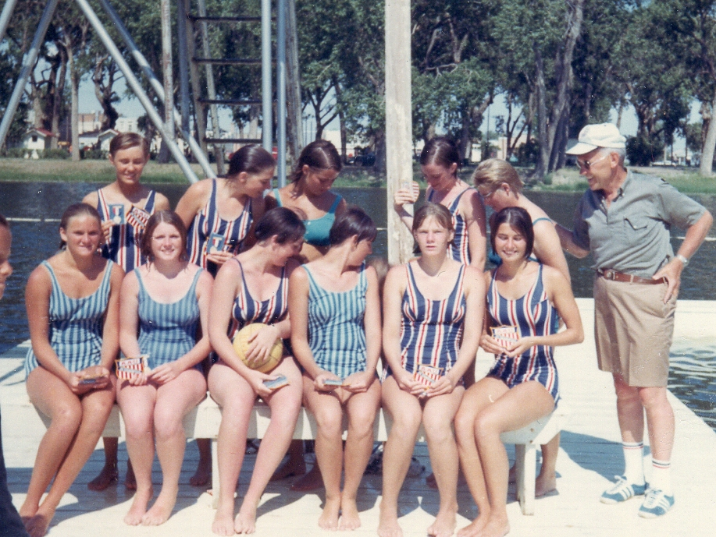
Williston Swimming
A Legacy that spans over 50 years

Slide 11

Our Purpose, Mission, and Vision:
Member of the USA Swimming Organization.
We are a competitive swim team which offers high quality coaching and technique instruction. We are constantly growing and training young swimmers to maintain a well-rounded competitive swim team.
The purpose of our team is to provide every member an opportunity to improve their swimming skills and achieve success at his or her level of ability, from novice to national competitor.
The Williston Sea Lions, a not-for-profit club, which is governed by a volunteer Board of Directors which meets on the first Tuesday of every month. All members are welcomed at each meeting and encouraged to be involved in team activities and fundraisers. Our club mission and vision supports and promotes the USA Swimming Safe Sport policies.

Slide 12

Our Mission
To inspire our athletes to achieve success in swimming and in life.
We support this mission by:
Encouraging our swimmers to be actively involved in their homes, schools, churches, community.
Celebrate achievements in the pool and outside (ie, academic honors, scouts, volunteer services, etc.)
Providing opportunities for our swimmers to excel in all areas of their lives through consistent and quality swim training program, mentor program, leadership opportunities on the local, state and national level of USA swimming.

Slide 13
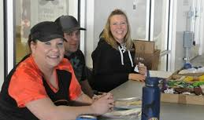

Vision: Compete. Succeed. Lead.
One Stroke at a time.
As a team we carry out this vision by encouraging participation on all levels of our club.
Because of our Parent/Family/Community Volunteers we have:
  Achieved Level 1 Club Recognition status and are 95% towards achieving Level 2 status.
  It has been noted that the welcoming spirit of the Sea Lions family and our fantastic facility have encouraged teams from around the state to make their way to compete at our meets. - With your help we are now able to host 3-4 home meets per year!
  We host 1-2 swim clinics/per year.

Slide 14
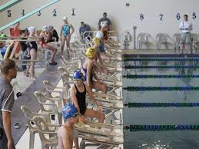
Achieving success includes YOU!
Board Members – Work together with the Head Coach to provide a successful program for all families in our program.
Officials – Required to run meets, for every 10 swimmers that attend a meet we must provide an official.
Fundraising – In order to keep costs down for our members we look for a variety of ways to raise funds for our team. As we raise funds, we work together with others in the community extending our reach, introducing new people to our program as well as provide needed services to others in the community.
Swim Meets
  Timers, concession workers, food for concessions, silent auction items, etc.

Slide 15
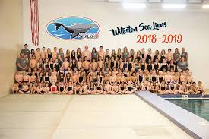
Meet the Coaches
Head Coach
  Karen Guglich
Lead Coaches
  Joanna Baltes (Senior)
  Karen Guglich (Level 3/Prep 9+)
  Melissa Pehrson (Level 2/Prep 7/8)
  Kim Weir (Level 1/Prep 5-6)
Assistant Coaches
  Cameron Elmer
  Kassie Gorder
  Brandy Logan
  Christina Luthy
  Hannah Reichman

Slide 16
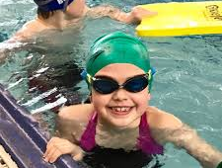
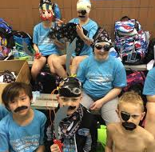
Groups and Expectations – PREP
Introduction to Competition Swimming
  Meets 1-3 days a week depending on age group
  Equipment needs: Cap, Goggles, fins, towel
  Be seated and quiet in the metal bleachers 5 minutes prior to practice start time.
  Use locker rooms to change.
  We are not responsible for your children until 10 minutes before and 10 minutes after practice time.
  What to expect:
    Learn proper breathing techniques
    Stroke work focusing on Freestyle, backstroke and body dolphin. Progressing into Breaststroke and butterfly.
    Starts from the wall and the block.
    Lots of kicking ☺
    Cheers
    New Friendships

Slide 17
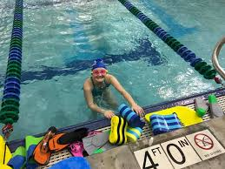
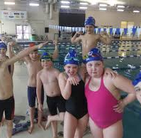
Groups and Expectations – LEVEL 1
Stroke Technique and Aerobic Conditioning
Season Goal: IMR Score, legal turns and starts
  Meets 4 days a week (Mon-Thus 6-7pm) (Ages 8+)
  Equipment needs: Cap, Goggles, fins, towel
  Be seated and quiet in the metal bleachers 5 minutes prior to practice start time.
  Use locker rooms to change.
  We are not responsible for your children until 10 minutes before and 10 minutes after practice time.
  What to expect:
    Learn proper breathing techniques
    Stroke work focusing on all for strokes
    Starts from the wall and the block.
    Lots of kicking ☺
    Cheers
    New Friendships

Slide 18
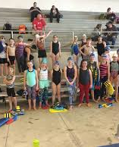
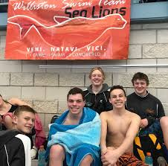
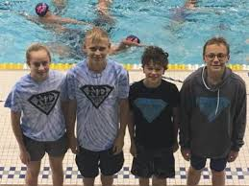
Groups and Expectations – LEVEL 2
Stroke Technique, Aerobic Condition, Race Training
Goal: Complete IMX Challenge, Set goals to Achieve Personal Best, Compete in the 500 Free
  Meets 5 days a week (Ages 9 +) 4:30-5:45
  Equipment needs: Cap, Goggles, fins, towel, water bottle
  Be seated and quiet in the metal bleachers 5 minutes prior to practice start time.
  Use locker rooms to change.
  We are not responsible for your children until 10 minutes before and 10 minutes after practice time.
  What to expect:
    Aerobic Development
    Develop all four strokes, including the 200 IM – Goal IMX Score
    Starts from the wall and the block/Turns and underwaters emphasized
    Use of Pace Clock
    Greater Commitment to training
    Will know their best time and seek to improve through goal setting

Slide 19
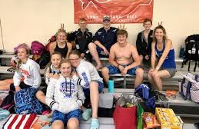
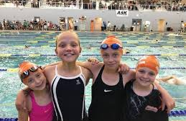
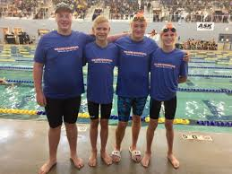
Groups and Expectations – Level 3
Stroke Technique, Aerobic Conditioning, Race Training
Goals: State Championships and Regional Meets, Set goals to achieve PB, Compete in the 400 IM
  Meets 5 days a week (Ages 11 +) 4:30-6:00
  Equipment needs: Cap, Goggles, fins, towel, water bottle
  Use locker rooms to change.
  What to expect:
    Aerobic Development
    Develop all four strokes including the 400 IM
    Starts from the wall and the block/Turns and underwaters emphasized
    Correct use of pace clock and tempo training
    Greater Commitment to training
    Will know their best time and seek to improve through goal setting

Slide 20
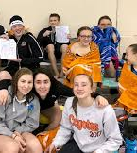
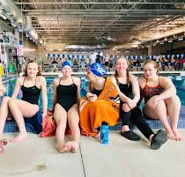
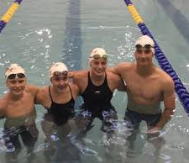
Groups and Expectations – SENIOR
Stroke Technique, Training in all Energy Zones, Season plan developed with each swimmers' goals in mind.
Goals: State Championships and Regional Meets, Prepare for college level swimming
Expectations of swimmers:
  Team Leader – asked to lead Cheers, help with younger groups, participate in LSC activities
  Swim at least 5 days a week (Ages 13 +) 4:30-6:30
  Equipment needs: Cap, Goggles, fins, towel, water bottle
  Read a Pace Clock and workout correctly
  What to expect:
    Training in all Energy Zones: Aerobic, Anerobic, Max Vo2, etc.
    Starts from the wall and the block/Turns and underwaters emphasized
    Use of Pace Clock, tempo trainers, buckets, etc.
    Will know their best time and seek to improve through goal setting

Slide 21

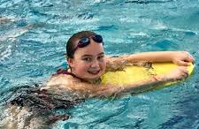

Important Dates 2019 - 2020
November 4 – First Day of Practice
November 19th – Orange and Blue Swim Meet
November 11th – No Practice
November 22 and 23 – Fitter and Faster Swim Clinic
November 27th – 29th – No Practice
December 15th – Williston/Minot Dual Meet @ Minot- Magic City Campus
January – Swim – A - Thon
March 12th – 15th – Sectionals
March 19th – 22nd – ND SC State Championships
Full Meet Schedule is on the Website
www.willistonsealions.com

Slide 22




Team Unify, Deck Pass, IMR/IMX, Safe Sport
Team Unify is our team website. www.willistonsealions.com
  Team Events
  Team Newsletter
  Swim Gear and Fan Gear
  Volunteer Opportunities
  Deckpass
    IMX/IMR
    Safe Sport

Slide 23




Communications and
Meet Results
Email
Facebook
Crew App
Team Unify
Meet Mobile

Slide 24



Swim Gear/
Fan Gear
Elsmore Swim
Squad Locker
Speedo

Slide 25

Thank you to our Sponsors

