Slide 1


2023 Open Water
Safety Plan

Slide 2



Open Water
Safety Plan
Requirements
  Monitoring Swimmers During Race
  Safety Communication Plan
  Feeding Station (more than 5K)
  Course Evacuation Plan
  Medical Services
  Accounting For Swimmers
  Technical Meeting/Briefing
  Safety during warm-up and warm-down
  Water and Air Temperature
  Water Quality

Slide 3

Open Water
Safety Plan
  Monitoring Swimmers During Race
  2023 Plan:
  1. ARC Certified Lifeguards (10 - 12), and Water Rescue Kayakers (10) will be used.
  2. All athletes will be observed at all times in the race by a member of the safety team. Elimination of “blind spots” is the primary goal.
  3. The course is a 500 meter straight-line course.
  4. The race course will be broken down into 10 zones of 50 meters each, with the following “first responders” as safety personnel:
  a. One certified Lifeguard for each 50 meters. There will be a total of 10 -12 Lifeguards . Each lifeguard will carry a Guard Rescue Tube (40 inch minimum”)

Slide 4

Open Water
Safety Plan
  Monitoring Swimmers During Race
  2023 Plan:
  4. (Continued)
  b. Along the Course: One Water Rescue Kayaker, or certified Lifeguard on a paddle board for each 50 meters. There will be a total of 10-15 Kayakers or Paddle-boarders on the course.
  c. All “first responders” shall have the capacity of to react to a need for assistance within 10 seconds, and are able to reach the swimmer within an additional 20 seconds.
  d. In 2018 there were 191 athletes on the course at the peak of competition, providing a gross ratio of one first responder per 9.10 athletes. A first responder ratio of one per 20 athletes is recommended. This does not include 4 - 5 additional boats for Officials (2 at turns, 2 on the outside of course, 1 transport for exchanging Officials).

Slide 5

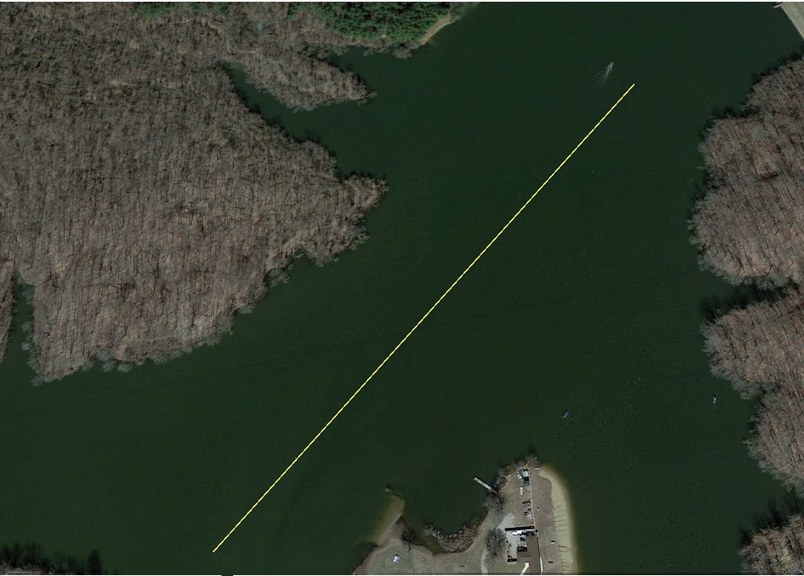





Open Water
Safety Plan
15&O = 4K (4 Laps)
13-14 = 3K (3 Laps)
11-12 = 2K (2 Laps)
10&U = 1K (1 Lap)
In Water Start
Beach Finish
500 Meters
10-12 Lifeguards and
10 Rescue Kayakers
Start
Finish

Slide 6

Open Water
Safety Plan
The Open Water Championship 2018
Ohio / AM / LE / KY / MI / IN Open Water Championship
Event | Gender | Age | Distance | Total | Start Time | 1st Finish | 50% Finish | Last Finish
1 | Boys | 15 & O | 4K | 70 | 10:00 AM | 10:46 AM | 10:58 AM | 11:16 AM
2 | Girls | 15 & O | 4K | 90 | 10:10 AM | 11:00 AM | 11:09 AM | 11:21 AM
3 | Boys | 13-14 | 3K | 64 | 11:00 AM | 11:35 AM | 11:41 AM | 11:55 AM
4 | Girls | 13-14 | 3K | 87 | 11:10 AM | 11:47 AM | 11:55 AM | 12:05 PM
5 | Boys | 11-12 | 2K | 48 | 12:00 PM | 12:25 PM | 12:28 PM | 12:36 PM
6 | Girls | 11-12 | 2K | 60 | 12:10 PM | 12:36 PM | 12:40 PM | 1:03 PM
7 | Boys | 10 & U | 1K | 40 | 12:45 PM | 12:58 PM | 1:00 PM | 1:16 PM
8 | Girls | 10 & U | 1K | 49 | 12:55 PM | 12:08 PM | 1:01 PM | 1:19 PM
Total |  |  |  | 508

Slide 7

Open Water
Safety Plan
The Open Water Championship 2018
Ohio / AM / LE / KY / MI / IN Open Water Championship
 |  | In Water Ratios |  |  |  |  | In Water Ratios
Time | In Water | FR | MED |  | Time | In Water | FR | MED
10:00 AM | 70 | 3.33 | 17.50 |  | 11:50 AM | 90 | 4.29 | 22.50
10:10 AM | 160 | 7.62 | 40.00 |  | 12:00 PM | 61 | 2.90 | 15.25
10:20 AM | 160 | 7.62 | 40.00 |  | 12:10 PM | 108 | 5.14 | 27.00
10:30 AM | 160 | 7.62 | 40.00 |  | 12:20 PM | 108 | 5.14 | 27.00
10:40 AM | 160 | 7.62 | 40.00 |  | 12:30 PM | 79 | 3.76 | 19.75
10:50 AM | 155 | 7.38 | 38.75 |  | 12:40 PM | 79 | 3.76 | 19.75
11:00 AM | 169 | 8.05 | 42.25 |  | 12:50 PM | 91 | 4.33 | 22.75
11:10 AM | 191 | 9.10 | 47.75 |  | 1:00 PM | 55 | 2.61 | 13.75
11:20 AM | 157 | 7.48 | 29.25 |  | 1:10 PM | 12 | .57 | 3.00
11:30 AM | 151 | 7.19 | 37.75 |  | 1:20 PM | 0 | N/A | N/A
11:40 AM | 136 | 6.48 | 34.00 |  | 1:30 PM | 0 | N/A | N/A
FR = First Responder (21) MED = Medical Responder (4)

Slide 8
Open Water
Safety Plan
  2. Safety Communication Plan
2023 Plan:
Safety communications will have three elements:
Water to Water – All Water Rescue Kayakers, and all Officials in boats will be equipped with 2 ways radios, allowing efficient and immediate communications with the Safety Officer, and Meet Referee.
Water to Land – Same as above, with the lifeguards/paddle-boarders with whistles.
Land to Water – Same as above, with the addition of the public address system, and lifeguards with whistles.

Slide 9

Open Water
Safety Plan
  3. Feeding Station
No Feeding Station
All Events are less than 5K

Slide 10
Open Water
Safety Plan
  4. Course Evacuation Plan
2023 Plan:
The following priority will occur in this order, if the Safety Officer, Meet Referee, Meet Director, or Independent Safety Monitor becomes aware of any situation requiring abandonment (including inclement weather).
1. Radio Communication to Officials and Safety Personnel on Course.
2. All Lifeguards issue a 3 loud short blast whistle command, and instruct all swimmers to evacuate the course.
3. Announcer instructs all swimmers, safety personnel, and Officials, to exit the course. If the reason for abandonment is inclement weather, announcer will instruct all athletes, coaches, parents, and meet personnel to go to the shelter, team bus, or vehicles, until inclement weather passes.
4. Everyone will be instructed to go to vehicles, until safe conditions return.

Slide 11
Open Water
Safety Plan
Course Evacuation Plan

Slide 12

Open Water
Safety Plan
  5. Medical Services
2023 Plan:
EMTs will be on-site from the Athens County EMS, as we have provided during the past years.
One additional EMT will be located at the Finish, observing and evaluating all finishing athletes.
In 2018, there were 191 athletes on the course at the peak of competition. This provides an MED ratio of one MED per 48 athletes on the course during peak competition.
An ambulance from the Athens County EMS Department will be on-site, as we have provided during the past years.

Slide 13
Open Water
Safety Plan
  5. Medical Services (Continued)
2023 Plan:
Hospital: O'Bleness Hospital, 55 Hospital Dr, Athens, OH 45701, is 10 miles from the meet location, and approximately 12 minutes away.
The Athens County EMS and on-site ambulance has direct communications with the emergency room at O'Bleness Hospital, and other EMS county personnel.
All recommended medical equipment will be available in the on-site ambulance with the Athens County EMS.

Slide 14
Open Water
Safety Plan
  6. Accounting For Swimmers
2023 Plan: The following “accounting for swimmer” system will be used.
Advance registration is required entry into The Open Water Championship. No deck entries or day-of-meet entries are allowed.
All competitors are pre-assigned Competitor Numbers.
All swimmers must check-in at Clerk Of Course, receive their Race Ticket, and be marked with their competitor numbers. Any swimmer not checking in, is scratched.
All scratches are sent to Admin 30 minutes before each race, which generates the Start List.
After mandatory pre-race Instructional Briefing (Technical Meeting), all athletes enter the Pre-Race Assembly Area. Referee collects each Race Ticket re-confirming the Athlete Name & Competitor Number markings.
Any swimmer that decides not to compete, after checking in, the Race Ticket is collected by a Referee, sent to Admin, as a post check-in scratch.

Slide 15
Open Water
Safety Plan
  6. Accounting For Swimmers (Continued)
2023 Plan:
The Race Tickets for each event are sent to the Chief Finish Judge.
During each race, all swimmers who abandon prior to the finish are DQ’d, the DQ is sent to the Chief Finish Judge, and the Race Ticket is pulled and handed to the swimmer.
As each swimmer completes the race, their competitor number is recorded on the Order of Finish Sheet, by the Finish Judges.
As each swimmer completes the race, their Race Ticket is handed to the swimmer.
The Order of Finish Sheet is sent to Admin by the Chief Finish Judge immediately following the conclusion of each event, accounting for all competitors that started, and actually finished.
Any remaining Race Tickets (unaccounted for swimmers) are immediately investigated by the Chief Finish Judge and/or Administrative Referee back to the Coaches and/or Parents.

Slide 16


Open Water
Safety Plan
  6. Accounting For Swimmers (Continued)
2023 Plan:

Slide 17

Open Water
Safety Plan
  7. Technical Meeting/Pre-Race Briefing
2023 Plan:
The pre-race instructional briefing (technical meeting) will contain the following:
Course Layout
Rules of the swim (Officiating – Yellow/Red Flag)
Water conditions
Marine Life
Weather Conditions
The Safety Plan
Emergency Conditions

Slide 18
Open Water
Safety Plan
  7. Technical Meeting/Briefing (Continued)
2023 Plan:
The Safety Communication Plan
The Evacuation Plan for clearing the race course (abandonment)
Safety Craft & Safety Personnel (lifeguards, paddle-boarders, kayakers)
On-site EMTs & ambulance – Albany Fire Department EMTs
Emergency Phone Numbers (park rangers, police, emergency room, etc.)
Local Hospital – O'Bleness Hospital, Athens, OH

Slide 19

Open Water
Safety Plan
  8. Safety during pre-race warm-up and post-race warm-down
2023 Plan:
A designated warm-up/warm-down is available to the left side of the competition course. Certified lifeguards on shore and kayakers will be on-duty during all warm-up/warm down sessions, and is closed to all boating traffic during these times.

Slide 20

Open Water
Safety Plan
  9. Water and Air Temperature
2023 Plan:
Three Thermometers (with both marking in Celsius and Fahrenheit) will be used before & during competition.
  Two Water Temperature Thermometers, located on the Turn Judge Boats, will be used to monitor Water Temperature.
  One Air Temperature Thermometer, located in the Administration Tent, will be used to monitor Air Temperature.
Temperatures will be recorded by Safety Officer (or designee):
  30 Minutes before competition (9:30 a.m.)
  Hourly throughout the competition (beginning at 10:00 a.m.)
  Posted on Whiteboard at Competition for all Athletes, Coaches, and Parents.

Slide 21
Open Water
Safety Plan
  9. Water and Air Temperature (Continued)
2023 Plan:
Follow Requirements:
  If the water temperature is below 16° C (60.8° F), no race can be held.
  For races of 5K and above, if the water is above 29.5° C (85° F), no race can be held.
  If the air temperature and water temperature added together are less than a total of 30° Celsius (118° F), no race can be held.
  If the air temperature and water temperature added together (in Celsius) are greater than 63° Celsius (177.4° F), no race can be held.

Slide 22
Open Water
Safety Plan
  9. Water and Air Temperature (Continued)
2022 Actual Measurement:
Water Temperature
  The water was measured at 74° F (23° C) at 9:30 AM on race day.
Air Temperature
  The Air Temperature was measured between 78° F and 91° F (26 ° C and 33° C).
Combined Water & Air Temperature ranged from 152° F to 165° F (49° C to 56° C)

Slide 23

Open Water
Safety Plan
  9. 2022 Actual Air Temperature
Ohio Open Water Championship June 22, 2022
Time | Day | Temp F | Dew Point | Humidity | Pressure | Visibility | Wind | Weather
8:53 AM | Wed | 78° | 65° | 64% | 29.12in | Unlimited | 6mph | Fair
9:53 AM | Wed | 81° | 67° | 62% | 29.11in | Unlimited | 6mph | Fair
10:53 AM | Wed | 83° | 69° | 63% | 29.09in | Unlimited | 3mph | Fair
11:53 AM | Wed | 86° | 71° | 61% | 29.09in | Unlimited | 3mph | Fair
12:53 PM | Wed | 88° | 73° | 61% | 29.07in | Unlimited | 7mph | Fair
1:53 PM | Wed | 91° | 75° | 59% | 29.06in | Unlimited | 6mph | Fair
data source: | www.intellicast.com

Slide 24

Open Water
Safety Plan
  10. Water Quality
2023 Plan
The venue, Lake Snowden, Albany, Ohio.
Water quality monitoring is performed by the Athens County Board of Health.
The Water Quality Report will be monitored & published for the two weeks prior June 21, 2023, the day of the meet.
If the Water Quality exceeds Ohio standards of 235 cfu per 100 ml, the event will be canceled.

Slide 25

Open Water
Safety Plan
  10. Water Quality – Actual
Location: Lake Snowden, Albany, OH
Date: 06/13/2022
Time: 11:45 AM Individual
Result: 81
Legend: Ohio Water Quality recommendations for public beaches of less than 235 per 100ml of water.

Slide 26
Open Water
Safety Plan
  Recommendations
  Local Governmental Authorities are very helpful & cooperative
  Document Everything
  Publish Your Data
  Use Meet Evaluations

Slide 27
Open Water
Safety Plan
Everything at
OhioOpenWater.com

