Slide 1

Take Your Beep
Starter Recertification Clinic
October 2020

Slide 2
Take Your Beep
  Agenda
          Philosophies and Concepts for Starters
          What the Heck IS a False Start?
          Discussion

Slide 3
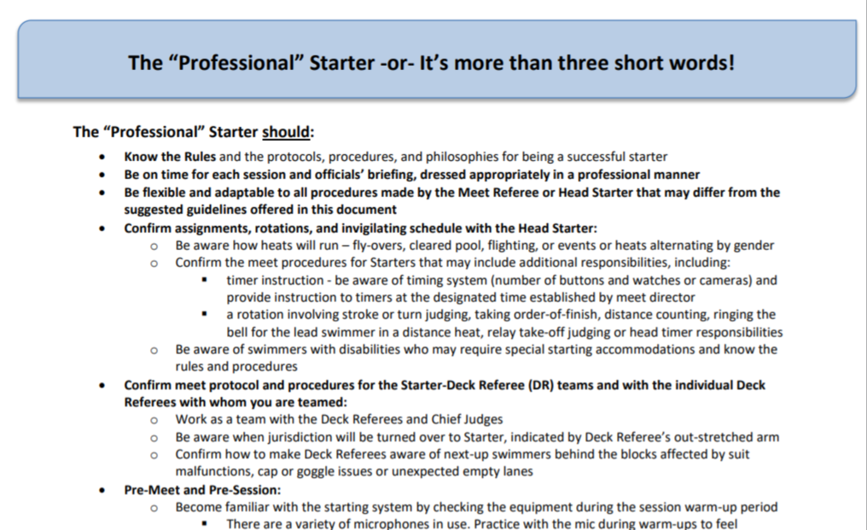
Take Your Beep
  Start at the beginning– Professional Documents from USA Swimming

Slide 4
Take Your Beep
    Philosophy of Starting
  Every swimmer deserves a good start.
  The starter’s job is to give every swimmer a fair, equitable, and (hopefully) good start.
  Good starting is an art.
    Preparation
    Empathy with the swimmers
    Quick information processing; responsive
    Patience, patience, patience
    Multi-tasking
    Self control and focus; conversational
    Humble and internally motivated; endless learning

Slide 5
Take Your Beep
    Philosophy of Starting
  Good starting takes practice.
  The deck ref and starter are partners.
    Communication before and during the meet
    DR cedes control to the SR. When???
    SR cedes it back after heads up
  Starters help each other and try to make the DR look good!

Slide 6
Take Your Beep
    Concepts for starters
  The individual versus the field
  The swimmers control the start
  Collaboration versus dual confirmation
  Stay in your box
  Protect yourself from distractions
  Patience before the TYM

Slide 7
Take Your Beep
    Just what is a false start? 103.1.3.A & D
Any swimmer starting before the starting signal is given shall be disqualified
if the Referee independently observes and confirms the Starter’s observation that a violation occurred.
Swimmers remaining on the starting blocks shall be relieved from their starting positions with the "stand up" command and may step off the blocks.
A swimmer who would otherwise be charged with a false start may be relieved of the charge if the false start was caused by the swimmer’s reaction to the “stand up” command.

Slide 8
Take Your Beep
    False start concepts for starters
      Stationary and wiggly swimmers
  Letting them set
  Letting them reset
  Standing a heat
  Stepping them down
  When to recall

Slide 9
Take Your Beep
  False Start Scenarios

Slide 10
Take Your Beep
    False start scenario #1:
    Swimmer leaves the set or stationary position with a forward starting motion prior to the starting signal and
    continues into the pool as the starting signal is given.
Is it a false start?
Yes, it is a false start if the starter observes and the referee independently confirms that observation. The swimmer would be disqualified at the end of the race.

Slide 11
Take Your Beep
    False start scenario #2:
    Swimmer leaves the set or stationary position with a forward starting motion, unsuccessfully tries to stop, and tumbles, falls, or dives into the pool prior to the starting signal being given.
Is it a false start?
Yes, it is a false start if the starter observes and the referee independently confirms that observation. The swimmer would be disqualified before the race proceeds.

Slide 12
Take Your Beep
    False start scenario #3:
    Swimmer leaves the set or stationary position with a forward starting motion. The starter says “Stand please” but the offending swimmer tumbles, falls, or dives into the pool prior to the starting signal being given.
Is it a false start?
Yes, it is a false start if the starter observes and the referee independently confirms. The stand command relieves the OTHER swimmers, not the offender. The swimmer would be disqualified before the race proceeds.

Slide 13
Take Your Beep
    False start scenario #4:
    Swimmer leaves the set or stationary position with a forward starting motion. The starter says “Stand please.” The offending swimmer is able to recover and remains on the block.
Is it a false start?
No, it is not a false start. The swimmer did not enter the pool and was able to comply with the stand command.

Slide 14
Take Your Beep
    False start scenario #5:
    Swimmer attains a set or stationary position but begins a forward starting motion. The starter says “Stand please.” The offending swimmer recovers and remains on the block but a second swimmer tumbles, falls, or dives into the pool.
Is it a false start?
No and no, neither is a false start. The offending swimmer recovered. The second swimmer reacted to the stand command and is relieved of the false start.

Slide 15
Take Your Beep
    False start scenario #6:
    Swimmer comes down but immediately becomes unbalanced and tumbles into the pool prior to the starting signal being given.
Is it a false start?
No. The swimmer never attained a stationary position.

Slide 16
Take Your Beep
    False start scenario #7:
    Swimmer attains a set or stationary position, leaves it but is able to resume the stationary position or to reset before the starting signal.
Is it a false start?
No, it is not a false start. The offending swimmer recovered and was able to attain a stationary position prior to the starting signal.

Slide 17
Take Your Beep
    False start scenario #8:
    Swimmer attains a set or stationary position, leaves it prior to the starting signal. As the swimmer is moving forward the starter says “Stand please.” The first swimmer plus a second swimmer dive into the pool.
Is it a false start?
Yes and no. The offending swimmer was unable to recover and remain on the block and should be charged with a false start. The second swimmer reacted to the stand command and should not be charged.

Slide 18
Take Your Beep
    False start scenario #8:
    Swimmer attains a set or stationary position, leaves it prior to the starting signal. A second swimmer sees the first and takes off as well. Both swimmers go into the pool.
Is it a false start?
Yes and yes. Both swimmers left their stationary positions prior to the starting signal and entered the pool.

Slide 19
Take Your Beep
    Other false start scenarios:
    The swimmer attains a stationary position then begins jiggling his foot prior to the starting signal being given.
    The swimmer leaves a stationary position prior to the starting signal. The referee observes it but the starter does not.
    The swimmer runs up and dives into the pool in her assigned lane AFTER the race has begun.
    Others??

