Slide 1
Middle Atlantic Swimming
Board Orientation
Andrew Austria
Chair Governance Committee
Notes:
test

Slide 2
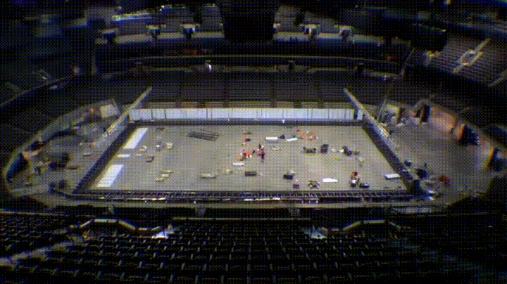
Overview
Understanding Middle Atlantic Swimming
Mission and Vision
Middle Atlantic Swimming DNA
Geographic Region
Demographics
Middle Atlantic Swimming Website
Governing Bodies
Organization Structure
Board of Directors Goals
Components of an Effective Meeting
Resources

Slide 3
Understanding Middle Atlantic Swimming
FINA is the international federation recognized by the International Olympic Committee for administering international competitions in water sports
Middle Atlantic Swimming (MASI) is one of 59 Local Swimming Committees (LSC's) of USA Swimming, the national governing body of competitive swimming in the United States.
USA Swimming is the national governing body for competitive swimming in the United States. It is charged with selecting the United States Olympic Swimming team and any other teams that officially represent the United States, as well as the overall organization and operation of the sport within the country.

Slide 4
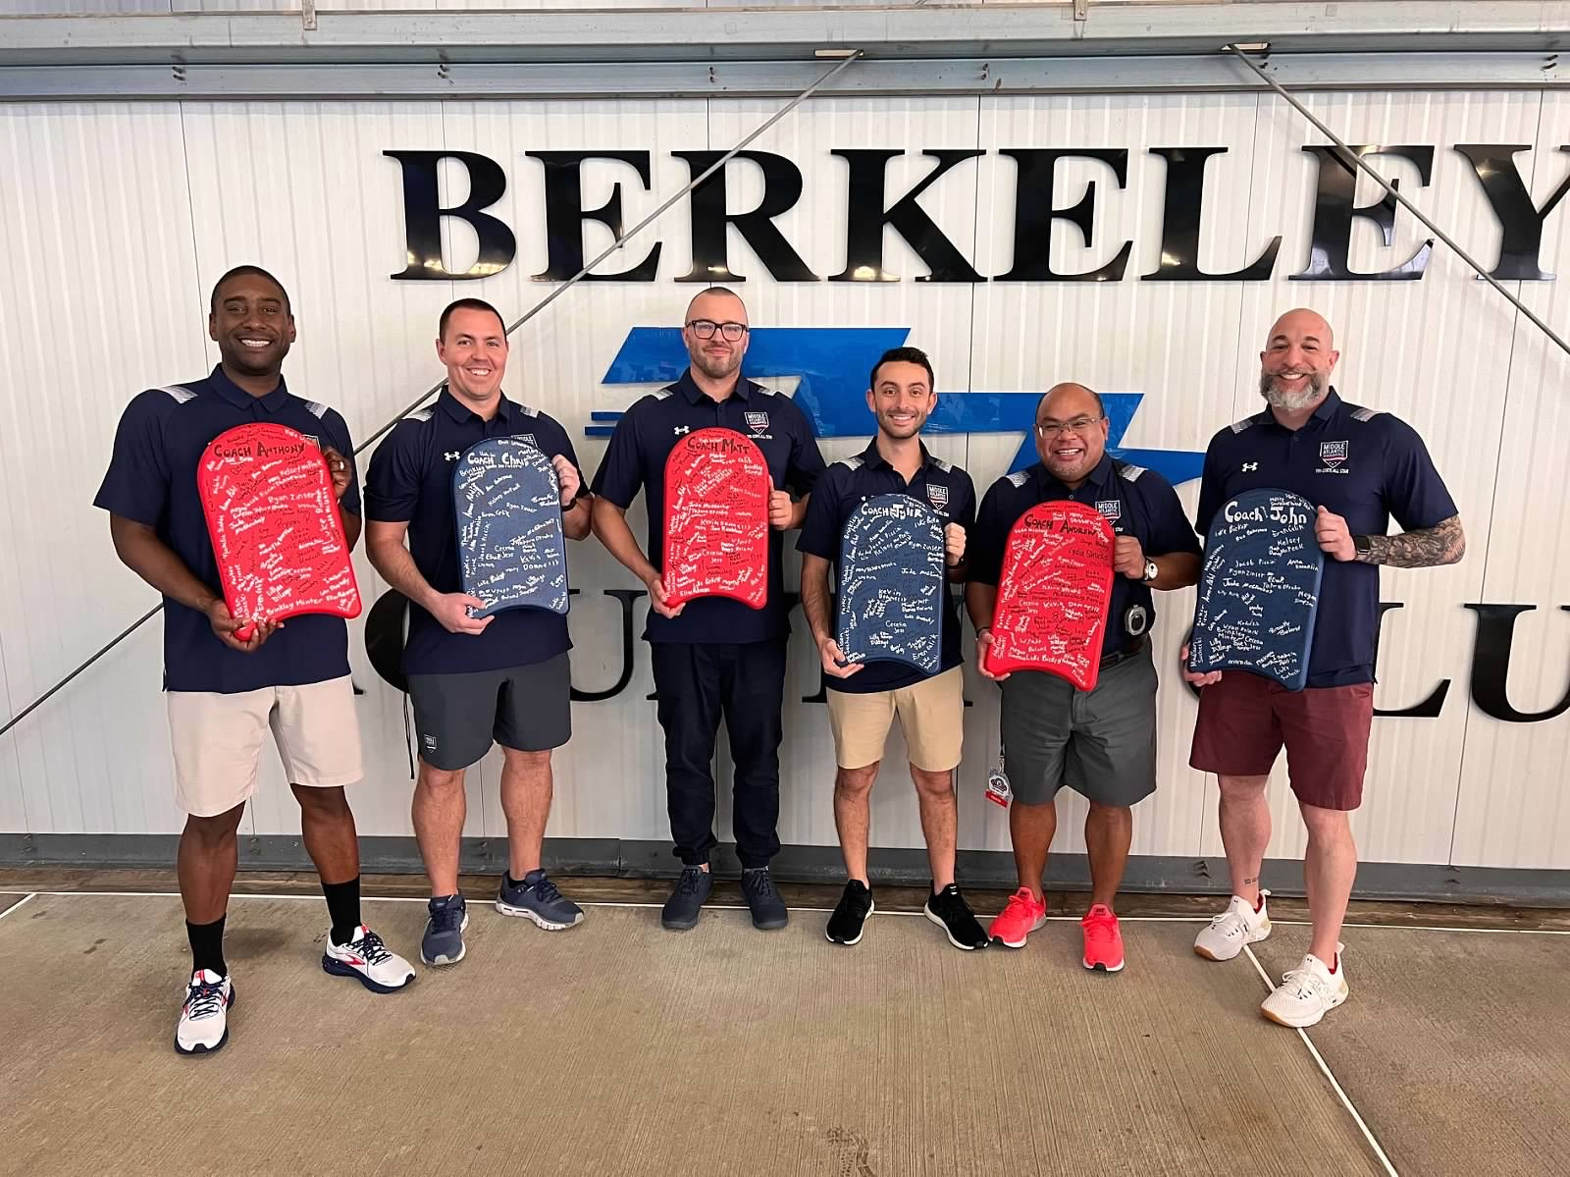
Middle Atlantic Swimming Mission and Vision
Mission: Middle Atlantic Swimming advocates the growth and development of a diverse swimming community through education, innovation, and a commitment to excellence
Vision: Strong Leaders. Innovative Coaches. Fast Swimming.
Leaders
Coaches
Swimming

Slide 5
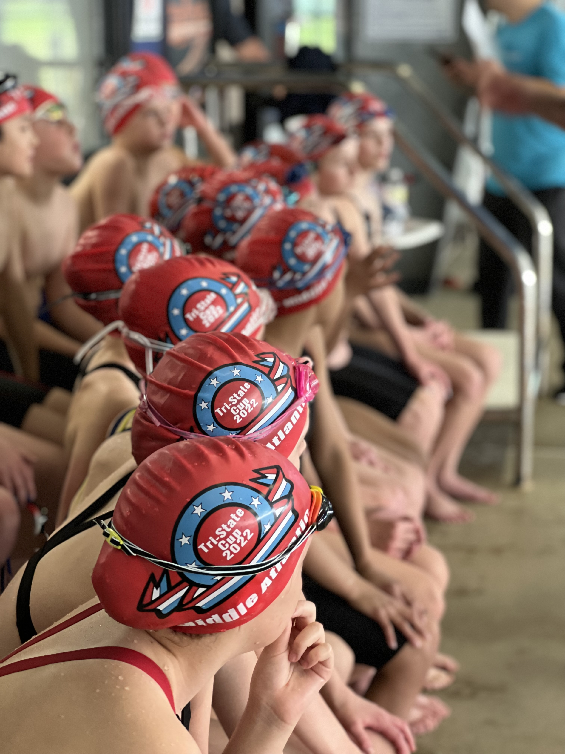
Understanding Middle Atlantic Swimming
Our Values Middle Atlantic Swimming strives to promote a safe, positive environment while providing competitive opportunities for members of all ages and abilities. We value integrity, fairness, leadership, innovation, and creativity. A Tradition of Excellence Of the 200 clubs awarded by the USA Swimming Excellence Program in 2018, 12 were from MASI Of over 3,000 USA Swimming clubs, 25 of the top 500 are part of Middle Atlantic Swimming. Middle Atlantic Swimming has had at least one athlete on each Olympic team since 1952.

Slide 6
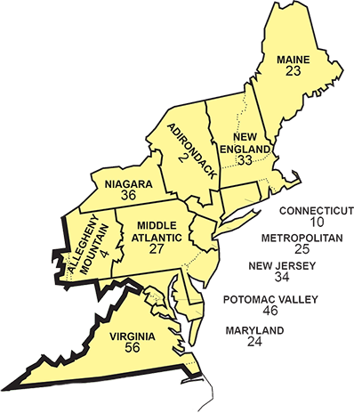
Middle Atlantic Swimming DNA
Middle Atlantic Swimming (MASI) is one of 59 Local Swimming Committees (LSC's) of USA Swimming, the national governing body of competitive swimming in the United States.
By The Numbers:
118 member clubs
11,000+ athletes
1,200+ officials, coaches and non-athlete members
Volunteer Type:
Athlete
Parent
Official
Coach
Geographic Location:
Eastern Pennsylvania
Southern New Jersey
Delaware

Slide 7
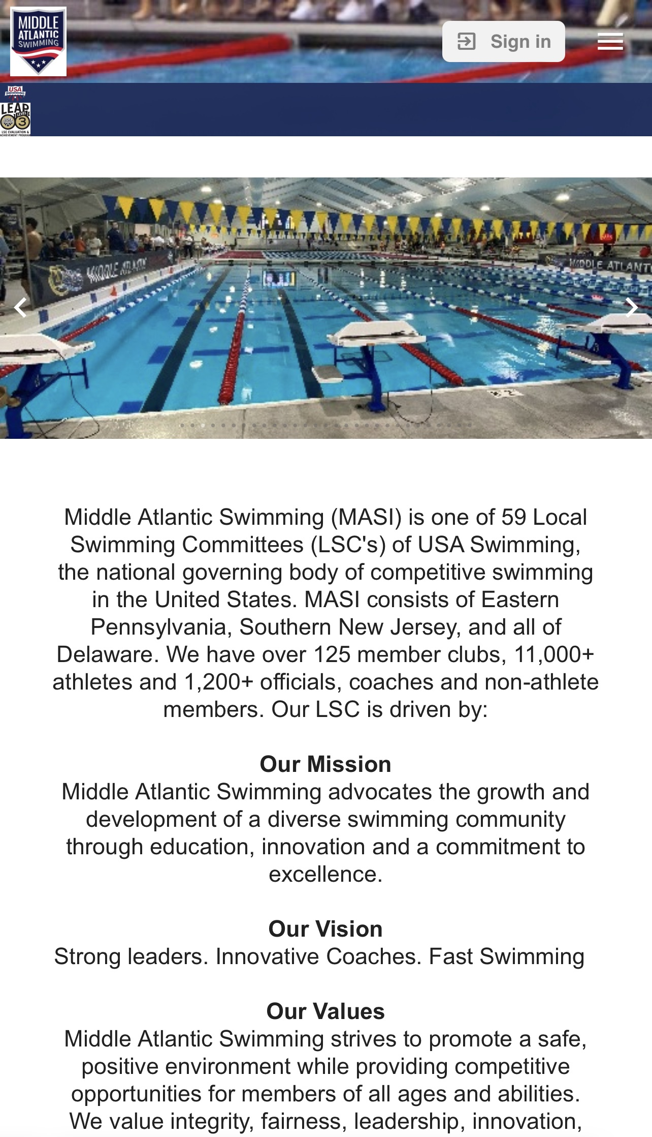
Middle Atlantic Swimming Website

Slide 8
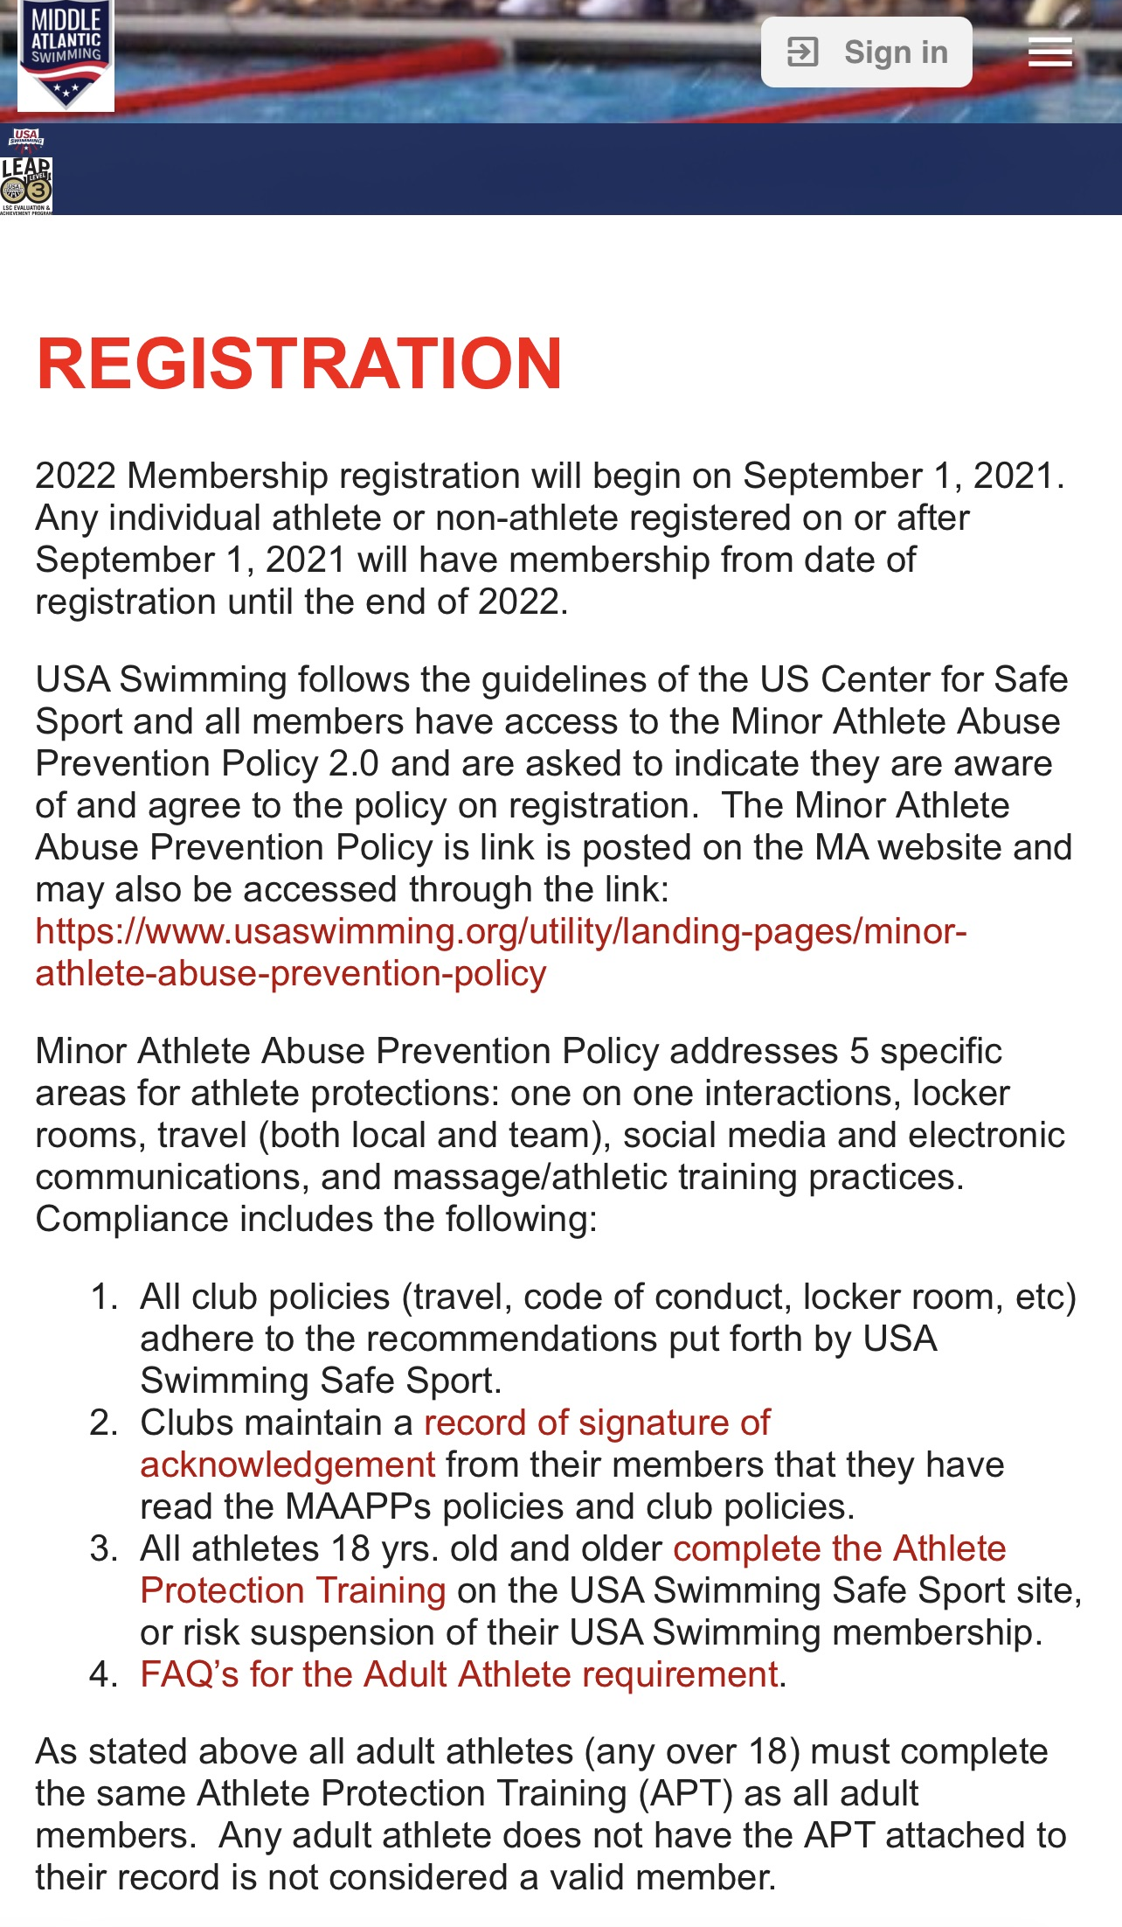
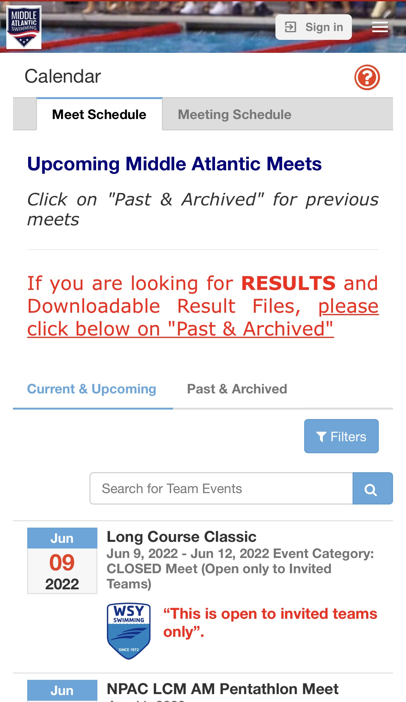
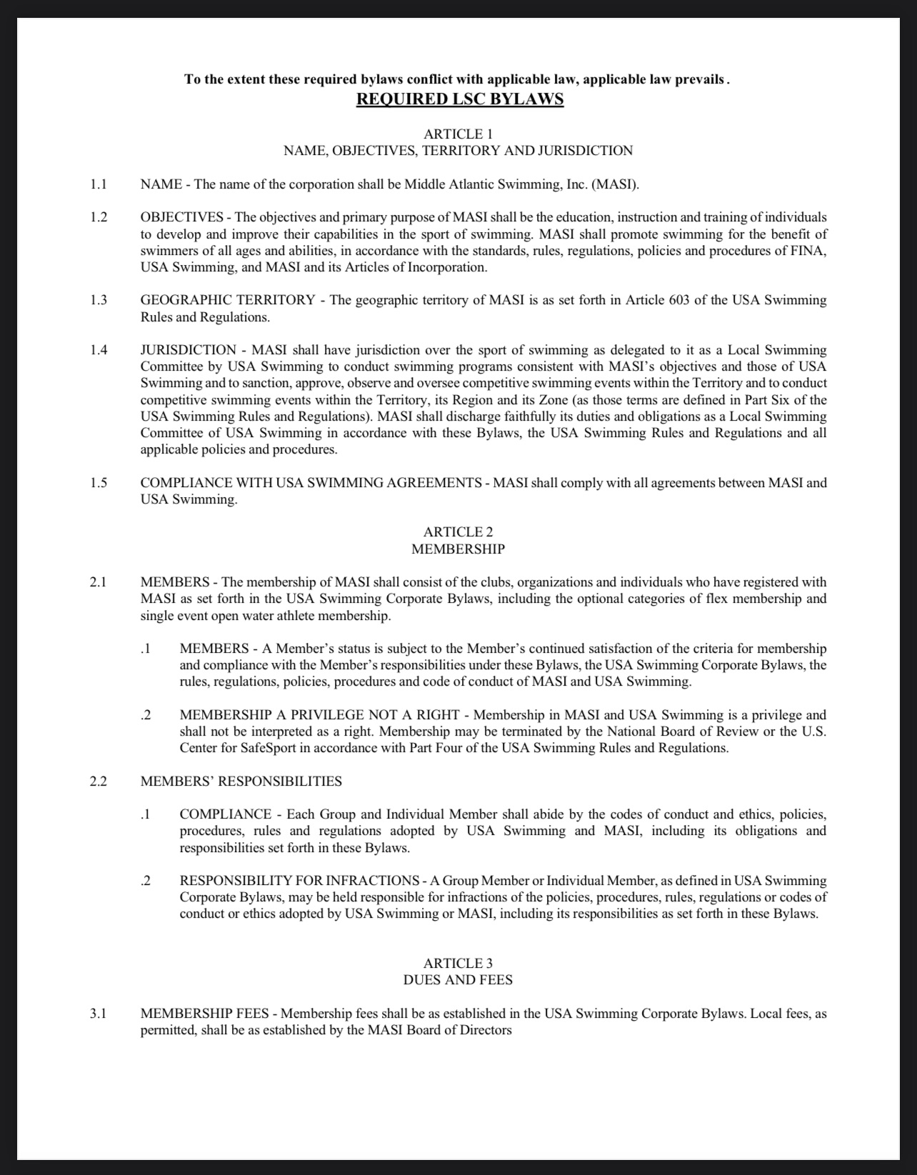
Middle Atlantic Swimming
Registration
Sanction Meets
Bylaws

Slide 9
Governing Bodies
Committee Chairs
Athlete
House of Delegates
Board of Directors
Club Representative
Non-Athlete Representative
Governance Committee

Slide 10
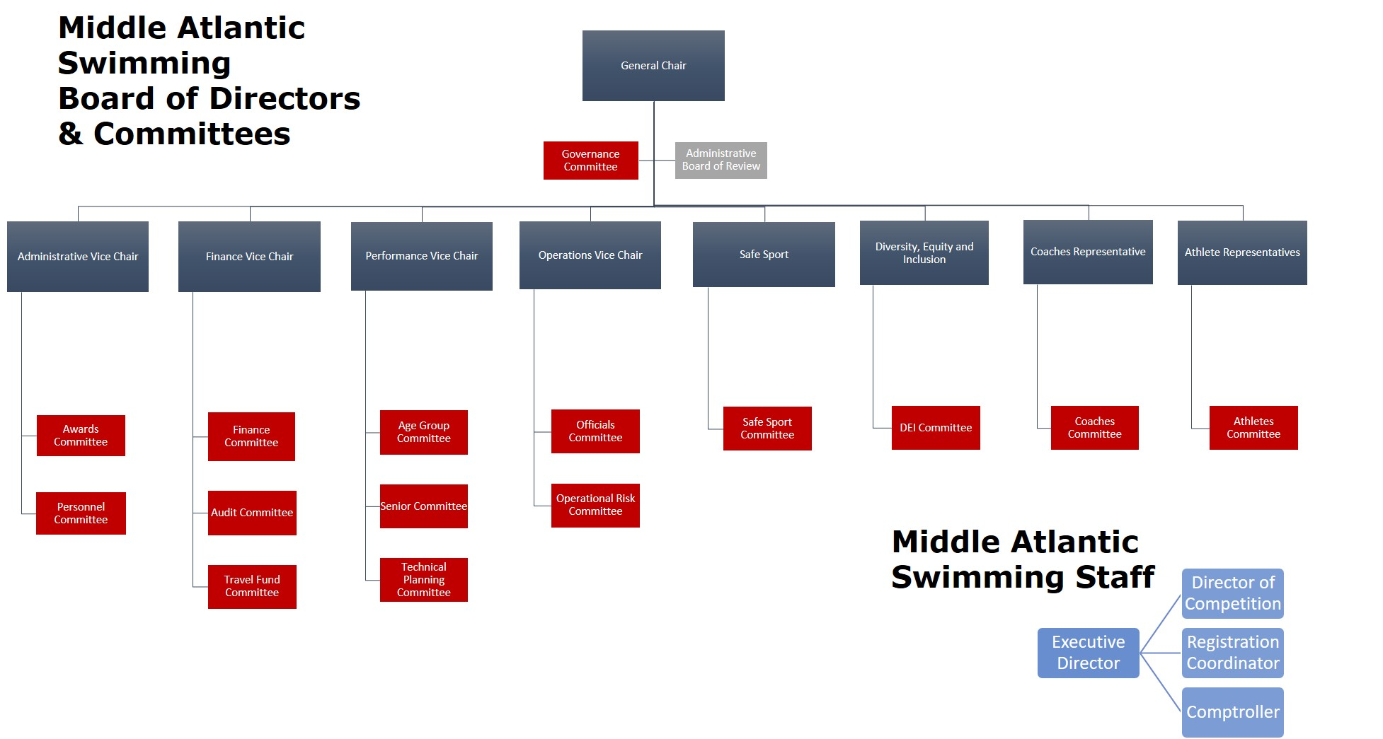
Organization Structure

Slide 11
Board of directors Objectives
The objectives and primary purpose of MASI shall be the education, instruction and training of individuals to develop and improve their capabilities in the sport of swimming. MASI shall promote swimming for the benefit of swimmers of all ages and abilities, in accordance with the standards, rules, regulations, policies and procedures of the Federation Internationale de Natation Amateur (FINA), USA Swimming and MASI.

Slide 12
Board of directors Goals and Directives
Support the mission and vision
Plan, strategize, and evaluate
Measurable Objective
Action Steps – Strategy and Tactics
Deadlines
Tracking
Reflect
Legal Duties – Care, Loyalty, and Obedience
Understand the Budget

Slide 13
Components of an Effective Meeting
Schedule
Agenda
Communication
Resources
Technology
Summary/Next Steps

Slide 14
Resources
Important Links:
Bylaws
Policy
Committee Chairs
Meeting Schedule
Conflict of Interest
Board Calendar
Strategic Communications Plan
Meeting Minutes
Budget

Slide 15
Thank You!

