Slide 1
MEET DIRECTOR WORKSHOP

Slide 2
TWO SIDES TO THE ROLE
MEET DIRECTOR: DRY SIDE
MEET DIRECTOR: WET SIDE
Use the Meet Director Guide for pre-meet planning and checklist
Pre-meet Recon!!!
SECURE KEY PERSONNEL:
MEET REF (required)
ADMIN OFFICIAL (required)
SAFETY MONITOR (optional)
ENTRY CHAIR (optional)
COMPUTER AND TIMING SYSTEM OPERATORS
HEAD TIMER - 2?
RUNNERS - 2?
MARSHALS - 4?
TIMERS
CONCESSIONS/HOSPITALITY
Decide what events to offer
Create the Meet Announcement
Send in sanction requests and Meet Information
Set up Hy-Tek file (or delegate!)
Act as Entry Chair (not always)
Oversee the control/timing table
Work with Admin Official
KNOW THE RULES
Process results
Post meet reporting

Slide 3
Pre-Meet
Meet Director
Post-Meet
Create a Meet Announcement
Follow the checklist, template, or update previous meet announcement
Concurrent tasks:
(may be delegated to others)
Secure pool
Officials
Volunteers
Timing Table timing system computer operator
Hospitality
Clerk of Course (if used)
Lane Timers
Program Printing
Concessions
Safety
Meet Marshals
Coaches’ meeting
File any reports ASAP with Admin Vice Chair
Submit Sanction Application – online through Niagaraswim.org
Don’t forget to submit payment!
Send Meet Backup, after results have been validated by Admin Official, as soon as possible, to Niagara Webmaster for posting and importing into SWIMS.
When Approved, add Sanction Number and submit final version for posting to Niagaraswim.org.
For open meets, submit meet events file for posting to Niagaraswim.org.
Numbers are added (with PDF) to Niagara Calendar when approved
Investigate times with AO as errors are reported and inform Niagara Webmaster.
Accept entries (send confirmations) until deadline
Evaluate the meet with your committee. What worked, what didn’t. Document for next year.
Submit USA-S Registration file to NI Registrar to look for errors. If errors, follow instructions returned by Niagara
Validate entries for time standards and entry restrictions per meet announcement. Make entry adjustments as needed.
Send Financial report and pay surcharges within 30 days of meet conclusion.
Seed the meet, create timeline, validate/adjust with meet referee.
Communicate with participating teams.
Keep all paperwork for 1 year.

Slide 4
THREE AREAS OF CONSIDERATION
SWIMMERS
Events offered
Timeline
COACHES
Communication
Warm ups
Events offered
Timeline
PARENTS/SPECTATORS
Communication
Timeline
Program

Slide 5
COMMUNICATE WITH YOUR MEET REFEREE
Include in pre-meet meetings
Consider sharing the Meet Announcement for feedback before sending to the Office for sanctioning
They can be a huge help getting your timeline under control

Slide 6
TERMS
Let’s head to the USA Swimming Rule Book Glossary and look through some definitions that might be of interest.

Slide 7
Responsibilities During The Meet
The Meet Director must be free to manage the meet, and should not assign themselves to any specific task such as officiating, marshaling, computer, etc.
If you have done a thorough job with your pre-meet responsibilities, your job will be largely limited to going from one work area to another making sure that everything is running smoothly. Delegation of jobs will make your life easier!
At all times during the meet keep communication with the Meet Referee, Clerk of Course and Admin Official.

Slide 8
COACHES MEETING – Some guidelines
Introductions
Thanks to host club Safety Officer, first-aid kit location, ice, emergency telephone, facility entrances, who administers first-aid
Weather rules and shelter areas – What is your evacuation plan including where swimmers will go during a cold weather meet.
Water stations and any other points about the deck (e.g. spectators on or near deck)
Coaches programs
Notes on timeline – fly-over starts, heat intervals, between session breaks, estimated session start and end time, any combined events (with 100% agreement of coaches present)
Warm-up information for subsequent sessions
Referee/starter protocol
No recall false start procedure
Delay of meet or missed heat:
Heat is closed when referee’s hand is extended to the starter; missed swims MAY be investigated and subject to referee’s discretion - swimmer MAY be inserted ______
Different referees, different circumstances. (Meet Director should know the referees position)

Slide 9
Deck Entries (if permitted in the meet information or unless there is a host club error)
Delivery of DQ’s: if coach leaves before session concludes
Use of cool down area
Distance events positive check-in location and procedure -
Timers and counters for these events
Split Time Verification requests – how to
Results posted at: _________
Awards procedure and end of meet results procedure
Time trials procedure: sign-up, when, eligibility. Closes at the start of event: ______ Amount: $5.00
Overnight information for equipment and gear on the deck
Hospitality information
Questions: for competition see Deck Referee, all other questions see Meet/Admin Referee
Feedback from coaches about meet or to host club?
Any other questions?
Next coach’s meeting scheduled during meet?
Adjourn

Slide 10
Basic Facts
As Meet Director YOU CAN’T LEAVE
Know what jobs you must assign to parent volunteers. This lets you know how many parents needed to run meets
Food: Coaches are there for up to 13 hours – that’s 3 meals
Do you need 2 computers for the admin official – that’s the network option in Hy-tek. You’ll need to purchase/add thru them
Know that 4 hour rule, what it means, how to work with it. It’s the planned timeline before the meet begins.
DQ Slips/Relay Slips – your responsibility

Slide 11
Basic Facts, cont.
The financial report. It’s in your best interest to file it accurately and on time. NI Swimming uses that info to determine future meet entry fees.
Take notes after the meet – what worked, what didn’t
Order of events should be set before meet. Know what works for you now. What worked last time.
Feedback to NI Swimming always interesting.
Include in your meet announcement that all entries will be acknowledged. Just so you cover yourself.
“Incident” protocol. Pool operator/staff location?
Vomit protocol?

Slide 12
OTHER
The meet announcement is your bible so prepare it with accuracy. Be sure to include all the required information using the current NI Meet Announcement Checklist and the format that you plan to follow. You must follow any procedures or policies stated therein unless they are overturned by the Meet Jury or the Meet Ref under the advice of the Meet Jury.
Any changes to the session format, venues, or other changes before the meet must be approved by the Admin Vice Chair and publicized to all the attendees

Slide 13
Please send an email within 48 hours to a club when their entries have been received and accepted or rejected for your meet. This is a courtesy and is especially important when clubs are trying to plan their meet schedule.
Any swimmer can ask to have their affiliation changed to UN-attached at a meet – even when they may have initially entered or been entered in the meet with a club affiliation. A swimmer designated as UN cannot, UNDER ANY CIRCUMSTANCES participate on a relay, or be included in any team scoring.

Slide 14
4 Hour Rule: In the strict interpretation of the rule, the timeline you generate before the meet is your planned session start/end time. Don’t plan on scratches!
Use 15 secs between races as a guide. Use 20 secs if you DO NOT use flyover starts. Allow time for timers to re-position if necessary.
Only events listed in the Meet Announcement can be conducted. Time Trials may be conducted if included in the Meet Announcement.

Slide 15
Swimmers must swim in events designated for their age group.
A swimmer that asks to have their time recorded at an ‘intermediate’ distance in a longer event, must complete the entire event without being disqualified. (how many watches?)
Meet Reconciliation – It is your duty as Meet Director to assure all swimmers in the meet are USA-S registered. Submit a USA-S Registration file from MM to the LSC Registrar before you run the meet. They will send back all corrections and help you coordinate clearing issues.

Slide 16
SAFE SPORT PRE-MEET RISK ASSESSMENT
How many entrances/exits to the deck. Monitored?
Other events? Sharing locker rooms?
Age range – 15&O with 10&U? Designated area for the younger swimmers?
Who is the designated person to receive information regarding any suspicious behavior?
Deck changes ARE NOT PERMITTED.
Use Meet Announcement to spell these things out.

Slide 17
The 4 hour rule
Your projected timeline prior to the start of the meet showed a
12 & Under session start time of 8:00am and a planned end time
of 11:30am. You were not able to start at that time due to starting
equipment malfunction. You actually started at 8:30am and were
finished 3 hours and 45 minutes later at 12:15. Were you in
violation of the 4 hour rule?
YES OR NO

Slide 18
The 4 hour rule
Your projected timeline prior to the start of the meet showed a
12 & Under session start time of 8:00am and a planned end time
of 12:30pm. You were able to start on time. You finished your session
earlier than anticipated…at 12:15!! Were you in violation of the
4 hour rule?
YES OR NO

Slide 19
The 4 hour rule
Your projected timeline prior to the start of the meet showed a
12 & Under session start time of 8:00am and a planned end time
of 11:45am. You were able to start at that time due to circumstances
beyond your control. You actually finished later than anticipated at
12:15. Were you in violation of the 4 hour rule?
YES OR NO

Slide 20
Registration – There are 4 ways a swimmer can prove he or she is registered for the current year Deck Pass App – This is an app for a smart phone and may also be accessed via a computer. A swimmer can pull up current information from SWIMS specific to themself. Deck Pass - All swimmers can print membership cards directly from USA Swimming Club roster – From a club portal (every club has one), a coach or administrator can produce roster showing swimmers who are currently registered to their club. Unattached swimmers will appear on a club roster with the attach date. The LSC Registrar! – When in doubt, just ask me! If you have a situation where an athlete is from another LSC, and they don’t have the proof on them, you’ll need an LSC Registrar to look them up.
or

Slide 21
· Remember everyone is a volunteer. Treat your workers with courtesy and respect.
· DO NOT attempt to answer questions or make decisions that fall under the rulings of the Meet Referee. This is not your job.
· Always know two things about your facility. Where the first aid equipment is kept and how to access it.
· Meet with the person in charge of the janitorial staff. Give them a timeline of when you need to open and close the facility. Make sure they are aware of all areas you will be using. Get a name of who will be
on duty for you each day. Find out where you can locate them during the meet operation.
·

Slide 22
Be prepared to pick up garbage and clean the deck after each day of competition. A good suggestion is to have on hand disposable rubber gloves (the kind used in the medical field work great) to use to pick up garbage.
Try to have workers continually check on bathrooms to make sure they have been kept supplied and cleaned by janitorial staff of the facility you are using.
Always have a location for lost and found. If possible print it in your heat sheets.
(you can add and staple a cover page with ads, café menus, messages etc.)
Stay in contact with all committee chairmen. If a chairman will not be commanding their appointed committee for anytime during the meet, ask them to tell you who will be in charge. Make sure you check with them to see if things are going okay, or if they have any questions. A switch of command in committees can cause chaos if there is lack of communication of changes.
Always check to make sure people in charge are, or will be, informed of any changes in the meet operations that would directly affect them and their job.
Remember, teams attending your meet are your guests. Treat coaches, swimmers, parents and other spectators with respect and courtesy.

Slide 23
· Have your heat sheets available on deck for your officials.
· Have on deck a printed copy of your meet announcement, USA Swimming Rules and Regulations current edition, and NI Rules and Regulations current edition.
· Remind your entry person to bring all original entries received from each team to the meet for reference when questions arise about entries.
· Ask for a post report from all committee chairmen with their helpful suggestions or ideas on how to improve their areas for next year.
· If time allows, several days after the meet write thank you notes to your committee chairmen and their workers, or post a general thank you note where everyone can see it
· After all is said and done …… Congratulate yourself! You’ve done a great job.

Slide 24
LATE ARRIVING ITEMS Question: What is an "exhibition swim"? Answer: Although both High School and NCAA rules do recognize exhibition swims in their rules, they are unique to those two organizations. For administrative purposes, however, it may be necessary to mark certain swims as "exhibition" in the meet database so that they do not place or score. Such swims, if done within the parameters listed in the meet invitation and in accordance with USA Swimming rules, are not truly exhibition swims and the times are eligible for inclusion in SWIMS. In USA Swimming, allowing kids to swim events that are not listed in the meet invitation or allowing kids to swim events for which they are ineligible (not in compliance with age group, gender, or entry requirements) requires the meet announcement to specify it is being allowed and should clearly state any times achieved in such situations are not eligible for entry into SWIMS. The above applies to all USA Swimming sanctioned or approved competitions, but may be modified for swimmers with a disability under the provisions of Article 105.1.1. Question: My swimmer is 10 years old and would like to achieve a time in the 200 yard butterfly event, but the event is never offered for swimmers 10 years old. Can I enter him/her with the 11-12 age group which does offer the event? Answer: No, a swimmer may not participate in an age group which does not correspond to his/her age. Article 205.2.4 states, "A swimmer must compete in the age group events according to the swimmer's age..." In addition, any time achieved while swimming in an age group that does not correspond to the swimmer's age would not be a valid time and would not be eligible for entry into our SWIMS database.

Slide 26
Mixed Relays
The Times & Recognition Committee will begin tracking
National Age Group (NAG) Records in Mixed Relays
Initially, this will not include the 800 FR.
Mixed relays must consist of 2 males and 2 females
(102.7.3)
Meet Management software in use allows mixed relays with any number of males and females
SWIMS does not flag a single-gender relay uploaded as a mixed relay

Slide 27
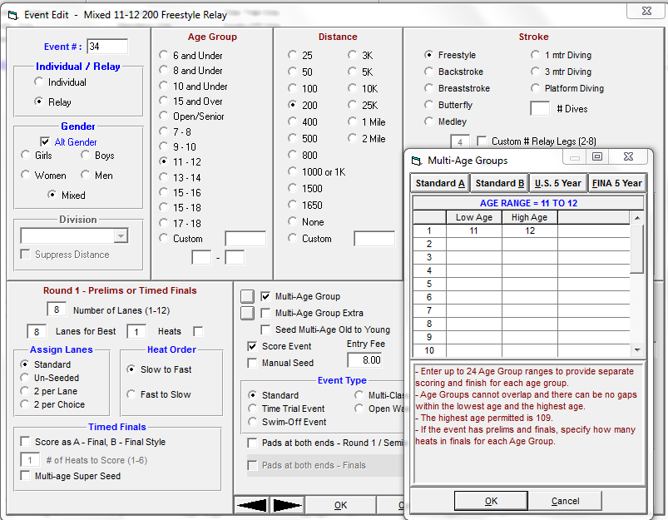
Mixed Relays

Slide 28
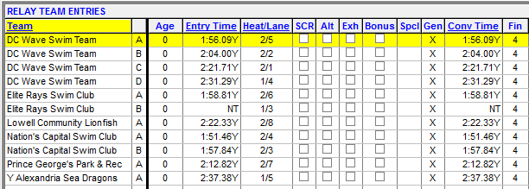
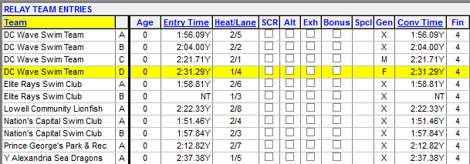
Mixed Relays

Slide 29
Niagara Swimming, Inc.
Conclusion of Meet Instructions
Within thirty (30) days after the event the host organization shall file:
The Meet Report using the form prescribed by the Administrative Vice Chairman, accompanied by payment of the surcharges on entry fees for the event. This must be MAILED to the address below.
Colin Adams
1500 Porterville Rd
East Aurora, NY 14052-9113
The Meet Financial Summary using the form prescribed by the Administrative Vice Chairman. Estimates in lieu of actuals are permissible in order to comply with the filing deadline.
The Officials Report using the form prescribed by the Officials Chair. email: officials@niagaraswim.org
Failure by the host organization to file reports within thirty (30) days after the event will result in a fine of $50 for each late report and suspension of any sanctions issued to the host organization for future meets until such time as the reports are submitted and the fine paid.
As soon as practicable after the event, the host organization shall submit the complete meet results as a Hy-Tek Meet Manager back-up file, or equivalent, to the Top Ten Coordinator for posting on Niagara LSC’s website.
email: webmaster@niagaraswim.org
In the Meet Manager Backup, please verify that the following is correctly entered in the Meet Set-up:
Meet Name (it should match what is on the sanction/calendar)
Facility Name
City, State, Zip and Country
Sanction Number starting with NI-
Start and End Date
Host LSC
Course
Revised 10/2018

