Slide 1
ESA
Parent Meeting September 14th, 2017

Slide 2
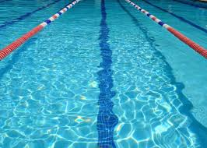
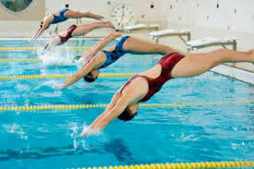

Slide 3
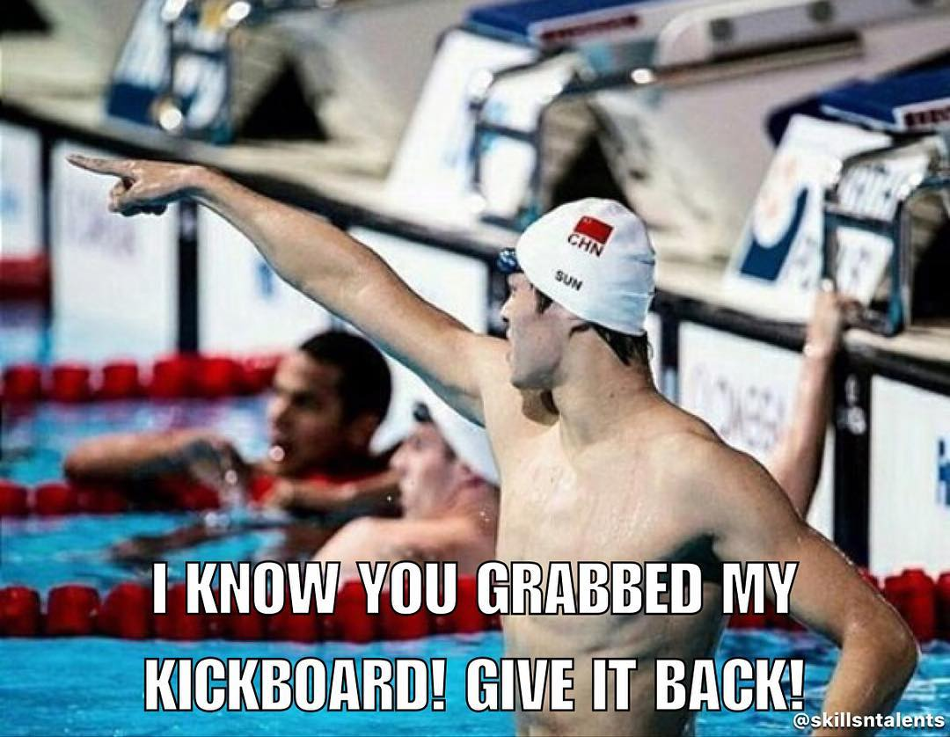

Slide 4
WELCOME TO ESA
The best place to swim!
250 + members
National Presence with Sr Program (NCSA, Winter Jrs, Olympic Trials)
NCAA / Scholarship Athletes
High School State Champions & Record Holders
Texas Top 15 Age Group Program
Very strong sense of community / support system
With-in membership
With Humble ISD

Slide 5
Harvey’s Impact
The Staff recognizes that everyone will have to make sacrifices
We also recognize that these are temporary sacrifices
Drive time, later nights, shorter workouts, less pool space and pool time issues are all possible scenarios
We all have to remain patient and diligent, and understand that the Staff will do everything it can to accommodate everyone, but it will not be perfect.

Slide 6
Coaching Staff
Ian Cross: Head Coach, Junior, Senior Lead
David Pink: President, Administration, Junior Assistant
Laurie Grafmiller: Age Group 3 Lead
Jorge Huerta: Age group 2,4 Lead
Josh Stibrich: Senior, Junior, Age Group 4 coach
Katy Stibrich: Age Group 1, Age Group 2
Morgan Rosentreter: Age Group 1, Developmental
James Maxwell: Age Group 1,2,3,4, Developmental
Amy Kline: Developmental

Slide 7
About Coach Cross
Wife Angela and Daughters Abby and Eve
ASCA Level 5 Coach at age 28
Swam for
SCSC/SJA/Fresno Dolphins in California
Parkway Swim Club in Saint Louis
National Record Holder (50 Free)/National Select Camp (Bronze/Silver and Gold)/National Qualifier (50/100 Free/200 Back)/Team Captain for Parkway Swim Club 3 years
U.S. Marine stationed out of Kaneohe Bay, HI (Echo Co 2 Bat 3rd Marines)
Coached for FLA Swimming in Fort Lauderdale 10 years and Coached in Saint Louis for FAST/CSP for 10 Years
Over 120 Top 10/Top 16 times
Over 15 #1 ranked times
Sectional Titles for women at FLA (2), CSP (1), and 2 times Sectional Titles for men 1 at FLA/1 at FAST. 2 times Combine team titles (1 at CSP/1 @at FLA)
2 National Junior Team Members/5 OT qualifiers

Slide 8
Vision:
A Scientific Approach (Physiological) to Swimming with an Uncompromising Work Ethic, combined with TEAM values and a Strong Family Bond, are the Foundations for Making OUR swim club great.

Slide 9
Team Culture
Outwork Everyone, anyway we can. The only way I know how to be successful is to work hard.
TEAM First Approach. Are the swimmers actions being a positive influence on the team?
Respect for Teammates and coaches, and treat each other like Family. Family does not always get along, but family always respects each other.

Slide 10
Parenting Young Swimmers
Support and positive energy, regardless of how the swimmers’ perform
Role is support, volunteer, cheerleader….not an assistant coach. There is no need to discuss any technical aspects of races with swimmers, because the coaches role is to do that.
Stay Positive in the stands about our team and our swimmers. Sit together and cheer for everyone. 1 swimmer’s success is good for the team…..10 swimmers’ success is better for the team
Expectations for Parents

Slide 11
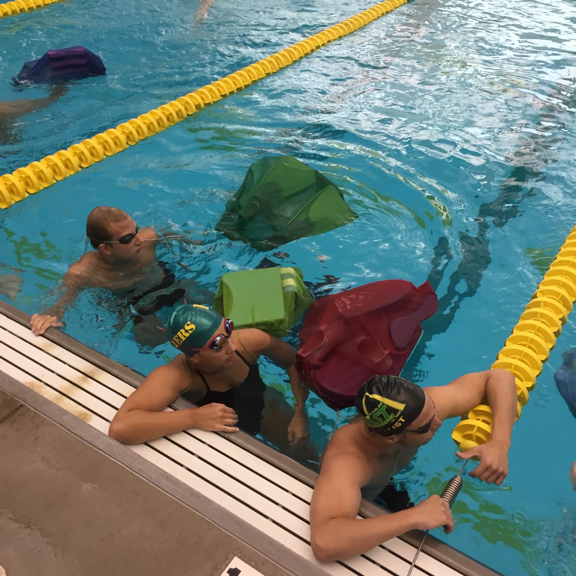
Policies
Volunteer, Anti-Bullying, Electronic use, Finals and Relays

Slide 12
Volunteering and Officiating With ESA
Kayla Verret - Volunteer Coordinator
Todd Johnson (Krista) - Officiating

Slide 13
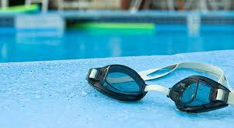
VOLUNTEER REQUIREMENTS
HOME MEETS
Families are required to work at each ESA home meet even if their swimmer is not participating in the meet.
Sept 29-30: IMX | 1
Oct 28: Halloween Classic 10 & U | 1
Oct 29: 11 & Up | 1
Mar 3: SC Champs 1: 8 & U | 1
Apr 6-8: Sprint Series | 2
May 27 or June 3: Summer Heat | 2
A shift is approximately 2 hours
Fines = $50 increments
Must sign in for credit

Slide 14
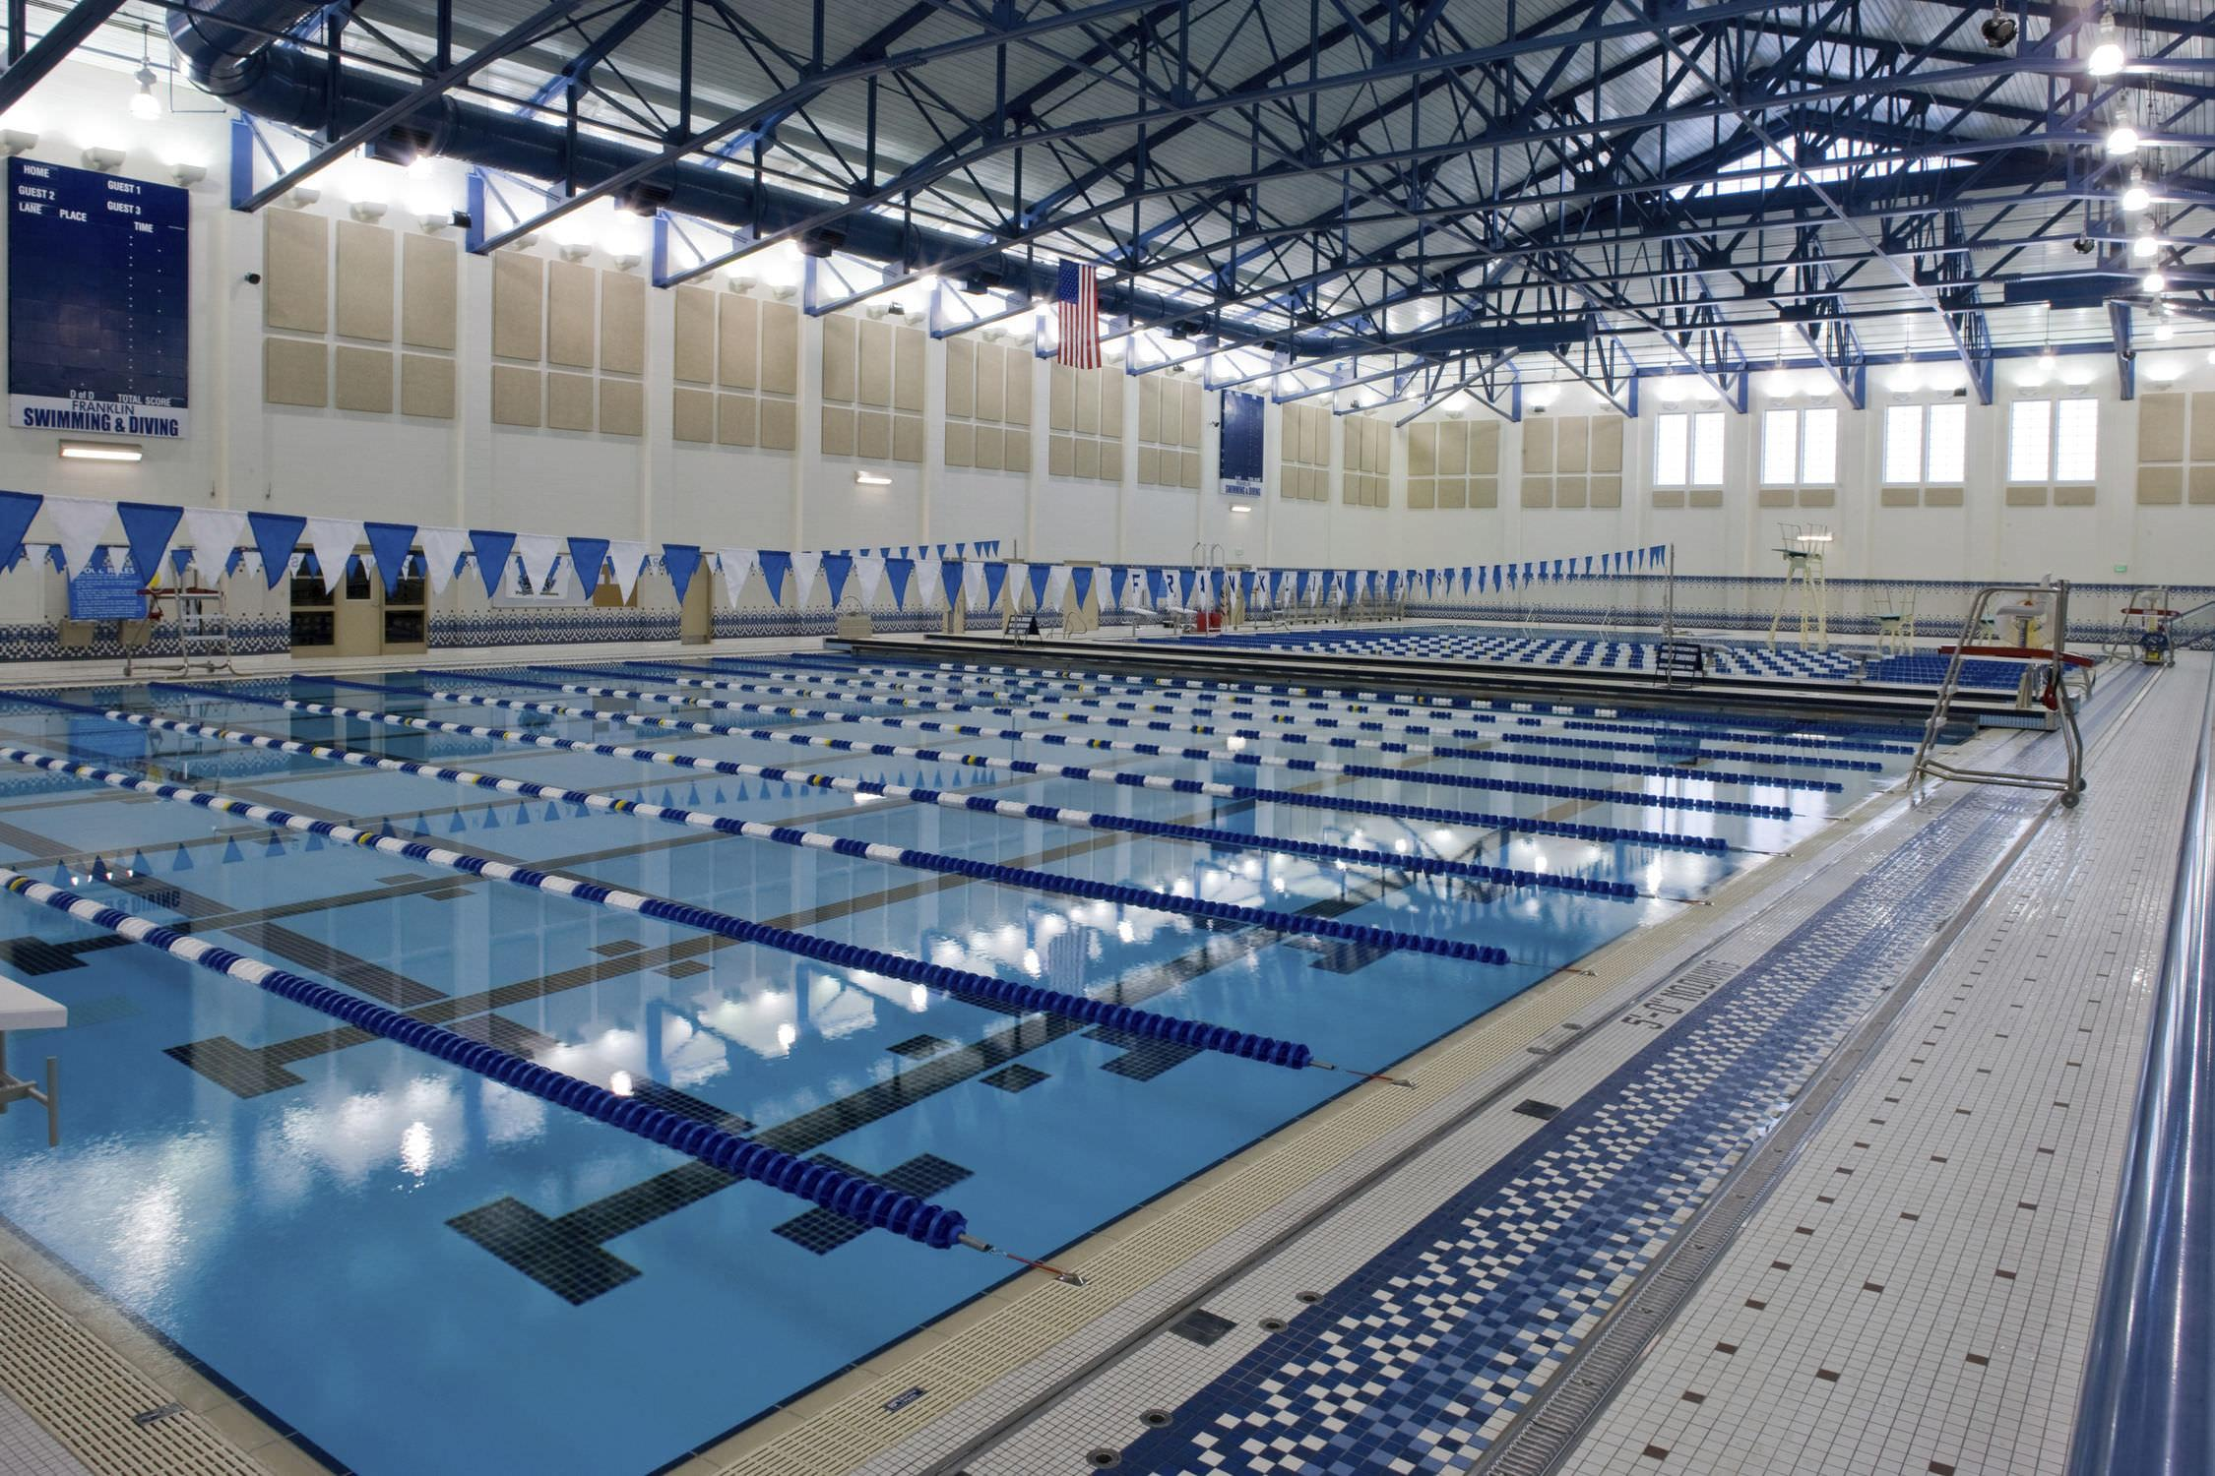
VOLUNTEER REQUIREMENTS
AWAY MEETS
Families are expected to time at away meets.
All timers must check-in 15 minutes prior to meet start.
Sign up and no-show = $25 fine
Late to lane 10 mins or more = $25 fine

Slide 15
WHAT’S NEW THIS YEAR?
12th grader = no home meet volunteering
Hospitality Room - Food Sign-up

Slide 16
LEADERSHIP POSITIONS
AWARDS - 1 co-chair position
HOSPITALITY ROOM - 2 positions
AWAY MEET TIMING COORDINATOR - 14 & under parent
HOME MEET TIMING COORDINATOR
SAFETY MARSHALL

Slide 17
Anti Bullying, Hazing
Excuses that do NOT work:
“Boys will be Boys.” This is not 1985. Boys have to learn to respect Everyone, especially when you have a sport that combines genders.
“Hazing builds team camaraderie”. It does not, it destroys it.
Any bullying or hazing has to be reported to me immediately.
THERE will be a zero tolerance policy with Bullying and Hazing. Both are considered the opposite of Team Unity and respect for teammates.
(Refer to Website for more Info)

Slide 18
Finals and Relays
All Swimmers, regardless of age or ability level, are expected to be there for all finals and relays the coaches place them in. All Swimmers, regardless of age or ability level, are expected to be there for all finals and relays the coaches place them in. Remember, we are building a TEAM, not individual swimmers.
Championship meets are won and lost with relays and finals swims.
Remember, we are building a TEAM, not individual swimmers.
Championship meets are won and lost with relays and finals swims.

Slide 19
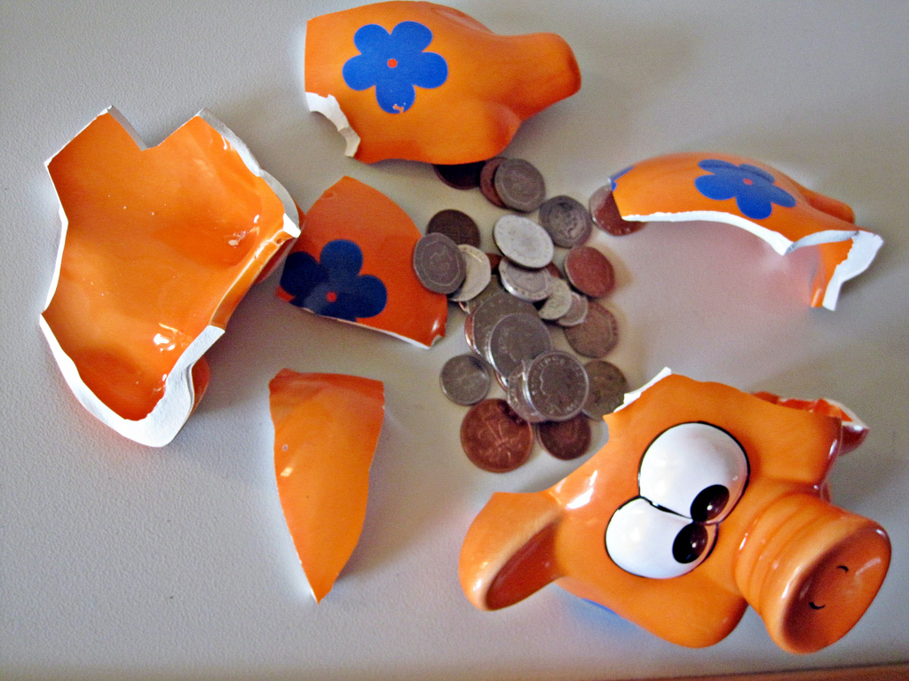
A Bit on Finances
Major Expenses
Rent
Payroll
Sources of Income
Dues
Hosting meets
Swim-A-Thon
Triathlon
Sponsorships
Company Match Programs
vs

Slide 20
ESA Booster Club
Booster Club… Helps with the fun stuff!
*Swim-a-Thon *Team Parties & Social Events *ESA’s End of Season Banquet *And more!
Your membership donation of $10 helps support booster club activities & includes an ESA Car Magnet or Drawstring Bag
We’re here to support the team!
Lisa Ozenne

Slide 21
Swim-a-Thon
Swim-a-Thon raises needed money for the team while supporting the USA Swimming Foundation. Swimmers ask family members, friends, & neighbors to pledge a certain amount of money per length of the pool swam or to make a flat tax deductible donation in support of ESA. Swimmers can earn participation and incentive awards, and we have extra fun with food & games.
ESA’s biggest FUNdraiser!
Nov. 3rd

Slide 22
Business Sponsorships
We ask our families to help us reach our business sponsor goal by participating in our Business Sponsor Challenge - a friendly competition amongst our swim groups. We ask that swimmers approach local businesses (or employers) for tax deductible donations to the team for which they will receive advertisements posted at the swim meets, in our heat sheets, and on our website. Parents, for every $250 worth of business sponsors you bring in, you will be awarded 1 volunteer credit!
Business Sponsor Challenge ends Oct. 10th (so logos/banners can be ready for meets) All groups can win!

Slide 23
Practice Groups
This is a DEVELOPMENTAL PROGRAM.
We want to create LEADERS at every level of our program. If you move swimmers up too early, they lose their confidence (they aren’t leading lanes anymore) and they lose their vocal leadership (no 15 year old is going to listen to a ten year old)
there are exceptions based on maturity, but not many
AGE BASED 10-Under Program
11-Over Age AND Ability based
NOTE:Please email coaches ahead of time to set up a meeting for after workouts

Slide 24
Practice Groups Cont.
The Group Structures and Group Placements are Fluid.
As we improve and get faster as a team, the groups will need to be arranged accordingly
Structure
Developmental, AG1,AG2,AG3,AG4, Junior and Senior
We are looking at future possibilities of adding groups, but this requires pool space

Slide 25
Workout/Meet Schedule
Under “MEET and EVENTS” Tab on the website.
(https://www.teamunify.com/EventsCurrent.jsp?_tabid_=30610&team=guesa)
Championship meets are expected 100% participation (8-un champs, Fall Champs, Gulf AG Champs, Senior Champs, TAGS, Sectionals, Junior Nationals, Nationals, NCSA, Olympic Trials)
For Workout Schedule, look under “Calendar” Tab on Website and go to “Pick a calendar” and look for your group
All Online

Slide 26
“Great Cultures Attract Great People. If You Build a Great Culture, Great People Will Come”
- John Wooden

Slide 27
Think of ESA as a community, a family, and a really fun place to come and achieve your goals.

Slide 28
Thanks!
Contact us:
www.eagleswimmingassociation.com

