Slide 1
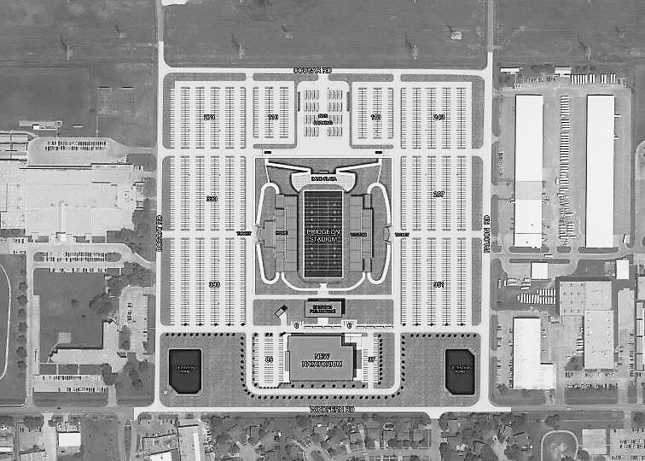
Bobcat Rd
Falcon Rd
Grass set up
Grass set up
No Parking
Grass set up
Grass set up

