Slide 1
Open Water Swimming: An Introduction Tracy Meece – MN Swimming

Slide 2
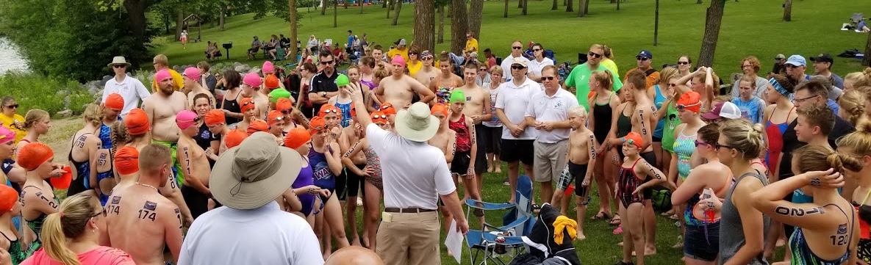
Pre-Race Preparations
Work for OW Officials can begin well before the event.
Safety Plan
Coordination with local organizers
Technical Meeting
Officials Meeting

Slide 3
Safety Plan
Safety plan is made of many parts:
Venue
Water Conditions
Marine Life/Wildlife
Medical Personnel/Care
Onsite and Offsite
Technical Information
Course map
Feeding

Slide 4
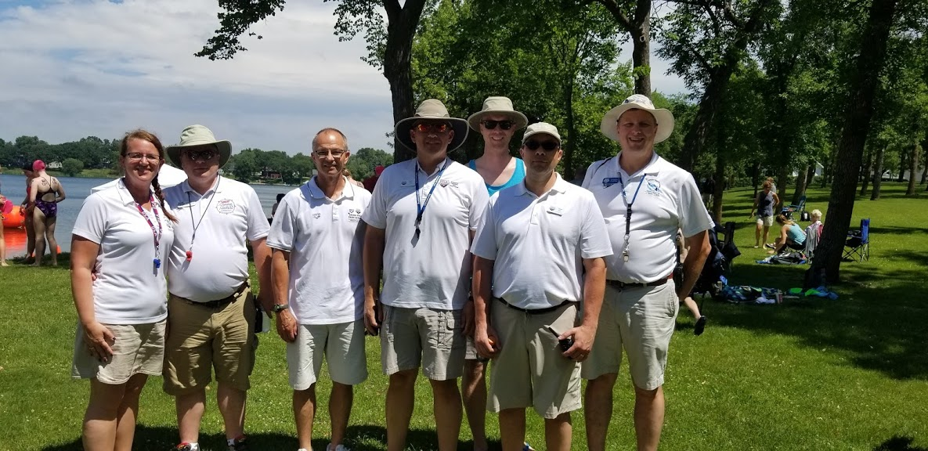
Technical Meeting
This meeting should include the athletes, coaches, officials.
Race Day Schedule
Race Procedures
Rules
Start/Finish information
Withdrawal Procedure
Conditions Report
Course Map
Safety Plan

Slide 5
Officials Meeting
Setting expectations and roles for officiating team is important:
Pre-Race responsibilities and procedures
In-Race responsibilities and procedures
Communication
ATHLETE SAFETY
Course Map

Slide 6
Pre-Race Check-In
Officials involved in each step of the check-in process to ensure athlete safety
Nail Inspection
Make sure fingernails and toenails are trimmed so that they cannot scratch another swimmer
Acceptable
Unacceptable

Slide 7
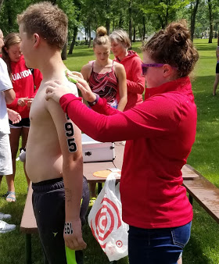
Numbering
Numbers need to be large enough to be read from a distance on all athletes
If possible, offer numbering the day before the event.

Slide 8
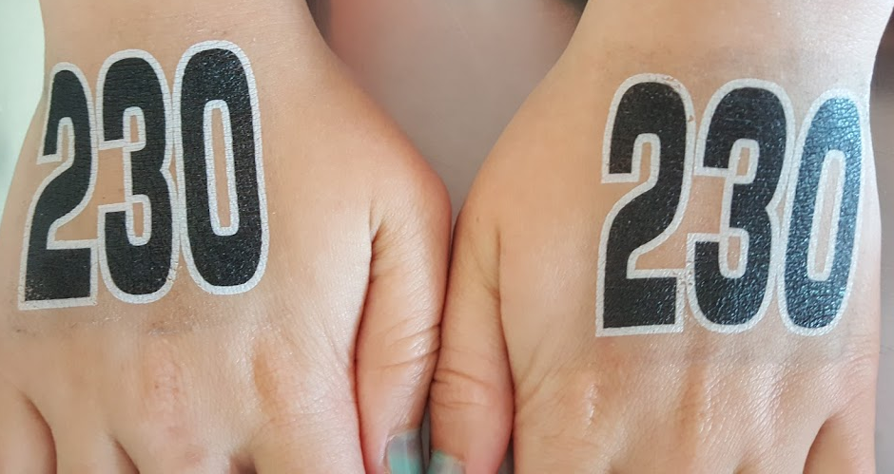
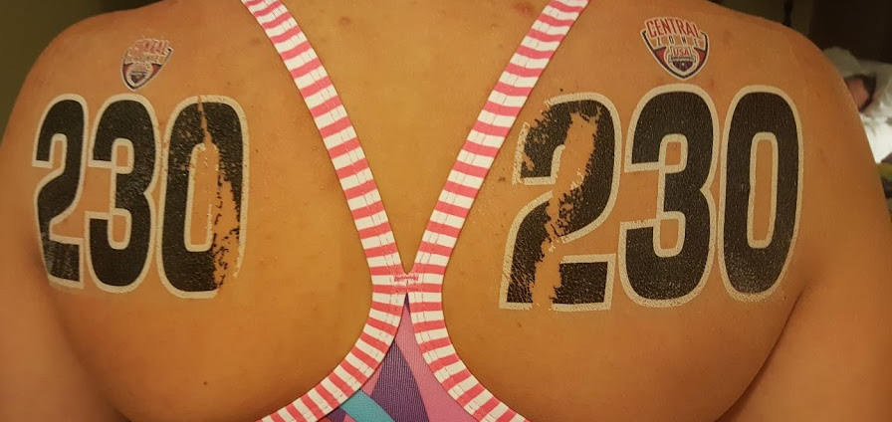

Slide 9
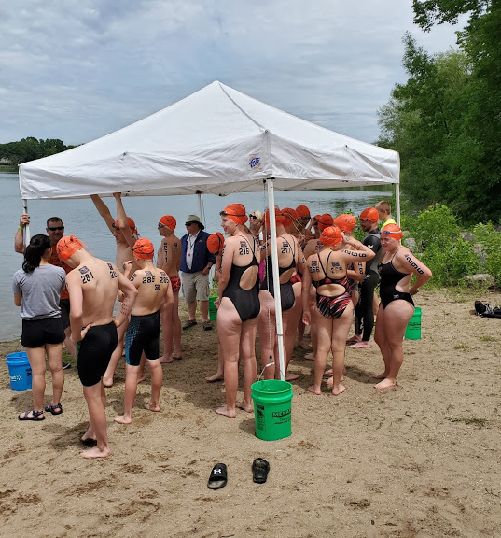
Pre-Race: Final Briefing
Changes from the technical meeting.
Start/Finish/Withdrawal procedures
Inclement weather plans
Athlete roll-call/Videotaping

Slide 10
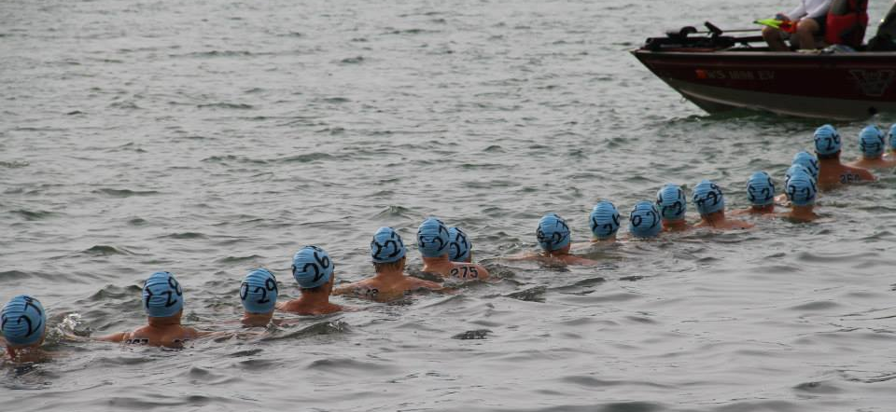
The Start
In Water Starts
Timing is important – don’t want to leave athletes treading water any longer than necessary.
Referee/Starter need to make sure athletes are aligned properly (line of sight or with a rope
Starting signal should be visual and audible

Slide 11
The Turn
Turn officials should be making sure that all athletes round the buoy as directed
Should also try to count athletes as they pass to keep an athlete count throughout the race.
Referees should be positioned such that they can watch the turn, while also being in position to move on quickly after the turn

Slide 12
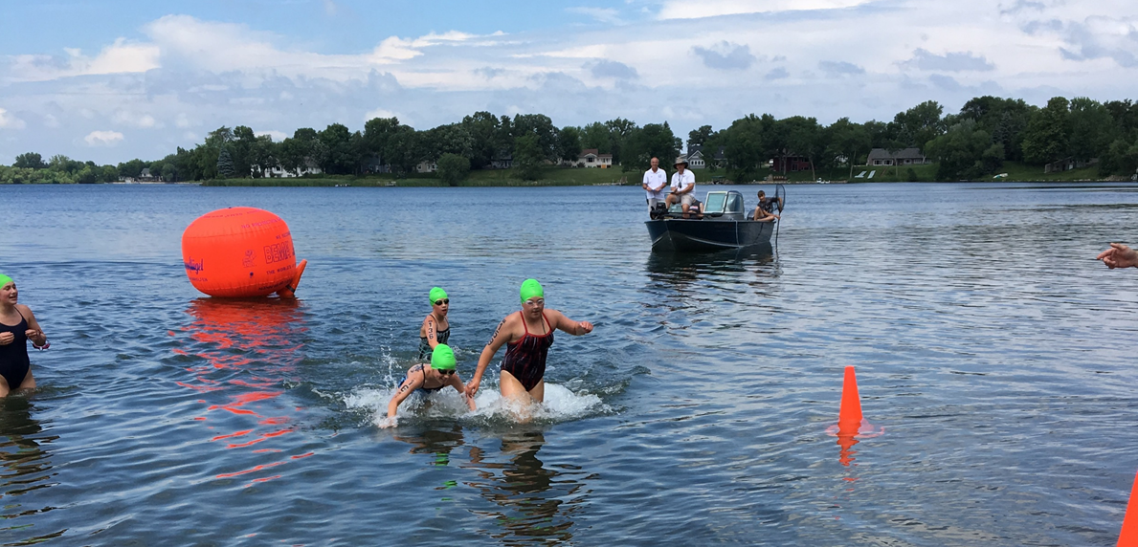
Boat Positioning
When possible, moving Referee boats should be with packs of swimmers (radio communication is key)
Allows Referee to view the pack to be watching for intentional interference
Puts Referee in position to officiate
Having 2 or more boats is helpful (inside/outside or both ends)

Slide 13
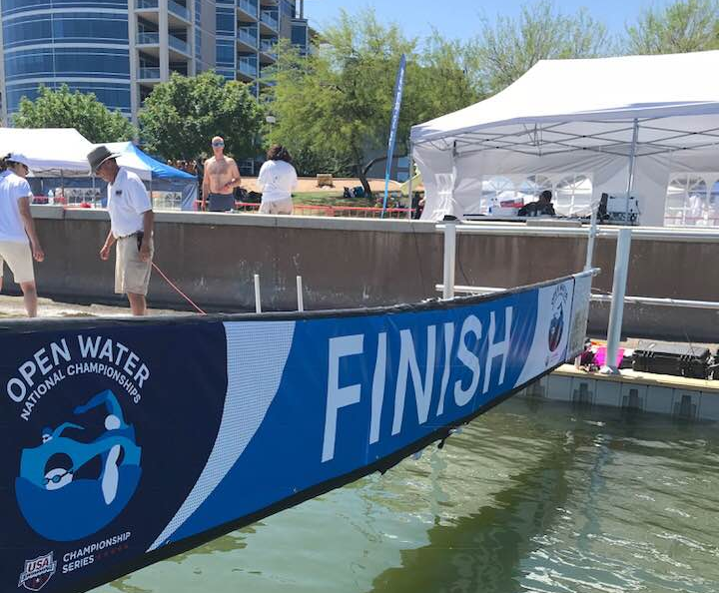
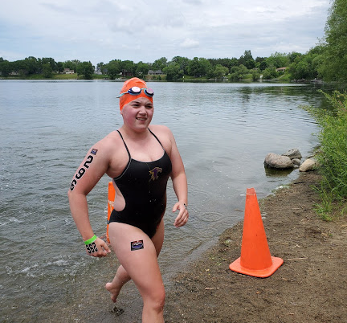
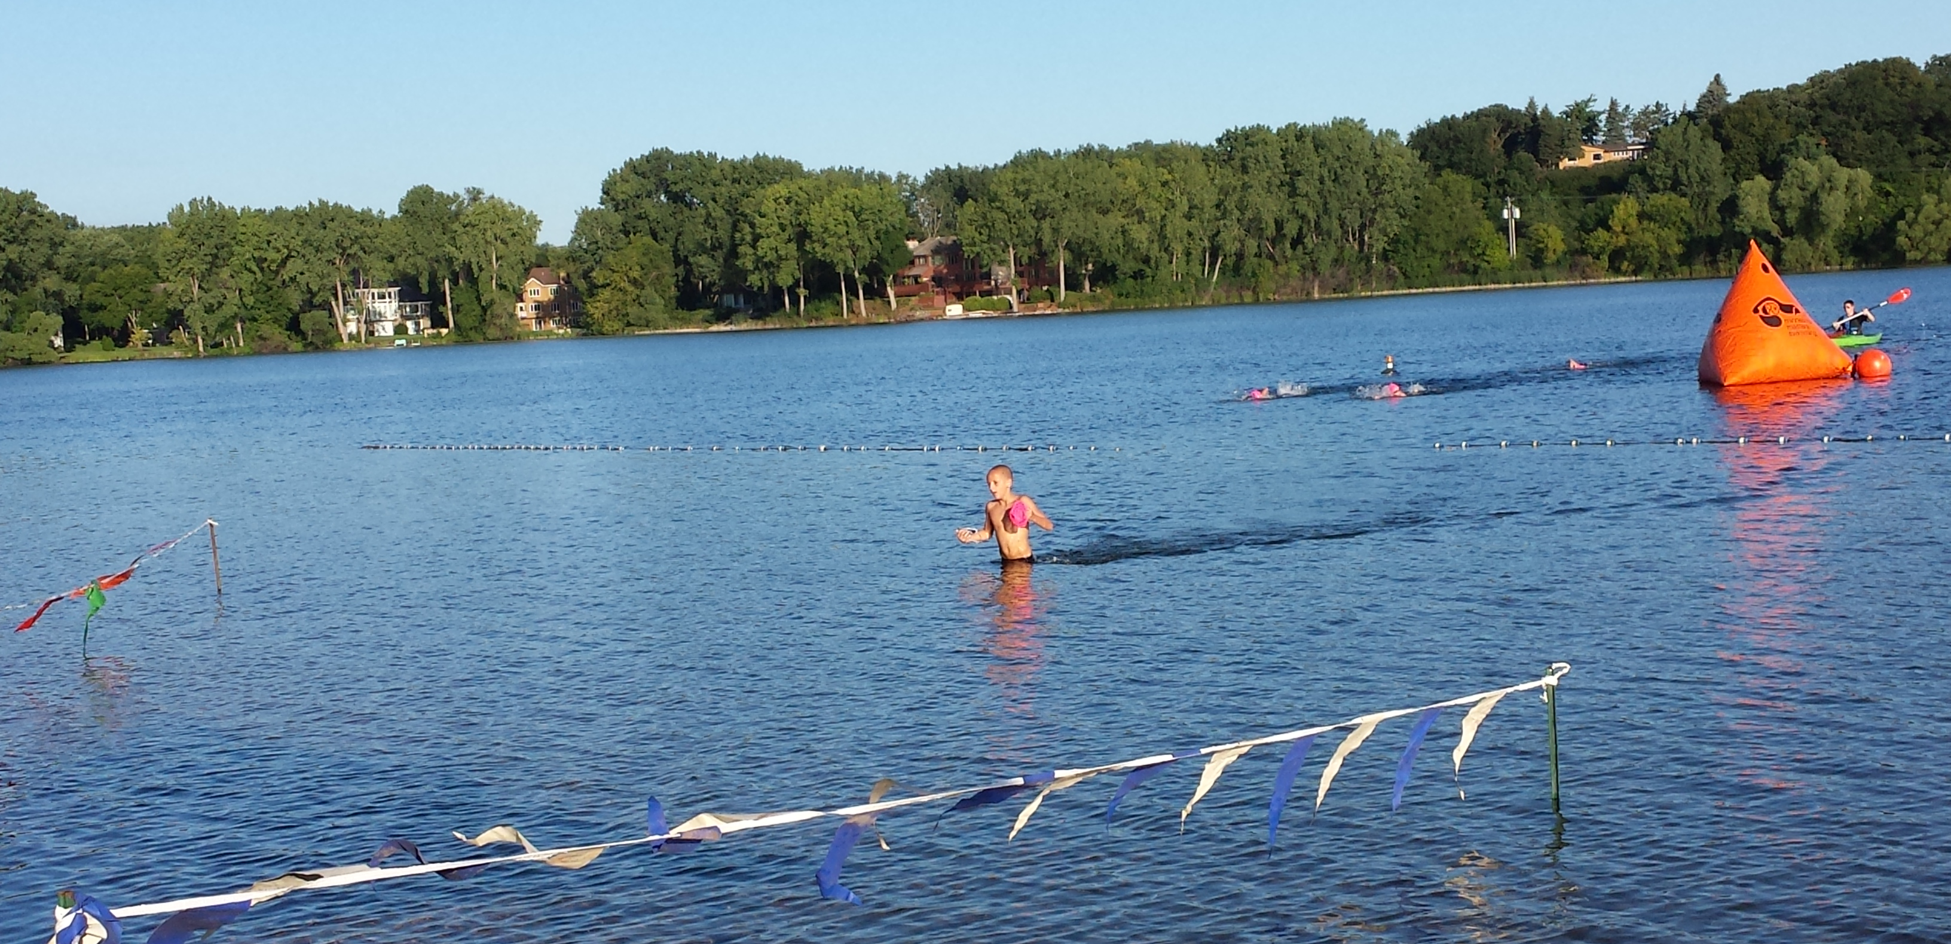
The Finish
Finish Judge/Timing Judge/Recorder
Should be set up in teams
Teams should be positioned on opposite sides of the finish structure
Referees should be positioned to observe the approach and finish
Need to look for contact or interference
Should also watch finish touches (if touch finish)

Slide 14
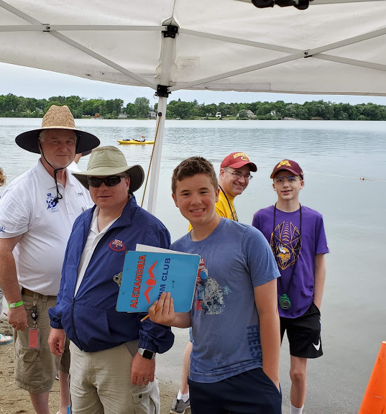
Be flexible – audibles will happen; be prepared for those things as they arise.
Allow parents to take photos of the athletes before they enter the water
HAVE FUN!

Slide 15
Questions? Please contact me anytime! Tracy Meece tjmeece1974@gmail.com 320-247-0940

