Slide 1
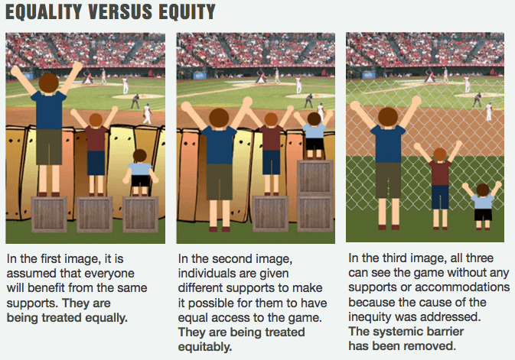
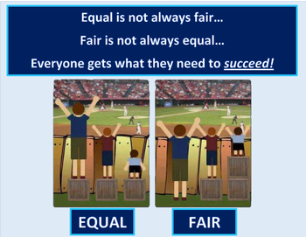
Diversity and Inclusion is not Disability
But
Disability is Diversity and Inclusion
Notes:
Hi-
I am Susan Mechler
First WOW!!
You all are very fortunate to have Chrissy she is amazing and tireless when it comes to Diversity Equality Inclusion, disability swimming and officials for all of you in Iowa
Thank you for inviting me to participate and present to you all Today.
I am a member of the Ohio Swimming LSC and am based in Southwest Ohio
I have been a USA swimming official since 2006 and have been involved with disability swimming officiating since 2010. I am currently a level II US Paralympics Swimming official, N3 USA-S official, and the current Central Zone Disability Coordinator. I was recently appointed to sit on the National Disability Committee and co-chair the engaging competition subcommittee. I am the past Regional US Paralympics Swimming Officials Coordinator for the Central Region.
I am extremely fortunate to have the opportunity to meet and talk with many coaches, parents, swimmers about disability swimming and connect them with resources and people to educate them further.
Everyone get what they need to succeed
Diversity and Inclusion are not Disability but disability is Diversity and Inclusion
We need to work and collaborate for the benefit of our athlets

Slide 2
IOWA DEI and Disability Presentation
In USA Swimming we are dedicated to making sure our athletes get what they need to be successful. We value diversity and promote inclusion
USA Swimming encourages people with disabilities to participate in the sport of swimming and facilitates their inclusion in USA Swimming programs through education and collaboration.
We seek to involve people with disabilities in existing competitions and programs for all swimmers, rather than provide unique disability-only opportunities.
Notes:
So Today, Chrissy and I will be talking with you about Diversity Equality Inclusion and Disability Swimming
DEI dedicated to making sure our athletes get what they need to be successful.
Disability : seeks to involve swimmers with disabilities in existing competitions and programs for all swimmers by giving SWADS -- Swimmers with a disability -what they need to be competitive within USA-S programs.

Slide 3
Objectives
What is DEI
What is Disability Swimming
Mission Of USA-S disability swimming
Officiating a USA-S swimmer with a disability ( SWAD)
Notes:
Thinks to know:
Please put any questions you may have in the chat Kerry and Phil will be monitoring the chat room for questions
There will be time at the end to answer any question and I will send Kerry my contact information if any of you would like to speak further or get more information.
Also Phil has sent handouts on
SWAD disability time standards
Officiating a swimmer with a disability
Information on the differences between Paralympics Swimming and Special Olympics
Take it away Chrissy.

Slide 4
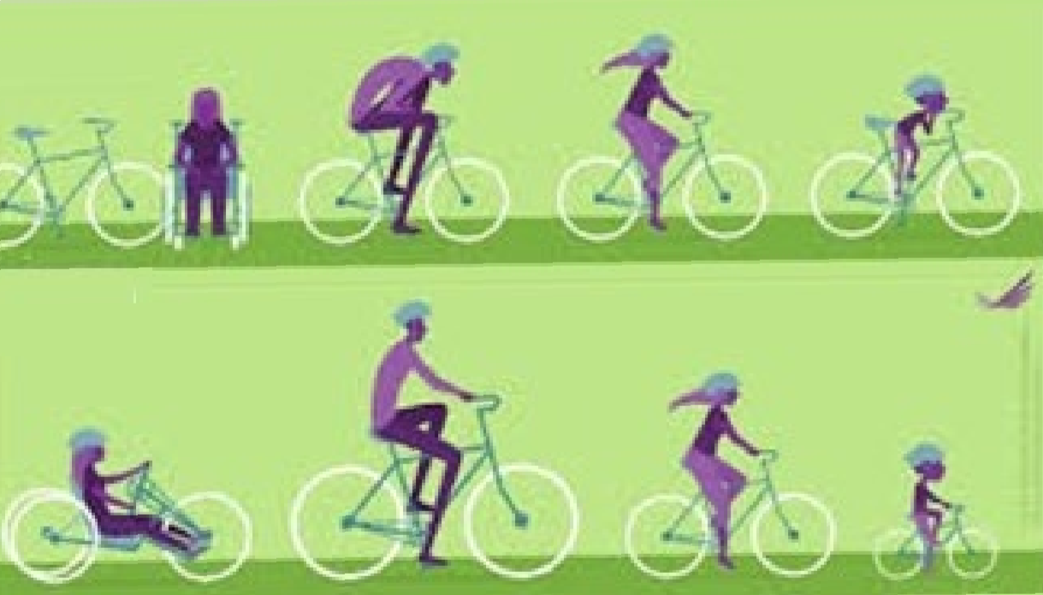
Introductions and Icebreakers ACTIVITY: What Do You See?

Slide 5
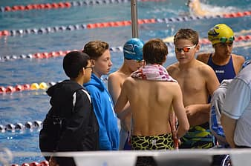
How does fairness come into play with our activity?
What is fair and what is right?

Slide 6
Equality aims to promote fairness.
This can only happen if everyone starts at the same point and needs the same amount of help.

Slide 7
Equity is recognizing differences and coming up with solutions to help everyone reach success.
It is always fair as it actively tries to level the playing field for everyone. It is the “right fit”, “right height”, and “aid in stepping forward” to succeed.

Slide 8
Different people need different things to succeed.
Instead of focusing on making or having things be fair, try to focus on what you, your teammates, friends, or family members need to succeed.

Slide 9
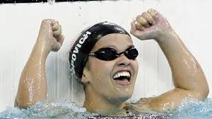
What are some things you need to succeed?
How might that differ or be the same from a teammate, friend, sibling, etc.?
We may not always be able to physically judge what that is.
Notes:
Ok, now that we are comfortable with DEI let’s include disability into the conversation notice what I did there?
This is a picture Erin Popovich., current co high performance director for US Paralympic Swimming
Three-time Paralympian and 19-time medalist, including 14 golds; she won seven golds in seven races, setting three world records and four Paralympic Games records at Athens in 2004
If you ask Michael Phelps and he will say she is my hero.
A little back ground information.
US Olympic Committee and US Paralympic Swimming combined together for organization and funding of athletes in 2019
USP swimming is under US Olympic Paralympic Committee as well as other sports.
Phil has sent a handout with want more information
FUN FACT: the 2016 Summer Games in Rio, The Paralympic Games had more people visit the Olympic Village than during the Olympics

Slide 10
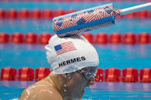
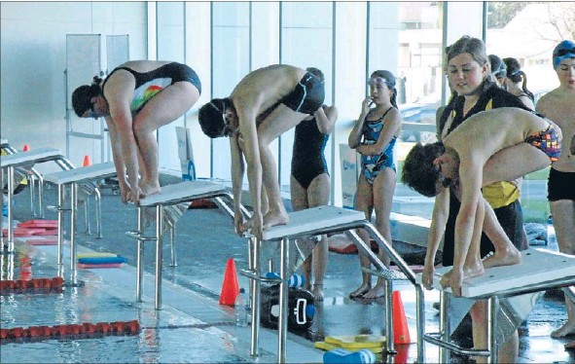
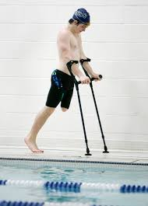
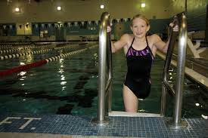
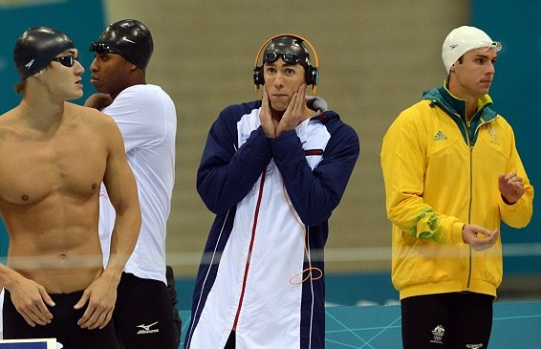
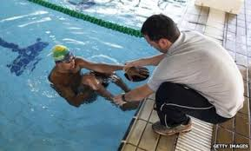
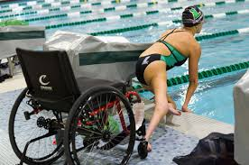
Notes:
These Pictures show some accommodations coaches may ask for when they are entering a SWAD into a USA-S meet
tapper ( visually impaired)
getting out of the pool by the ladder,
assistant on deck and for start ,
start from the pool deck
In water start
,headphones when others are talking around a swimmer This is not necessarily a accommodation but something we need to be aware of
. Notice the swimmer on Crutches .. The coach may let the meet Referee know when entering the SWAD in the meet that this swimmer will not be swimming breast stoke/ butter fly with simultaneous leg movements.

Slide 11
Olympic Sports
U.S. Paralympics Sports
Track and Field
Cycling
Sitting Volleyball
Sled Hockey
Wheelchair Basketball
Swimming
ETC……………
Notes:
US Olympic Committee and US Paralympic Swimming combined together for organization and funding of athletes in 2019
USP swimming is under US Olympic Paralympic Committee as well as other sports. USP manages competition which includes athletes from all the disability groups think of an umbrella. Each group may hold their own competitions, but they all compete under USP for selection to International events ie Paralympic games (Tokyo). Each disability group feeds into one Collective Organization USP for selection to go to the Paralympic games
FUN FACT: the 2016 Summer Games in Rio, The Paralympic Games had more people visit the Olympic Village than during the Olympics

Slide 12
Paralympics VS. Special Olympics
What is the difference?
The disability categories of athletes that compete in the programs are different.
The training, criteria, and philosophy under which the athletes compete are different.
The structures of the individual organizations are different.
https://isacra.org/information-and-resources/for-coaches/paralympics-or-special-olympics-what-is-the-difference/
Notes:
Paralympics and Special Olympics
Have different Categories, Training Criteria, and Philosophy

Slide 13
Athletes
Paralympics
Athletes mainly have physical disabilities as opposed to intellectual ones. However, there are also three categories for blind swimmers and one for swimmers with intellectual disabilities. Although there is no age limit or minimum for the Paralympic games, as long as the athlete is at a reasonable age to compete, most Paralympians are young adults between 18 and 30 years of age because the level of competition is elite.
Development in the technique and power of the sport requires many years of training. There are age divisions at a junior level, but when a junior age athlete moves into actual Paralympic competition events, there are no age divisions.
Special Olympics
Athletes must have cognitive delays (intellectual or developmental disabilities). The age minimum is eight years old, and a majority of athletes involved with Special Olympics are children, although adults do participate, too. There are age divisions.
Notes:
Paralympics: mostly physical disabilities although intellectual and visual disabilities are included. No age limit however, Paralympians are between 18- 30 years of age
The level of competition is elite there are divisions but when junior athletes move to actual Paralympics competition there is no age division
Special Olympics: Athletes must have intellectual or developmental delays minimum age is 8 yrs old. Majority of participants are children

Slide 14
Training
Paralympics
An athlete training for the Paralympics, on the other hand, has essentially the same training regimen as an Olympic athlete, with year-round, intense daily and highly specialized training in a specific sport. Some Paralympic athletes train along with Olympic athletes at the Olympic training facilities in their countries.
Special Olympics
Although there are some exceptions, generally, an athlete going to a Special Olympic competition may spend one season learning to swim and practicing swimming once or twice a week and then go to a swim meet. The next season, the athlete may practice volleyball and then compete in Special Olympics volleyball games.
Notes:
For Paralympic athletes it is essentially the same training regimen as an Olympic athlete year round intense specialized training in a specific sport with own training facilities train along side traditional Olympics athletes.
Colorado Springs Olympic training center. Has both traditional and Paralympic athletes living and training in their resident halls.
Special Olympic: one season practicing a sport , practice 1-2 times a week then compete. The next season may practice another sport and compete.

Slide 15
Criteria & Philosophy under which athletes participate
Paralympics
In Paralympic activities, athletes with disabilities are welcomed to train, and the benefit to physical health is noted, but the emphasis is on elite-level competition. Only the few athletes who meet qualifying standards compete at national and international levels. Qualifying standards are set for each event and become harder and harder at each level of competition.
Each sport in the Paralympic Games has its own criteria and standards, so to compete, an athlete must be one of the best based on her or his performance. but the emphasis is on elite-level competition
Special Olympics
The Special Olympics believes in using athletics as an avenue to reach an individual person’s maximum potential. No one is excluded or left out based on their skill. All athletes are welcomed and rewarded for working hard, trying their best, and maximizing their potential. Selection for higher level competition, such as advancing from a state to a national level, may occur through a lottery type system.
Notes:
Paralympics: athletes with disabilities are welcomed to train. but the emphasis is on elite-level competition. Each sport has its own criteria and standards, so to compete, an athlete must be one of the best based on her or his performance. but the emphasis is on elite-level competition
Special Olympics: Special Olympics believes in using athletics as an avenue to reach an individual’s maximum potential. No one is excluded or left out based on their skill. Selection such as state and national level competition may occur through a lottery type system.

Slide 16
USA Swimming encourages people with disabilities to participate in the sport of swimming and facilitates their inclusion in USA Swimming programs through education and collaboration.
We seek to involve people with disabilities in existing competitions and programs for all swimmers, rather than provide unique disability-only opportunities.
Notes:
In USA-S SWADS participate in inclusion programs and USAS-Swimming aims to have SWADS compete in existing competitions and programing vs providing disability-only opportunities

Slide 17
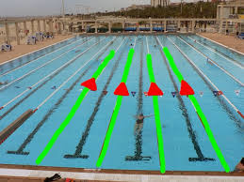
Disability Swimming in USA-S
is about creating parallel competition for USA-S swimmers with a disability.
Notes:
Parallel competition not disability competitions. Which was why the USA-S Championship time standards for swimmers with a disability where developed about 3 years ago. You may know them as Motivational Time standards

Slide 18
USA Swimming -swimmers with a disability
Any swimmer who has a permanent physical or cognitive impairment that substantially limits one or more major life activities
Includes persons with:
Physical
Visual
Hearing
Cognitive disabilities
Notes:
USA-S defines a swimmer with a disability as any swimmer who has a permanent physical or cognitive impairment that substantially limits one or more major life activities

Slide 19
USAS Para Swimming Motivational Time Standards
History and Rational
Para swimmers have had no standards in which to attach personal goals until they’ve been classified and reached the Can-Am standard. From there it’s quite a leap to emerging times with U.S. Paralympics.
SWADS have been graciously accepted in many meets, but with little consistency.
Unfortunately, they have also been denied access to several meets due to no available standards.
More recently, standards for para-swimmers have been despairingly applied across meets of similar ability in comparison to those for traditional swimmers.
These standards represent 3 years of research and development by several members of the disability committee in collaboration with other professionals and volunteers with a vested interest in disability swimming.
Notes:
Phil as a Handout of times standards and groupings based on a SWADs abilities to send to everyone.
I am going to give you a background and rational for why these time standards where developed
At the Developmental Level age -group swimming- USA-S is inclusion.
Once swimmers get to the upper level meets USA-S separates swimmers out based on a qualifying time ( you need to have a qualifying time to be entered into a championship meet) these times where developed to provide SWADS with a time standard to shot for in order to keep advancing to more competitive meets in USA-Swimming. It is also about paper work, These times go into the swims database so as a USA- swimmer with a disability continues to advance there are valid times for other swim programs like U.S. Paralympic swimming. These time standards give swimmer with a disability a time standard within USA-S. To be competitively included in USA-S competitions

Slide 20
USA-S Groupings For Time Standards
P1 - non-ambulatory (wheelchair bound): limited use of all four extremities.
P2 - dwarfism, multiple limb deficiencies, ambulatory with assistance, can be wheelchair bound with high functioning upper body.
P3 - single limb deficiencies, visual impairments, and intellectual impairments, ambulatory without significant assistance.
Notes:
As I mentioned before, USA-S developed 3 groupings of abilities tied to time standards
A SWAD is identified by their abilities/ placed in a group by the coach or swimmer themselves. There is no medical documentation tied to these groupings.
If a swimmer or a coach states the swimmer has those abilities then they are attached to that grouping and aim for those times for that group
the first group non-ambulatory (wheelchair bound): limited use of all four extremities.
The second group dwarfism, multiple limb deficiencies, ambulatory with assistance, can be wheelchair bound with high functioning upper body.
The third group- single limb deficiencies, visual impairments, and intellectual impairments, ambulatory without significant assistance.

Slide 21
USAS National Disability Committee Motivational Para Time Standards
LSC Championships
Zone Championships
Sectional Championships
Notes:
These time standards are for entry into LSC , Zone and Sectional Championship level meets

Slide 22
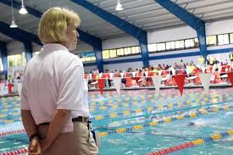
Protocol for officiating a swimmer with a disability
The coach notifies the Meet Committee/ Meet Referee when a swimmer with a disability is entered into a meet and requests necessary accommodations.
Responsibilities - Swimmer: 105.1.2A
The swimmer (or the swimmer's coach) is responsible for notifying the Referee, prior to the competition, of any disability of the swimmer and of the requested modification. The swimmer/coach shall provide any assistant(s) or equipment (tappers, deck mats, etc.) if required
Notes:
When a SWAD is going to swim in a meet, The coach enters swimmers with a disability into the meet electronically, or, on the paper entry form.
The coach provides advance notice of any necessary accommodations the SWAD my need to be inclusively competitive To the meet referee or the meet director

Slide 23
Protocol for officiating a swimmer with a disability
The Meet Referee communicates back with the coach and makes any reasonable accommodation(s) for swimmer.
The Meet Referee is responsible for communicating any swimmer and accommodation(s) to assigned officials before the meet begins.
105.1.2 B (2)
Instructing the Starter and Stroke & Turn officials as to the accommodations to be made for the swimmer
Notes:
The meet referee and coach discuss necessary accommodations
The meet referee communicates with involved officials any accommodations agreed upon.

Slide 24
Necessary Accommodations
Goes beyond, “They need to swim in this lane”
Take longer to get to blocks
Have an assistant at the blocks
In the water start
Longer to get out of the pool.
Any stroke movement(s) that are different from technical rules & regulations of USA-S swimming
Ask to see if a mat can be placed at lane getting in and out of the pool
Hand signals for the start
Notes:
Here are some examples of necessary accommodations .
As stroke and turn officials we are interested in any stroke movement(s) that are different from technical rules & regulations of USA-S swimming.
Not able to turn rt foot out during breaststroke.
As I mentioned before with the swimmer – not able to preform simultaneous leg movements
One hand touch
Non simultaneous arm movements

Slide 25
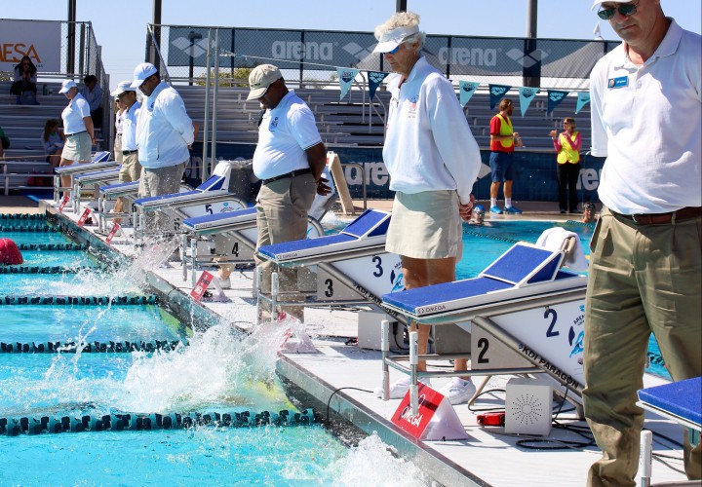
The Officials’ Job
know the rules
observe swims
when observe something in violation with the rules, raise your hand and report what you observed
ALL swimmers competing in a USA-S sectioned meets are observed by the rules and regulations of USA-S
Notes:
It is the official’s job to know the rules, observe the swims and report any violations we observed
Remember when I talked earlier about the paperwork
Here is a Story
I was at a senior meet, Coach came up to me, I was deck ref at the time, " Why did I not see any officials hands go up?" "My swimmer just swam 50 breast with a scissor kick." I need to see hands go up and then discuss if it was because of her necessary accommodation or because of something else she did.

Slide 26
Protocol for officiating a swimmer with a disability
It is the responsibility of the CJ and/or the Deck Referee to vet any observations reported from an official for ANY swimmer
ALL swimmers competing in a USA-S sectioned meets are observed by the rules and regulations of USA-S
Notes:
During the next briefing, we discussed what happened. I got this question: “Why didn’t you let us know that a disabled swimmer was swimming.” My response, was 2 fold.
First- The swimmer comes first, The same with DEI USA-S. put the swimmer first.
Swimmer with a disability
Second . Why did you need to know in they have a disability?
Every swimmer in the meet is swimming under the USA-S rules and regulations. The Meet referee is aware of any necessary accommodations for any swimmers and has passed that information as needed to the appropriate official
What needed to happen to provide inclusive competitive competition.
Official, raise your hand if you observed something in violation of the rules, (under water recovery, non-simultaneous arms, one arm touch, scissor kick, foot not turned out, alternating kick,) whatever you observe in violation. Report that to the CJ. The CJ should have information to vet it. Because no hands went up, we failed in provide INCLUSIVE competition. By not reporting what was observed we simply provided a lane of water with no competitive opportunity for the swimmer and coach to learn and improve.

Slide 27
REMEMBER
Same rules apply in USA Swimming for both able-bodied and swimmers with a disability
Observe swims per the meet protocol
If something is observed in violation of the rules, raise your hand and report it
ALL swimmers competing in a USA-S sectioned meets are observed by the rules and regulations of USA-S
Notes:
Same rules apply in USA Swimming for both traditional and swimmers with a disability
As official’s, we Observe swims per the meet protocol
If something is observed in violation of the rules, raise your hand and report it
Phil also, has the USA-S Trifold for officiating a swimmer with a disability to sent to everyone which is a pocket guide to rule 105 that you can keep with you.
This trifold is editable to include your LSC Logo
Officials chair and disability contact information.

Slide 28
THANK YOU!
Christine Beagle
Chair: Diversity & Inclusion
Iowa Swimming, Inc
chrissy.beagle@iaswim.org
Susan Mechler
Central Zone Disability Coordinator
Member: National Disability Committee
susan.mechler@gmail.com
513-305-2848
Notes:
Thank you all for your time and attention today. I appreciate the invitation to come and speak with you all..
Does anyone have any questions for Chrissy or myself.?

