Slide 1
EMERGENCY MEETING UPDATES TO THE MAINE DECD’S COMMUNITY SPORTS COVID-19 PREVENTION CHECKLIST
November 6th, 2020 | 8:00 PM

Slide 2
WHAT TO EXPECT & RULES OF ENGAGEMENT
Informational presentation by Taylor Rogers, General Chair, and Henry Clauson, Officials Chair, followed by Q & A
MESI Board of Directors will have their questions heard first followed by members of MESI

Slide 3
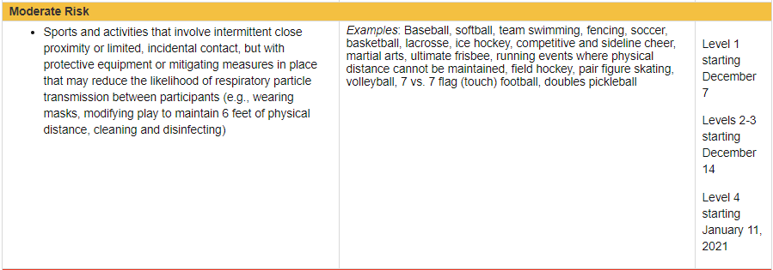
NEW CHALLENGES

Slide 4
NEW CHALLENGES
From: Johnson, Heather <Heather.Johnson@maine.gov> Sent: Friday, November 6, 2020 5:00:07 PM
Mike,
I’m really sorry but they did in fact intend "team swimming" to mean all swim team-type activities, not only relay swimming events. Their concern is more about the gathering of people on the pool deck and in the facilities, since there is limited space there. That's why they considered that a "moderate risk" activity, while individual swimming is considered lower risk.
I think everyone is really focused on the next couple of weeks and stemming the tide that we are currently in.
Sorry,
Heather

Slide 5
NEW CHALLENGES
LEVEL 1 | December 7th, 2020 LEVEL 2 & 3 | December 14th, 2020 LEVEL 4 | January 11, 2021

Slide 6
IMPLICATIONS
Violations of the DECD’s Community Sports Guidelines are now considered to be a violation of the Governor’s Executive Order.
Violations of these orders are a Class E crime, punishable by up to 6 months in county jail and a fine of up to $1,000.00

Slide 7
GENERAL UPDATES
FACE COVERINGS
COUNTY-BASED RESTRICTIONS
“While face coverings may not be compatible with some activities, experience in different states with fall sports shows that they can be safely and effectively worn during competition. As such, face coverings are required for all individuals at practices and competitions at all times, including players, coaches, staff, and officials while engaging in practice or competition.”
“The Maine DHHS and Maine CDC have developed a Health Advisory System to categorize counties for school district's use. Organizers of community sports should suspend competitions and group practices in counties categorized as "Yellow." "Red" suggests a county has a high risk of COVID-19 spread and that all organized sports are inadvisable.”
CURRENTLY YELLOW: Franklin, Knox, Somerset, Washington

Slide 8
GENERAL UPDATES | OPERATIONAL REQUIREMENTS
COHORTING
TRANSPORTATION
“Keep players together in small, stable groups with dedicated coaches or staff, and make sure that each group of players and coach avoid mixing with other groups as much as possible.”
“Teams might consider having the same group of players stay with the same coach or having the same group of players rotate among coaches”
“Limit the use of carpools or van pools. When riding in a vehicle to a sports event, encourage players to ride with persons living in their same household. Carpooling with individuals from different households is not recommended.”
“If carpooling with individuals outside one’s household group is necessary, increase ventilation in the vehicle, and all riders must wear a facial covering, and use hand sanitizer.”

