Slide 1
OFFICIAL-bration #OfficiallyAwesome
Notes:
Why Succession Planning?

Slide 2
Summer Meets
Notes:
Why Succession Planning?

Slide 3
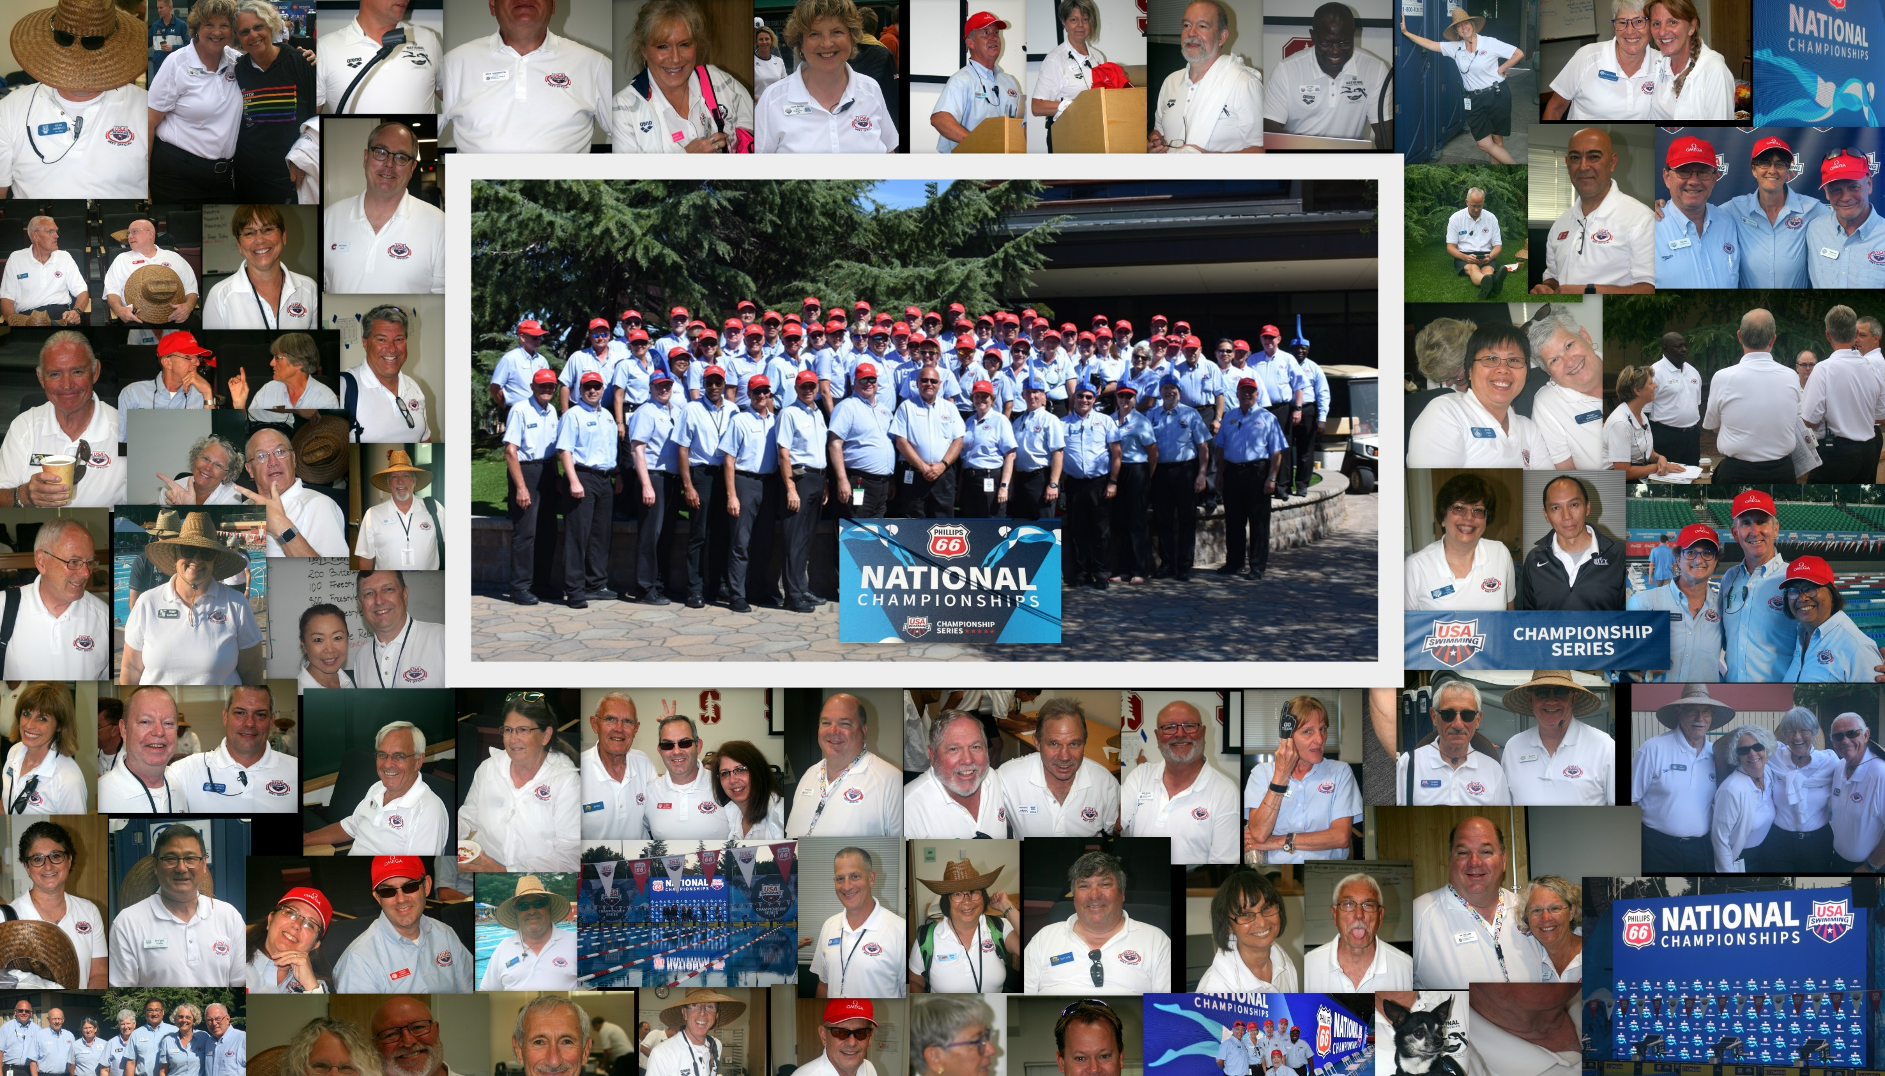
Nationals
Dave coddington, Referee

Slide 4
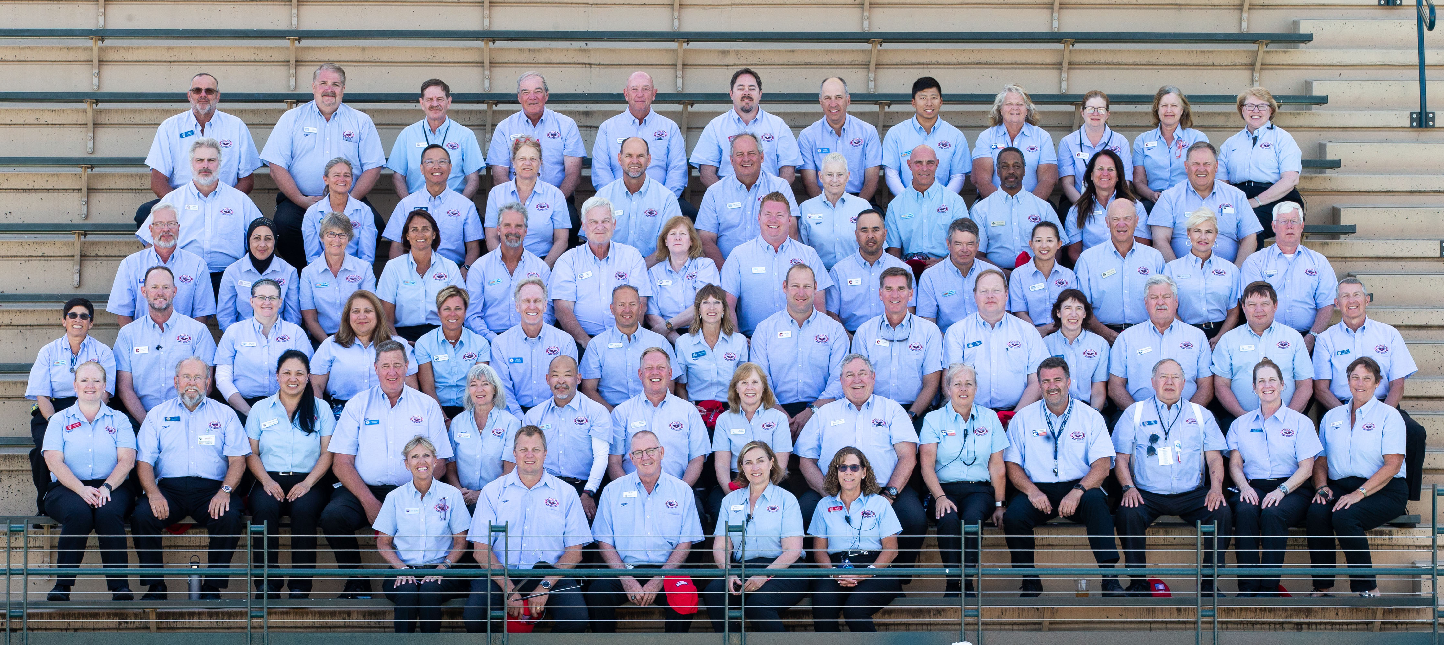
Junior Nationals
Trish Martin, Referee

Slide 5
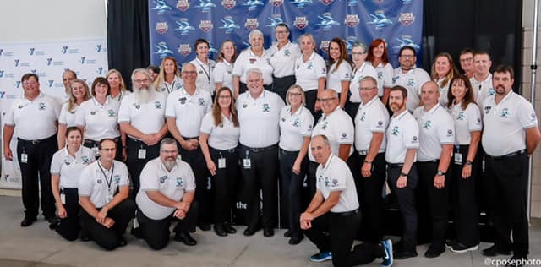
Futures – Des Moines
Peter Lagow, Referee

Slide 6
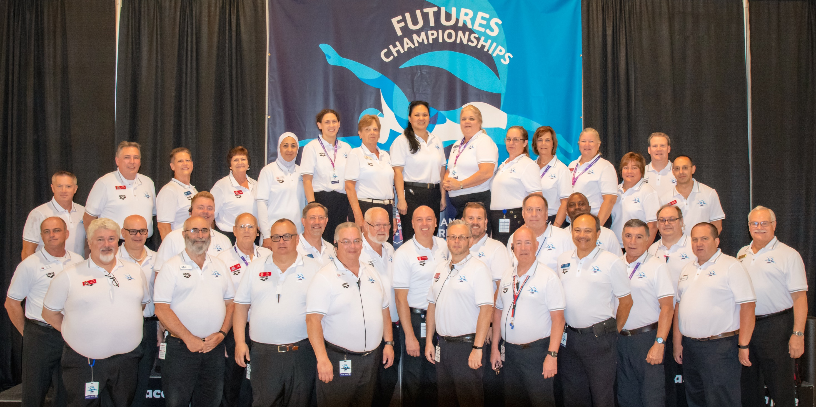
futures
Geneva – Mickey Smythe
Futures – Geneva
Mickey Smythe, Referee

Slide 7
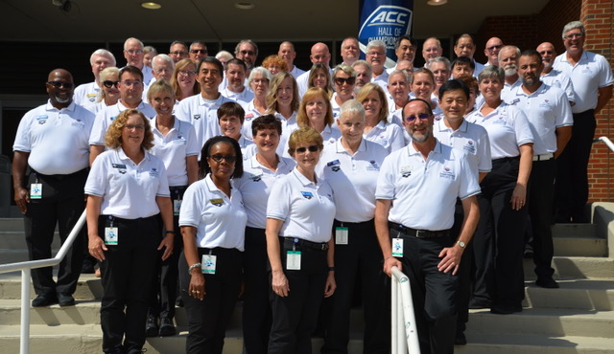
Futures – greensboro
Anne lawley, Referee

Slide 8
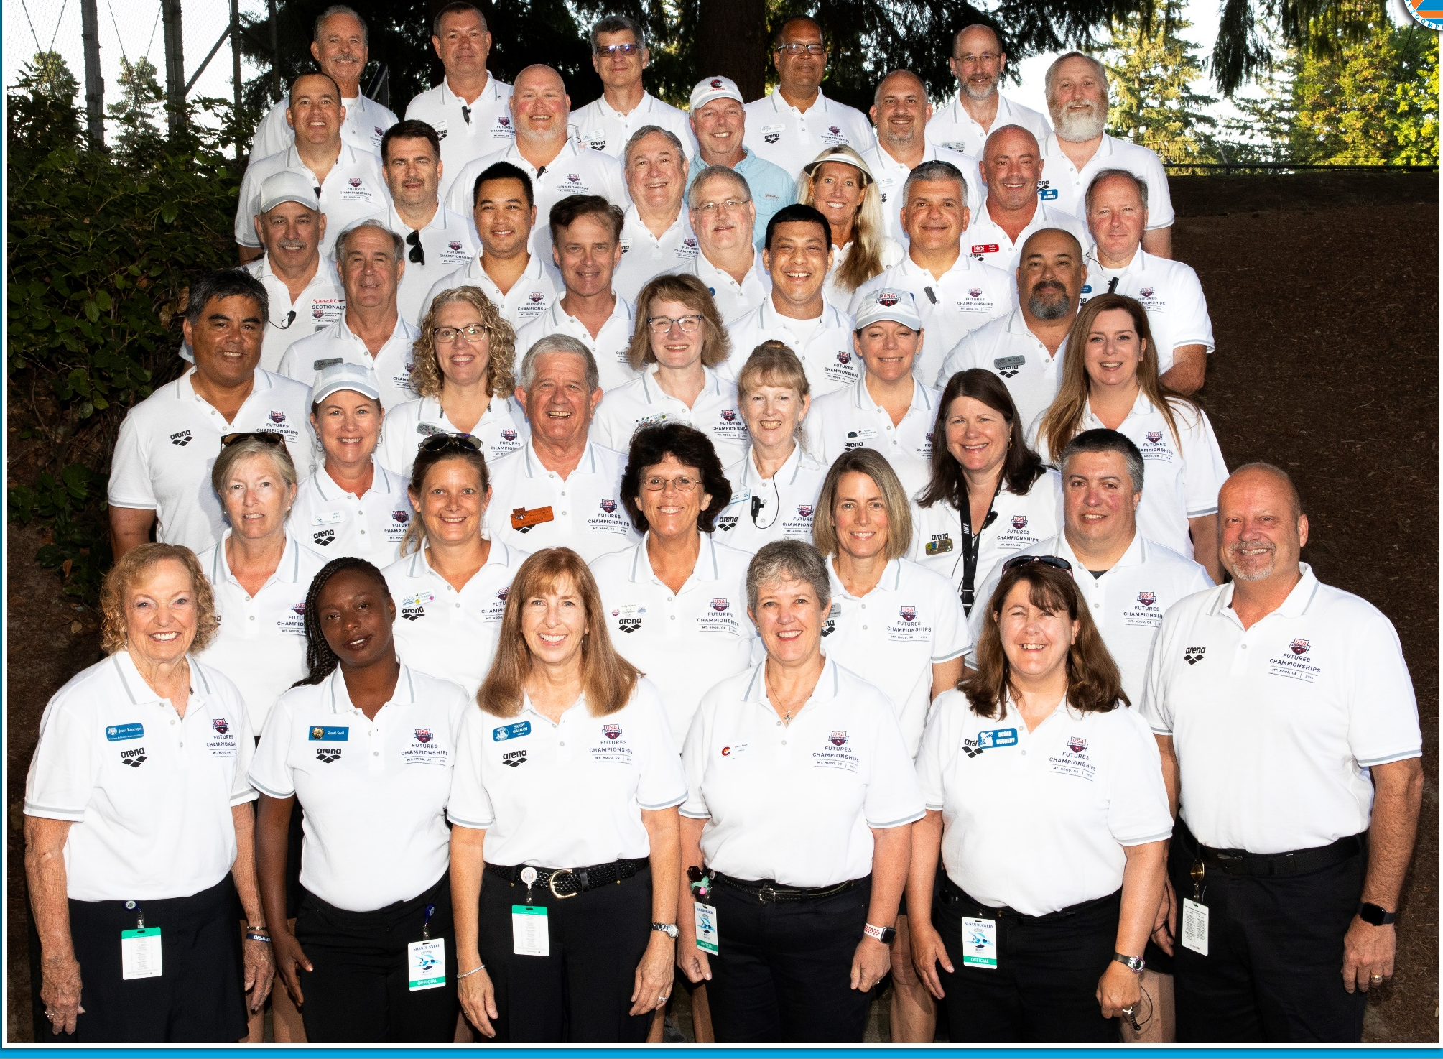
Futures – Mount Hood
Phil lakota, Referee

Slide 9
International
Notes:
Why Succession Planning?

Slide 10
Pan Ams
Jay Thomas, UANA TSC
Cecil Gordon, UANA tsc
Lisa Vetterlein, Starter/Deck Official

Slide 11
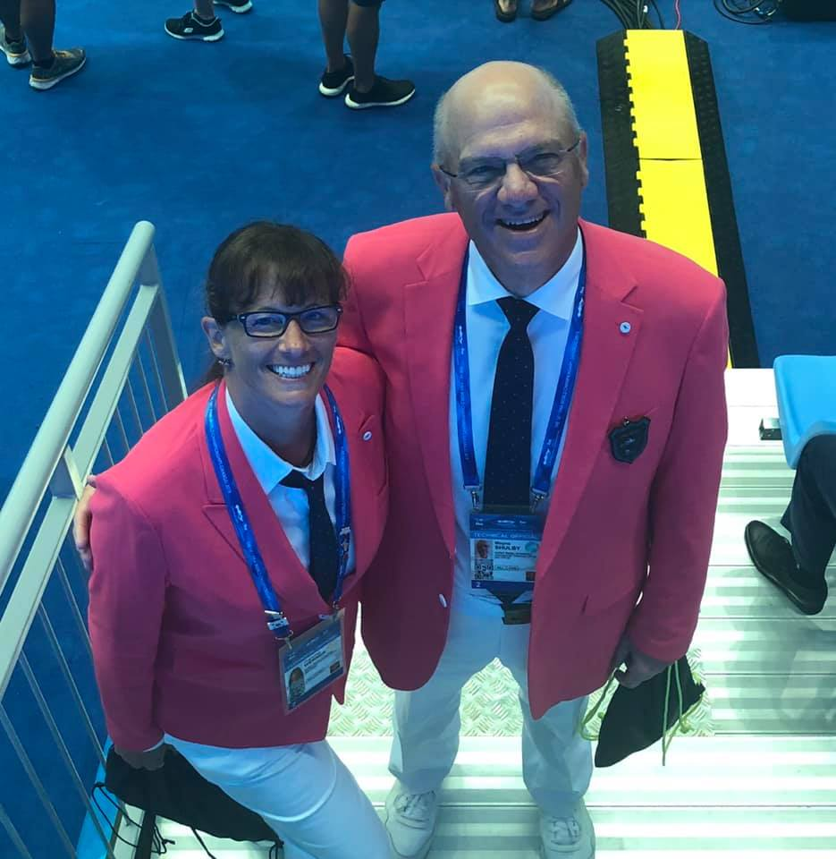
World championships
Fran Werner, Starter
Wayne shulby, deck official

Slide 12
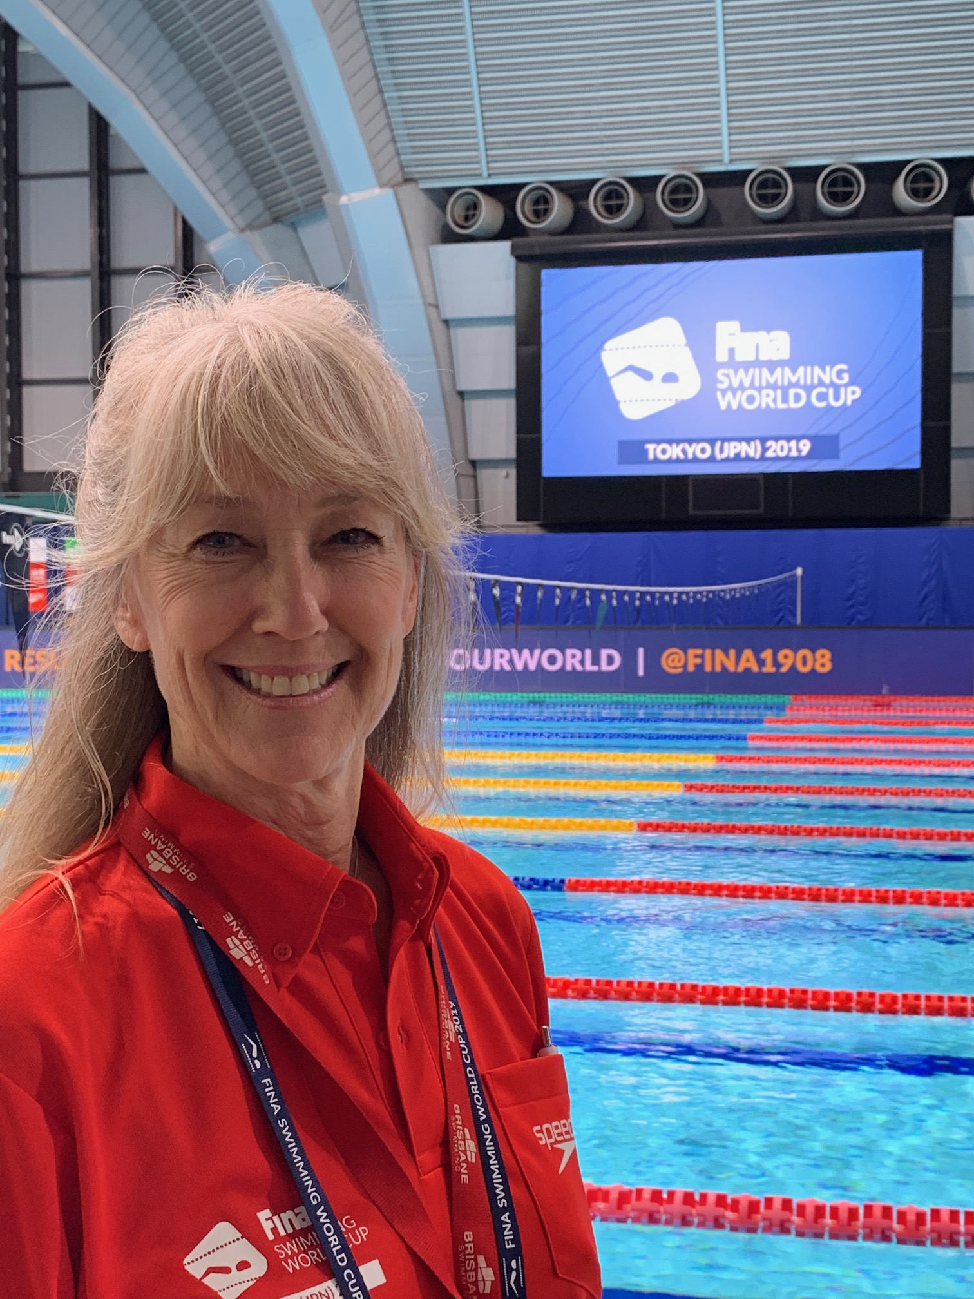
Kathleen Scandary, Referee
World Cup Kathleen Scandary, Referee

Slide 13
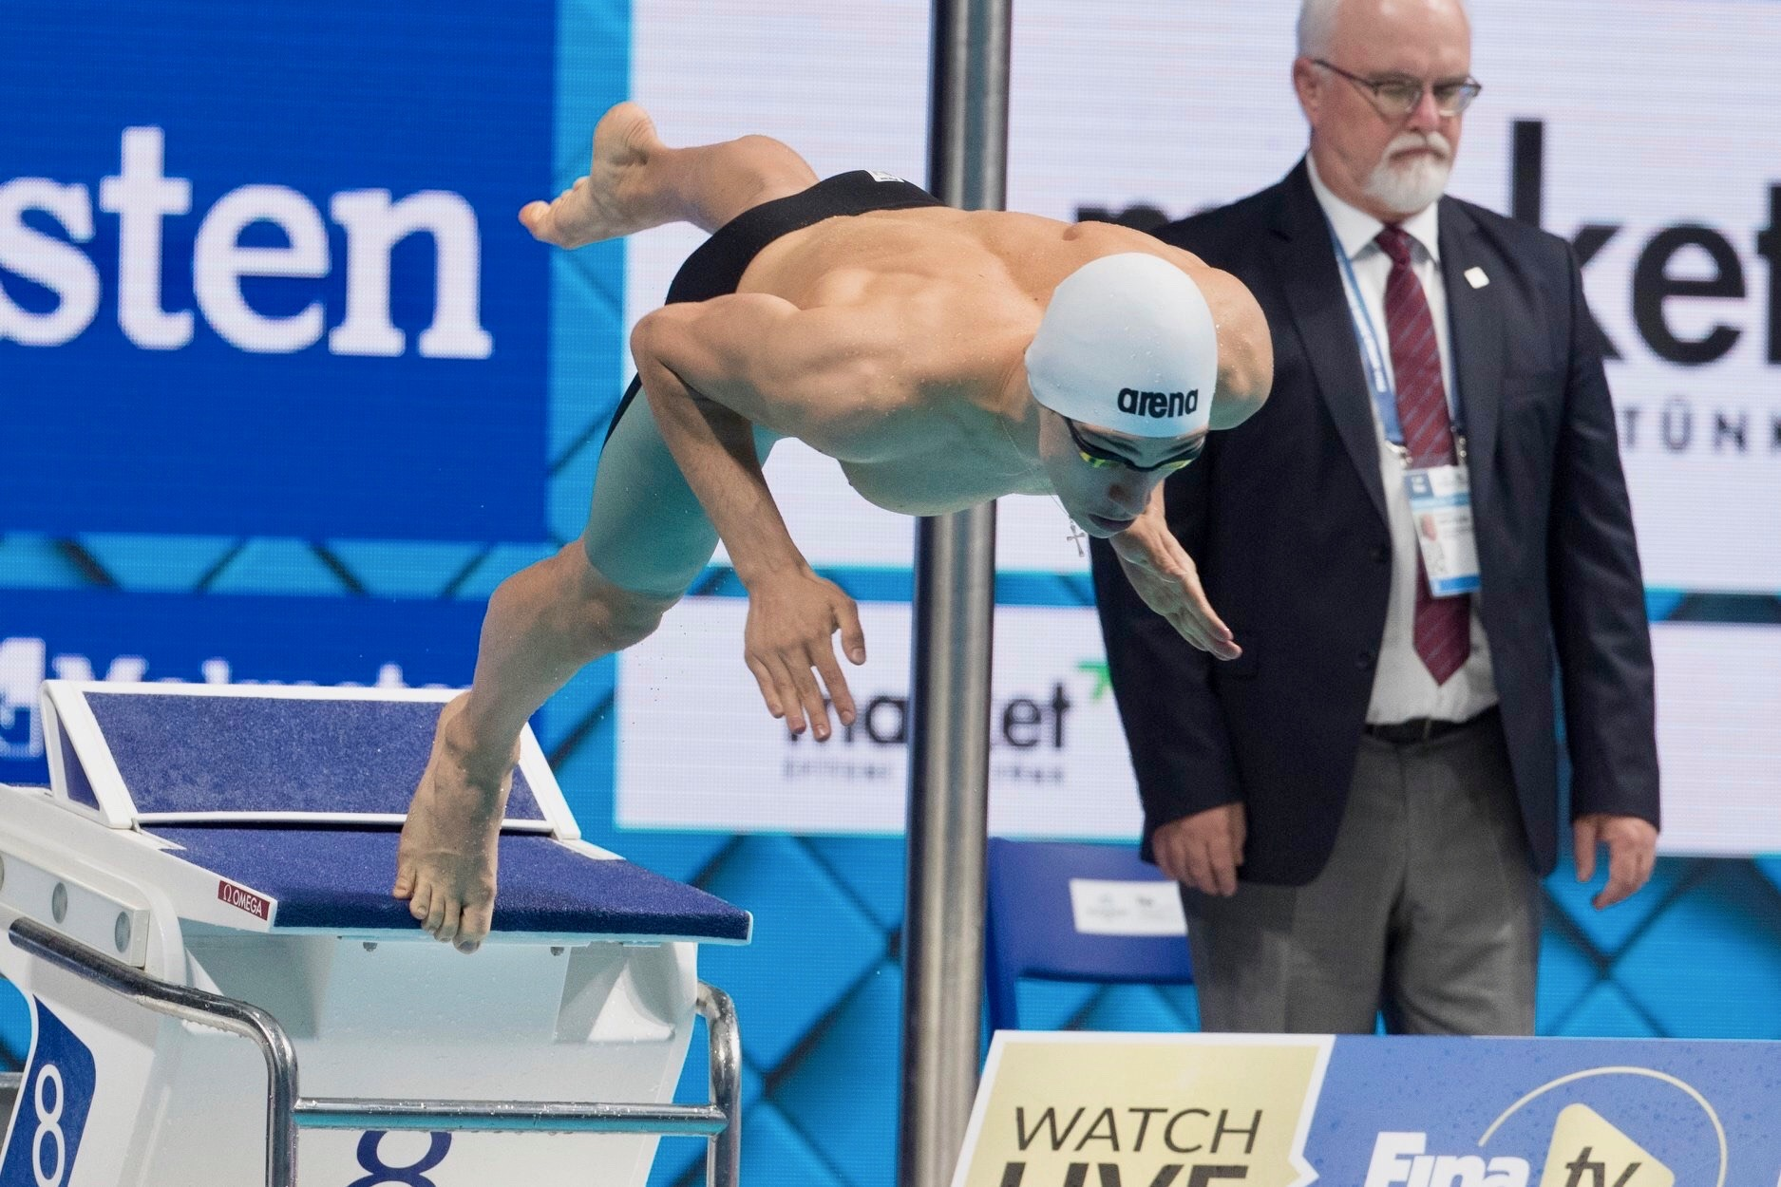
World juniors Robert Broyles, Deck Official

Slide 14
World University Games Amy Hoppenrath, Referee

Slide 15
Winter 2019 / 2020
Notes:
Why Succession Planning?

Slide 16
U.S. Open
Jamie Cahn, Meet Referee

Slide 17
Junior Nationals
Jason Johnson – referee East
Don Hougherty – referee West

Slide 18
Tyr pro swim series
Greensboro – Jim Holcomb
Knoxville – Melissa Hellervik-Bing
Des Moines – Sandy Drake
Mission Viejo – Robert Broyles
Indianapolis – Jim Sheehan

Slide 19
Notes:
Why Succession Planning?

Slide 20
MEET REFEREE
Clark Hammond

Slide 21
ADMINISTRATIVE REFEREES
Jacki Allender – Administrative referee
Peter Lagow
Lisa Olack

Slide 22
DECK REFEREES
JAMIE CAHN
SANDY DRAKE
Jim Holcomb
Kathleen scandary
Wayne shulby

Slide 23
STARTERS
Denice Wepasnick - Head Starter
Dick Duncan
Eric Peterson
Fran Werner

Slide 24
CHIEF JUDGES
Don Hougardy – Team lead
Dana Covington
Kim Downs
Jason Johnson
Trish Martin
Mike Urbanowicz
Lisa Vetterlein

Slide 25
UNDERWATER CAMERAS
Dan McAllen
Robert Broyles

Slide 26
TIME TRIAL REFEREE / FINALS CALL ROOM
Mark McCaw

Slide 27
Carol Zaleski

