Slide 1
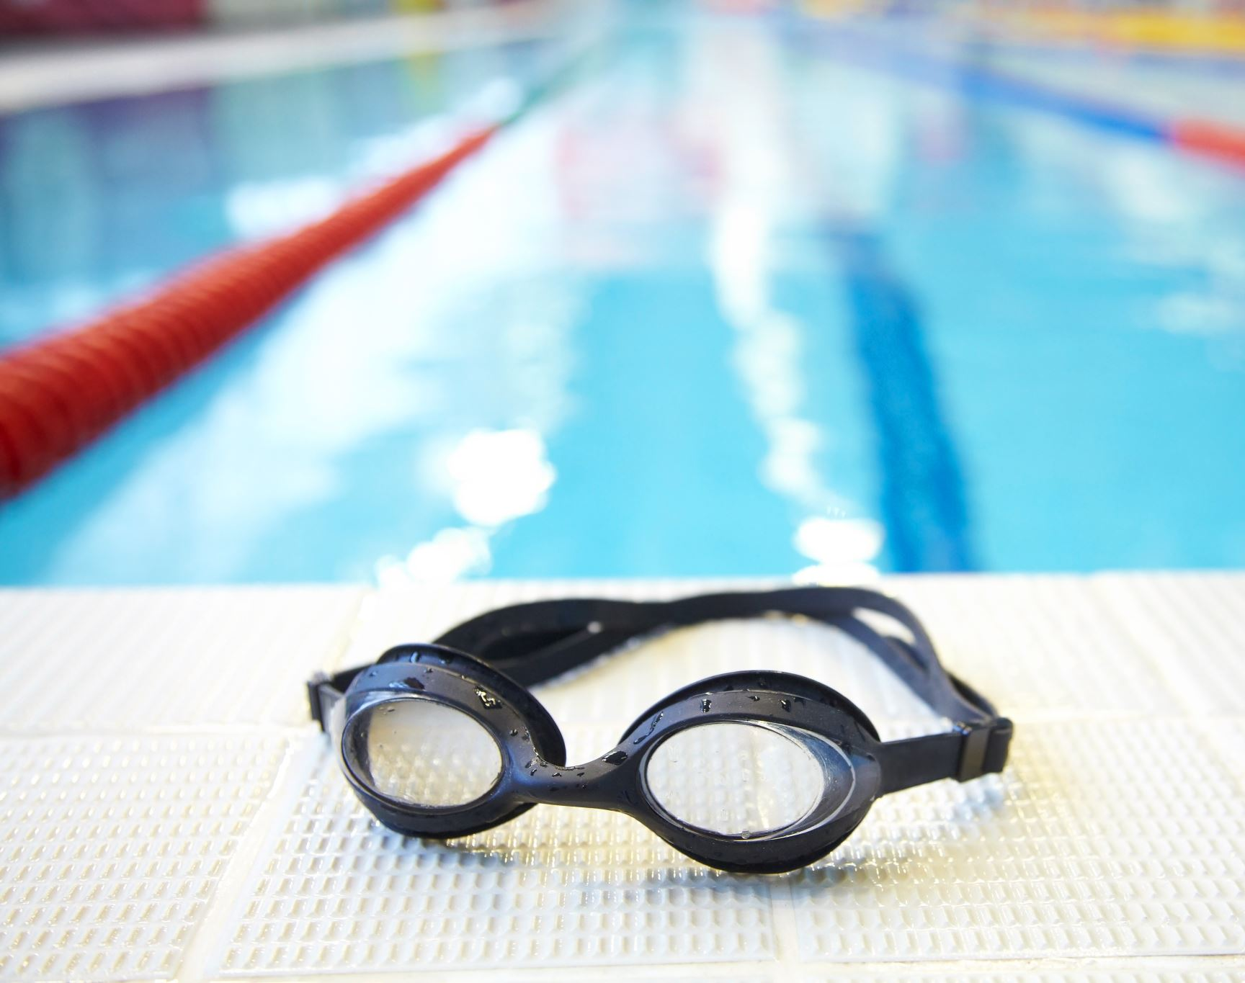
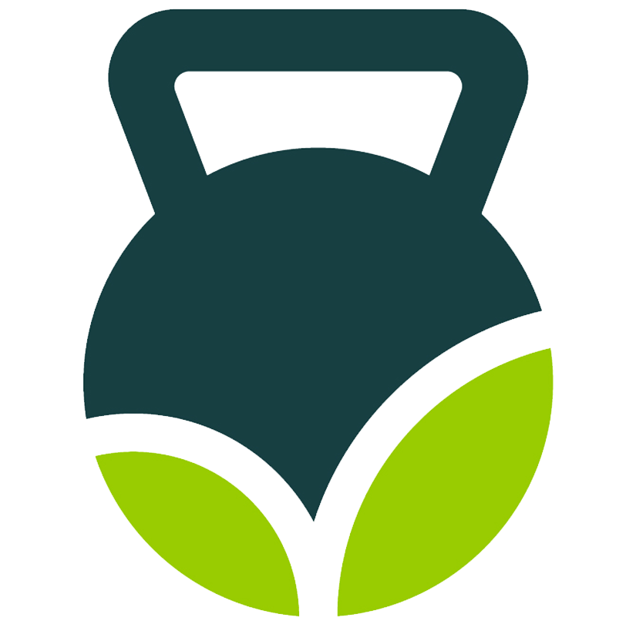
Fueling for Swimmers
Sara Kostelnick, RD, LD, ACSM-CPT
Achieving Your Best
Wellness Dietitian

Slide 2
Why is Sports Nutrition Important?
Foundation of athletic success!
Individualized planning that allows athletes to perform at their best
Supplies the right type of food, energy, nutrients, and fluid to keep your body well hydrated and functioning at peak levels
Each person has different needs based on sport, intensity, frequency, duration, gender, age, etc
Notes:
What and when you eat is important to swim your fastest and recover stronger
Proper nutrition can improve recovery, and prevent/improve stomach issues
If you are not focusing on this important aspect of your training, then you may not be reaching your potential!

Slide 3
NUTRITION CAN MAKE A GREAT ATHLETE GOOD OR A GOOD ATHLETE GREAT!

Slide 4
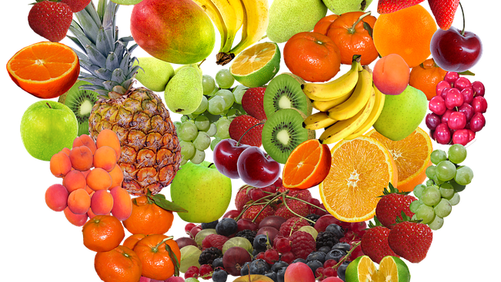
Eat Healthy Foods Most of the Time
Eat mostly fruits, veggies, whole grains, healthy proteins, and healthy fats
Eat the correct portion sizes
Adjust your nutrition to your training schedule and workouts each day
Stay hydrated!
Notes:
To perform at your best, you need to give your body nutrients every day:
Eat mostly fruits, vegetables, whole grains, healthy proteins, and healthy fats
ALL meals should have should have healthy sources of protein, fat, and carbs
Eat the correct portion sizes so that you have a healthy body fat percent
Sprinters and divers typically have a lower body fat percent (16-20%) and distance swimmers have a higher body fat percent (18-22%)
Having a strong, lean body is great for swimmers, but carrying excess body fat or excess weight can slow you down
Adjust your nutrition to your training schedule and workouts each day
Eat more when working out hard, and less when not – your nutrition will vary with one a day practices, two a day practices, and taper weeks
Stay hydrated!
Listen to your thirst and have water available all day
Everyone’s hydration needs are different – half your body weight in ounces (a 120 pound person needs 60 ounces of water per day)
Water, coffee, and tea are your best modes of hydration
Sports drinks are okay during practice – you still sweat when you are swimming!
Unhealthy foods can prevent your body from recovering stronger, so you won’t get as much out of your training if you are eating junk food, fast food, lots of added sugar, and other nutrient scare foods

Slide 5
Practice, Practice, Practice
Train your gut!
Experiment to find out what works best for you
Plan ahead
Keep track of what you are doing
Notes:
You need to train your gut just like your muscles, ligaments, tendons, lungs, and heart
There are many ways to meet your nutrition, hydration, and electrolyte needs
Experiment to find out what works best for you
Plan ahead and keep track of what you are doing so you can monitor performance and make changes as needed.
Work this out in practice!
You can use apps like MyFitnessPal or work with a sports dietitian

Slide 6
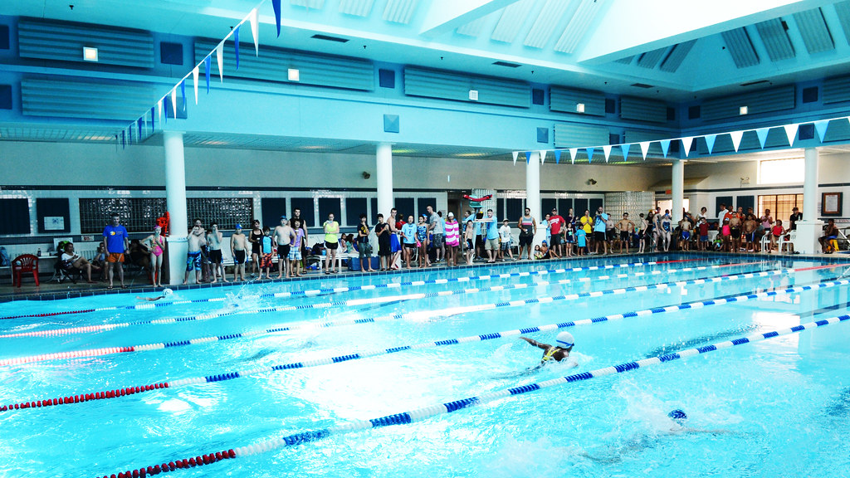
Swim Meet Tips
Don’t do anything new
Don’t eat heavy or hard to digest foods
Focus on easy to digest carbohydrates in small amounts
Timing is very important
Short time between races – focus on easy to digest carbs and sip fluid
Longer time between races – eat as soon as you can and have a little protein with healthy carbs and fluid
Notes:
Eat healthy foods the day before – avoid heavy, high fat foods, junk foods, fried foods, and lots of high sugar foods
Don’t do anything that you haven’t done before
Expect to not absorb nutrients as well during extreme conditions of racing, so don’t eat heavy or hard to digest foods
Focus on easy to digest carbohydrates in small amounts – DON’T OVEREAT!
Timing is very important
Short times between races – focus on sports drinks, chews, gels, and water so you don’t overload your stomach
Longer times between races – eat as soon as you can and have a little protein with healthy carbs
Generally, include foods that are low-fat and easy to tolerate, however, be sure to listen to your body
Your teammate may tolerate something better than you do

Slide 7
Short Time Between Races – less than 45 min
Canned fruit/applesauce or fruit leathers
Sports drinks, coconut water
Energy chews with caffeine
Graham crackers or saltines
Notes:
Canned fruit/applesauce or fruit leathers/Clif fruit ropes
Energy Gels or chews with caffeine

Slide 8
Long Time Between Races – 45+ minutes
Fresh fruit: bananas, apples, grapes
Clif bar or granola bar
PB cracker sandwiches or cheese and crackers
String cheese or Babybel cheese
Salted peanuts or other salted nuts
Baked chips, pretzels, goldfish

Slide 9
Morning Practice
Pre-workout – you need fluid and carbs
Have breakfast about 30 minutes before practice starts
Focus on healthy carbohydrates
Drink water or a sports drink 5 minutes before you start
During workout – you need fluid, carbs, and electrolytes
During breaks, drink sports drink
Drink something at least every 30 minutes for better absorption
Post-workout – you need fluid, carbs, electrolytes, and protein
Eat and drink immediately after getting out of the pool
Chocolate milk
Vanilla Greek yogurt
Clif bar and string cheese
PB&J sandwich and milk
Within 1-2 hours after practice – have a meal or snack
Brown rice cake with almond butter
Graham crackers and peanut butter
Banana and string cheese
Granola bar or PB&J sandwich
Notes:
Drink a few sips often for better absorption – listen to your thirst
You can utilize a meal replacement shake like a protein shake post-workout but it must have carbs

Slide 10
Afternoon or Evening Practice
2-3 hours before practice
Have a healthy meal with protein, carbs, and fat
Yogurt with granola, fruit and nuts
PB&J sandwich, apple, and string cheese
Regular lunch with sandwich or wrap, yogurt, fruit, veggies with dip, small treat
30 minutes pre-workout
Drink sports drink or water and have a snack
Graham crackers
Banana
Granola bar
During workout & post workout
Same as morning practice

Slide 11
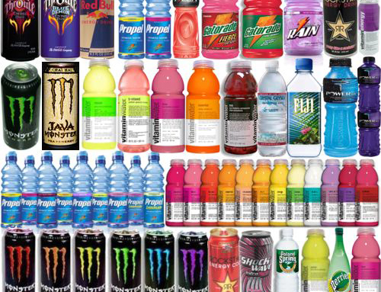
Sports Drinks
Look for:
6-8% carbohydrate solution
Electrolytes
Examples:
Gatorade
Accelerade
Powerade
Tailwind
Body Armour

Slide 12
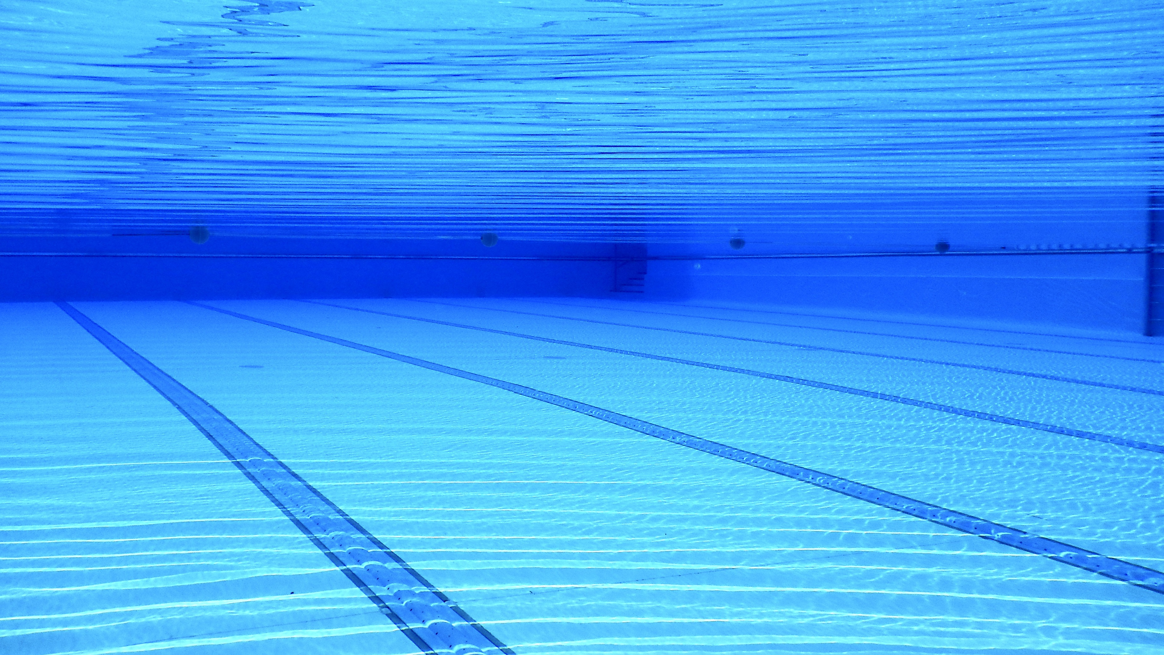
Final Tips
Plan ahead
Be consistent
Time your fuel around workouts
What you eat will affect your performance
Notes:
Plan ahead
Bring snacks and fluid with you
Prepare the night before!
If you don’t have healthy food available, you won’t be able to eat it
Also, having a plan can help you to avoid unhealthy choices
Be consistent
This is one of the most important ways to achieve your potential
You are working out hard, why not get the most out of it?
Time your fuel around your workouts
Get the most out of what you eat at these times – it matters!
What you eat and drink, your body fat percentage, and your timing of fueling will all affect your performance
Make it work FOR you, not AGAINST you!

Slide 13
QUESTIONS?
RMR testing
Free 30-minute nutrition consults with a Registered Dietitian
Email info@achievingyourbest.net
Call 417-720-3670

