Slide 1
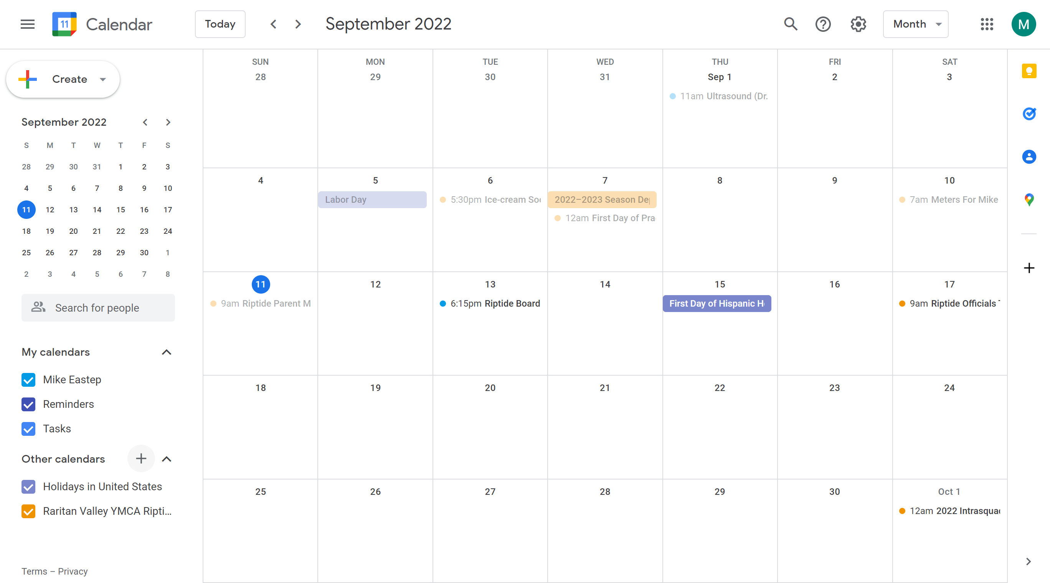
Login to your Google Calendar
Click “+” next to Other Calendars

Slide 2
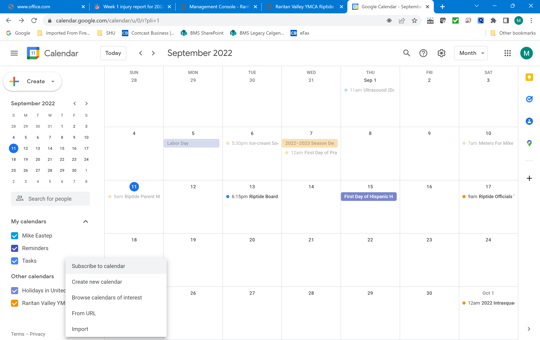
3. Click “Subscribe to Calendar”

Slide 3
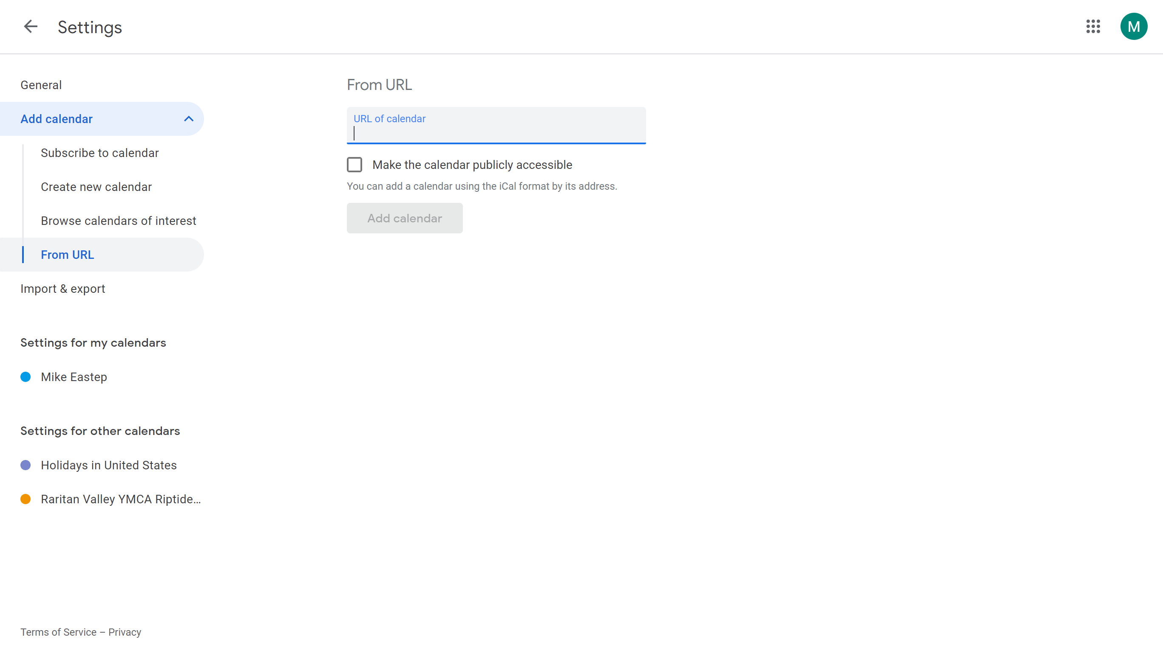
4. Select “From URL”
5. Paste the URL link from the RVY Riptide Calendar (https://www.teamunify.com/rest/ics/system/3/General.ics?key=%2F6W7suO%2FpbteIZIKavNBCQ%3D%3D&enabled=true&startDate=1659326400000&endDate=1693540800000)

Slide 4
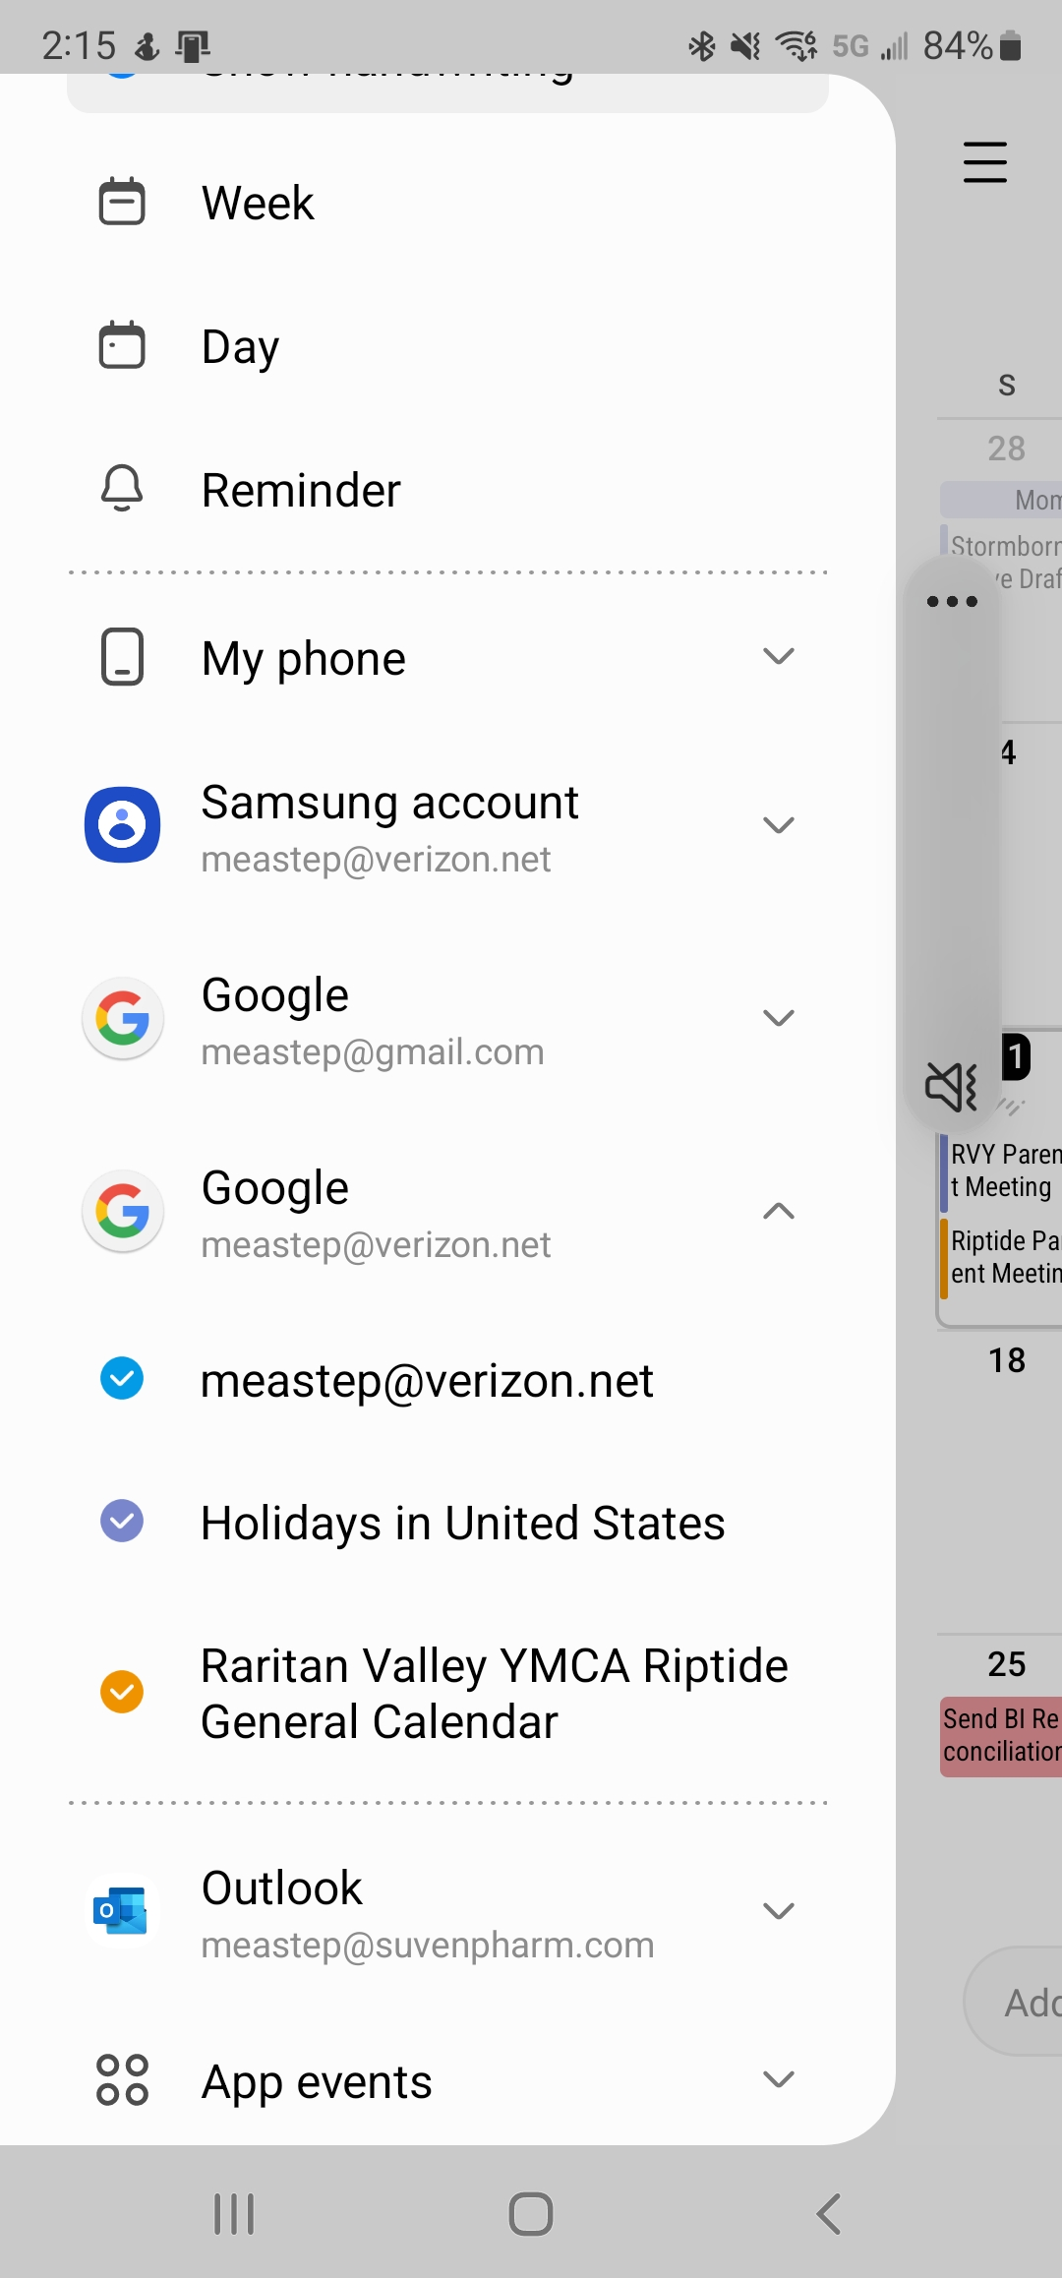
6. In Samsung Calendar, click the “≡” to see the accounts
7. Click the “˅” next to your Google account and ensure
“Raritan Valley YMCA Riptide General Calendar” is selected

Slide 5
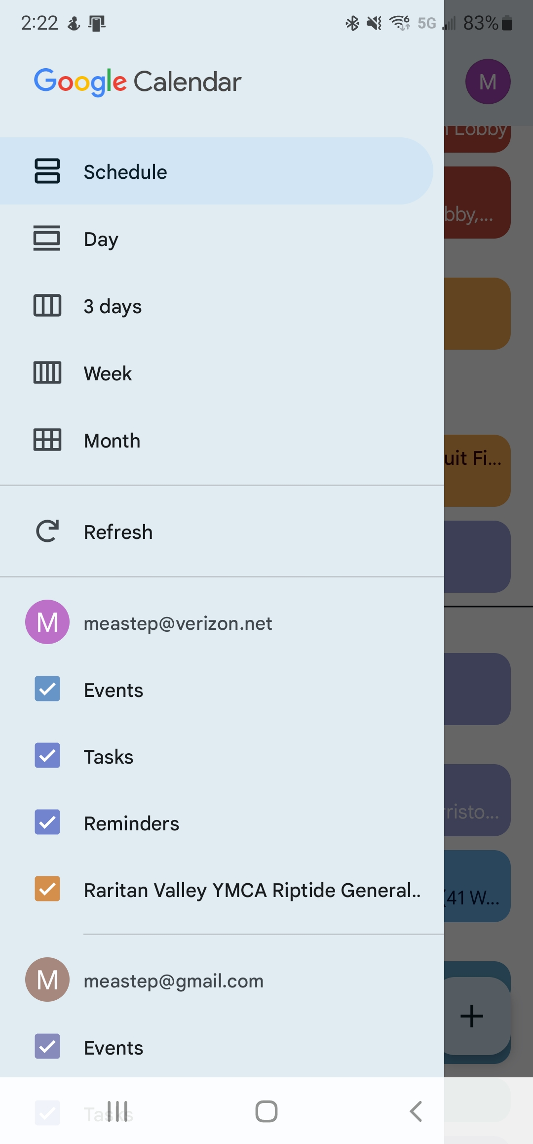
6. In Google Calendar, click the “≡” to see the accounts
7. Ensure “Raritan Valley YMCA Riptide General Calendar” is
selected

