Slide 1

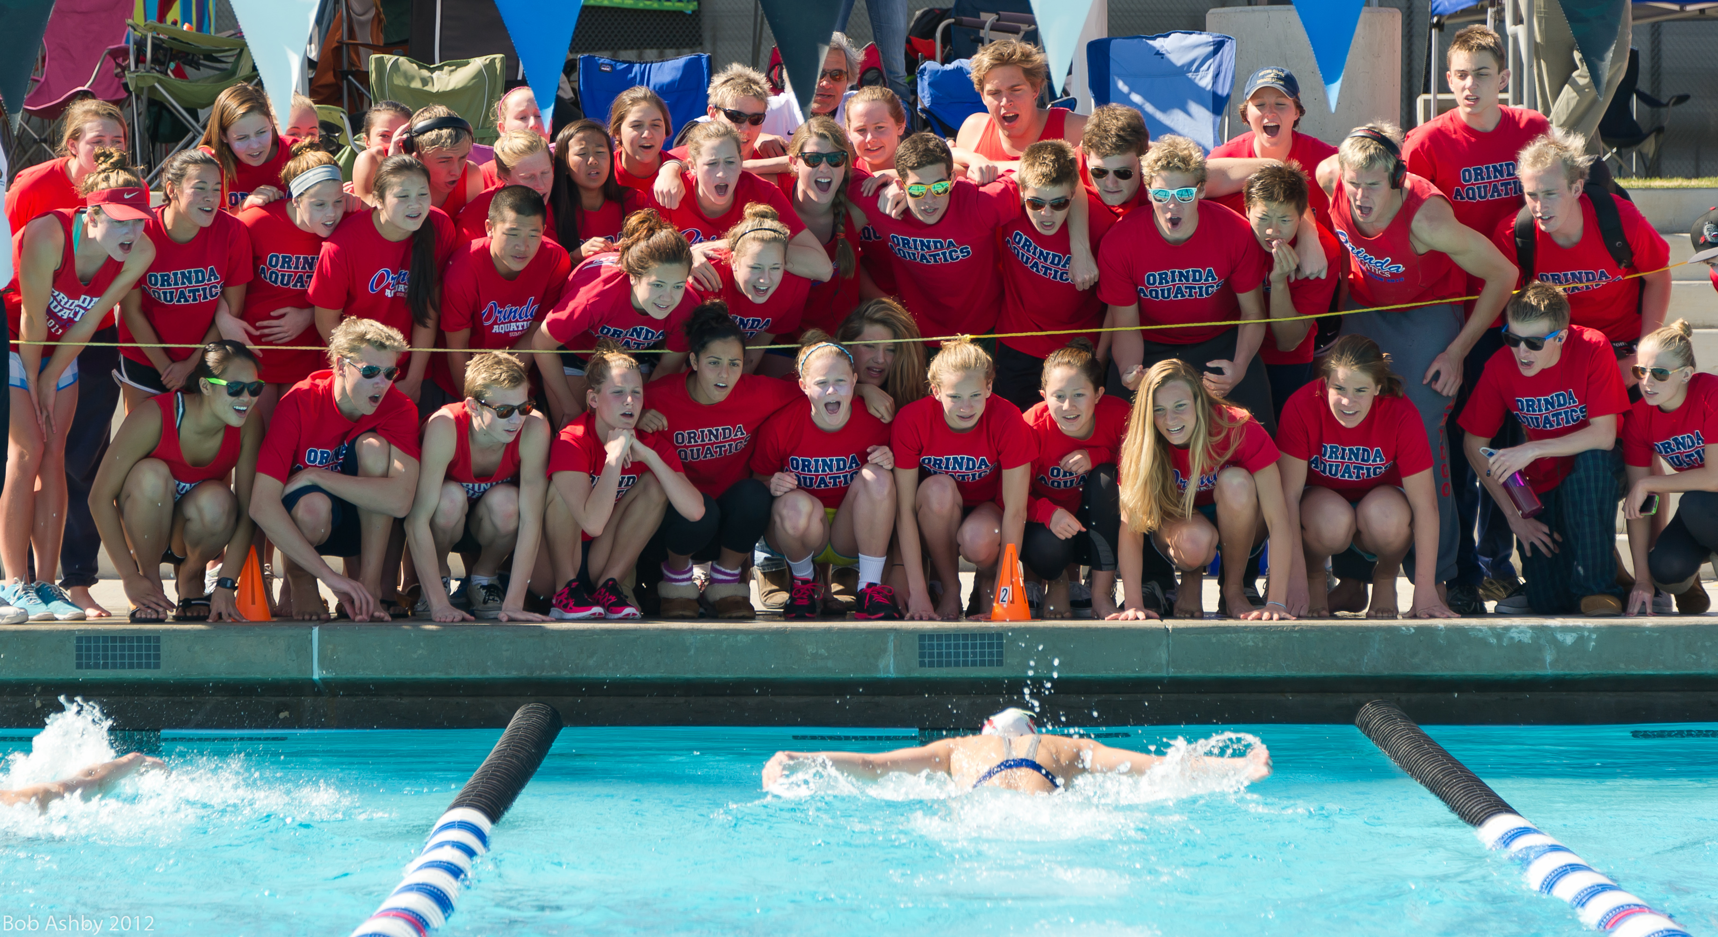
Orinda Aquatics
Parent Education Series #3
Putting Character First

Slide 2


Summary
A life’s work, and the most pressing issues facing children and society –
in 40 minutes

Slide 3
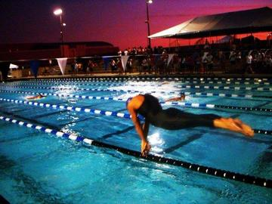
Overview
Philosophy/Rationale
Challenges
Lessons/Purpose
Process
Policy

Slide 4
“Integrity has no need of rules.” Albert Camus
Integrity-based vs. rules-based.

Slide 5
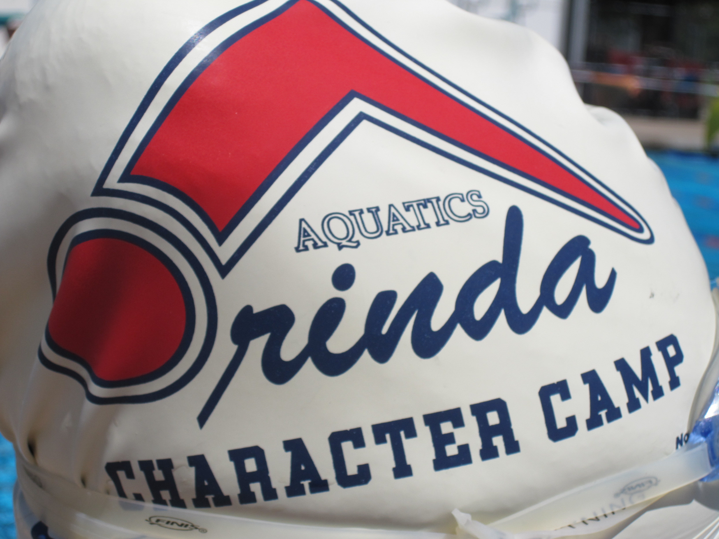
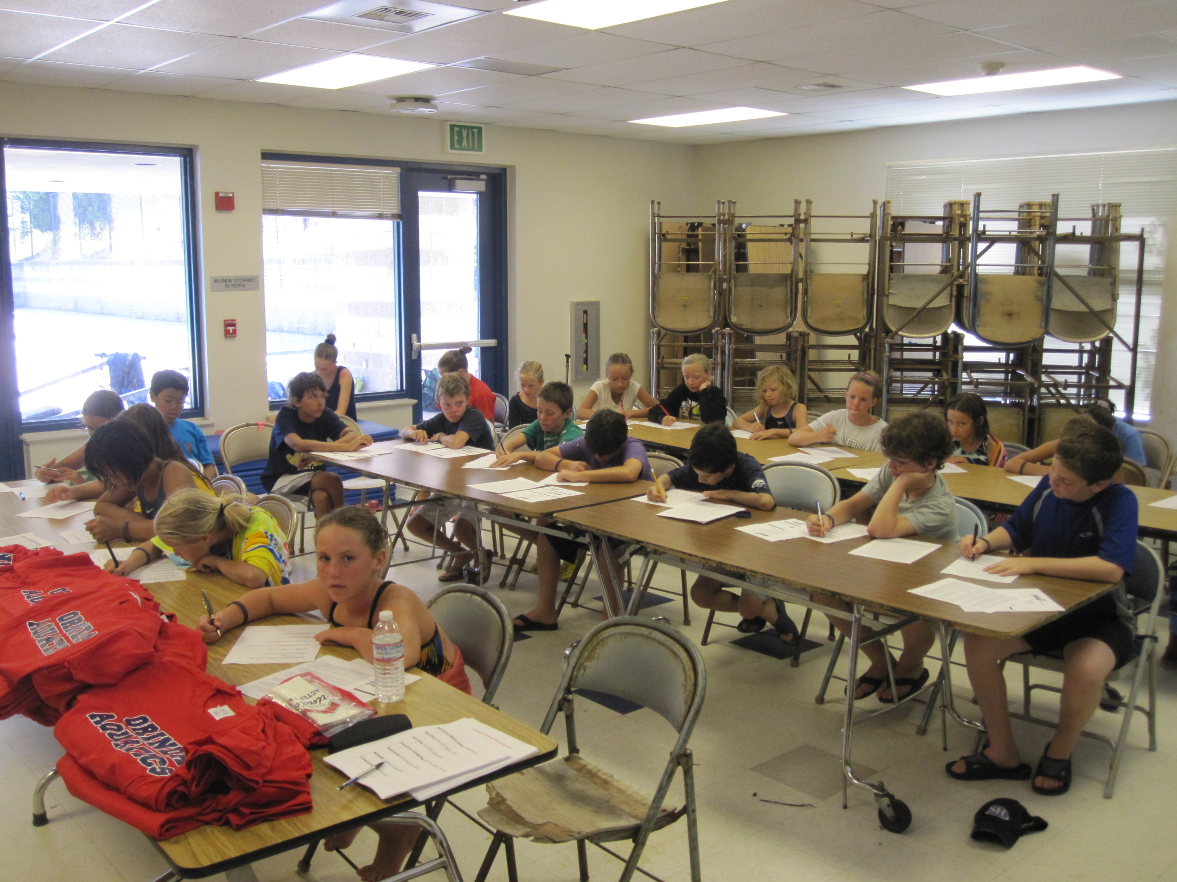
Background
Growing up
Exploring/near obsession
Life commitment to coach
Sports as life’s greatest learning ground
Life mission to work with youth in a moral/ethical backdrop
The art of teambuilding
Success at Pinole and Meadow in the 80’s and 90’s
Ran “Character Camp” for 10-14 year-olds in Lamorinda

Slide 6
For ASCA
A six hour “Life Skills” presentations
A 385-page guidebook on character in sports
Several articles on character development, culture, leadership, club development
Lectures at numerous World Clinics and internationally
Orinda Aquatics is widely, if not unanimously regarded as the model for character in swimming
Coaches come to visit Orinda Aquatics
Boards (of the largest clubs) reach out for guidance

Slide 7
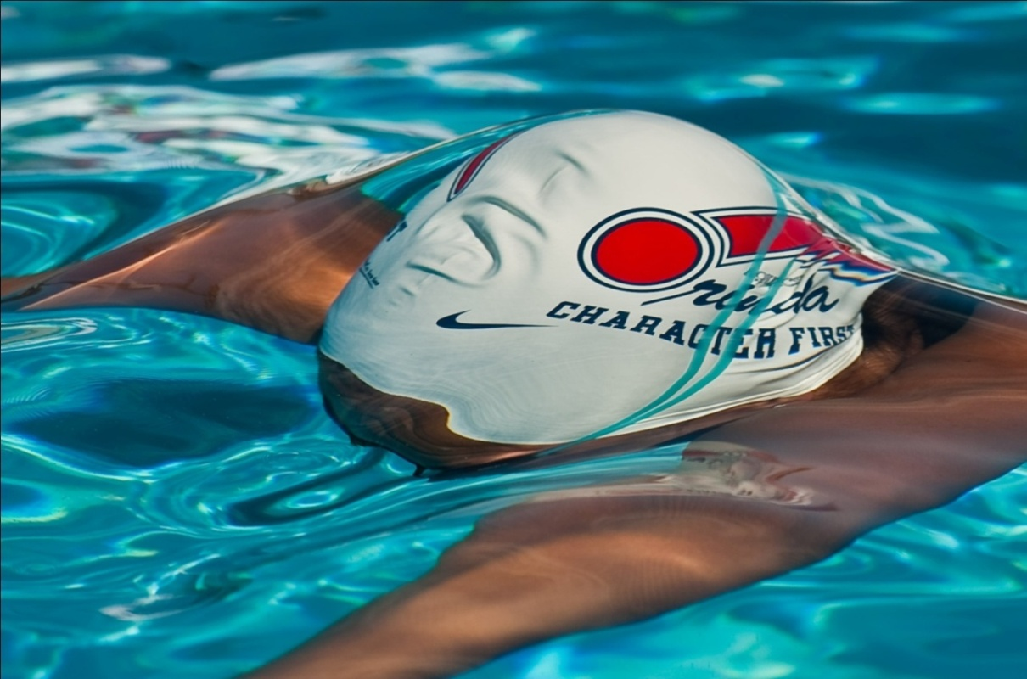


The American Swimming Coaches Association
Developing High-Character Athletes
and High-Character Teams
“Character is the basis of happiness and happiness the sanction of character.” Santayana
Don & Ron Heidary
Orinda Aquatics
Donated to ASCA
Purchased/utilized by many coaches at all levels

Slide 8

The American Swimming Coaches Association
World Clinic, Cleveland, Ohio 2015
The Cultural Headwind
“Stay ahead of the culture by creating the culture.” unknown
Don Heidary
Orinda Aquatics

Slide 9
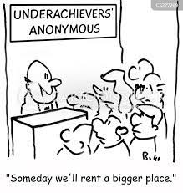
Introduction
The vast majority of teams and athletes underperform (and under experience).

Slide 10
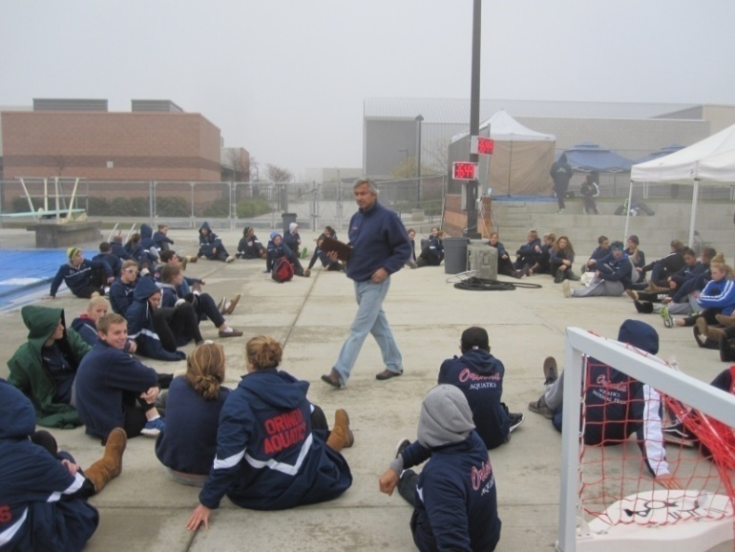
Where does character fit into coaching?
You don’t get paid for it.
You don’t get (professionally) recognized for it.
You will get push-back early in the process from parents and the “ruling class.”
The time you commit to it will cut into pure coaching.
For the most part, colleges don’t recruit character.
So who really cares, and at what level does it really make a difference?

Slide 11
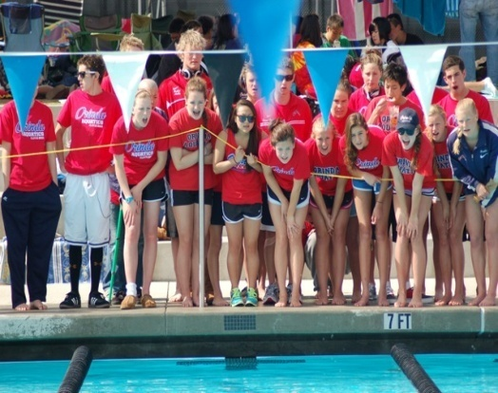
And the real benefit may very well be in the unseen…
Self-esteem
Self-awareness
Accountability
Connectedness
Improved academics
Saying no to a drug, alcohol, or sex introduction
Choosing role models over social models
A better/healthier family life
A more productive college experience
Being a better employee
Dealing with a life crisis
Becoming a true leader
Making a difference in the lives of others
And quite possibly in becoming a better swimmer and teammate.
And mitigates burnout

Slide 12
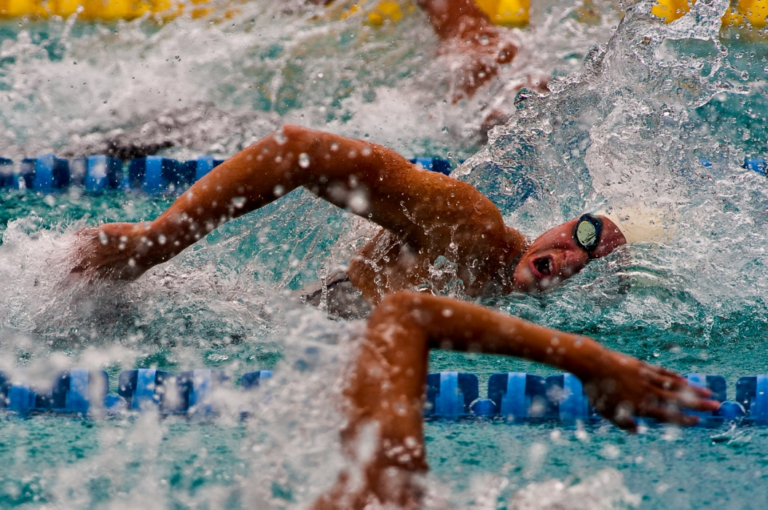
Developing Leaders
In sports and in society
50 collegiate team captains

Slide 13

Empowering Cultures
“To say that your fate is not tied to my fate is like saying your end of the boat is sinking.” Hugh Downs

Slide 14

Anchor
Culture must be an anchor in the organization
A blanket wrapped around the team
NOT driven by the “social elite” or …

Slide 15


The Standard Model
Integrity and sportsmanship mentioned in Mission Statement
Coaches may talk about it at a higher level
It is generally absent in the daily process
Coaches (and boards) end up putting out fires of poor behavior, giving up, or looking the other way
No “lines in the sand”, or coaches are complicit

Slide 16
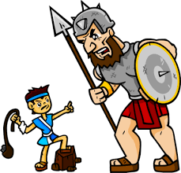
A Character Culture vs. Society
Trying to offer an alternative to the teen social norms

Slide 17
Challenge the (societal) Status Quo
Key to understand…
Where in our culture do we celebrate character and humility? We would argue that society is anything but character based.
How does one become humble, self-confident, positive, and selfless when marketing tells us that we are not good enough and society tells us success is the only measure of achievement? It is either self-doubt (marketing) or EGO (winning to be fulfilled), and neither support a healthy athlete or team.
Why are so many teens depressed? Were they at 6, 8, or 10?

Slide 18
Teachers and coaches are “noble”, but…
Pro athletes are idolized (with so many ego- driven, materialistic, and poor role models)
Wall Street executives are envied for their money, power, etc. (not ethics)
Celebrities are worshipped for their popularity and lifestyle (how many are really happy?)
Why are there so many character breakdowns in politics, business, etc?
How many teen magazines are character, or service based vs. fashion, or appearance based?
How many character-based video games would sell?
How many kids get into a great college because of character, compassion, or leadership?

Slide 19
How many TV Shows are character-based vs. attitude, materialism, sex, promiscuity, language, alcohol, appearance, etc.
And with Reality TV, it is conflict that sells
“the EDGIER THE BETTER” says a popular TV network when they orchestrated 57 “F bombs” during a prime time awards show. The goal, “bring in the younger viewers”.
Even music (the language and the message) “explicit” vs. “clean” purchased at10-1 (if that!)
Musicians as role models?
  One was asked to pull his saggy pants up prior to boarding a plane, His response, “F - that”.
Pro Athlete – “grows up” (at age 28). One of the greatest football players admits that he “had it all wrong”, that after spending his career focusing on himself, he now realizes it is about the team. This could have happened when he was 10!

Slide 20
Questions Quintessential
Why can’t the most successful people be the most humble, and appreciative?
Why can’t athletes instinctively put the team first and look to ensure the success of others even ahead of their own?
Why can’t kids welcome and embrace every challenge?
Why can’t kids’ best friends be their parents?
And, why can’t a child dream of being a leader as well as an Olympian?

Slide 21
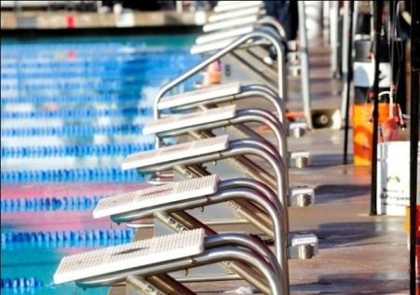
In an age where media and celebrity seem to create more false identities than products or music, we ask them to not follow the masses or the trends; but their heart and their conscience. DR

Slide 22
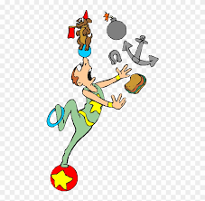
(Concurrent) Challenges
Drugs
Alcohol
Vaping
Bullying
Cheating
Lying
Language
Social Media
Peer Pressure
Self worth/Sense of self
Apathy
Work ethic

Slide 23


What the Heck is Water?
“Two young fish swam by an older fish. As the older fish passed, he said, “Hey boys, how’s the water?” One of the younger fish looked at the other and said, “what the heck is water?” David Foster Wallace, This is Water
Do most kids even know what their culture is and what it represents? Or when they’re hooked?

Slide 24
“Prepare the child
for the path,
not the path
for the child.”
Unknown

Slide 25

“The world is a dangerous place, not because of those who do evil, but because of those who look on and do nothing.
Albert Einstein

Slide 26
The Culture of Cultures - we must:
Understand why cultures exist
Understand what they are
Understand their affect
Redefine them in terms of what is:
  Right for humanity
  Right for athletics
Sell the benefits
Implement them
Change the paradigm
Change the world
Give kids and athletes back to themselves

Slide 27
A Change in Culture, A Change in Life
(from a 17-year-old girl who changed teams and cultures)
“I think about where I would be had I not changed teams, and honestly its scary. I was becoming a person I did not want to be. I have learned what is truly important in life, and I am not sure when or if I would have figured it out. I never realized what it was like to be around negative people because that type of person was always me. Additionally, I dreaded swimming and now I love it again and it has been a rebirth.”

Slide 28
The team culture sways a social lifestyle
Dear Orinda Aquatics,
I can only imagine where I would be today, right now, if I had never joined Orinda Aquatics back in seventh grade. I see myself spending this Saturday night in my parentless house with a dozen members of my high school’s top partiers, already a few drinks deep in my parent’s liquor, behaving like a sloppy mess. I see myself dancing with boys I don’t even like, breaking my mom’s glass top coffee table, and getting into a car with a girl who swears she’s safe to drive but clearly isn’t. And I wouldn’t even care. It would just be another typical Saturday night. Instead, I’m here sitting on my couch writing a letter to the team that changed the entire course of my life, the team that I owe everything to.
In middle school, I found myself, like so many others do, at a crossroads of sorts. The girls I considered my best friends were making choices that made me uncomfortable on all kinds of levels, but I could still feel myself slipping down with them. Looking back, I can see just how far I was about to fall.

Slide 29
Olympic “Toxic Environment”
Their London Olympics swimming team was beset by “culturally toxic incidents” including misuse of prescription drugs and bullying that highlighted a failure of culture and leadership, a report said. A culture existed within the team which “did not appear to assist or support high-level performance for most people.”
“There were enough culturally toxic incidents across enough team members that breached agreements (such as getting drunk, misuse of prescription drugs, breaching curfews, deceit, bullying) to warrant a strong, collective leadership response that included coaches, staff and the swimmers,” the report said. “No such collective action was taken.”
The review recommended creating an ethical framework of what the (Olympic) team stands for, updating internal codes of conduct and implementing better processes for managing issues around standards and expectations.
“It has been a time of reflection and review and a time to be honest and open about how we can take the right steps towards future success. Before we look at winning gold medals, we want to win back the admiration of the nation.”
Disciplinary issues affected the team’s unity in London and some swimmers were pursuing their own goals rather than those of the squad, the news paper reported, and that some swimmers behaved more like schoolboys than Olympians at a pre-games camp. (no team concept)
“Poor behavior and disrespect within the team were not regulated or resisted strongly by other team members, and it was left unchecked or without consequence by staff and coaches on a number of occasions,” the Review said. (no leadership)
This is not an “Olympic” issue. It is a club issue, an age-group issue, a high school issue, and a societal issue.

Slide 30

Developing athletes against a societal backdrop that challenges the very core of our sport…

Slide 31

and the essence of human development

Slide 32
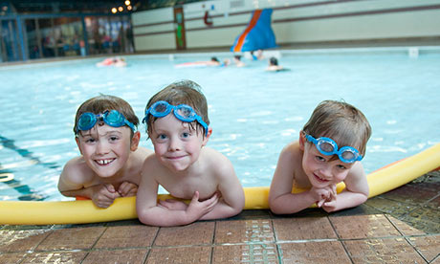
How do you get from this, to...
Culture creators?

Slide 33
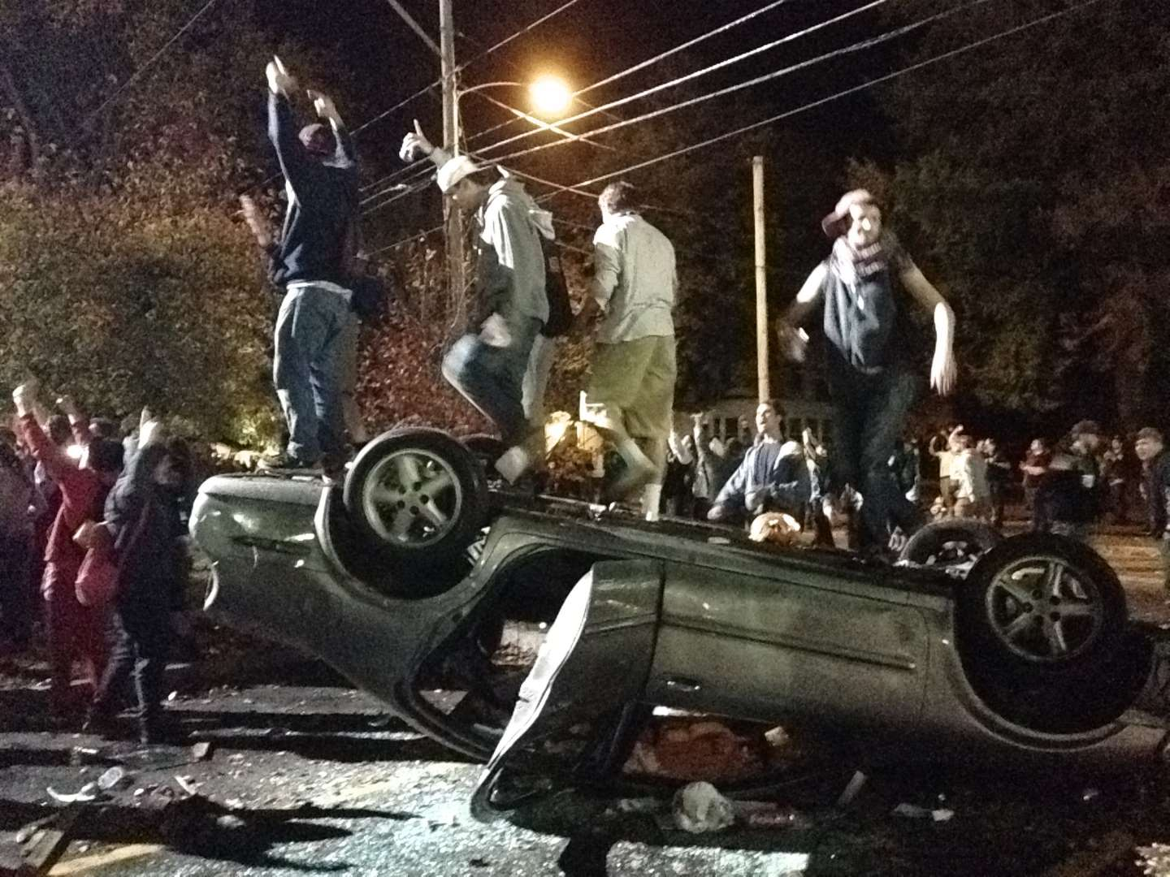
Giant youth party, fueled by alcohol and the internet, turns violent and abusive.
“Mob Scene at High School – 500 students participated in what was a mob scene with rampant alcohol abuse and hazing and bullying.
Two bus loads of students on a ski trip detained for massive drug and alcohol use/possession (parents defended).

Slide 34
Are we raising resumes or high-character individuals?
Two sides of the same coin
(
The resume of a high school athlete
3.8 GPA
Eagle Scout
School Officer
Popular
Volunteer
All-American athlete
Polite and respectful in public
The character of the same high school athlete
Heavy drug/alcohol use (and thinks it is OK) on campus/at competition (a “train wreck”)
Lies to parents, coaches
Cheats in school
Self-absorbed/self-destructive
Drove kids while under the influence
Losing identity/needs acceptance

Slide 35

Who can/will draw a line in the sand?
“98% of teenagers lie to their parents.” … why?

Slide 36
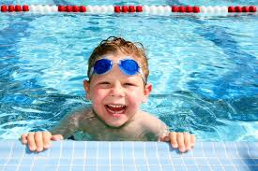
Cute kid
Who and what will he become?
      Bully?
      Into drugs/alcoholic?
      A discipline problem?
      Social elite?
      Apathetic/lazy – path of least resistance?
      A non-athlete?
      A great “athlete”?
      A great leader/a difference maker?
      A collegiate athlete?
      A collegiate leader?
      An inspiration?

Slide 37
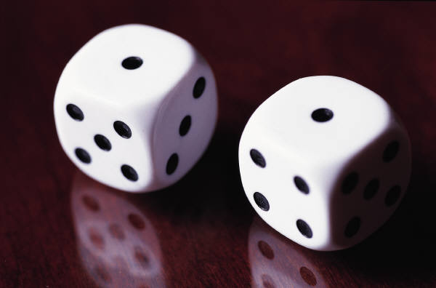
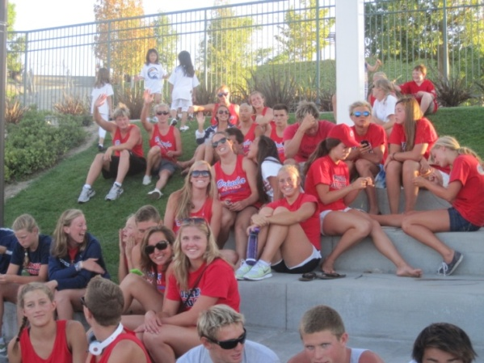
What will be the driving influence(s)?
  Luck
  Destiny
  Self-esteem
  Parents
  Siblings
  Social friends
  Community
  Teachers
  Teammates
  Coaches
  Team culture
High school meet example

Slide 38
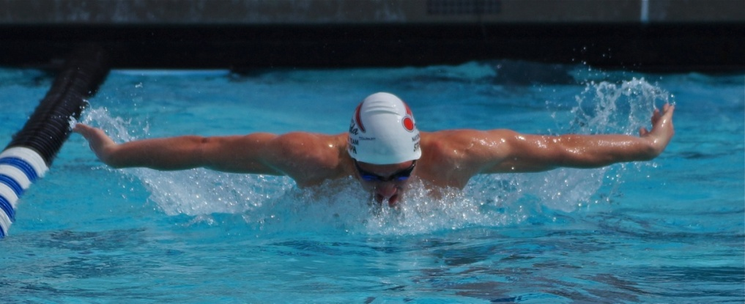
It would equate to:
The better the person
The better the athlete
The better the swimmer
The better the teammate
The better the culture
This formula is irrefutable.

Slide 39
An all-too-common story
(same person)
A Great swimmer
  Innately talented
An average athlete
  Poor attendance
  Poor work ethic
  Little focus
  Comes late
  Just cares about winning
A bad teammate
  Doesn't help
  Doesn’t cheer
  Doesn’t mentor or lead (in a positive direction)
  Doesn’t really care

Slide 40
Parent Survey? Do parents really care?
If you asked parents why their children are doing sports, or what they hope their children would get from it, how many would say…?
Work ethic
Humility
Perseverance
Sacrifice
Team (first) attitude
(the most important life virtues)

Slide 41

How Many Parents Even Know if Their Child.… (or want to know)
Really works hard?
Really cares?
Respects others?
Is at risk?
Has any leadership skills?
Deals with adversity?
We, as coaches, do. We quite possibly have the most critical information as to their child's overall well-being.

Slide 42


Vision
Create a vision of a high-character, positive group
Wind at back vs. wind at face

Slide 43
Vision – for athletes and leaders
“A rock pile ceases to be a rock pile the moment a single man contemplated it, bearing within him, the image of a cathedral.”
Antoine de Saint-Exupery

Slide 44

Perpetual Leadership Model
Seniors driven to lead
Integrity, humility, work ethic
Junior Swimmers eager to learn (and lead)

Slide 45
Areas of Focus/Demand
Integrity – do the right thing
Respect – NEVER lie
Attitude – Always positive
Work ethic – path of most resistance
Humility – NO EGO
Service – be a good teammate
Sell virtues as opposed to norms

Slide 46

Implied Consent
There should be implied consent for any athlete, at any age, to:
  Be a good teammate
  To commit to the athletic process
This is where breakdown begins, only to accelerate.

Slide 47
Demonstrations of Integrity/Leadership
Self-run Workouts
Travel (75 teenagers – no chaperones)
an extremely

Slide 48
Discipline
NOT the moral police (and do not want to be)
We watch very closely
We take action if:
  it affects the team
  the child is at risk

Slide 49


Reciprocal Relationship
A two-way street – the basis of our relationship
They give everything – We give everything
Voicemail from Kevin Honey last week: “What you do is different because you ask kids to sign a 3–4-year commitment (agreement/contract) and you sign a life commitment (agreement/contract)

Slide 50
Senior Group
Weekly Meetings – articles, letters, discussion
Aggressive discussion about hard teen issues
Quotes on workouts
Examples of inspiration, leadership, challenging the social status quo
Coach vigilance (watching in all areas)

Slide 51
Junior Group
Promotion of the bigger concept of “future leader” (learn it now) and avoiding teen traps and pitfalls (discussed)
Make clear that you cannot be on the team if you are not a good teammate
Weekly Meetings – articles, letters, discussion
Quotes on workouts
Examples of inspiration, leadership, challenging the social status quo in middle school)
Coach vigilance (watching in all areas)

Slide 52
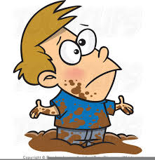
Challenges
Kids – being accountable (and honest)
Parents – defending kids to any extreme
For other teams - Boards (fire coaches)
“If you step in a puddle, don’t blame the puddle.”

Slide 53

Questions?
Thank you for attending.

