Slide 1
Lassiter Swim and Dive
2021-22
End of season banquet
2/16/2022

Slide 2
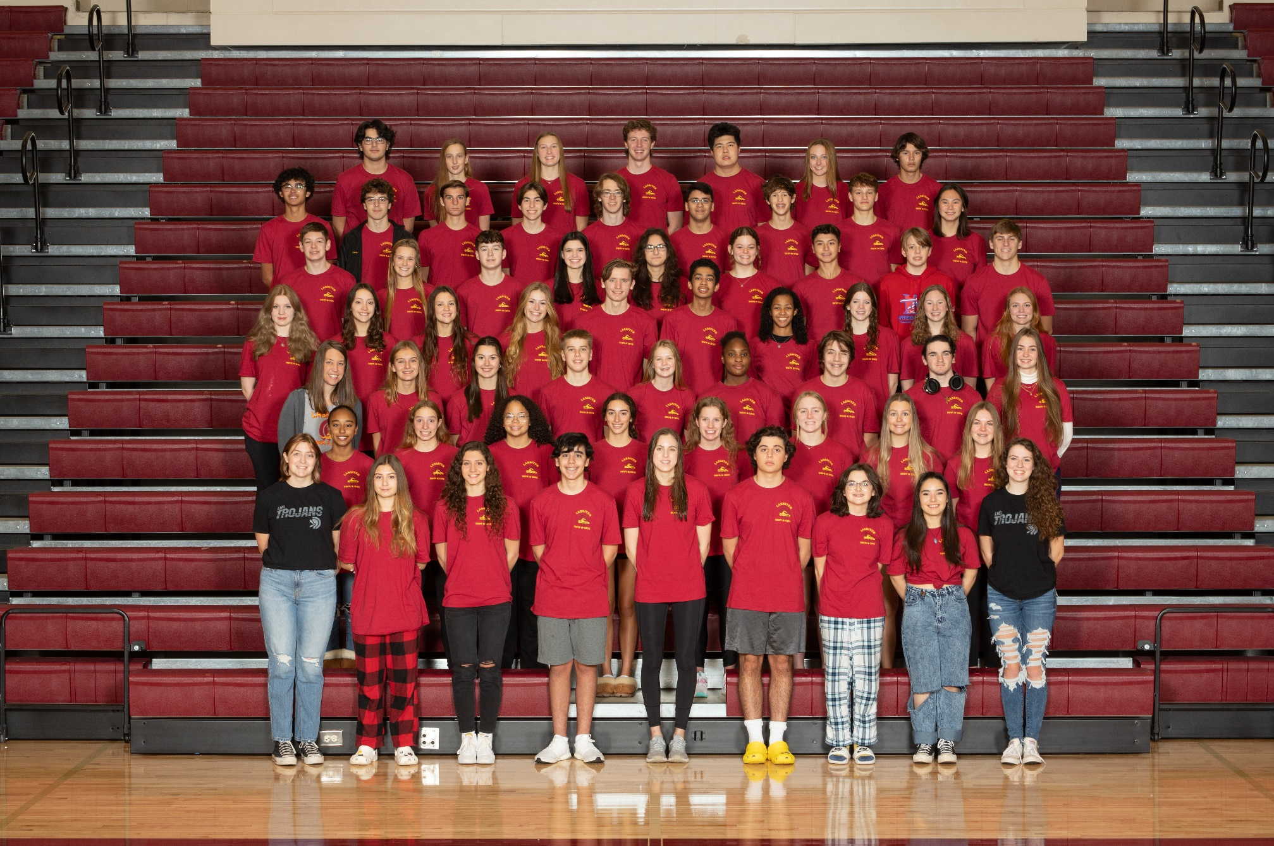
GO TROJANS

Slide 3
Lassiter Invite Duck Raffle
FOCUS has been providing the FAST Fins Adaptive Swim Team since January of 2009. Every season we serve around 80 children and teens with special needs and their siblings by giving them the opportunity to be part of a team experience. FAST Fins provides eight separate practices across metro Atlanta supervised by physical and occupational therapists, recreation instructors, and experienced volunteers who provide a welcoming and supportive environment for swimmers to grow in their abilities. Swimmers practice for months in the spring and fall seasons leading up to the biannual intra-squad meet that brings all of our separate practices together to compete and celebrate their accomplishments. FAST Fins is always evolving to better serve our swimmers’ needs and FOCUS is constantly striving to provide the best programs for its families. We hope to keep swimming for years to come.

Slide 4
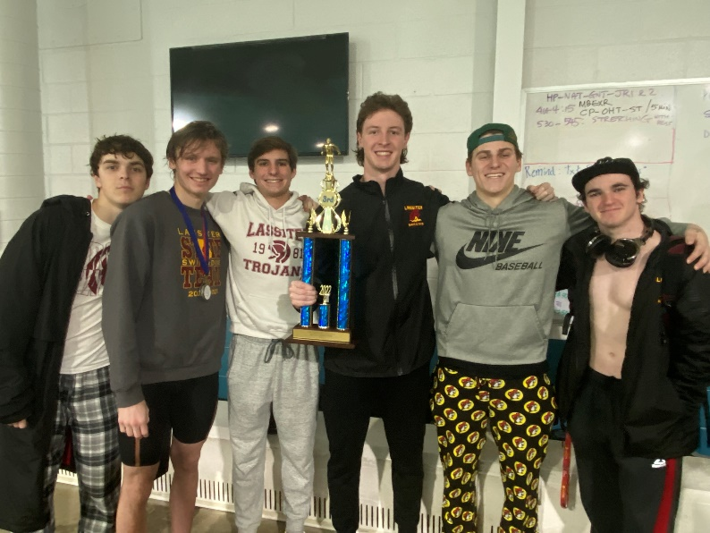
2021-22 Accomplishments
Boys
3rd Place Cobb County Championship
10th Place GHSA 6A State Championship
Girls
2nd Place Cobb County Championship
1st Place GHSA 6A State Championship!!!

Slide 5
2021-22 VARSITY COUNTY TOP 10: BOYS
Keifer Duong (10th 100 Breast)
Elliot Elmore (7th 100 Fly, 1st 100 Breast)
Adam O’Brien (1st 100 Fly, 3rd 100 Back)
Parker Tanke (7th 200 IM, 6th 100 Back)
Aidan O’Brien (10th 100 Fly)

Slide 6
2021-22 VARSITY COUNTY TOP 10: GIRLS
Allison Brown (4th 200 Free, 2nd 500 Free)
Francie Carson (2nd 200 Free, 3rd 100 Free)
Finnly Jollands (10th 200 IM, 3rd 100 Back)
GiannaMarie Conti (6th 200 IM, 9th 100 Breast)
Kate Bradley (4th 100 Fly, 5th 100 Back)
Rose Jones (5th 100 Free, 8th 100 Breast)

Slide 7
2021-22 VARSITY COUNTY TOP 10: GIRLS CONTINUED
Maggie O’Shaughnessy (5th 200 IM, 3rd 100 Breast)
Sophia Parker (4th 50 Free, 2nd 100 Fly)
Gavin Suchan (9th 500 Free)
Morgan Shaw (9th 100 Fly)
Bridget O’Shaughnessy (5th 200 Free, 3rd 500 Free)
Elizabeth Tilt (1st 200 IM, 1st 100 Fly)

Slide 8
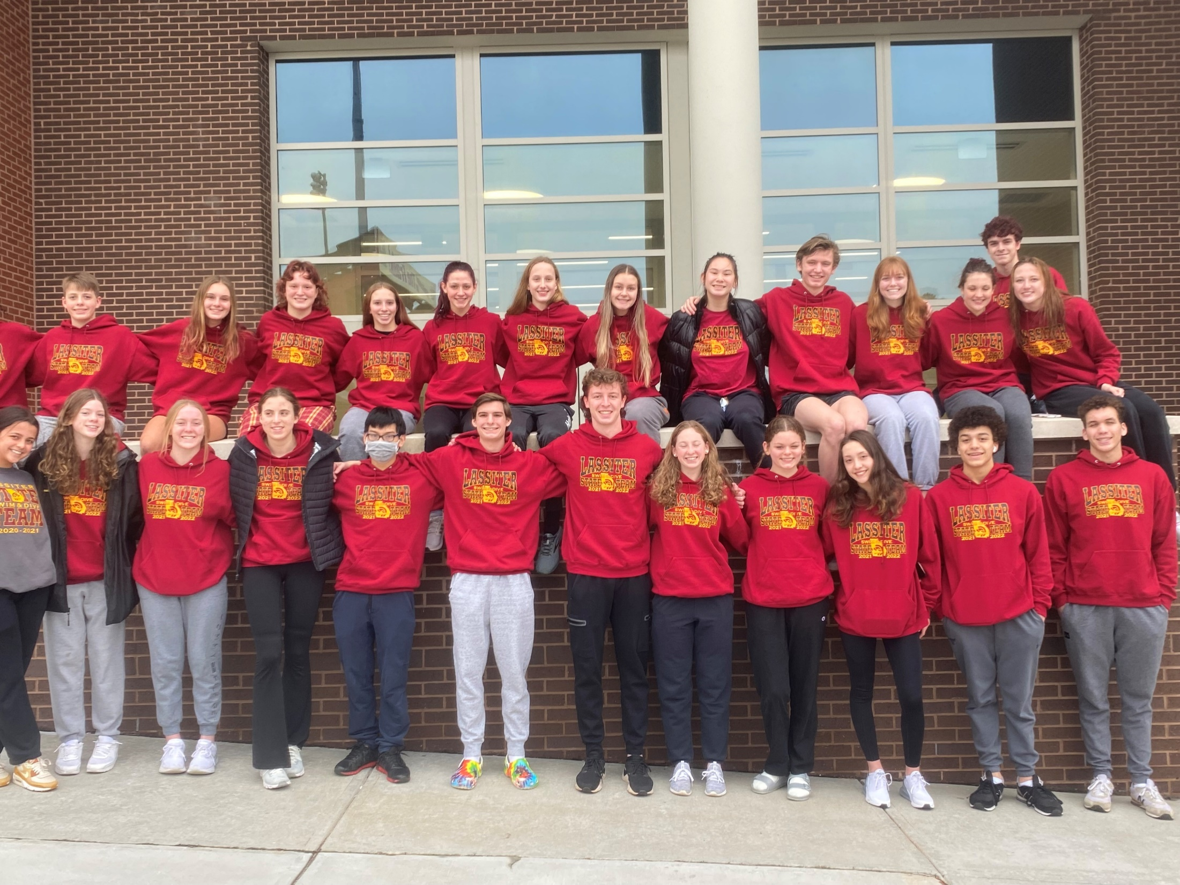
2021-22 State Team
Elizabeth Blanco
Kate Bradley
Allison Brown
Francie Carson
Gianna Conti
Keifer Duong
Elliot Elmore
Jason Franklin
Cosy Gale
Finnly Jollands
Rose Jones
Caroline Lee
Kate Lindsley
Carter Loftin
Cody Miles
Grace Moor
Adam O’Brien
Aidan O’Brien
Bridget O’Shaughnessy
Maggie O’Shaughnessy
Sophia Parker
Olivia Peters
Abby Peyton
Andrew Pokorny
Morgan Shaw
Parker Tanke
Elizabeth Tilt

Slide 9
2020-21 GHSA 6A State Championship Top 20: Boys
Elliot Elmore (9th 50 Free, 12th 100 Breast)
Carter Loftin (1st Diving)
Parker Tanke (8th 200 IM, 13th 100 Back)

Slide 10
2020-21 GHSA 6A State Championship Top 20: Girls
Kate Bradley (5th 100 Fly, 4th 100 Back)
Francie Carson (2nd 200 Free, 2nd 100 Free)
Maggie O’Shaughnessy (6th 200 IM, 2nd 100 Breast)
Allison Brown (3rd 200 Free, 2nd 500 Free)
Morgan Shaw (10th 50 Free, 8th 100 Fly
Bridget O’Shaughnessy (4th 200 Free, 3rd 500 Free)
GiannaMarie Conti (8th 200 IM)
Finnly Jollands (7th 50 Free, 2nd 100 Back)
Sophia Parker (12th 200 Free, 4th 100 Fly)
Cosy Gale (8th 100 Free)
Rose Jones (7th 100 Free, 7th 100 Breast)
Elizabeth Tilt (1st 200 IM, 1st 100 Fly)

Slide 11
State Relay Recognition
Boys 200 Medley Relay- 6th
Parker Tanke, Elliot Elmore, Adam O’Brien, Jason Franklin
Girls 200 Medley Relay- 1st
Elizabeth Tilt, Maggie O’Shaughnessy, Sophia Parker, Francie Carson
Girls 200 Freestyle Relay- 1st
Kate Bradley, Finnly Jollands, Sophia Parker, Allison Brown
Girls 400 Freestyle Relay- 1st
Allison Brown, Bridget O’Shaughnessy, Francie Carson, Elizabeth Tilt
Boys 400 Freestyle Relay- 9th^{th}
Parker Tanke, Aiden O’Brien, Elliot Elmore, Adam O’Brien

Slide 12
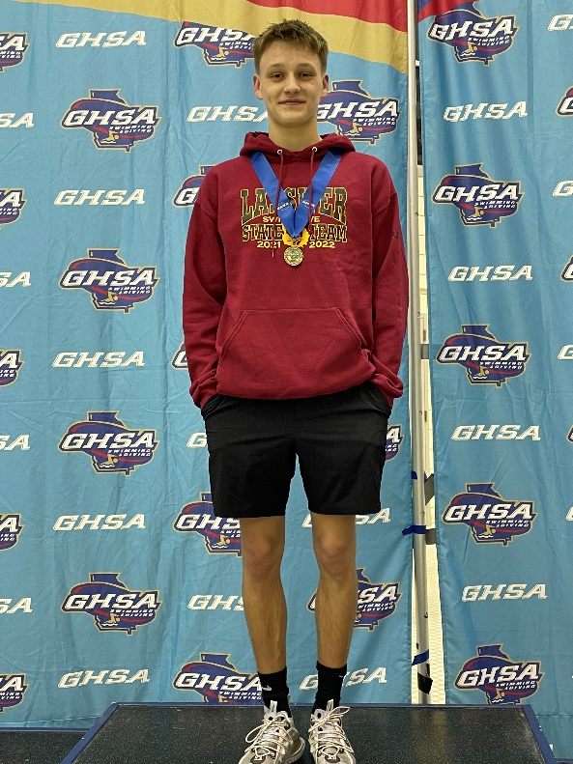
STATE CHAMPS!
Carter Loftin
Elizabeth TIlt
Dive
200 IM
100 Butterfly

Slide 13
All America Qualifiers and NFHS Honor Roll
Consideration
Francie Carson- 200 Free, State Prelims, 1:49.55
Carter Loftin- 11 dives, Noah Smith Invitational, 495.75
Girls 200 Medley Relay- State Finals, 1:44.09
Elizabeth Tilt, Maggie O’Shaughnessy, Sophia Parker, Francie Carson
Girls 200 Free Relay- State Finals, 1:35.91
Kate Bradley, Finnly Jollands, Sophia Parker, Allison Brown
Automatic
Girls 400 Free Relay- State Finals, 3:27.06
Allison Brown, Bridget O’Shaughnessy, Francie Carson, Elizabeth Tilt
NFHS Honor Roll
Elizabeth Tilt- 200 IM, County Finals, 1:59.15
100 Fly, County Finals, 53.30

Slide 14
2021-22 New School Records: Individuals
Francie Carson
200 Freestyle, State Prelims, 1:49.55
Previous record from 2017
Carter Loftin
6 Dives, N Gwinnett Meet, 343.00
Previous record from last season
12 Dives, State Meet, 654.90
Previous record from last season
Elizabeth Tilt
200 IM, County Finals, 1:59.15
Previous record from last season
100 Fly, County Finals, 53.30
Previous record from last season

Slide 15
2021-22 New School Records: Relays
Girls 200 Medley Relay
State Finals, 1:44.09
Elizabeth Tilt, Maggie O’Shaughnessy, Sophia Parker, Francie Carson
Previous record from 2011
Girls 200 Freestyle Relay
State Finals, 1:35.91
Kate Bradley, Finnly Jollands, Sophia Parker, Allison Brown
Previous record from 2009
Girls 400 Freestyle Relay
State Finals, 3:27.06
Allison Brown, Bridget O’Shaughnessy, Francie Carson, Elizabeth Tilt
Previous record from 2011

Slide 16
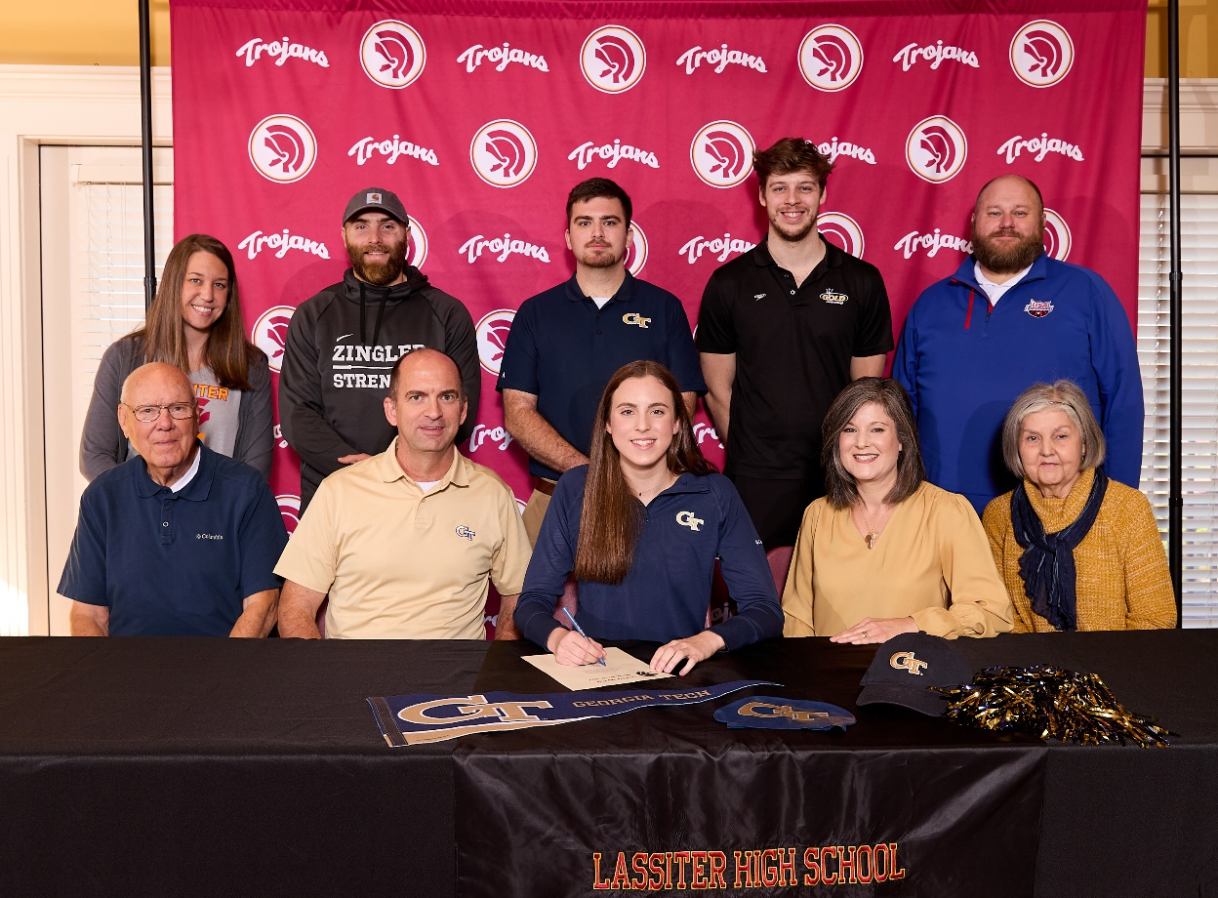
Class of 2022 Signees
Allison Brown
Georgia Institute of Technology

Slide 17
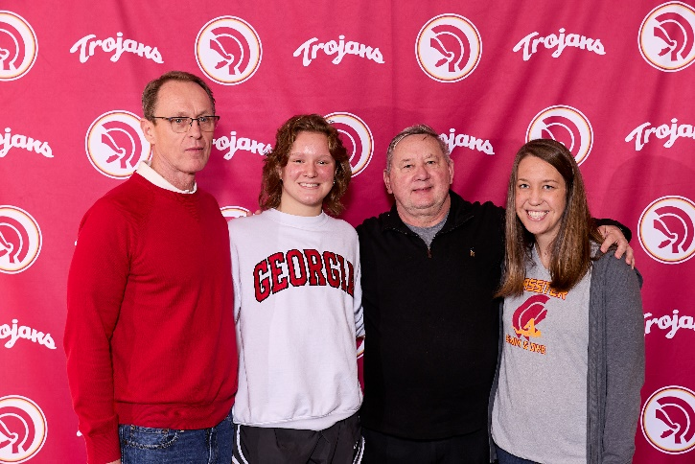
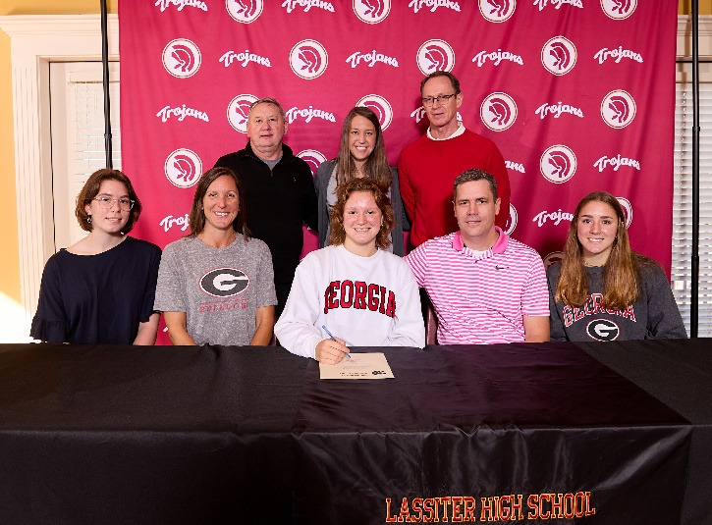
Class of 2022 Signees
Francie Carson
University of Georgia

Slide 18
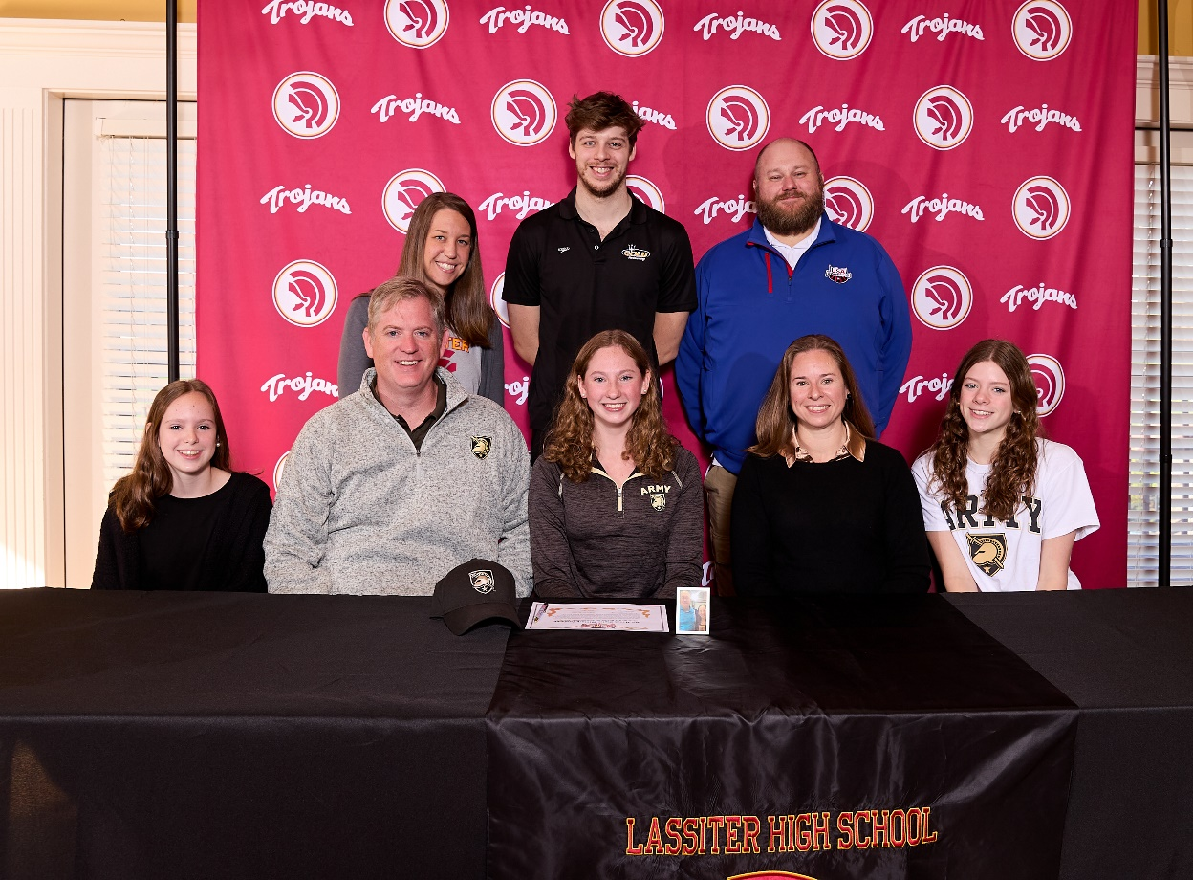
Class of 2022 Signees
Bridget O’Shaughnessy
United States Military Academy at West Point

Slide 19
Underclassmen
Letter and Certificate Presentation

Slide 20
Freshmen
Evelyn Barber
Kate Bradley
Mathias De Araujo
Elizabeth George
Eva Godinez
Oren Horak
Finnly Jollands
Rose Jones
Ryan Kotarba
Alexander Magdusian
Madison Maturine
Cody Miles
Annabeth Miller
Haiden Miller
Austin Moon
Maggie O’Shaughnessy
Marcelo Paez Benavides
Elijah Ronemous
Annabelle Simmons
Patrick Wilson

Slide 21
Sophomores
Mackenzie Bryant
Sophia Bucaj
Gianna Conti
Kate Duong
Elliot Elmore
Julian Farah
Cosy Gale
Tim Harrison
Daniel Horne
Kathryn Lindsley
Lindsey McCrea
Aidan O’Brien
Alex Presuel
Julia Randall

Slide 22
Juniors
Arsh Ali
Yan Babayeuski
Griffin Dilworth
Emily Freeland
Maddie Hobby
Nathan Judd
Caroline Lee
Jessica Lee
Carter Loftin
Nicolas Magdusian
Grace Moor
Sophia Parker
Olivia Peters
Maya Roberts
Morgan Shaw
Ella Sortino
Gavin Suchan
Parker Tanke
Elizabeth Tilt
Bridget Walsh

Slide 23
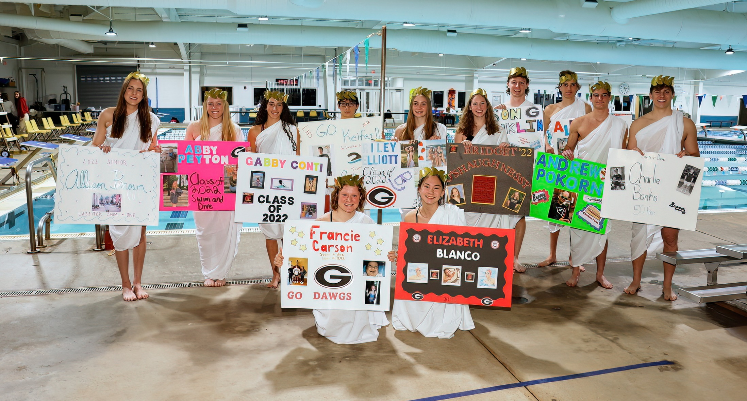
2021-2022 Senior Class

Slide 24
Seniors in the Classroom
Swimmers and Divers in the Class of 2022 have an average weighted GPA of 4.02!
Academic All Americans- Varsity Letter Recipient with a weighted GPA of 3.75 or higher
*CSCA Scholarship due Friday!
Charlie Banks
Elizabeth Blanco
Allison Brown
Francie Carson
Gabi Conti
Keifer Duong
Riley Elliot
Jason Franklin
Josh Howard
Bridget O’Shaughnessy
Adam O’Brien
Abby Peyton
Andrew Pokorny

Slide 25
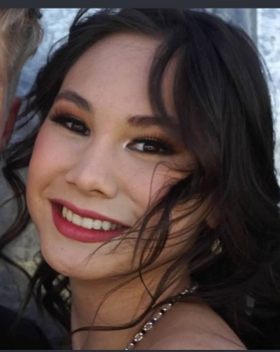
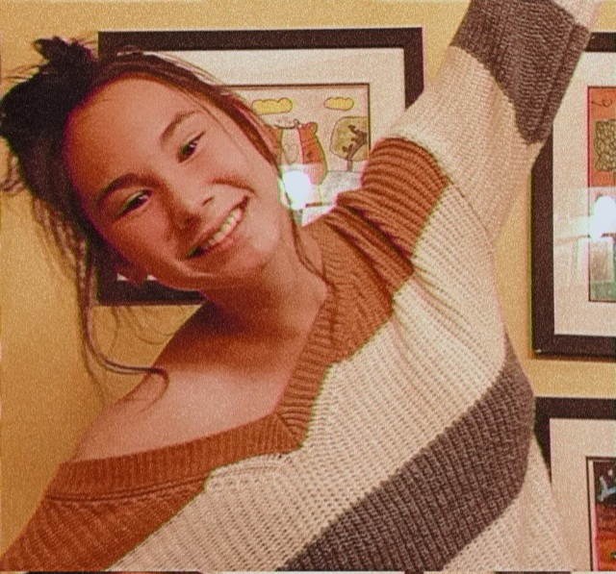
Elizabeth Blanco
4 year team member
Favorite Event: 100 Back and 200 Medley Relay
Favorite Memory: Praying around the ice bucket before relays
Plans to attend UGA and taking the career path of a nurse practitioner

Slide 26
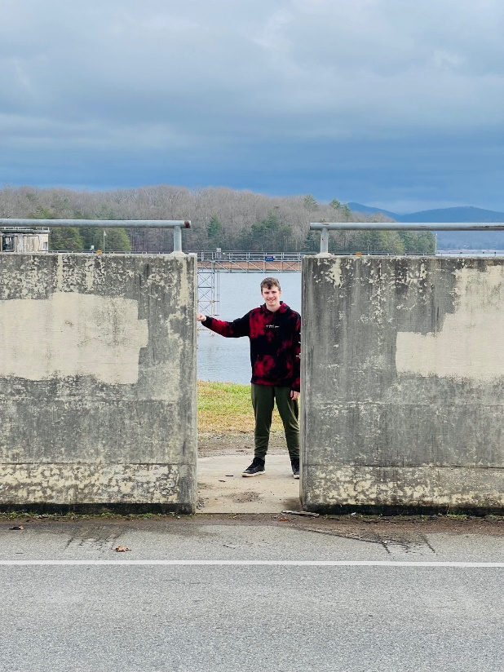
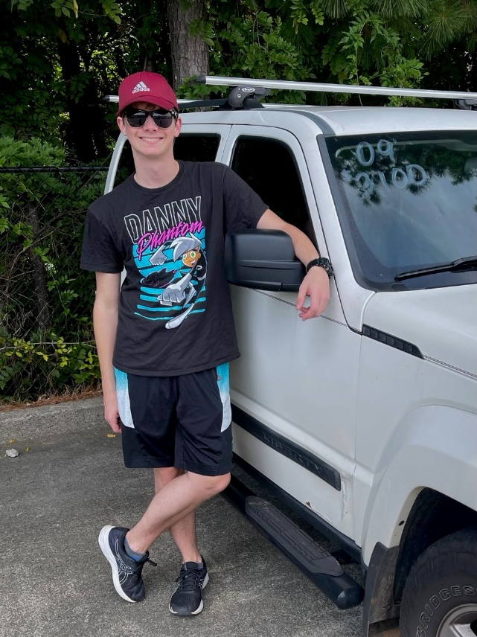
Seth Claycomb
3 year Team Member
Favorite Dive: Reverse
Favorite Memory: dive nicknames
Plans on going to college and becoming an engineer.

Slide 27
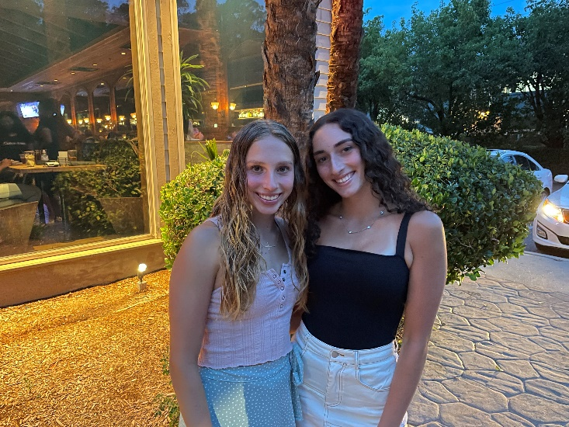
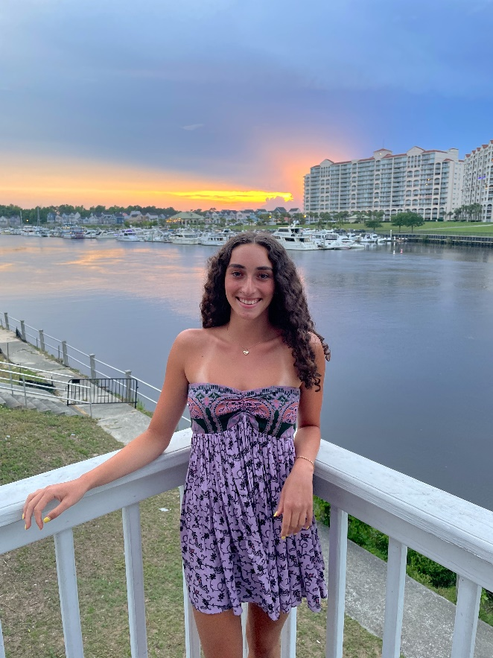
Gabi Conti
2 year team member
Favorite Event: 100 Breast
Favorite Memory: getting food after meetings
Unsure about college but wants to be an aerospace engineer

Slide 28
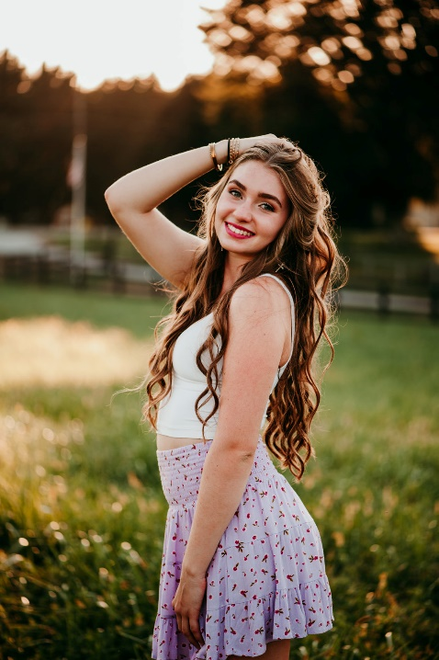
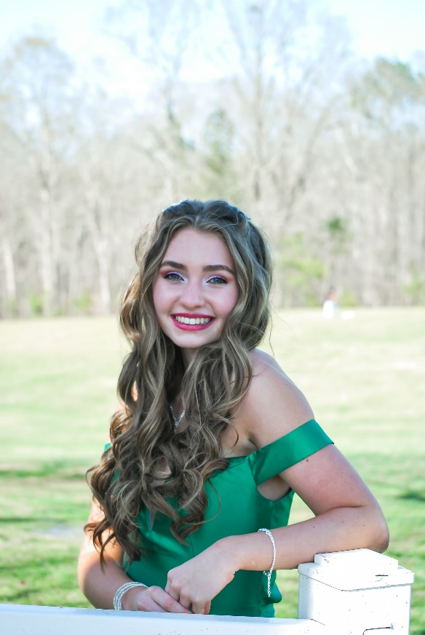
Riley Elliot
4 year team member
Favorite Event: 100 Back
Favorite Memory: Going out for food after meets
Plans on attending UGA and majoring in Biology on a pre-med track

Slide 29
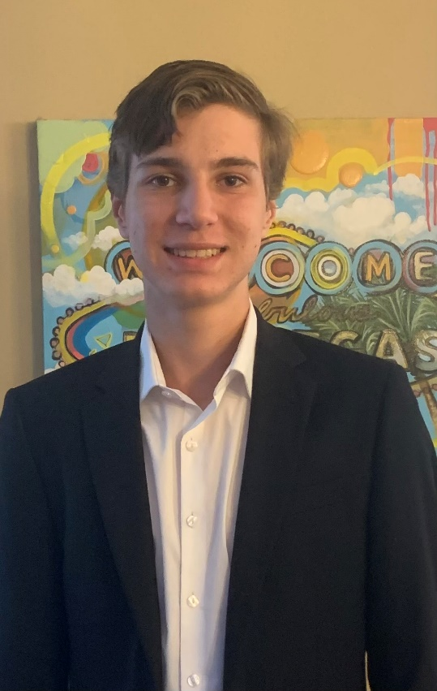
Alex Hill
3 year team member
Favorite Event: (Dive) Front Meets
Favorite Memory: Watching people flop in the water
Plans on attending college and studying forensics

Slide 30
Josh Howard
1 year team member
Favorite Event: 100 Breast
Favorite Memory: Competing against friends in races
Plans on attending KSU

Slide 31
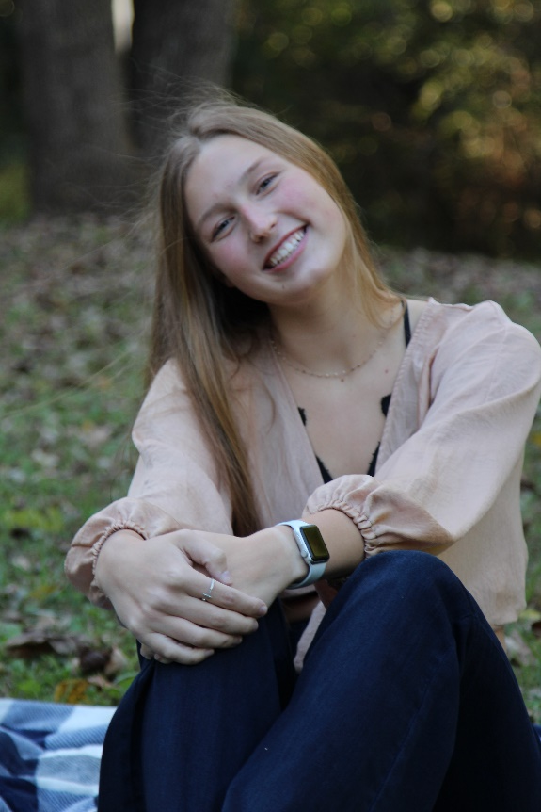
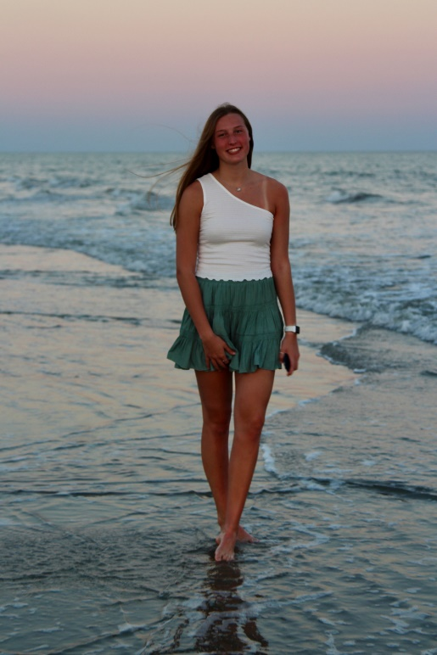
Kate Kudlac
1 year team member
Favorite Event: 100 Breast
Favorite Memory: Maddie’s honking cough at practice
Plans on playing Volleyball at Colorado School of the Mines and studying biomedical engineering

Slide 32
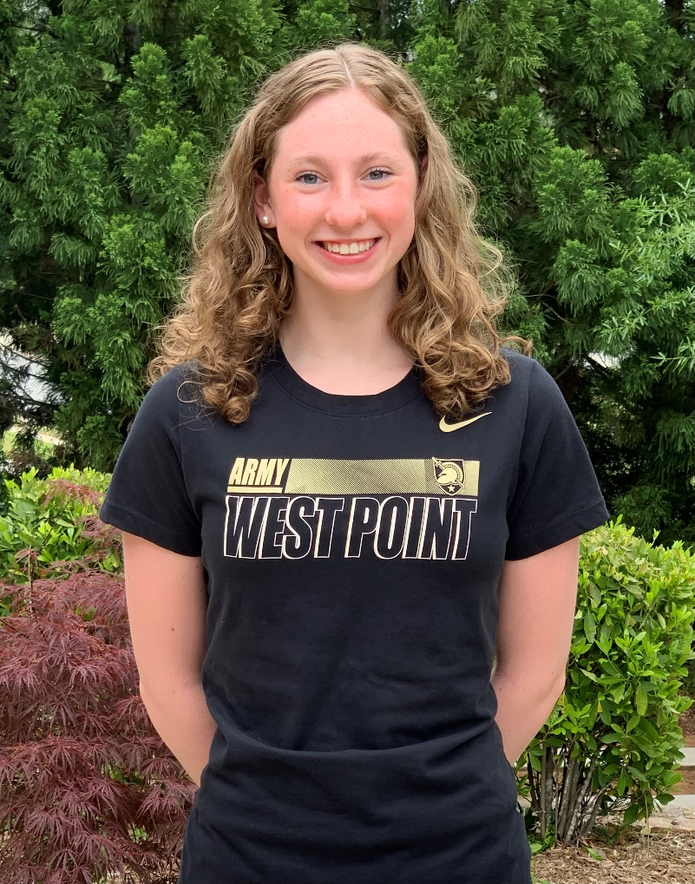
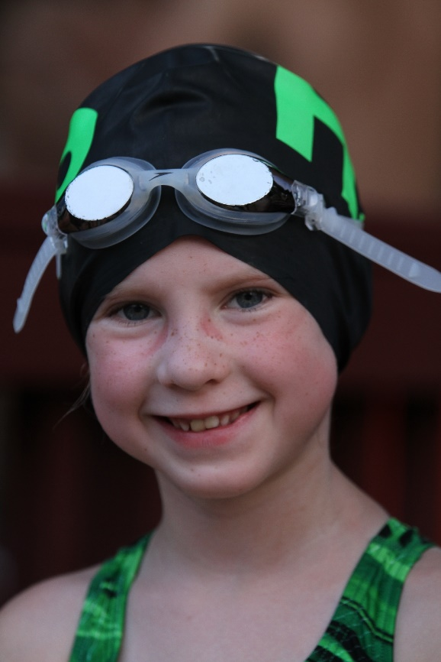
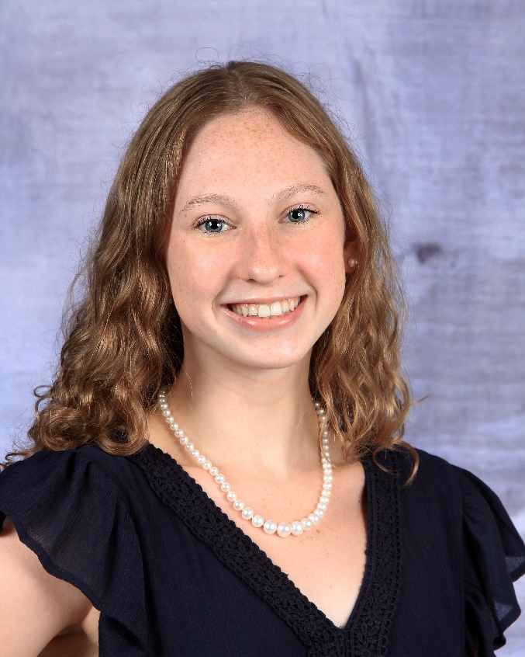
Bridget O’Shaughnessy
2 year team member
Favorite Event: 500 Freestyle
Favorite Memory: having had the incredible opportunity join such dedicated, talented, and supportive team, sitting in our freezing cars in the sketchy Chick-fil-a parking lot after Junior year county
Plans on swimming at The United States Military Academy at West Point; Major in Law and Legal Studies & Minor in Terrorism Studies

Slide 33
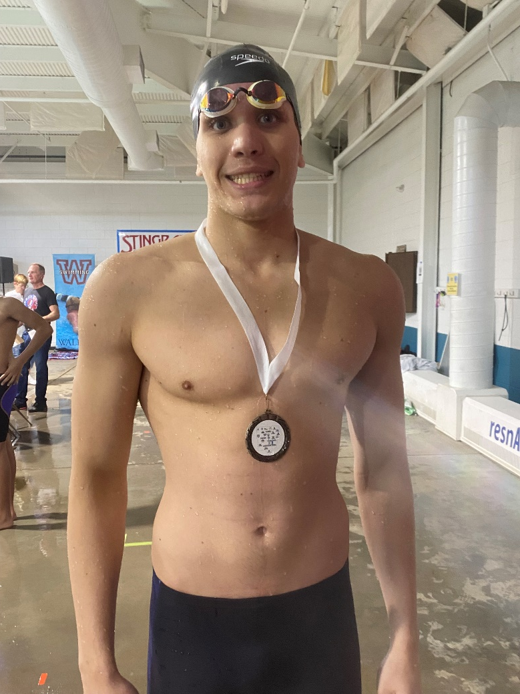
Adam O’Brien
3 year team member
Favorite Event: 100 Fly
Favorite Memory: Sophomore year county
Plans on swimming in college while majoring in mechanical engineering.

Slide 34
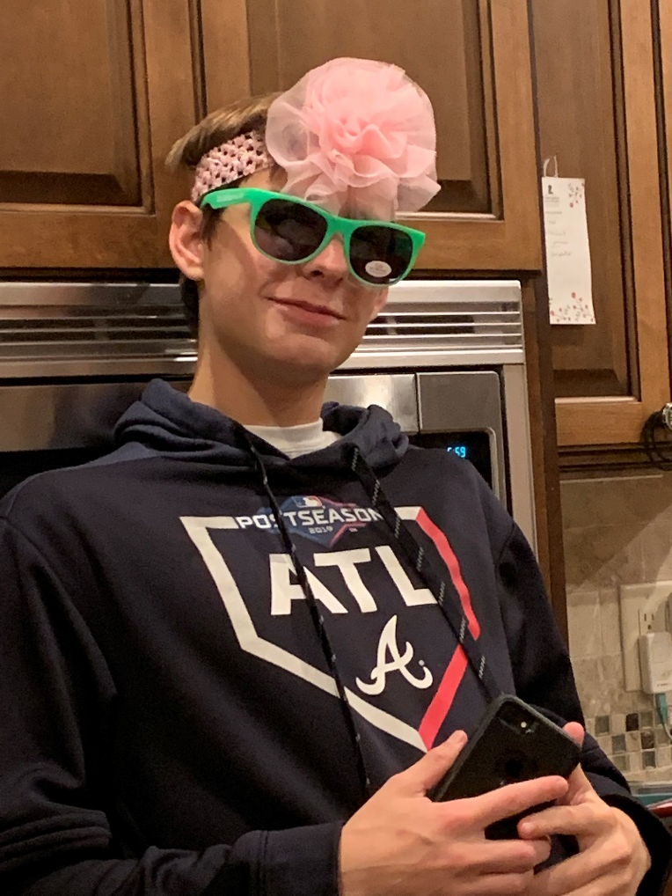
Andrew Pokorny
3 year team member
Favorite Event: 100 Back
Favorite Memory: making state for the first time
Unsure about college

Slide 35
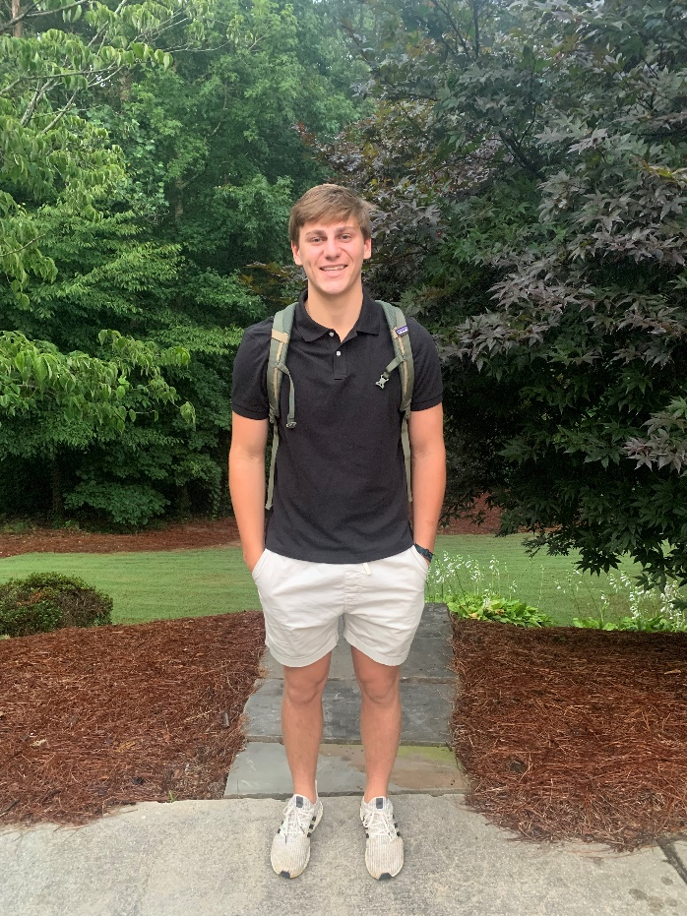
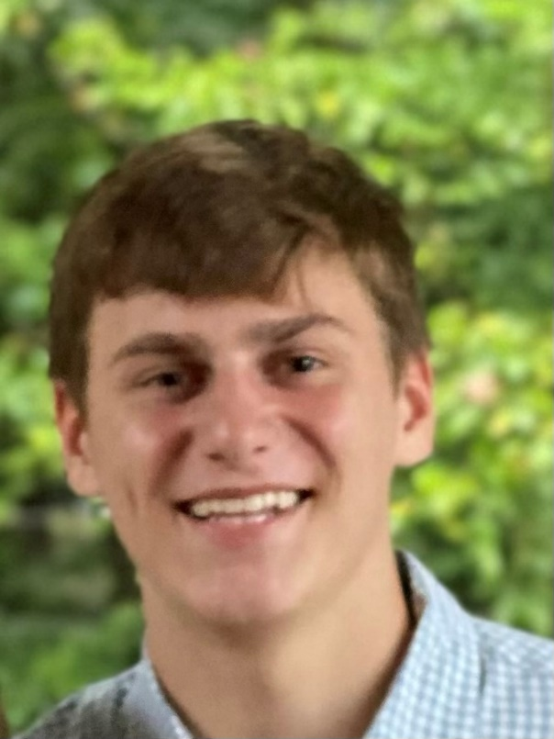
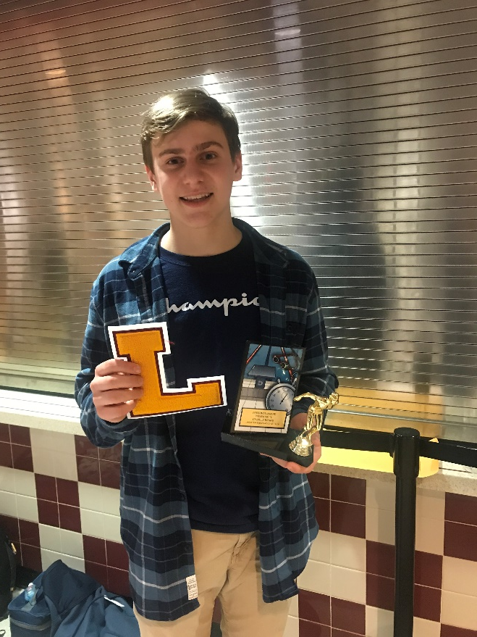
Charlie Banks
4 year team member
Team Captain
Favorite Event: 50 Free
Favorite Memory: winning the medley relay at county junior year
Plans to play baseball in college

Slide 36
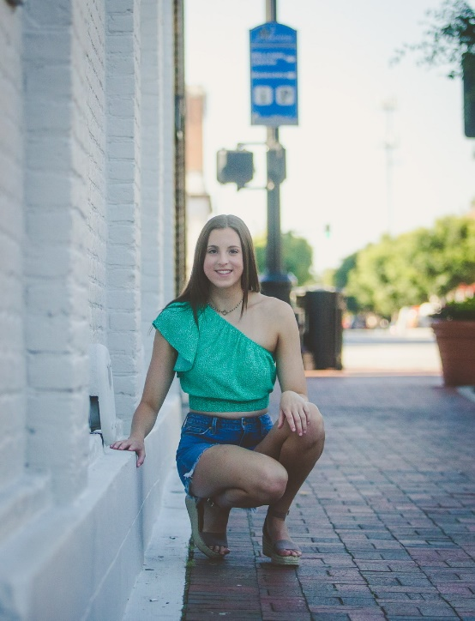
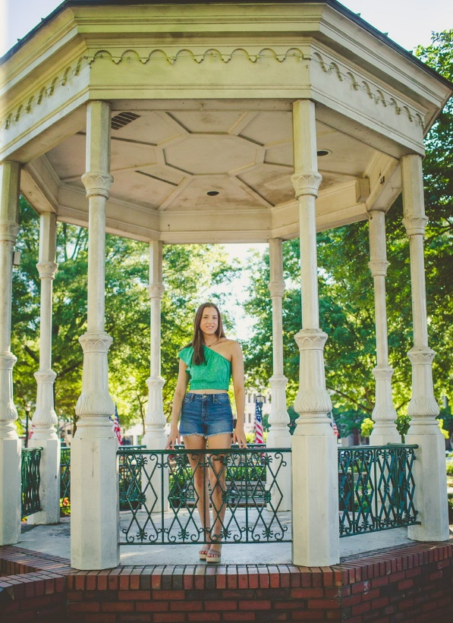
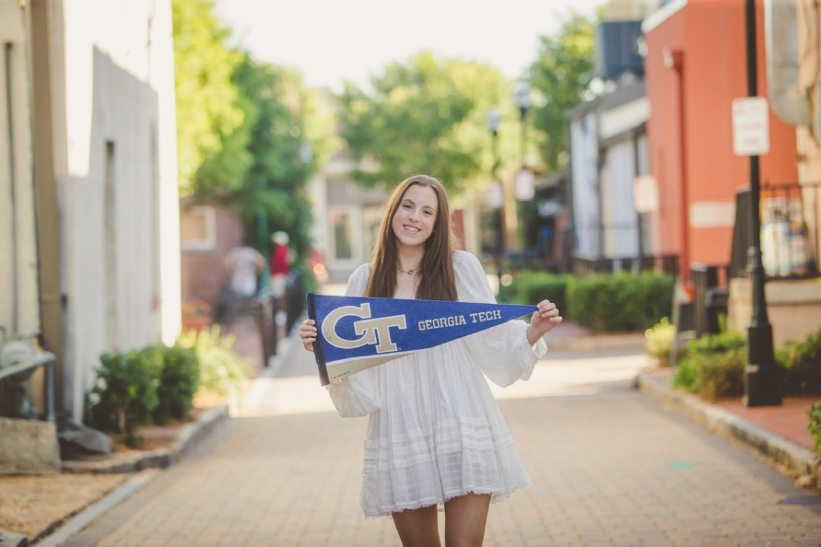
Allison Brown
4 year team member
Team Captain
Favorite Event: 500 free
Favorite Memories: Swimming on relays at county and state and cheering on her teammates.
Will be swimming at Georgia Tech and majoring in either Neuroscience or Industrial Engineering

Slide 37
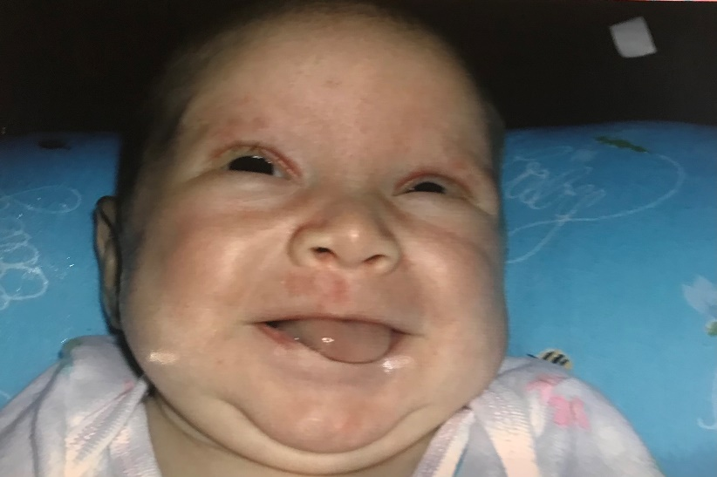
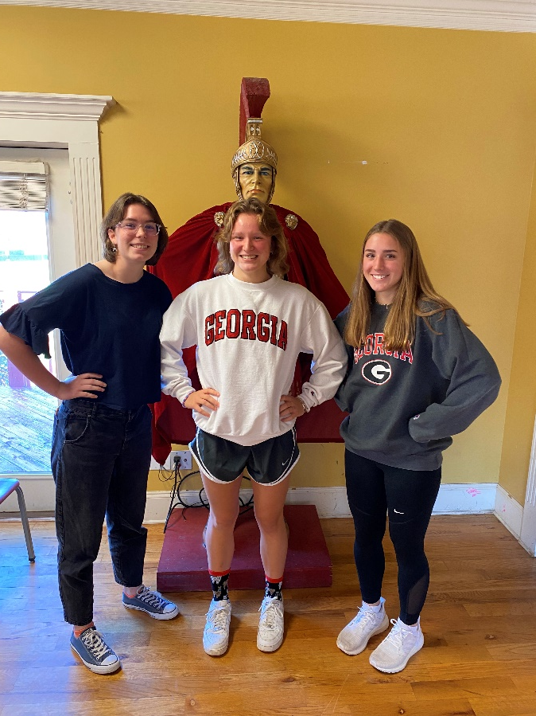
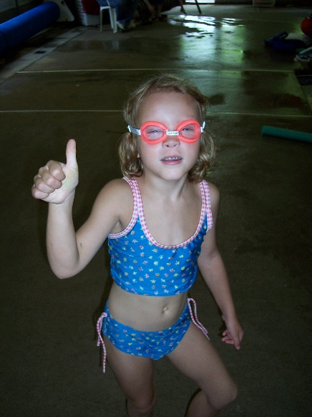
Francie Carson
4 year team member
Team Captain
Favorite Event: 200 Free
Favorite Memory: Bus rides to state, singing terribly with my teammates, leading cheers, state and county relays, my Mariah Carey walk out song at county
Plans on attending and swimming at UGA

Slide 38
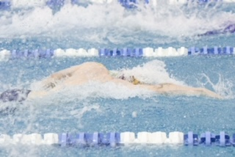
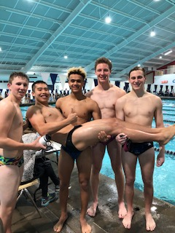
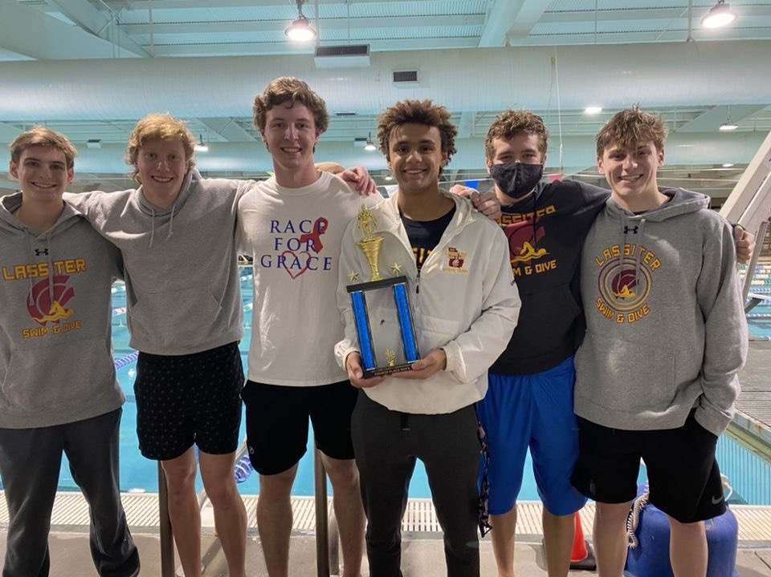
Jason Franklin
4 year team member
Team Captain
Favorite Event: 50 Free
Favorite Memory: Celebrating the girls state team win at Georgia Tech my sophomore year
Plans on attending UGA and majoring in mechanical engineering

Slide 39
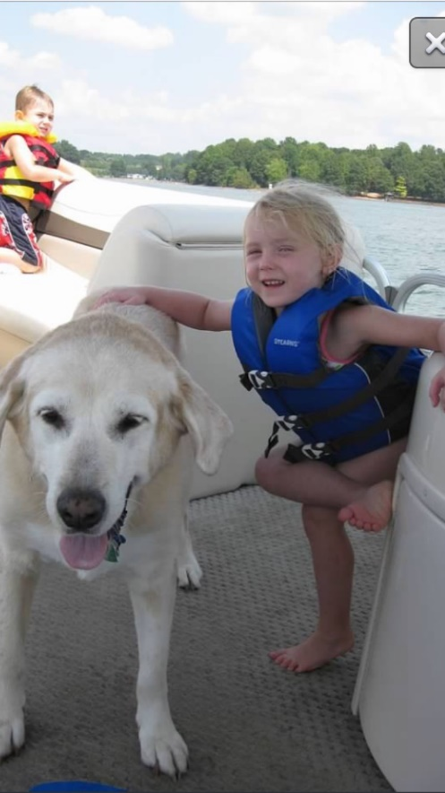
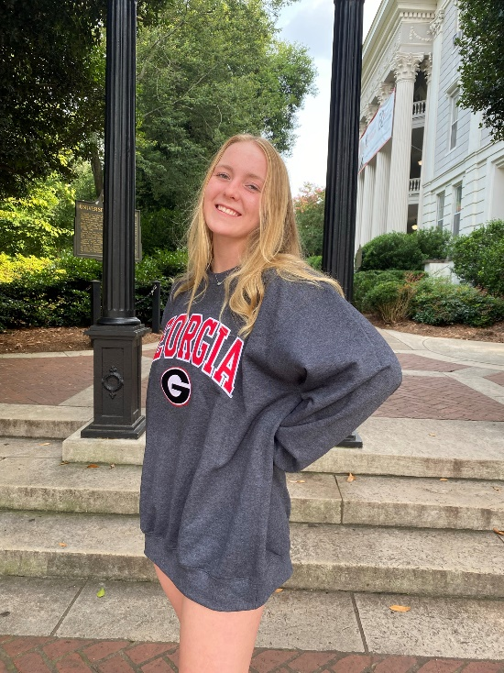
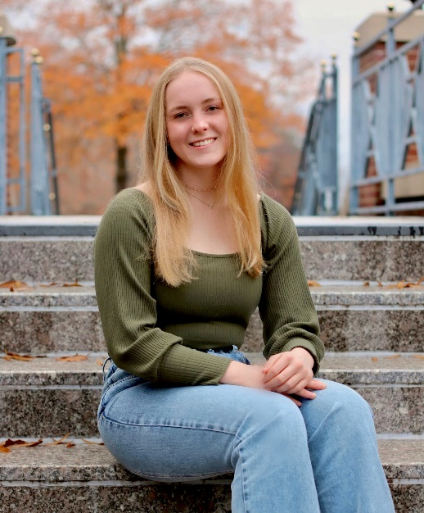
Abby Peyton
4 year team member
Team Captain
Favorite Event: 50 and 100 Free
Favorite Memory: bus rides to and from state and winning state back to back to back!
Plans on attending UGA and majoring in Biology

Slide 40
High Point Award
The High Point Award is given to a boy and a girl in each grade level. These swimmers or divers have contributed the most to the team point wise during the 2021-22 season. Point totals were based on all meets throughout the season and on individual as well as relay swims.

Slide 41
High Point Award Winners
9th
Austin Moon
Kate Bradley
10th
Elliot Elmore
Gianna Conti
11th
Parker Tanke
Elizabeth Tilt
12th
Jason Franklin
Francie Carson

Slide 42
Most Dedicated Award
The most dedicated award is given to a boy and girl who has consistently worked hard towards their goals throughout the 2021-22 season. They have put forth a tremendous amount of effort and practice and it has shown in their times and performances at meets.

Slide 43
Most Dedicated Award Winners
Griffin Dilworth
Grace Moor

Slide 44
Rookie Award
The Rookie Award is given to a boy and girl who are first year team members who have made a huge impact on the team in their short amount of time on it. These recipients have consistently had a good attitude, work ethic and have contributed a lot to the team point wise at meets. We are glad to have these rookies ☺

Slide 45
Rookie Award Winners
Austin Moon
Maggie O’Shaughnessy

Slide 46
Most Improved Award
The most improved award is given to both a boy and girl who have made the most progress in both their times and success at practice throughout the season. There hard work has been shown in meets and they should be very proud of their progress!

Slide 47
Most Improved Award Winners
Elijah Ronemous
Maya Roberts

Slide 48
Captain Award
The Captain Award is given to a member of the 2022 graduating class. These recipients have gone above and beyond the coaches’ expectations and have always been there to support the team in any and every way. They have been model athletes for the younger team members to look up to and the team and coaches will greatly miss them next season.

Slide 49
Captain Award Winners
Jason Franklin
Abby Peyton

Slide 50
2022-23 Captains
……………………….

Slide 51
2022-23 Swim & Dive Captains…
Carter Loftin
Grace Moor
Sophia Parker
Gavin Suchan
Elizabeth Tilt
Parker Tanke

Slide 52
THANK YOU!!!!!! To all Parents but especially these ones! *Senior Parents
Executive Board
*Lisa Peyton (CoPresident)
Jenny Gale (CoPresident)
Kim Tanke (Vice President)
*Michele Franklin (Secretary)
Doug Tilt (Treasurer)
Committee Chairs
Amy Moor (Spirit Wear)
Melinda Conti and *Kylee Elliott (Banquet)
Rhonda Tilt (Caps/Suits)
Stefanie and Rob Brown (homecoming float and holiday party)
Kelli O’Shaughnessy (website and food table)
Mary George and *Amy Banks (Pasta Party)

