Slide 1
Lassiter Swim and Dive
2022-23
End of season banquet
2/15/2023

Slide 2
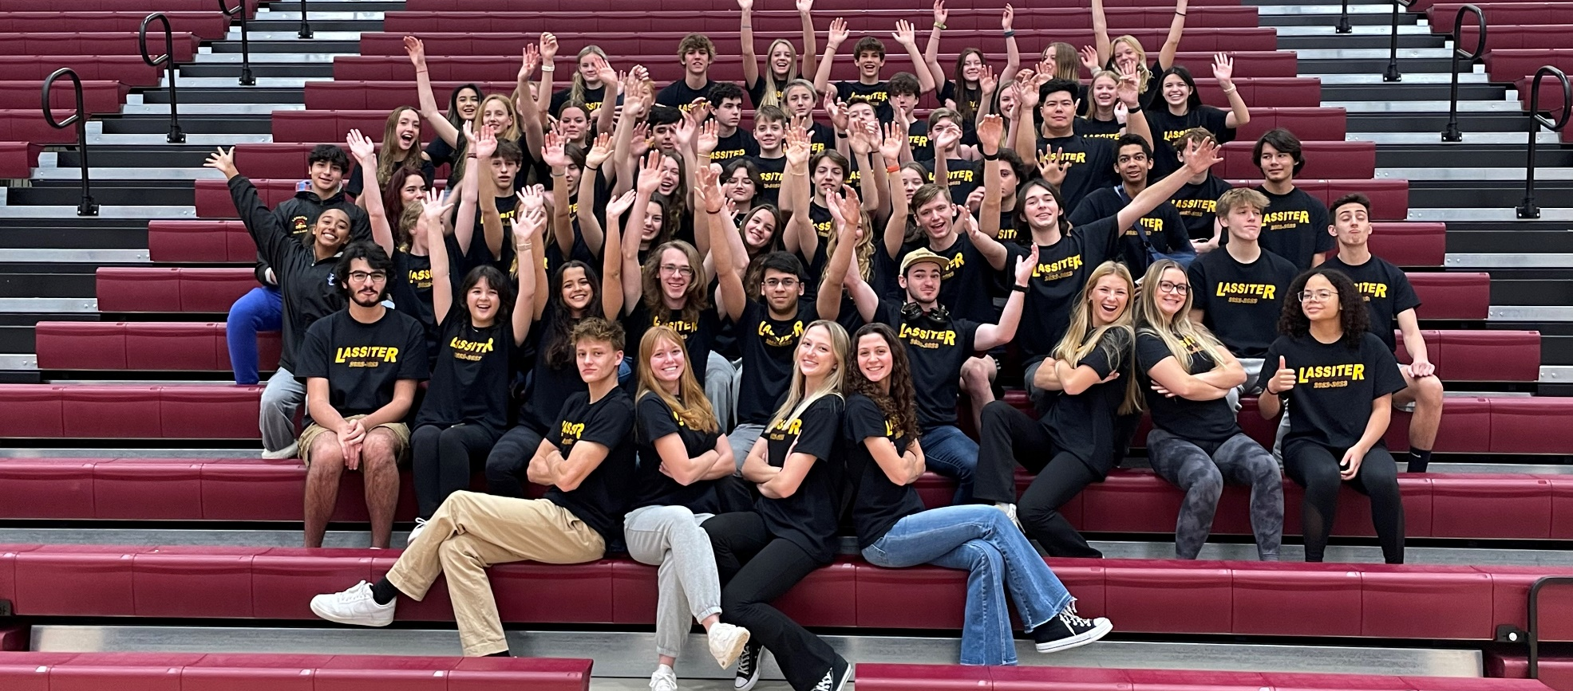
GO TROJANS

Slide 3
FOCUS FAST FINS
FOCUS has been providing the FAST Fins Adaptive Swim Team since January of 2009. Every season we serve around 80 children and teens with special needs and their siblings by giving them the opportunity to be part of a team experience. FAST Fins provides eight separate practices across metro Atlanta supervised by physical and occupational therapists, recreation instructors, and experienced volunteers who provide a welcoming and supportive environment for swimmers to grow in their abilities. Swimmers practice for months in the spring and fall seasons leading up to the biannual intra-squad meet that brings all of our separate practices together to compete and celebrate their accomplishments. FAST Fins is always evolving to better serve our swimmers’ needs and FOCUS is constantly striving to provide the best programs for its families. We hope to keep swimming for years to come.

Slide 4
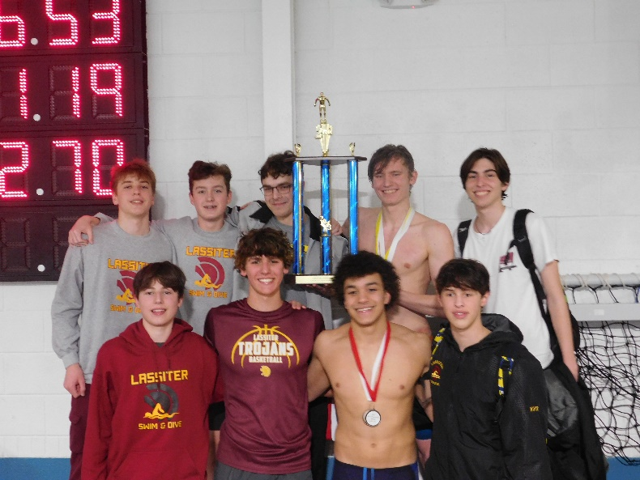
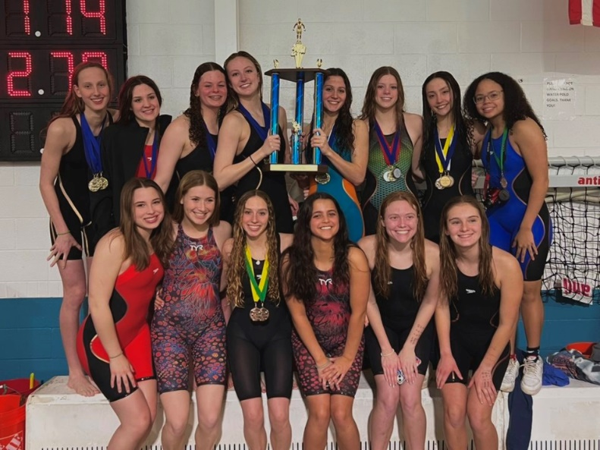
2022-23 Accomplishments
Boys
2nd Place Cobb County Championship
4th Place GHSA 6A State Championship
Girls
2nd Place Cobb County Championship
1st Place GHSA 6A State Championship!!!

Slide 5
2022-23 VARSITY COUNTY TOP 10: BOYS
Elliot Elmore (4th 100 Fly, 3rd 100 Breast)
Carter Loftin (1st Dive)
Cody Miles (9th 200 IM, 5th 500 Free)
Parker Tanke (2nd 200 IM, 5th 100 Back)
Aidan O’Brien (10th 100 Fly)

Slide 6
2022-23 VARSITY COUNTY TOP 10: GIRLS
Cosy Gale (6th 100 Free)
Finnly Jollands (1st 50 Free, 1st 100 Back)
Kate Bradley (3rd 200 IM, 4th 100 Fly)
Rose Jones (3rd 200 Free, 2nd 500 Free)
Gianna Conti (4th 200 IM, 5th 500 Free)
Maggie O’Shaughnessy (2nd 200 IM, 2nd 100 Breast)
Sophia Parker (3rd 50 Free, 1st 100 Fly)
Morgan Shaw (5th 100 Fly, 6th 100 Back)
Elizabeth Tilt (1st 200 Free, 1st 100 Free)

Slide 7
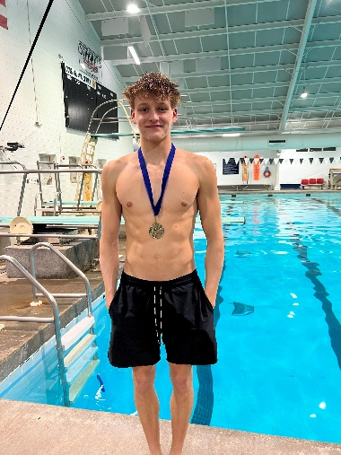
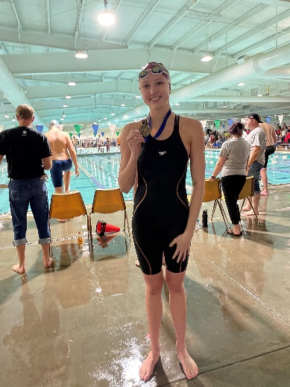
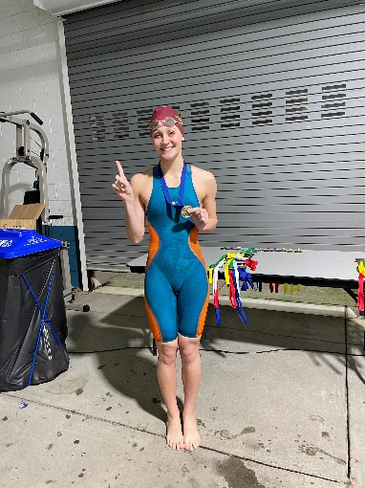
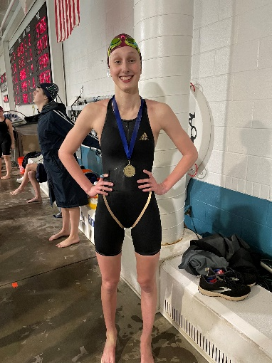
2022-23 County Champions
Carter Loftin
Dive
Finnly Jollands
50 Free
100 Back
Sophia Parker
100 Fly
Elizabeth Tilt
200 Free
100 Free

Slide 8
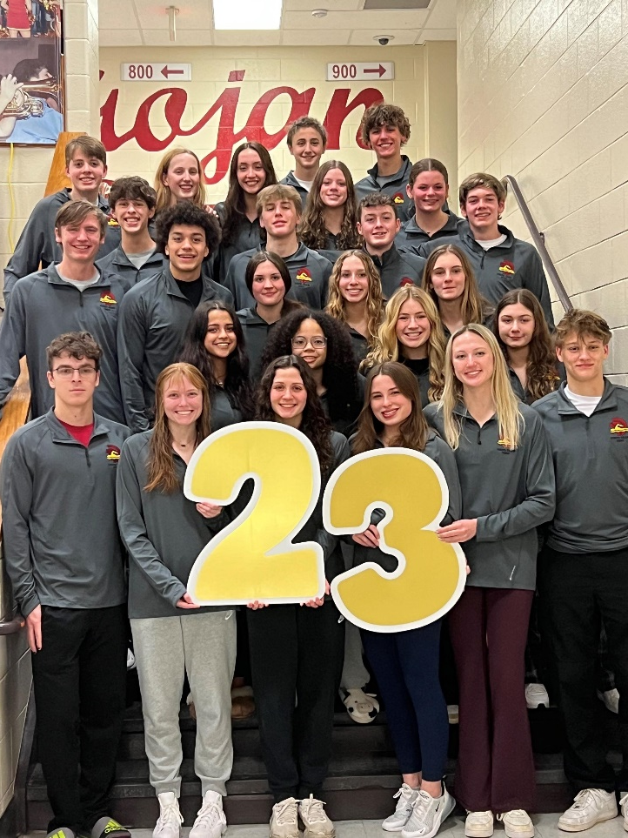
2022-23 State Team
Kate Bradley
Sophia Bucaj
Gianna Conti
Elliot Elmore
Griffin Frankel
Cosy Gale
Will Griffis
Maddie Hobby
Daniel Horne
Finnly Jollands
Rose Jones
Ryan Kotarba
Caroline Lee
Kate Lindsley
Carter Loftin
Cody Miles
Austin Moon
Grace Moor
Aidan O’Brien
Maggie O’Shaughnessy
Sophia Parker
Morgan Shaw
Gavin Suchan
Parker Tanke
Elizabeth Tilt
Patrick Wilson

Slide 9
2022-23 GHSA 6A State Championship Top 20: Boys
Elliot Elmore (9th 100 Fly, 3rd 100 Breast)
Griffin Frankel (17th 500 Free)
Parker Tanke (6th 200 IM, 9th 100 Back)
Cody Miles (11th 200 IM, 7th 500 Free)
Aidan O’Brien (18th 50 Free, 13th 100 Fly)
Ryan Kotarba (15th 100 Breast)
Carter Loftin (1st Diving)

Slide 10
2022-23 GHSA 6A State Championship Top 20: Girls
Kate Bradley (4th 200 Free, 2nd 100 Back)
Maggie O’Shaughnessy (2nd 200 IM, 2nd 100 Breast)
Morgan Shaw (9th 100 Fly, 8th 100 Back)
Gianna Conti (6th 200 IM, 6th 500 Free)
Finnly Jollands (2nd 50 Free, 1st 100 Back)
Sophia Parker (7th 50 Free, 3rd 100 Fly)
Cosy Gale (11th 100 Free, 11th 100 Back)
Rose Jones (2nd 200 Free, 2nd 500 Free)
Elizabeth Tilt (1st 200 IM, 1st 100 Fly)
Kate Lindsley (17th 50 Free)

Slide 11
State Relay Recognition
Boys 200 Medley Relay-
5th (Tanke, Miles, O’Brien, Elmore)
Girls 200 Medley Relay-
1st (Jollands, O’Shaughnessy, Parker, Jones)
Girls 200 Freestyle Relay-
1st (Tilt, Shaw, Bradley, Parker)
Girls 400 Freestyle Relay-
1st (Jones, Jollands, Bradley, Tilt)
Boys 200 Freestyle Relay-
4th (Elmore, Wilson, O’Brien, Tanke)
Boys 400 Freestyle Relay-
11th (Wilson, Griffis, Moon, Miles)

Slide 12
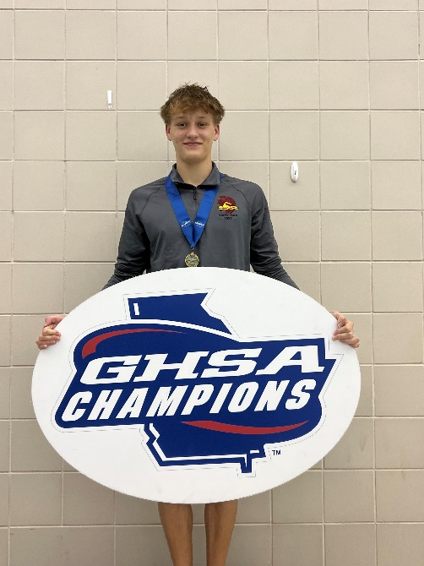
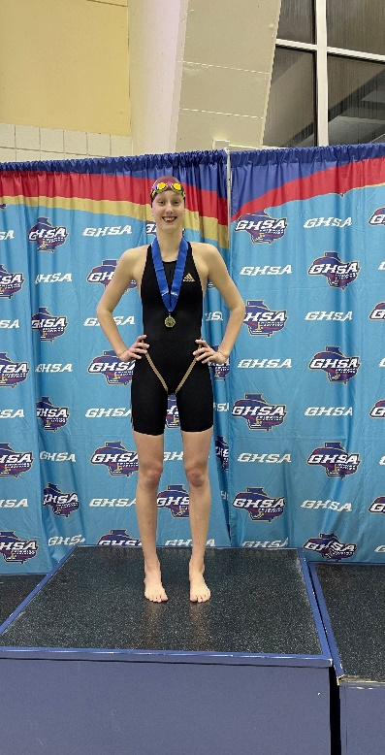
STATE CHAMPS!
Carter Loftin
Dive
Finnly Jollands
100 Back
Elizabeth Tilt
200 IM
100 Fly

Slide 13
All America Qualifiers
Consideration
Rose Jones- 200 Free, State Finals, 1:50.49
Carter Loftin- 11 dives, Wheeler Invite and County Championships, 555.70 and 602.40
Elizabeth Tilt- 50 Free, County Prelims (relay lead off), 23.24
Girls 200 Free Relay- County Finals, 1:36.34
Elizabeth Tilt, Cosy Gale, Kate Bradley, Sophia Parker
Automatic
Elizabeth Tilt- 200 Free, County Finals, 1:48.23
100 Free, County Finals, 50.13
200 IM, State Finals, 2:01.32
100 Fly, State Finals, 53.83
Girls 200 Medley Relay- State Finals, 1:44.01
Finnly Jollands, Maggie O’Shaughnessy, Sophia Parker, Rose Jones
Girls 400 Freestyle Relay- County Finals, 3:26.45
Rose Jones, Finnly Jollands, Kate Bradley, Elizabeth Tilt

Slide 14
2022-23 New School Records: Individuals
Elizabeth Tilt
200 Freestyle, County Finals, 1:48.23
Previous record from 2022
Also set County Championship Meet Record
100 Freestyle, County Finals, 50.13
Previous record from 2011
Also set County Championship Meet Record
50 Freestyle, County Prelims (Relay Lead Off), 23.24
Previous record from 2015
Also set County Championship Meet Record
Carter Loftin
11 Dives, County, 602.40
Previous record from 2021
Also set County Championship Meet and All Time County Record
12 Dives, State Meet, 675.70
Previous record from last season

Slide 15
2022-23 New School Records: Relays
Girls 200 Medley Relay
State Finals, 1:44.01
Finnly Jollands, Maggie O’Shaughnessy, Sophia Parker, Rose Jones
Previous record from 2022
Also set County Championship Meet and All Cobb County Record
Girls 400 Freestyle Relay
County Finals, 3:26.45
Rose Jones, Finnly Jollands, Kate Bradley, Elizabeth Tilt
Previous record from 2022
Also set County Championship Meet Record

Slide 16
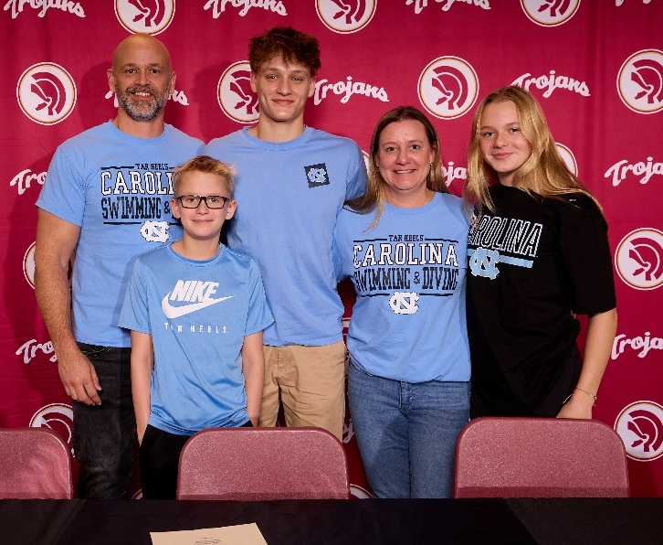
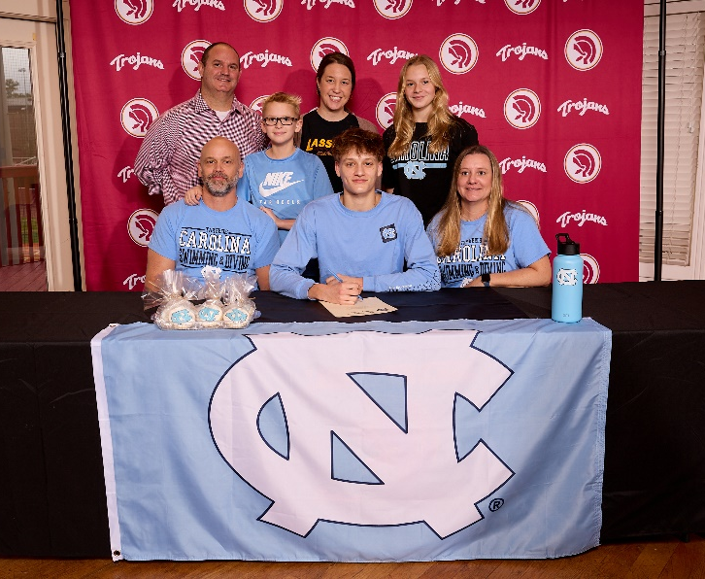
Class of 2023 Signees
Carter Loftin
University of North Carolina
Dive

Slide 17
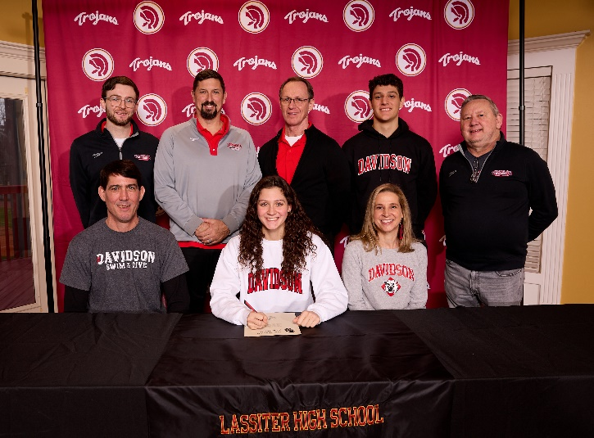
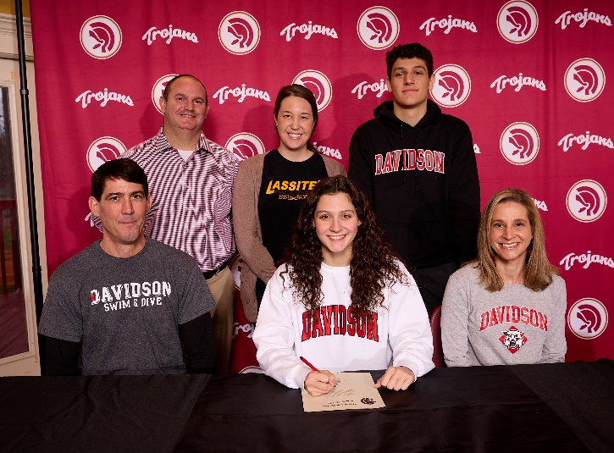
Class of 2023 Signees
Sophia Parker
Davidson College
Swim

Slide 18
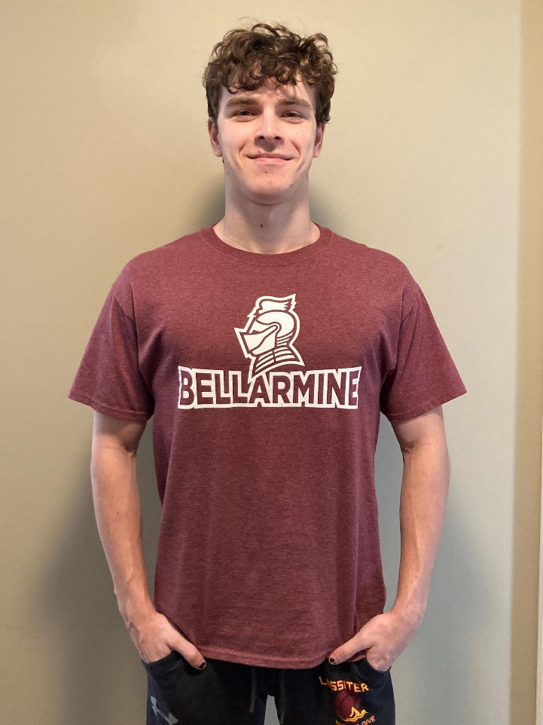
Class of 2023 Signees
Parker Tanke
Bellarmine University
Swim

Slide 19
Underclassmen
Letter and Certificate Presentation

Slide 20
Freshmen
Lindsey Bohlin
Sophia Cain
Livia Chasteen
Chloe Cummings
Griffin Frankel
Sara Garber
Elizabeth Gavieres
Kaitlyn Gregory
Will Griffis
Sophia Hogue
Ethan Jones
Will Joseph
Jonathan Lewelling
Ashlyn Loftin
Charlie Rath
Ethan Silver
Kaiti Stutz
Micah Villanueva

Slide 21
Sophomores
Evelyn Barber
Kate Bradley
Mac Brune
Mathias De Araujo
Elizabeth George
Eva Godinez
Oren Horak
Finnly Jollands
Rose Jones
Ryan Kotarba
Alexander Magdusian
Natalie Meredith
Cody Miles
Annabeth Miller
Austin Moon
Maggie O’Shaughnessy
Marcelo Paez Benavides
Elijah Ronemous
Annabelle Simmons
Alexis Thornton
Patrick Wilson

Slide 22
Juniors
Mackenzie Bryant
Sophia Bucaj
David Cofield
Gianna Conti
Elliot Elmore
Julian Farah
Cosy Gale
Tim Harrison
Daniel Horne
Kate Lindsley
Aidan O’Brien
Alex Presuel
Julia Randall
Anthony Rath

Slide 23
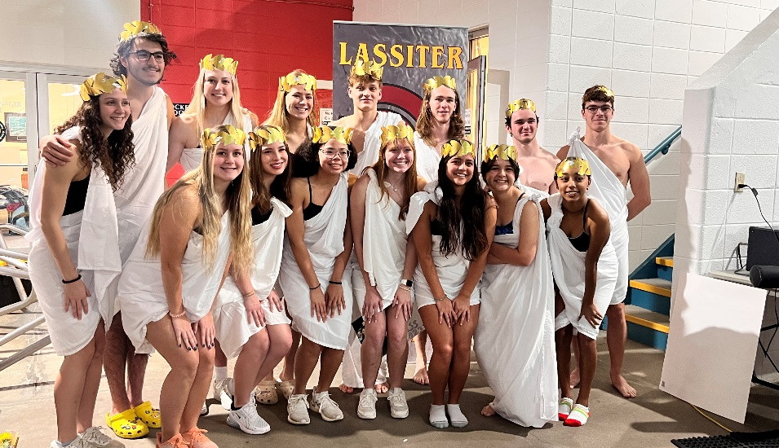
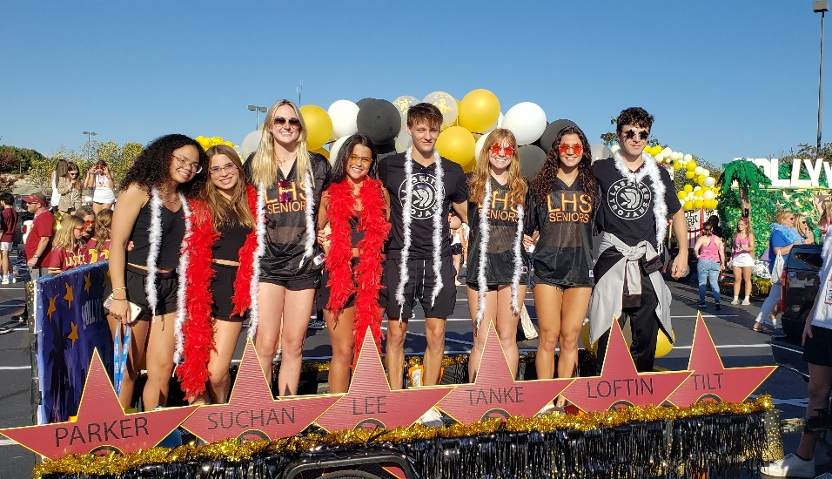
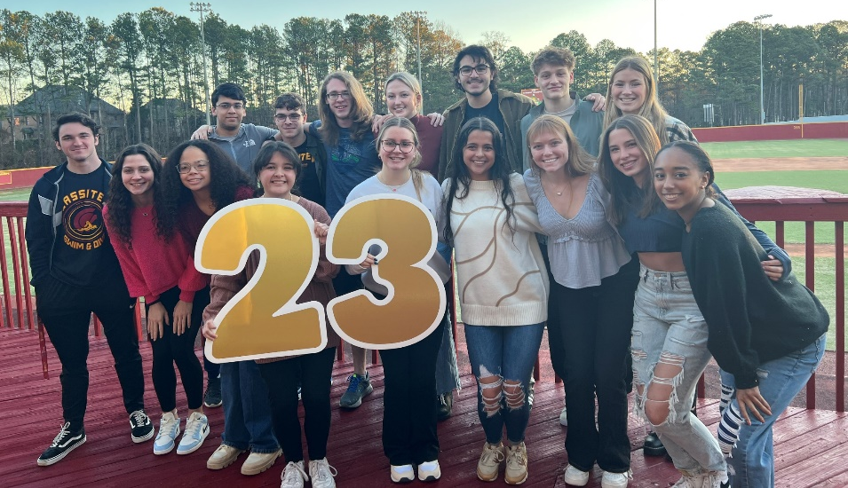
2022-2023 Senior Class

Slide 24
Seniors in the Classroom
Swimmers and Divers in the Class of 2023 have an average weighted GPA of 4.205!
Academic All Americans- Varsity Letter Recipient with a weighted GPA of 3.75 or higher
*CSCA Scholarship due Friday!
Griffin Dilworth
Maddie Hobby
Caroline Lee
Carter Loftin
Grace Moor
Sophia Parker
Olivia Peters
Maya Roberts
Morgan Shaw
Gavin Suchan
Elizabeth Tilt

Slide 25
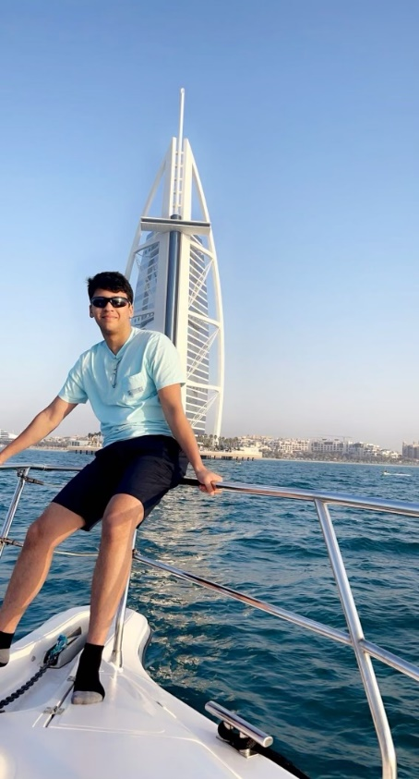
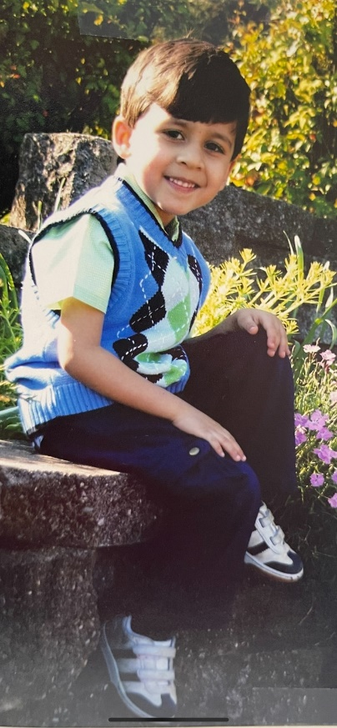
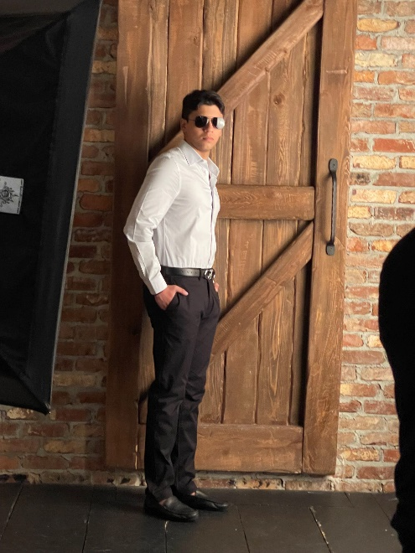
Arsh Ali
2 year team member
Favorite Event: 50 Free
Favorite Memory: Bus rides to meets
Unsure on college but plans to major in mechanical engineering.
"Be yourself - confidence starts here."

Slide 26
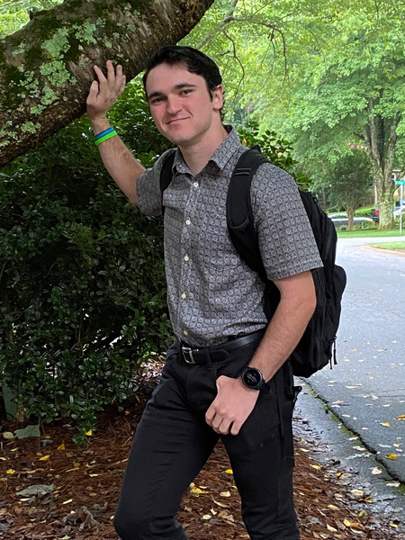
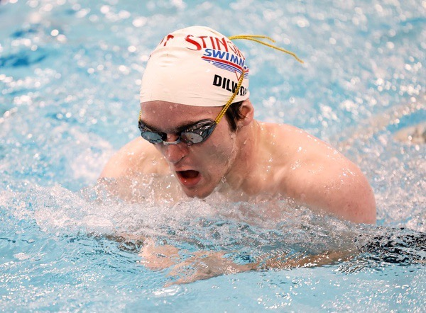
Griffin Dilworth
4 year Team Member
Favorite Event: 100 Breast
Favorite Memory: tying for 3rd by getting the exact same time as someone in 100 breast.
Plans on being a classical studies major in college
“Music is a moral law. It gives soul to the universe, wings to the mind, flight to the imagination, and charm and gaiety to life and to everything.” – Plato

Slide 27
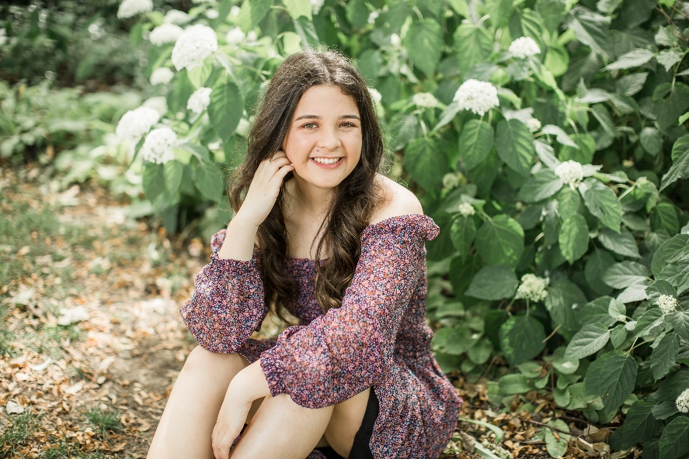
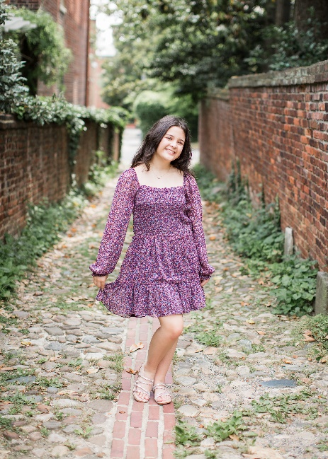
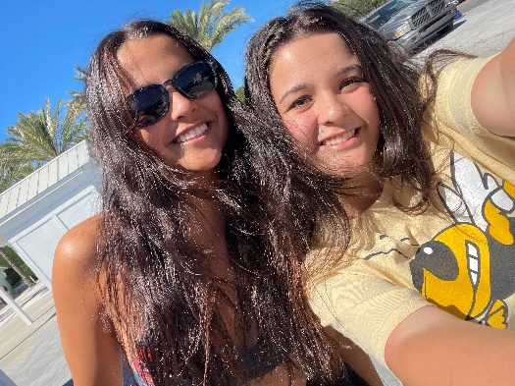
Jessica Lee
2 year team member
Favorite Event: (Dive) Front Dive
Favorite Memory: her first dive tryouts
Plans on attending the University of South Carolina and studying International Business
“The way to get started in life is to quit talking and begin doing.”

Slide 28
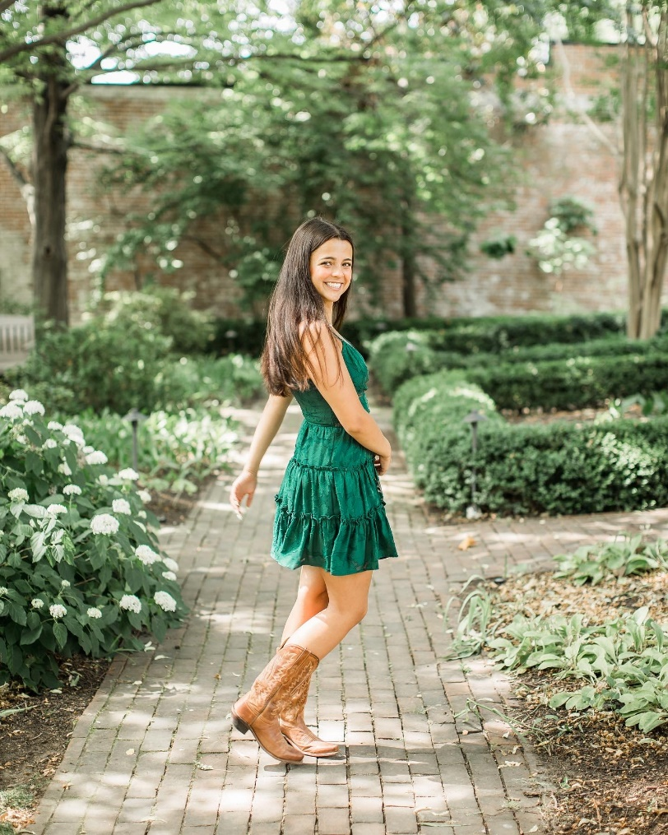
Caroline Lee
4 year team member
Favorite Event: 100 Free
Favorite Memory: swimming at finals with her best friends in 2021.
Plans on attending LSU and majoring in marketing.
“Never let the fear of striking out keep you from playing the game.”

Slide 29
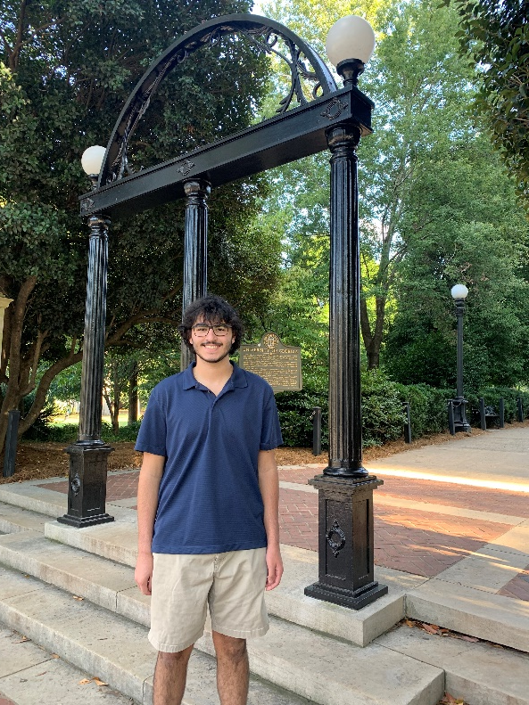
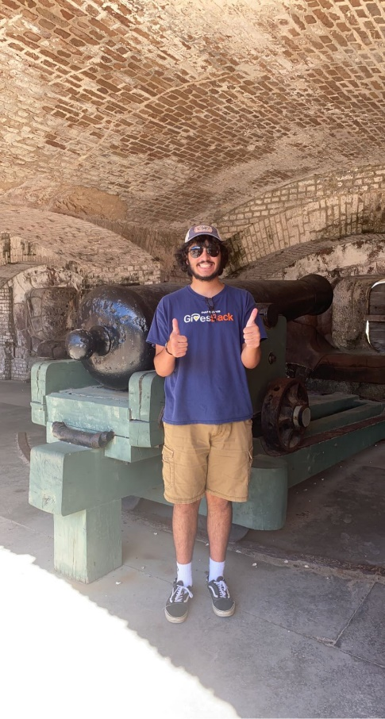
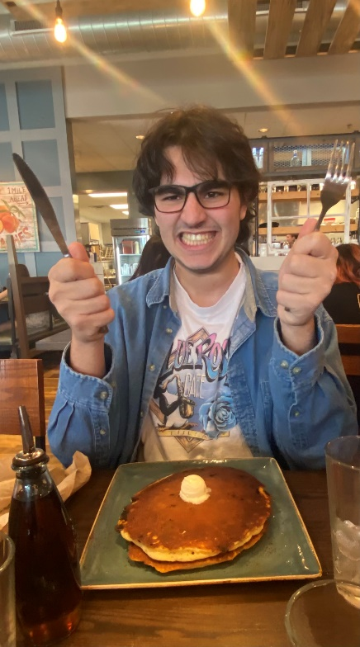
Nicolas Magdusian
4 year team member
Favorite Event: 100 Back
Favorite Memory: playing manhunt at the team bonfire.
Plans on attending UGA and majoring in business.
“The further back you look the farther forward you can see.”

Slide 30
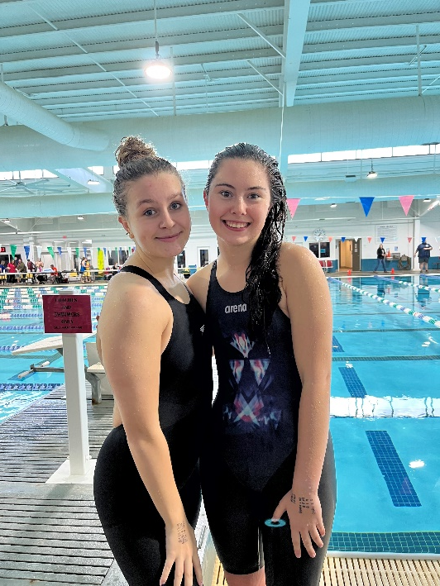
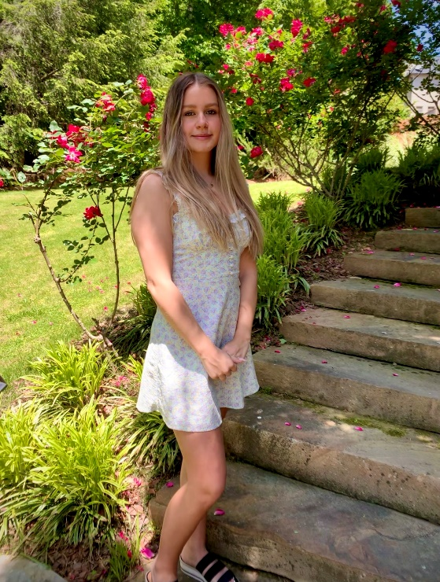
Olivia Peters
4 year team member
Favorite Event: 100 Back
Favorite Memory: when there was a fire at state
Plans on majoring in International Affairs in college.
“Life’s an adventure.”

Slide 31
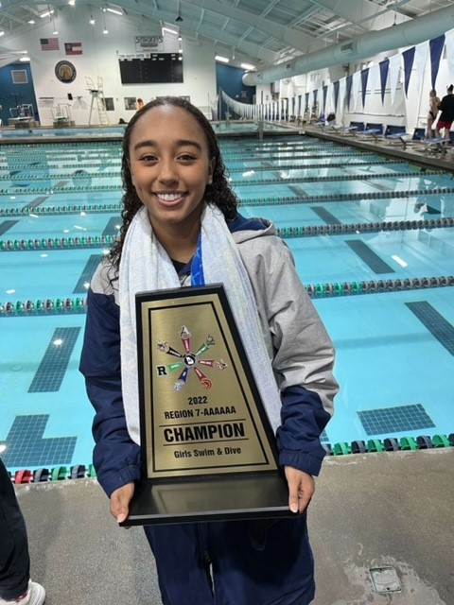
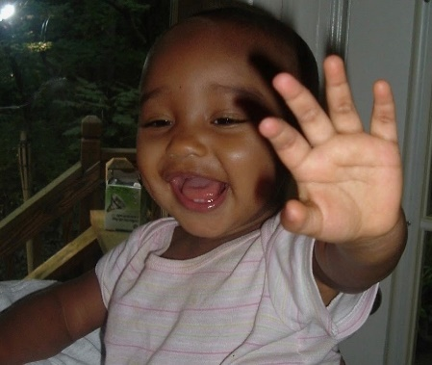
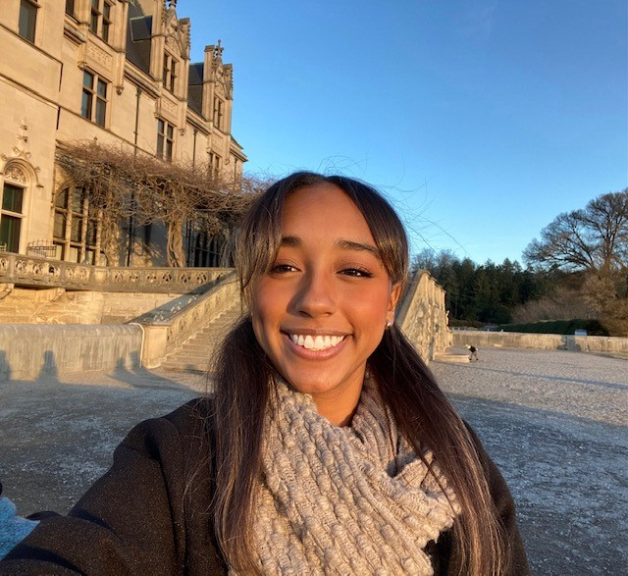
Maya Roberts
3 year team member
Favorite Event: 100 Free
Favorite Memory: Pasta Parties
Unsure on college but plans on majoring in architecture.
“Jesus on a cracker.”

Slide 32
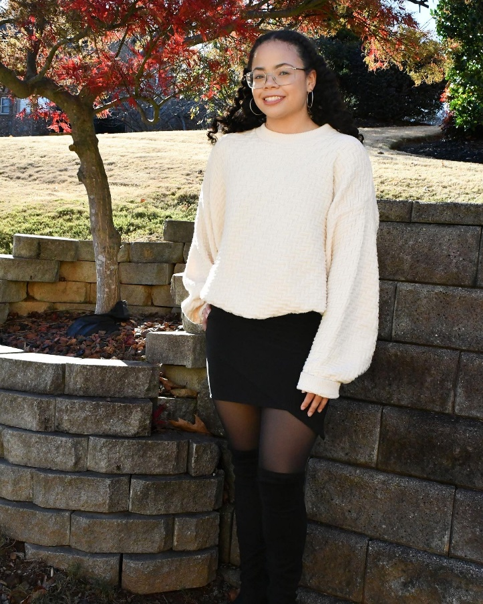
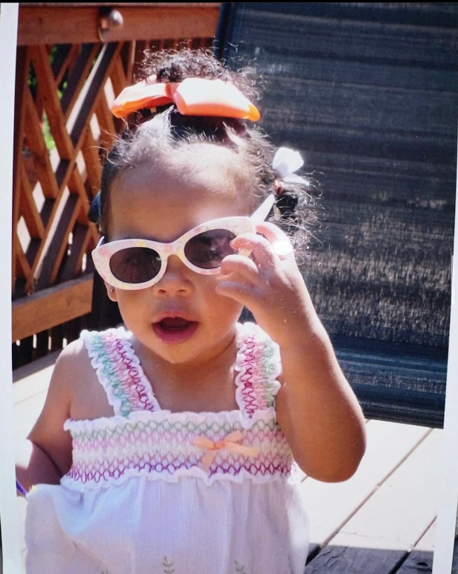
Morgan Shaw
4 year team member
Favorite Event: 100 Fly
Favorite Memory: Fire alarm going off at GA tech and we all had to go out in the freezing cold. I lost my phone and freaked out and then when we came back inside they played 'fire' themed songs
Unsure on College Plans
“All day....I could do this all day!” - Schmidt

Slide 33
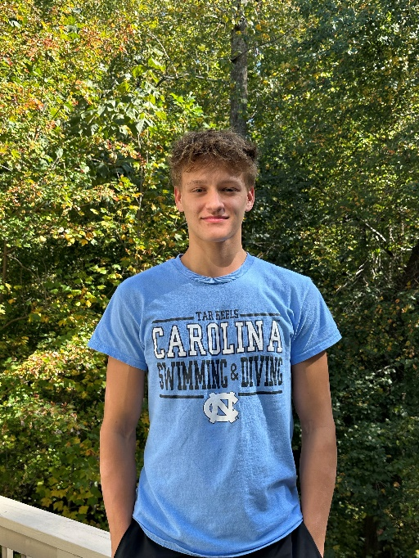
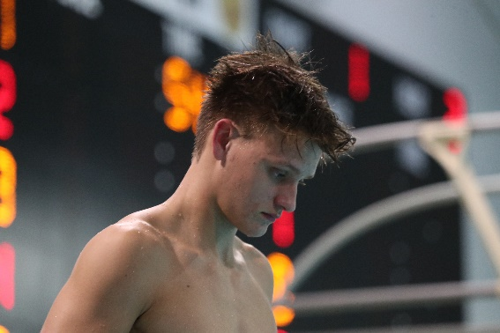
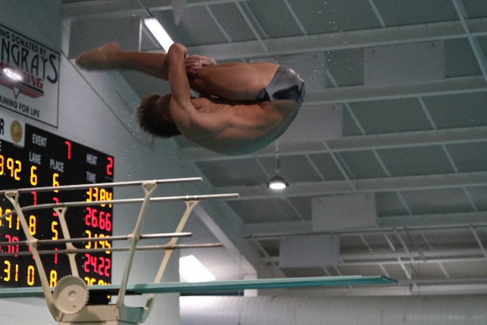
Carter Loftin
4 year team member
Team Captain
Favorite Event: Diving
Favorite Memory: The team bonding during the North Gwinnett meet or having new members join the dive team!
Plans on attending University of North Carolina to Dive and majoring in Environmental Engineering.
"Falling down is not failure. Failure comes when you stay where you have fallen."

Slide 34
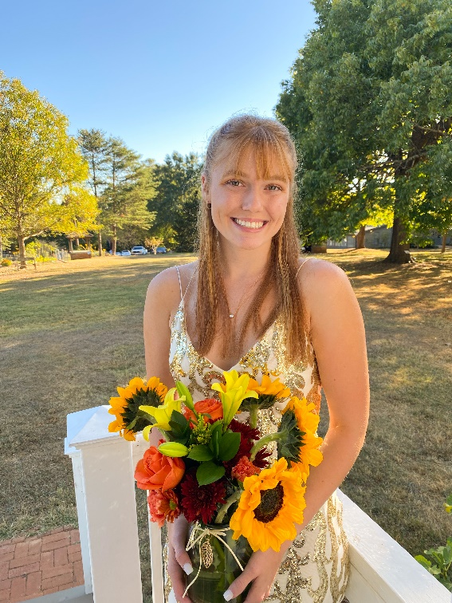
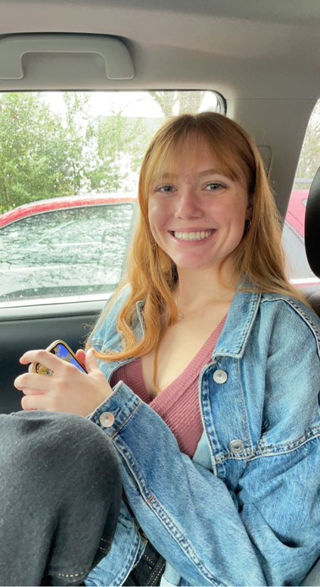
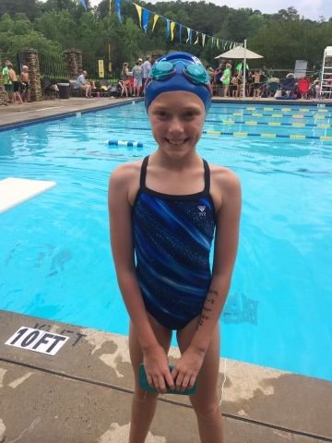
Grace Moor
4 year team member
Team Captain
Favorite Event: 100 Breast
Favorite Memory: Winning state junior year
Undecided on college but plans on majoring in Chemistry on a premed track

Slide 35
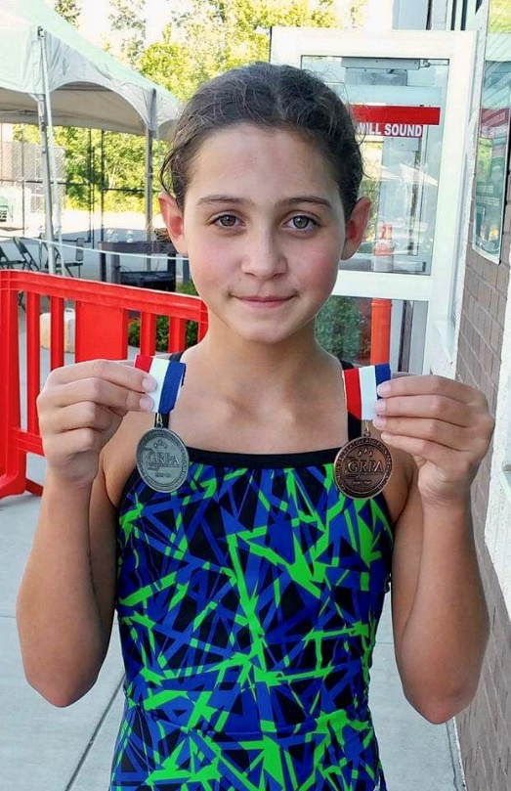
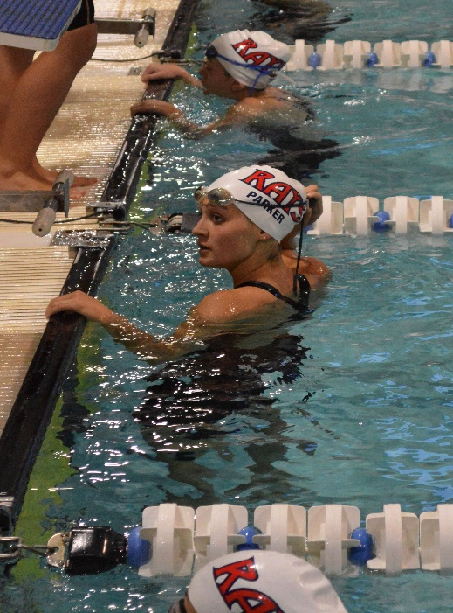
Sophia Parker
4 year team member
Team Captain
Favorite Event: 100 Fly
Favorite Memory: Placing 2nd in 100 butterfly her sophomore year
Plans on continuing to swim at Davidson College and pursue a career in the medical field.

Slide 36
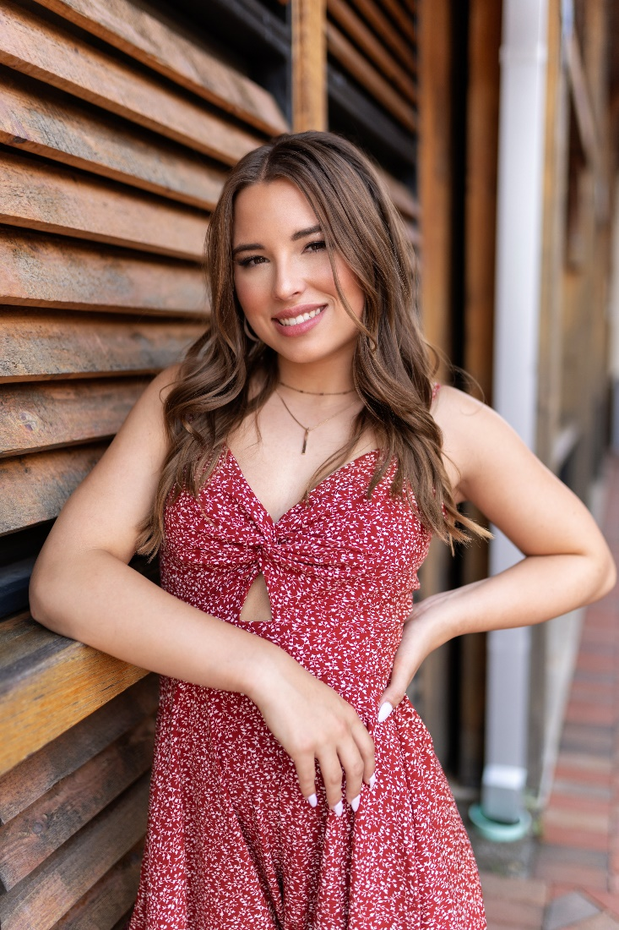
Gavin Suchan
4 year team member
Team Captain
Favorite Event: 200 Free
Favorite Memory: Team bus rides to away meets and state, girls sleepover after county.
Plans on attending UGA and majoring in Criminal Justice
“Live each day as if it were your last.”

Slide 37
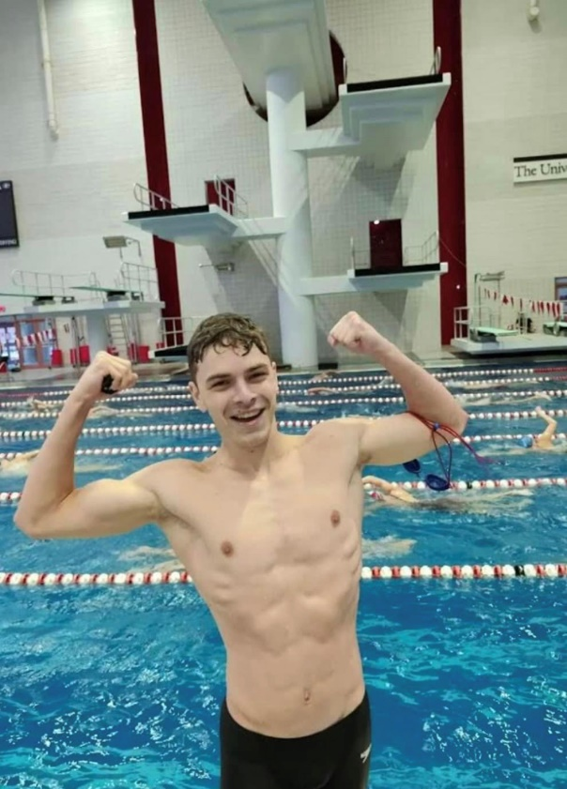
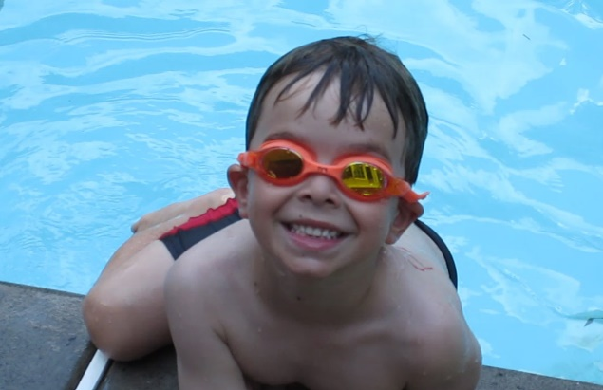
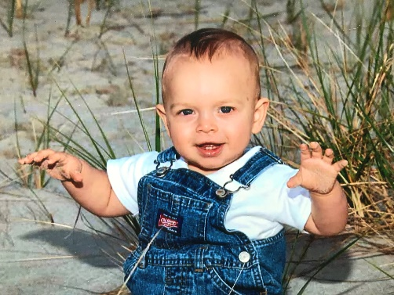
Parker Tanke
4 year team member
Team Captain
Favorite Event: 200 IM
Favorite Memory: Dying his hair red with the team before the state meet junior year.
Plans on continuing his swimming career at Bellarmine University and wants to be a Physical Therapist.
“Just try your best.”

Slide 38
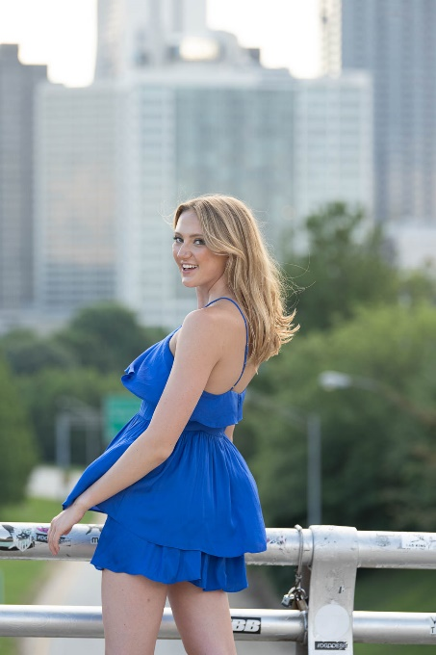
Elizabeth Tilt
4 year team member
Team Captain
Favorite Event: 100 Free
Favorite Memory: Waffle House runs after winning state.
Plans on continuing to swim in college and studying astrophysics.
“Confidence is found in vulnerability.”

Slide 39
High Point Award
The High Point Award is given to a boy and a girl in each grade level. These swimmers or divers have contributed the most to the team point wise during the 2022-23 season. Point totals were based on all meets throughout the season and on individual as well as relay swims.

Slide 40
High Point Award Winners
9th
Griffin Frankel
Ashlyn Loftin
10th
Austin Moon
Finnly Jollands
11th
Elliot Elmore
Kate Lindsley
12th
Parker Tanke
Sophia Parker

Slide 41
Most Dedicated Award
The most dedicated award is given to a boy and girl who has consistently worked hard towards their goals throughout the 2022-23 season. They have put forth a tremendous amount of effort and practice and it has shown in their times and performances at meets.

Slide 42
Most Dedicated Award Winners
Austin Moon
Annabelle Simmons

Slide 43
Rookie Award
The Rookie Award is given to a boy and girl who are first year team members who have made a huge impact on the team in their short amount of time on it. These recipients have consistently had a good attitude, work ethic and have contributed a lot to the team point wise at meets. We are glad to have these rookies and looking forward to the future ☺

Slide 44
Rookie Award Winners
Jonathan Lewelling
Ashlyn Loftin

Slide 45
Most Improved Award
The most improved award is given to both a boy and girl who have made the most progress in both their times and success at practice throughout the season. There hard work has been shown in meets and they should be very proud of their progress!

Slide 46
Most Improved Award Winners
David Cofield
Sophia Bucaj

Slide 47
Captain Award
The Captain Award is given to a member of the 2023 graduating class. These recipients have gone above and beyond the coaches’ expectations and have always been there to support the team in any and every way. They have been model athletes for the younger team members to look up to and the team and coaches will greatly miss them next season.

Slide 48
Captain Award Winners
Carter Loftin
Grace Moor

Slide 49
2023-24 Captains
……………………….

Slide 50
2023-24 Swim & Dive Captains…
David Cofield
Gianna Conti
Elliot Elmore
Cosy Gale
Julia Randall
Aidan O’Brien

Slide 51
THANK YOU!!!!!! To all Parents but especially these ones! *Senior Parents
Executive Board
Jenny Gale (CoPresident, SR Presentations)
Mary George (CoPresident, Pasta Party)
Kim Tanke* (Vice President)
Kelli O’Shaugnessy (Secretary and website)
Doug Tilt* (Treasurer)
Committee Chairs
Amy Moor* and Kathryn Loftin (Spirit Wear)
Melinda Conti (Banquet)
Miriam Jones (Caps/Suits)
Terri Elmore (homecoming float)
Lori Kotarba and Caroline Horne (holiday party)
Wendy Bucaj and Caroline Randall (Sr Bfast)
Brenda Miles (Pizza Party)
Erin Jones and Marjorie Rath (food table)

