Slide 1
New Coach Introduction Class Series: Preparing for the season

Slide 2
Welcome!
Congratulations on becoming a high school coach!
This class is the first in a planned series.
Several topics today to help you get the season underway.
This is new– feedback is welcomed! What didn’t we cover that we should?

Slide 3
Build the school relationship
Who to know- make allies!
Athletic Director
Administration- principal, guidance counselors, superintendent, board members
Athletic boosters
Other coaches, school activities

Slide 4
Build the school relationship
AD- primary relationship.
Before you meet, set your coaching philosophy. Why are you doing this? Goals? Know this for yourself and your AD– it will drive the season.
Set mutual expectations
Know each other’s goals for the team
How does an AD see a successful coach
What have other coaches done well/issues

Slide 5
Build the school relationship
Budget
What can you do for meets- host/travel
Practice facility, if not school owned
Equipment/suit needs- who pays?
Software- don’t do this by hand!
Hy-tek/Team Unify.
Get software/access/backups from prior coach

Slide 6
Build the school relationship
Certifications – while written for one school, should be universal in Ohio
Most certifications should be done prior to you coaching- don’t put you, your program or your school in jeopardy!

Slide 7
Build the team
Recruit!
Captains- have them lead!
School announcements
Social media
Other coaches at your school.

Slide 8
Build the team
Student/Parent meeting
Season expectations
Team rules/guidelines
Key dates- practices, meets, other activities
Gather contact information!

Slide 9
Build the team
COMMUNICATE!!!!!
Email, Remind, TeamSnap In-school
Better to over communicate than not
At least one email a week- recap/what is upcoming
Parents, students, AD
Entries prior to meet/results after meets
Social media- let the community know you exist

Slide 10
Build the season
When/where to practice
Getting meets
Will you host?
Travel
League
Other coaches
Volunteers- you will need plenty!

Slide 11
Build the season
Plan the season
How should practice progress through the season? HS swimming is different than club swimming. Plan ahead!
Let the team know what is coming on a regular basis.

Slide 12
Key Season Dates
Practice start date – October 29
Meet start date- November 29
Sectionals – February 7-12
Districts – February 14-19
State Meet – February 23 – 26

Slide 13
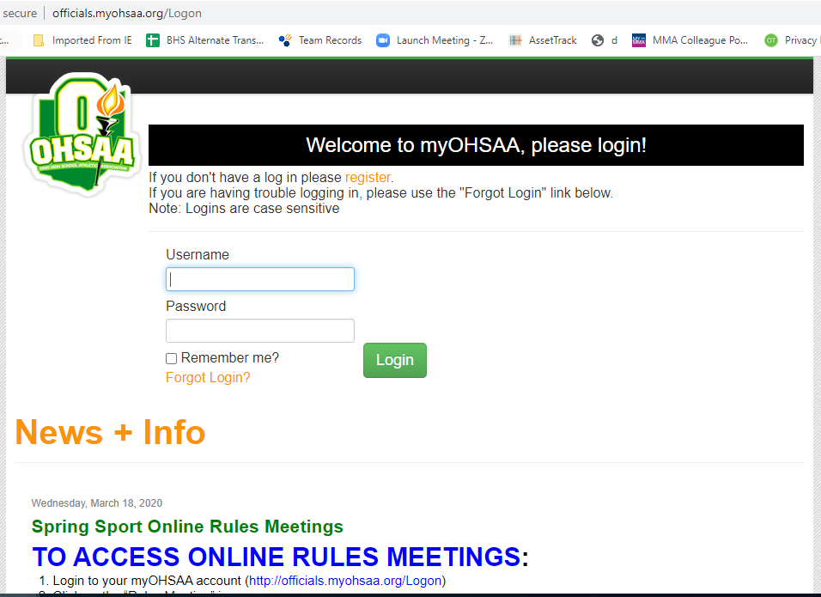
Rules Interpretation Meeting
Online-- MyOHSSA.ORG October 13th- November 30th
Contact your AD for login
YOU MUST DO THIS!

Slide 14
Memberships
OHSSCA $35.00 State Membership*
NISCA $50.00 National High School*
(saves cost of AA certificates)
ASCA $88.00 National All Coaches*
*Membership information can be found on each website.
MUST BE AN OHSSCA MEMBER TO BE ON COACH OF THE YEAR BALLOT, AWARD PRESENTERS, ATHLETE SCHOLARSHIPS.

Slide 15
Websites
NISCA – http://niscaonline.org
ASCA – www.swimmingcoach.org
OHSSCA – www.ohssca.org
Southwest District Athletic Association – https://www.ohsaa.org/SWDAB-home
OHSAA – www.ohsaa.org
Local District – www.swimmeet.com
USA Swimming – www.usaswim.org

Slide 16
Open Discussion
Any questions or concerns?
petepuma01@yahoo.com
Good luck this season!

