Slide 1
Midlakes Dive Summer 2021
Season Kickoff Meeting and Training for Parents
June 19th, 2021
Hosted by Kathy McDonald & Pauline Fox, Midlakes Dive Co-Representatives midlakesdiving@gmail.com

Slide 2
Welcome to Midlakes Diving!
Goals: Safety, Skills, FUN!
The Midlakes Dive League is a novice league designed to introduce young people to and encourage their enjoyment of diving in a safe and positive environment.
Midlakes Dive is governed by Midlakes ByLaws and Midlakes Dive Operating Plan, updated yearly
Midlakes Dive League Representatives: Kathy McDonald (STC) & Pauline Fox (PL)
This presentation, a “Dive Parent Guide”, Judging Video, and more are available on the Midlakes Dive website (TeamUnify site)

Slide 3
Agenda for Today
Introductions
Calendar & Key Dates
Insurance and Covid Safety Procedures
Dive Basics
Meet Format & Volunteering
Volunteer Training Video (7 min)
Training for Judges & Scorers
Midlakes Dive Website: This presentation, Judging Video, Parent Quick Info Sheet, and more...

Slide 4
Introduction to our Dive Teams
Welcome back, Seattle Tennis Club (STC) and Phantom Lake (PL)
Mercer Island Beach Club (MIBC)
Mercerwood Shore Club (MSC)
Newport Hills Swim and Tennis Club (NHSTC)
Woodridge Swim Club (WR)

Slide 5
Divers from other Midlakes Clubs
Divers from other Midlakes Clubs that do not have a Dive Team may join a Dive Team that is accepting new members if approved by the Midlakes Board Representatives and the Club.
Divers pay the fee to the accepting club for the Dive program only and may only use the club’s facilities during dive practice, meets, and at private instruction if available.
The club may choose to add a 10% non-member surcharge to aid with administrative fees.

Slide 6
Dive Team Contacts
Midlakes Dive Representatives – Kathy and Pauline, midlakesdiving@gmail.com Pool Managers MIBC – Katie Boussaneault MSC – Paul Von Destinon NHSTC – Julie Prado PLC – Claudia Stern STC – Roger Miron WR – Dee Huff | Parent Representatives MIBC – Courtney Kinsman-Cordero MSC – Keith and Jenny Capasso NHSTC – Kristen McSherry PLC – Pauline Fox and Katie Ostler STC – Kathy McDonald WR – Marissa Stratton Coaches MIBC – Ally Lavin and Brooke Andrews MSC – Katie Francke and Anna Bertlin NHSTC – Lilje Stratton and Erin Whipple PLC – Aidan Richter STC – Izzy Doud and Meilan Uyena WR – Anna Troje

Slide 7
2021 Key Dates
June 19 (Sat): Midlakes Dive Season Kickoff Meeting
June 21 (Mon): Official Midlakes Dive Practices May Begin
June 30-July 26: Meets on Mondays & Wednesdays (5 total):
Wed 6/30, Wed 7/7, Mon 7/12, Mon 7/19, Mon 7/26
July 28 (Thurs): Dive Champs meeting for Coaches & Parent Reps
July 31 (Sat): Junior Championships: 8’s & 10’s @NHSTC
August 1 (Sun): Senior Championships: 12’s & 14’s & 17’s @NHSTC

Slide 8
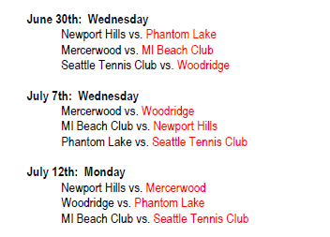
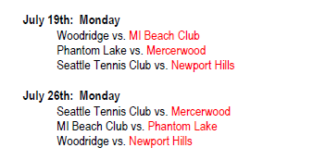
2021 Meet Schedule

Slide 9
2021 Dive Championships
All divers are invited!
In order to attend champs, diver must compete in 2 meets or may dive as “exhibition” if did not compete in 2 meets.
In person: Newport Hills Swim & Tennis Club
Junior Champs, 8’s & 10’s: Saturday, July 31: 8:00am-12:00pm
Senior Champs, 12’s, 14’s, 17’s: Sunday, Aug. 1: 8:00am-12:00pm
Medals and ribbons awarded at event

Slide 10
AAU Insurance
AAU Membership and Insurance
Individual divers = Purchase $16 AAU youth athlete membership with Extended Coverage (AB). Usually purchased by family and information provided to Parent Reps.
Every diver must have this AAU coverage before first practice - submit to Parent Rep or Coach.
AAU provides excess insurance for all our divers as long as EVERY diver has it. If your diver does not have an AAU membership then get it ASAP.
Extended Coverage is required. This allows us to practice and compete at our Midlakes pools instead of a registered AAU facility (e.g. KCAC). If you need to add Extended (AB) coverage then it’s best to call AAU directly at 1-407-934-7200.

Slide 11
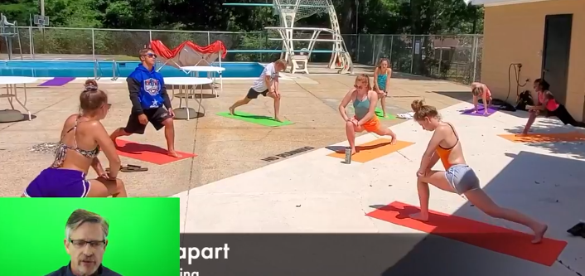
Practice Format
Midlakes Recommends this, and your Club may have their own Safety Procedures...
Practice Layout
Visually mark separate zones using towels/yoga mats/orange cones/duct tape/sidewalk chalk.
Warm-Ups
Dryland warm-up on individual mats/towels, at least 6 feet away from each other.
Diver Equipment during Practice
Each diver should have a dedicated space to keep shammies, towels, jackets, bags, etc. that is 6 ft away from other divers’ equipment. Divers should access their space following distancing restrictions.
No shared equipment, e.g. mats, chairs.
Remember This: Our divers under age 12 are not vaccinated yet. Please take care and practice Covid safety procedures diligently.

Slide 12
Practice Format
Midlakes Recommends, but your Club may have their own Safety Procedures...
Parents
May walk their child to practice
Follow pool guidelines for social distancing and limitations on attendance/capacity
May stay in their cars
If permitted on pool deck, must stay 6 ft apart.
Dive Practice Schedule
Limit capacity based on current pandemic guidelines
Discipline for Not Following Social Distancing Restrictions
Divers who do not follow their club’s social distancing or mask protocols during practice will receive one warning and then be removed from practice if disruption continues.
Coaches should contact parents of any disruptive divers to advise that a warning was given.
Coaches should notify lifeguard on duty and/or pool manager of social distancing infractions. Please check with your pool manager for notification process.

Slide 13
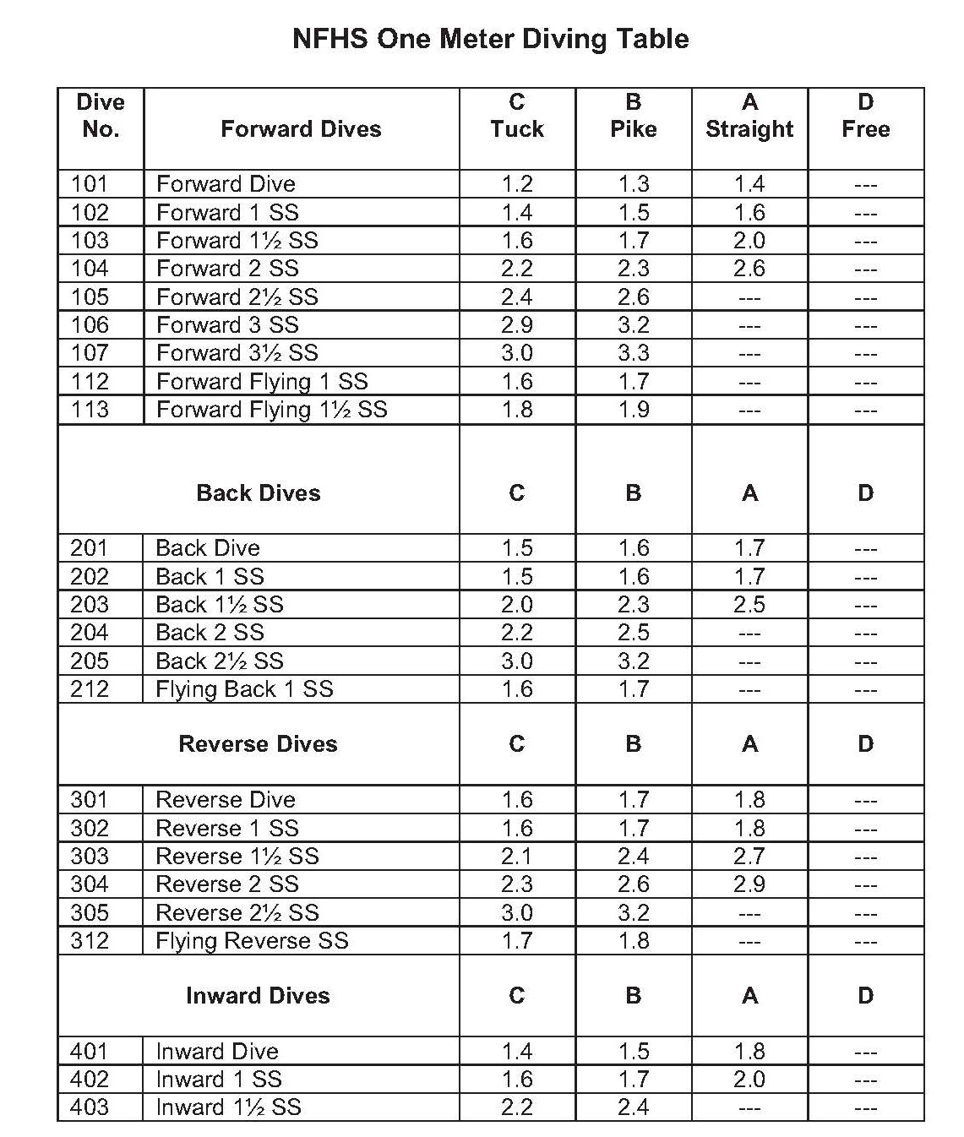
Dive Basics
DIVE GROUPS
Forward
Back
Reverse
Inward
Twist
DIVE POSITIONS
Tuck (C)
Pike (B)
Straight (A)
Free (D)
DEGREE OF DIFFICULTY (DD)
# 101 Forward Dive DD 1.2 Tuck, 1.3 Pike, 1.4 Straight
#201 Back Dive DD 1.5 Tuck, 1.6 Pike, 1.7 Straight

Slide 14
Meet Format Options
In-Person Meets
Our clubs will individually decide if they are able to host dive meets in-person or will hold the meets virtually. This information will be communicated to you prior to the first meet on June 30.
***NEW If held in-person, each club will notify the “Away” team of safety protocols in advance of the meet, e.g. parking, spectators, masking, and other protocols.
Virtual Meets
If a virtual format is selected, then the “Home” and “Away” teams will BOTH host parallel meets at each pool and each team provides at least three judges. Virtual meets may happen at any time that is convenient for the pool on the day of the meet.
The designated “Home” team will be responsible for collecting the scores from the “Away” team and preparing ribbons, then delivering ribbons to the “Away” team’s pool.
The scores of the 3 judges will be used. We will not toss out the high and low score as we would normally do with 5 judges.

Slide 15
Meet Groupings
Meet Groupings – Age, Gender, “A”/”B”
Divers participate against other divers in a similar age group.
Your age is based on how old you are at the start of the season as of June 15 for Midlakes. If you turn 11 on June 17 then you still compete in the 10 and under group. Lucky you!
Girls compete against girls, and boys against boys. There are also 2 levels, A and B.
“A” Divers = divers who won two meets (against competition) in a season, or won dive championships for their age group in the previous season, or were already an “A” diver from the previous season and did not change age groups, or have qualified to dive at state level, or by coach designation.
“B” Divers = everyone else.
“A” divers compete against other “A” divers and “B” vs. other “B”. It often happens that there will be one “A” diver in an age group who automatically wins due to lack of other “A” divers.
Older divers and “A” divers also perform more dives at a meet because of their experience level.
8 and under (basically age 6-8) 10 and under (9 and 10 year-olds) | 12 and under (11 and 12 year-olds) 14 and under (13 and 14 year-olds) 17 and under (15, 16, and 17 year-olds)

Slide 16
Meet Basics
1. Announcer says the diver name and club, the name and number of the dive with the position, and the Degree of Difficulty.
a. Every dive has a number and position. Groups are forward, back, reverse, inward, twist.
b. Position can be tuck, pike, straight, or free.
c. Each dive has a Degree of Difficulty (DD) score.
d. Coaches can change the dive on the board (DD can go down, but not up).
2. After scores are read by announcer, the scoring table will cross off high and low scores and add together 3 remaining scores, then multiply that number by the Degree of Difficulty to provide the diver score for that round.
3. Divers accumulate points each round and are awarded placement based on their total score.
4. After each age group finishes, the announcer shares the results and the award ribbons are distributed.
5. The team with the most points wins the meet.

Slide 17
Required Dives
Midlakes Required Dives
“A” Divers do one extra dive for their age
8’s B: 3 total = Forward jump + 2 dives / 2 groups
8’s A & 10’s B: 4 total = Forward dive + 3 dives / 2 groups
10’s A & 12’s B: 5 total = Forward dive + 4 dives / 3 groups
12’s A & 14’s B & 17’s B: 6 total = Forward dive + 5 dives / 3 groups
14’s A & 17’s A: 6 total = Forward dive + 5 dives / 4 groups

Slide 18
Meet Format
Volunteers provided by the “Home” team (6 total)
Announcer, 2 Scorekeepers, 3 Judges
Volunteers provided by the “Away” team (2 total)
2 Judges
Scoring
With 5 judges, we drop the high and low scores, then total the remaining 3 scores and multiply by the Degree of Difficulty.
Ribbons
The “Home” pool provides the award ribbons for 1st-6th place for each age group.
Virtual Meets
Each team may decide to use only 3 judges due to volunteer availability. Then tally scores and multiply by the DD. We will not drop the high and low.
After the meet, the “Away” team will send their scoring sheet to the “Home” team for tabulation. The “Home” team will send a copy of the final sheet to the “Away” team.

Slide 19
Meet Format
Safety procedures may vary by pool...
Pool Rules/Recommendations
Temperature check at pool entry may be required. Check with your pool’s procedures.
No use of locker rooms
One at a time entry to use toilet only, wash hands
One-way travel into and out of pool deck area from outside facility
One-way travel around pool deck
Family viewing areas (if permitted due to attendance or pool capacity restrictions) will be designated and set up prior to meet within current pandemic guidelines.

Slide 20
Spectators
APPLAUD EVERY DIVER!
Spectators, if the pool permits families to remain as spectators, make sure you clap for every dive, not just your own athlete! Let’s make this a fun and supportive season!

Slide 21
Midlakes Dive Summer 2021
Volunteer Judge and Scorer Training
June 19, 2021
Hosted by Kathy McDonald & Pauline Fox, Midlakes Dive Co-Representatives midlakesdiving@gmail.com

Slide 22
Be Confident Judges!
Don’t be nervous.
Judging is easy to learn.
It’s the best seat at the pool.
Meets cannot happen without you!

Slide 23
Midlakes
Judging Video
Intro & example dives
(7 min)

Slide 24
Three Parts of the Dive
Midlakes Diving is intended to be a fun, recreational sport. Scores given to divers represent the best attempts of our parent volunteer judges to help divers get used to being evaluated and to encourage self-development and healthy competition.
THE THREE PARTS OF THE DIVE
APPROACH AND HURDLE
FLIGHT
ENTRY

Slide 25
Approach and Hurdle
APPROACH AND HURDLE
The approach and hurdle comprise the diver’s actions on the board before and including the takeoff. A quality approach will create momentum and a great hurdle will generate power, and height for the dive. This allows the diver more time in the air to perfect position and execute somersaults and twists.
A quality forward-facing dive will include a 3-step hurdle. This means the diver’s arms will swing back and forth and raise up in time with their steps. Additionally, their knee will lift to aid in the power and height of the dive.
A quality backward-facing dive where the diver stands at the edge of the board looking back toward the ladder, e.g. back dives and inwards, will include a steady stable initial position followed by dropping and then lifting the heels off the edge of the board with an arm circle timed with the heels to create power and height.

Slide 26
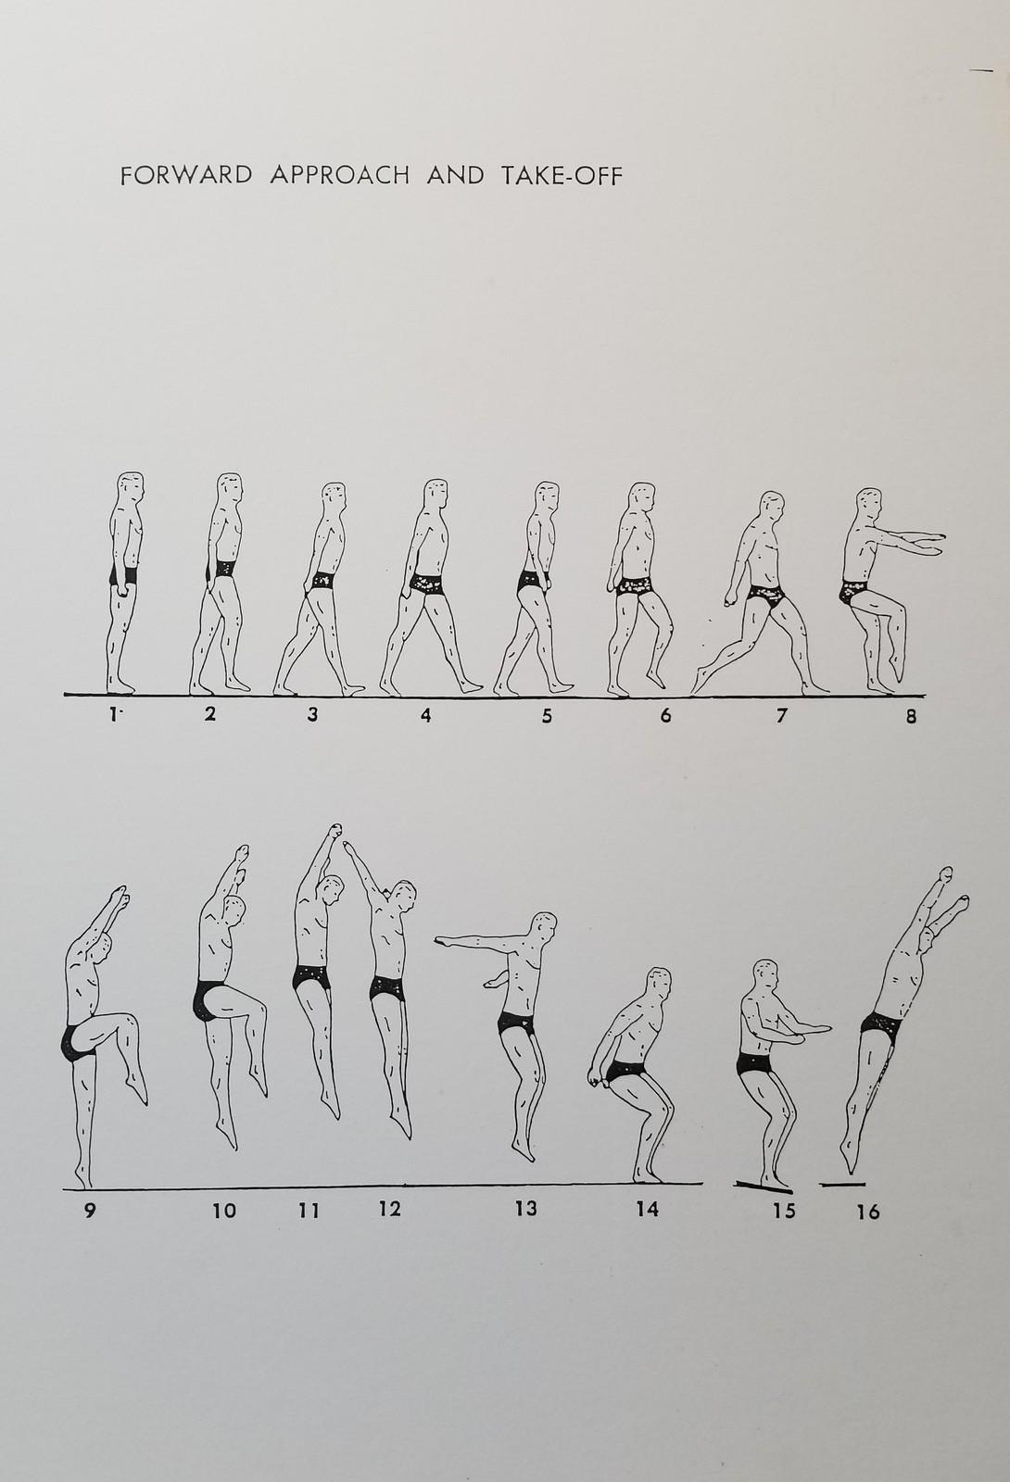
Approach and Hurdle
APPROACH AND HURDLE (cont’d)
Here is a visual aid for the forward approach.
The diver moves their arms as they stride then lift their knee to create power in the spring before dropping back to the board for the powerful takeoff.

Slide 27
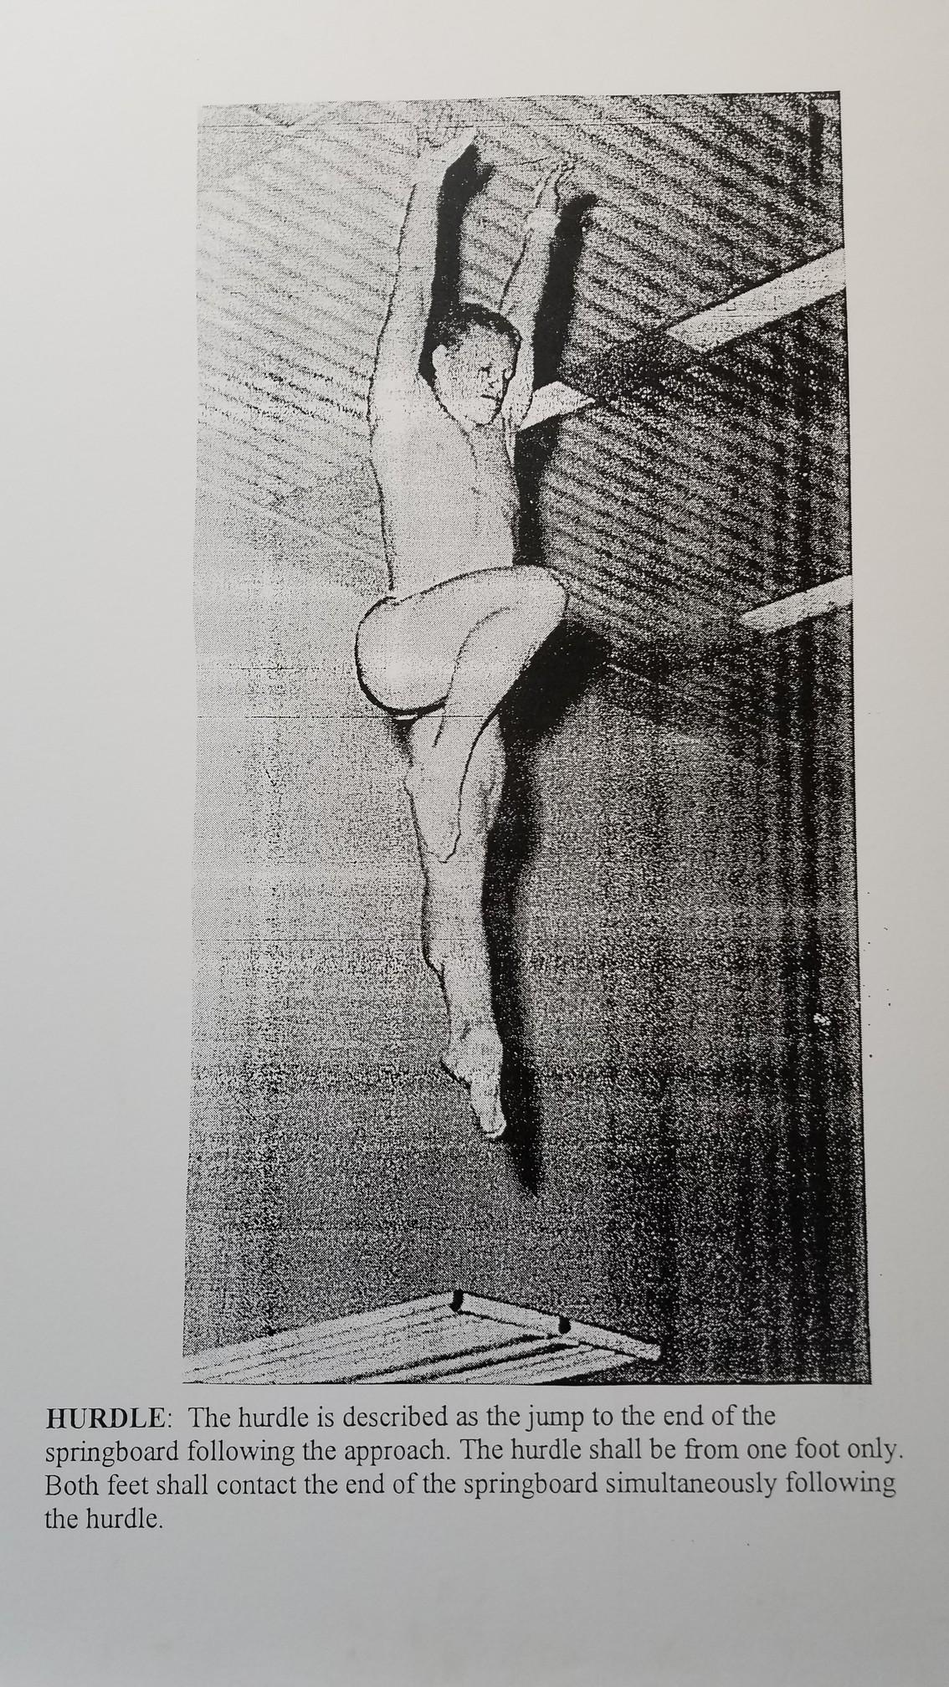
Approach and Hurdle
APPROACH AND HURDLE (cont’d)
Here is another visual aid for the forward hurdle position. From this point the diver has generated power in the spring to create height in the dive.

Slide 28
Approach and Hurdle
APPROACH AND HURDLE (cont’d)
Evaluating the Approach and Hurdle
Did the diver execute a hurdle? If not, there may be limits on scoring, e.g. for a “line-up” where the diver simply falls into the water from a standing position, or a 1-step, standing, or incomplete hurdle.
Was the diver’s approach and hurdle graceful or awkward? A graceful, easy hurdle that seems effortless should score better.
Did the diver create power and height with their hurdle? A dive that left the board with strength and confidence and rose up higher should score better.
A quality hurdle is hard to do! This is the most important part of the dive since a poor hurdle typically results in poor quality for the rest of the dive. Make sure to pay attention to this part and reward divers accordingly.
ONE-STEP HURDLE = MAX SCORE 4 POINTS

Slide 29
Dive in Flight
FLIGHT
This is the diver’s position and execution of the dive while in the air.
Dive positions include:
Straight – The diver’s body should be straight as an arrow during flight.
Pike – The diver’s body should appear to bend in half at the waist as they grab the back of their calves before extending to a straight entry
Tuck – The diver’s body should tuck their knees to their chest and grab them around the shins before extending to a straight entry.
Free – Usually used with twisting dive. The diver would not appear straight, pike, or tuck.
Somersaults and Twists
The execution of the announced number of somersaults and twists.
Is it a 1 SS or a 1 ½ SS?
Is it a ½ twist or a full twist?

Slide 30
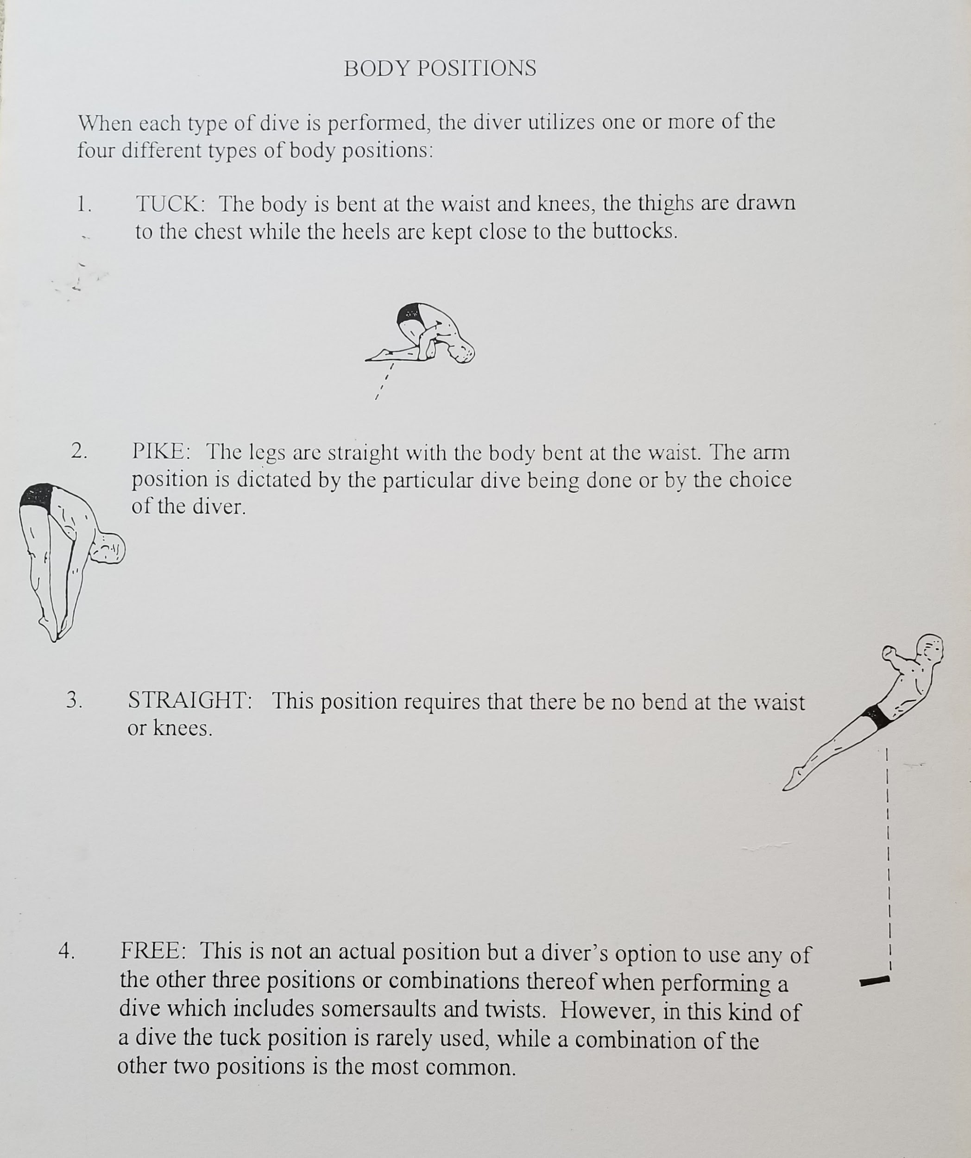
Dive in Flight
FLIGHT
An illustration of the positions.

Slide 31
Dive in Flight
FLIGHT (cont’d)
Evaluating the Flight
Did the diver generate a good amount of height? Insufficient height means the diver may not have enough time to achieve the desired position or rotations.
Did the diver get into position, i.e. pike, tuck, straight? If not, it may be considered a “failed dive”. If they achieved the correct position and “locked in” their pike or tuck or held a ramrod straight body in the the mid-flight, the diver should score higher. If they got into position but looked sloppy or didn’t “lock in” their tuck or pike, the dive should score lower.
Did the diver’s dive appear graceful or awkward? A dive that appears graceful and seems effortless should score better.

Slide 32
Entry
ENTRY
The entry means just what it sounds like – when the diver enters the water. A quality entry has several components:
Completion – The diver should have completed the execution of the flight portion and returned to a straight position for entry to the water. Issues may include:
Still in tuck or pike
Still in rotation or twist
Position – Arms should be directed toward the water.
For a head-first entry, arms should be straight, next to the ears, and hands locked.
For a feet-first entry, arms should be straight, locked to the sides of the body pointed down.
Jumps are an exception since they are a skill and arms should always be in the upright position despite the feet-first entry.

Slide 33
Entry
ENTRY (cont’d)
Splash – The less splash the better! This means the diver has achieved a straighter body and more vertical position and has cleaved the water neatly with their hands. A diver with relatively less splash should score better.
Location – The diver should enter the water close to the board at a reasonably safe distance.
This isn’t swim team! We are not aiming to get across the pool.
Divers should go up, then come down, not go out.

Slide 34
Entry
ENTRY (cont’d)
Evaluating the Entry
Did the diver complete the flight portion of the dive and execute all positions, twists, and rotations and returning to a straight position for entry?
Did the diver enter the water with arms in the correct position for jumps, head-first, or feet-first dives?
Did the diver control the splash?
Did the diver end at a safe but close distance to the board? Too close where you feel the diver was unsafe would score lower. Too far with an angled and not vertical entry also scores lower.

Slide 35
Scoring
SO HOW DO I SCORE IT ALL?
A perfect 10 is an Olympic caliber dive. Our young athletes are not at this level. Most dives will fall between 3 and 7. It helps to consider all three parts of the dive and evaluate them, then add them. For instance
Approach and Hurdle
Really strong, graceful, and generating height – 2.5 - 3
Solid with less grace or height – 1.5 – 2.0
Sloppy or awkward - 0.5 or 1.0
Flight
Great height, achieved position, appeared graceful almost easy – 2.5 - 3
Good height, mostly in position, completed satisfactorily – 1.5 – 2.5
Sloppy or awkward, break in position - 0.5 or 1.0
Entry
Achieved straight vertical entry, minimal splash, appeared graceful almost easy – 2.5 - 3
Solid with less grace or more splash, possible slight rotation at entry – 1.5 – 2.5
Sloppy or awkward, splashy, not vertical, didn’t complete flight portion - 0.5 or 1.0
Scoring: 2.0 + 1.5 + 1.5 = 5.0 1.0 + 1.5 + 1.0 = 3.5 2.5 + 2.5 + 2.0 = 7.0

Slide 36
Scoring
BE CONSISTENT!!
After you evaluate the first dive, you can simply go up and down relatively from there.
For instance, you feel like the first dive merits a 4.5 – it had a good hurdle and height but was a bit sloppy in air and ended splashy.
The next diver was more graceful, really straight, nice vertical entry with less splash but was a little bit rotated when they entered and didn’t get a lot of height. Maybe that is a 5.5.
The diver after that had great hurdle and height, a slight break from their straight dive in the air, but an excellent entry. She might get a 6.0.
The next diver was somewhat in between the first and the second so you score her a 5.0.
A dive needs to really make you think “WOW” before you give it a 7 or higher.

Slide 37
Scoring
Common questions...
Do I give a bigger score to a more complex dive?
No. The Degree of Difficulty or DD makes up for the complexity. A forward jump has a DD of 1.0. A forward somersault in the Tuck position has a DD of 1.2. A backward somersault in the Pike position has a DD of 1.6. The DD is multiplied with the total of the judges’ scores and this allows a diver doing more complex dives to score better even if they did not do as well as the diver doing a simpler dive.
Do I give a bigger score to the little kids? They’re so cute and I don’t want to hurt their feelings.
No. They are cute, however these are competitive athletes and they are also pretty smart. They will know if they don’t deserve the inflated score and it will cause them to question the judges’ fairness. This can actually ruin the sport for them. Be fair. They know when they do well and they know when they don’t.

Slide 38
Scoring
More common questions:
I’m still nervous about judging even after the training? Do I have to do it?
Your team needs you to volunteer. It takes a lot of practice to become confident in judging and the only way to get the practice is to do it. It’s okay to be nervous. Just give it a go. It gets easier over time.
I think I gave too high of a score to the first diver. Should I reset for the next diver to something more reasonable?
No. The important thing is that you stay consistent. If you see that you are higher than the other judges, then that’s okay. Your bar is set differently. As long as you are consistently higher and rewarding better dives with higher scores and worse dives with lower scores it will all average out.
My score was a lot different than the other judges’ scores. Did I do it wrong?
It’s okay to confer with the other judges and ask why they gave a higher or lower score than you did. Maybe they saw it differently. You might have missed the lack of height in the dive or maybe they didn’t see the rotation at entry that you saw. That’s the beauty of having multiple judges.

Slide 39
Exceptions
GOT IT ALL FIGURED OUT?
Let’s talk about a couple of other things!
Exceptions
Jumps – straight body, no rotation
Eggroll – a skill that prepares divers for somersaults and the sensation of spinning in the air before entering the water
Lineup – a dive from a standing position with no approach or hurdle
Coach-Assisted Dives – the coach actively helps the diver on the board
Back Dive ½ Twist – an extra dive that we add for divers without enough variety in their portfolio
Free Position – typically for twisting dives where the diver may use arms to generate rotation
Balks, Failed Dives, Breaks in Position
Balk – the diver had a significant break in the approach and hurdle
Failed Dive – the diver did the “wrong” dive, e.g. 1 SS instead of 1½ SS, or tuck instead of pike, etc.
Broken Position – the diver left the assigned position, e.g. had knees tuck when should be straight. This may result in a failed dive or at least a scoring deduction depending on the break.

Slide 40
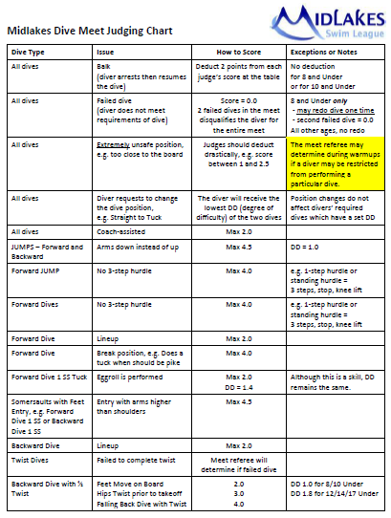
Judging Chart
In a nutshell…
We have this Judging Chart available on the Dive page of the Midlakes website with scoring forms, dive lists and requirements, judging information and more.
Midlakes Forms:
https://www.teamunify.com/SubTabGeneric.jsp?team=reclmslwa&_stabid_=199459

Slide 41
Questions?
QUESTIONS ON ANY OF THESE DIVES?
Forward Jump and Back Jump
Forward Dive
Back Dive
Egg Roll
Front Somersault
Back Somersault
Inward Dive
Back Dive Half Twist
Reverse
QUESTIONS ON ANY OF THESE POSITIONS?
Straight
Tuck
Pike
Free

Slide 42
How to Score a Dive
Volunteer Scorer Training
At each meet, the announcer calls out the diver’s name, their club, and the dive to be performed.
The diver executes the dive and the judges rate it using the dive scorecards.
The scorer collects the scores from the judges as announced, totals them, multiplies the total score for the dive by the degree of difficulty, and then adds together the cumulative score of all the dives.
The announcer continues to the next diver and the process begins again.
At a virtual meet, just one scorer may be used to collect the scores.
Later the scorer can enter them to the spreadsheet for tallying and computation.
The “away” scorer will email their sheet to the “home” scorer.
The new tally spreadsheet is located on our Midlakes website along with other forms at:
https://www.teamunify.com/SubTabGeneric.jsp?team=reclmslwa&_stabid_=199459

Slide 43
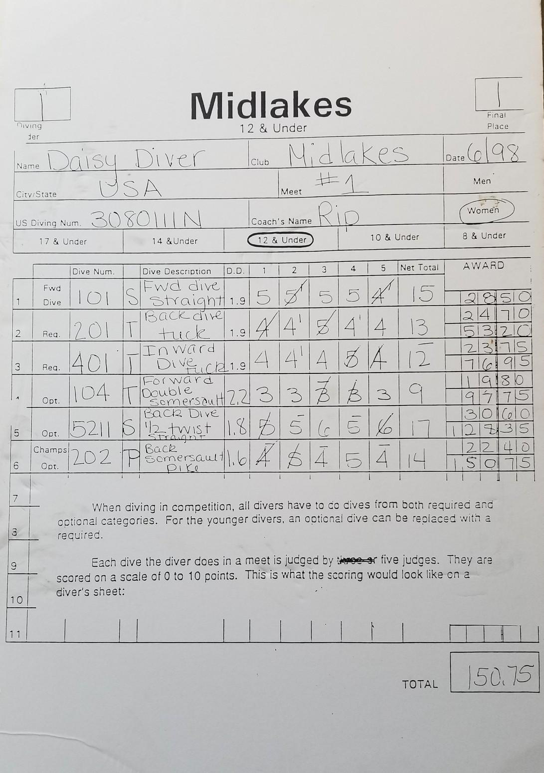
Marking a Score Sheet
Recording & Adding Scores
Here is a sample dive score sheet. You can see that Daisy from “USA” dive team performed 6 dives.
The first dive is a required dive and the Degree of Difficulty (DD) is set by Midlakes rules regardless of the position (tuck, pike, straight).
Scores with a half, e.g. 3.5, 4.5, 5.5, are notated with a straight mark over or to the upper right of the whole number.
This makes it faster when recording.
The remaining dives have DDs that are based on the type of dive and position. The high and low score are removed. Then the remaining 3 scores are totaled and multiplied by the DD.
Then track the ongoing total as each new dive is scored.

Slide 44
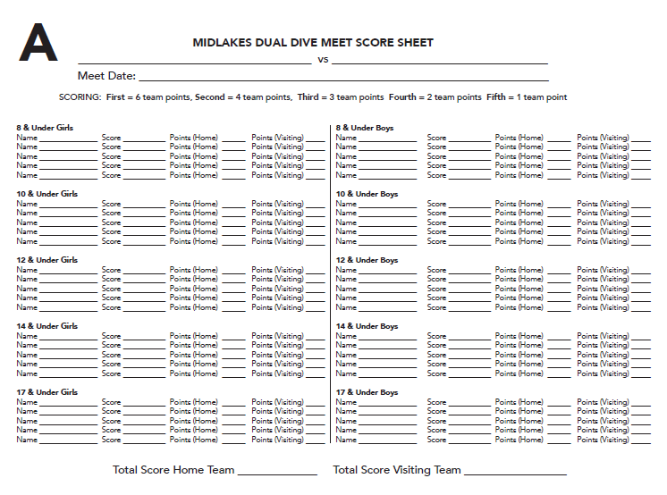
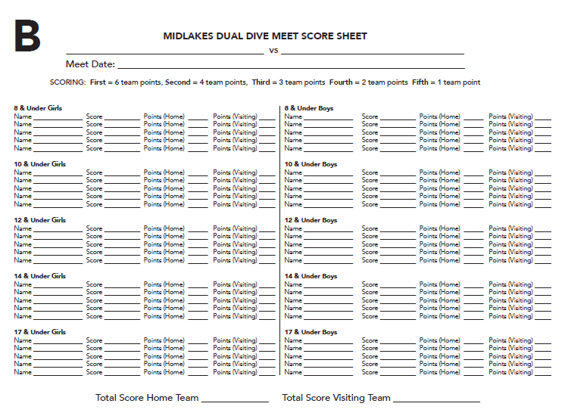
Dual Meet Score Sheet
Volunteer Scorer Training
Here is a sample of the final meet scoring sheet. Use one for “A” level divers and one for “B”. Send a copy of these to the Midlakes Dive Rep after the meet.

Slide 45
QUESTIONS?
Thank you for joining us, Parents.
Enjoy the season and have a great time! Thank you for participating!
We will post this presentation on the Midlakes Dive Website.

