Slide 1
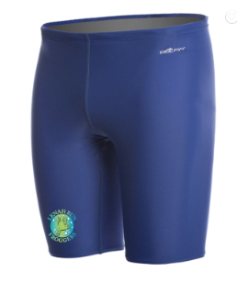
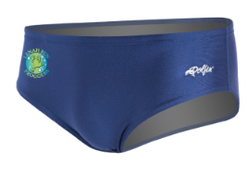
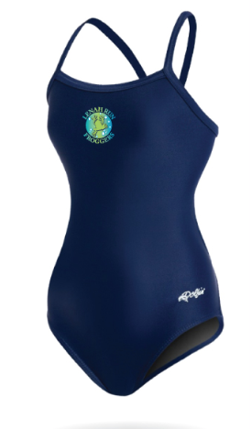
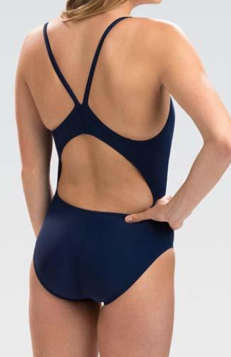
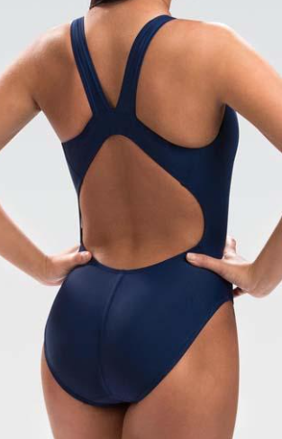
LENAH RUN FROGGERS
Dolfin Xtrasleek Solids…is the swim suit for the season, we are going with a solid color in hopes of making the ‘uniform’ more consistent from season to season so we look more like ‘one team’…even if a new suit is not purchased every year.
LADIES will have two suit options – V2 Back or HP Back, and SPIRITPACK WILL INCLUDE ($60) one suit, one swim cap (silicone), and one team t-shirt
MEN will have two suit options – Jammers ($45) or Briefs ($40), and SPIRITPACK WILL INCLUDE one suit and one team t-shirt
***Additional caps will be available for purchase for Men & Ladies
The new logo…
Ladies option – V2 back
Ladies option – HP back

