Slide 1
Mountain High Swim League Scoring Presentation 2019
Scoring Committee

Slide 2
MHSL Scoring Training 2019
Contact Info
Strong Recommendation: use “permanent” e-mail addresses
Meet your Division's Scoring Committee Representative
The High Notes
How to Run a Meet (tutorial)
This Does Not Cover Team Unify / Team Manager
The league provides Meet Manager
Your team’s Management Software is your team’s responsibility
Contact your vendor’s Support for Help

Slide 3
Scoring Committee
Scoring Chair: Sandra Kelly (Dam West)
A1 Division Rep: Kath Tanner (Wheatlands)
A2 Division Rep: Curt Gooden (Cook Creek)
B Division Rep: Ellen Stotler (Castle Pines Crocs)
C Division Rep: Jason Williams (Castle Pines Village)
D Division Rep: Larry Sifers (Willow Creek III)
Call your division representative if you have a scoring issue
Report dual meet scores to division rep by Sunday 6 pm

Slide 4
The High Notes
Division Realignment
MM 6 Current Version: 6.0Ea (no updates unless a bug)
P & P update reminders:
Only accept a single entries file (subsequent relay-only file OK)
Mandatory Exceptions Report
Deck Adds: Swimmers not previously entered in meet can deck-add
Swim-offs
Score to Division Scoring Rep
Meet DQ Record form (after meet)—for all home meets--optional
Paper Chase—due at AS Heating meeting
Cards for Relays
Meet Mobile
New Records & New AS19—on website
Records Submission

Slide 5
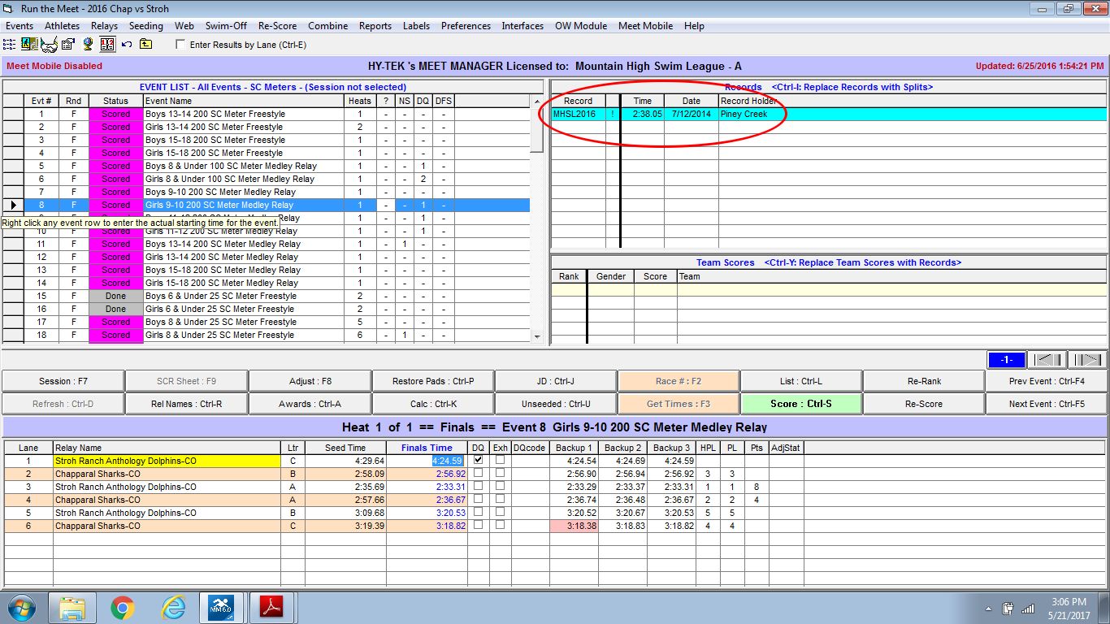

Slide 6
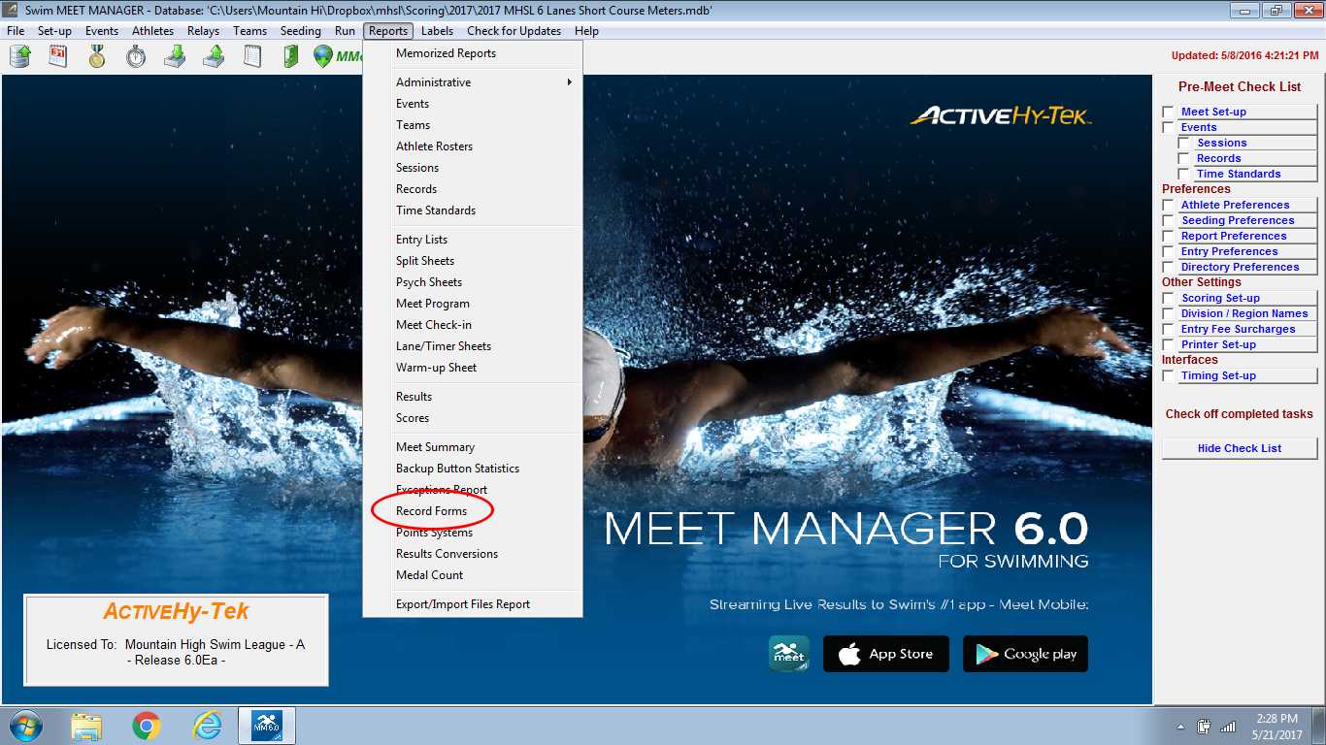

Slide 7
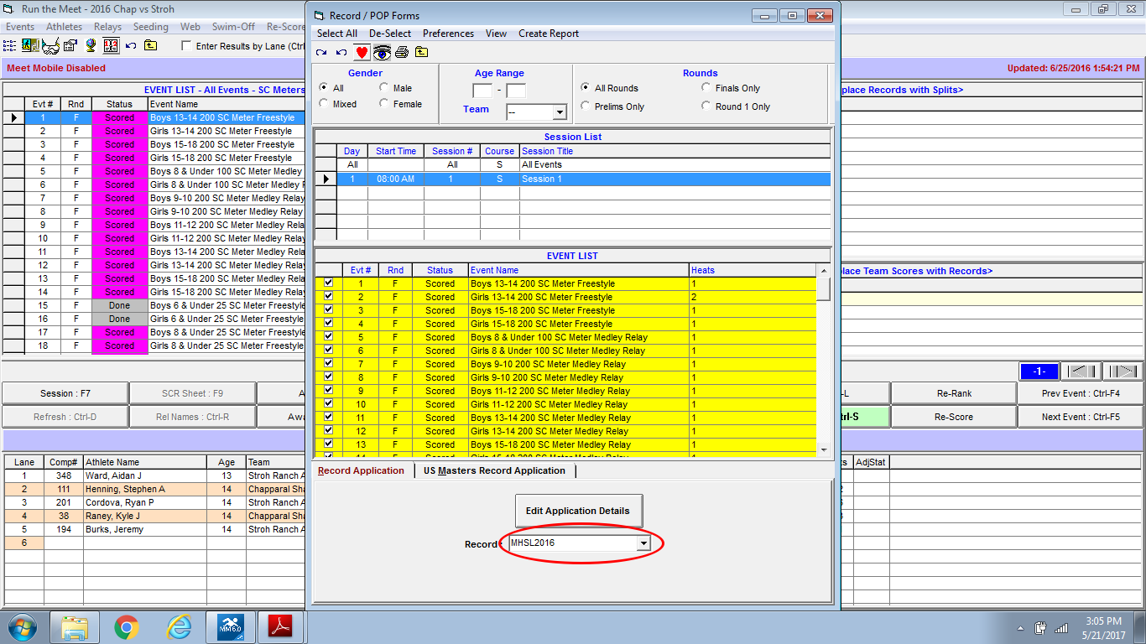

Slide 8
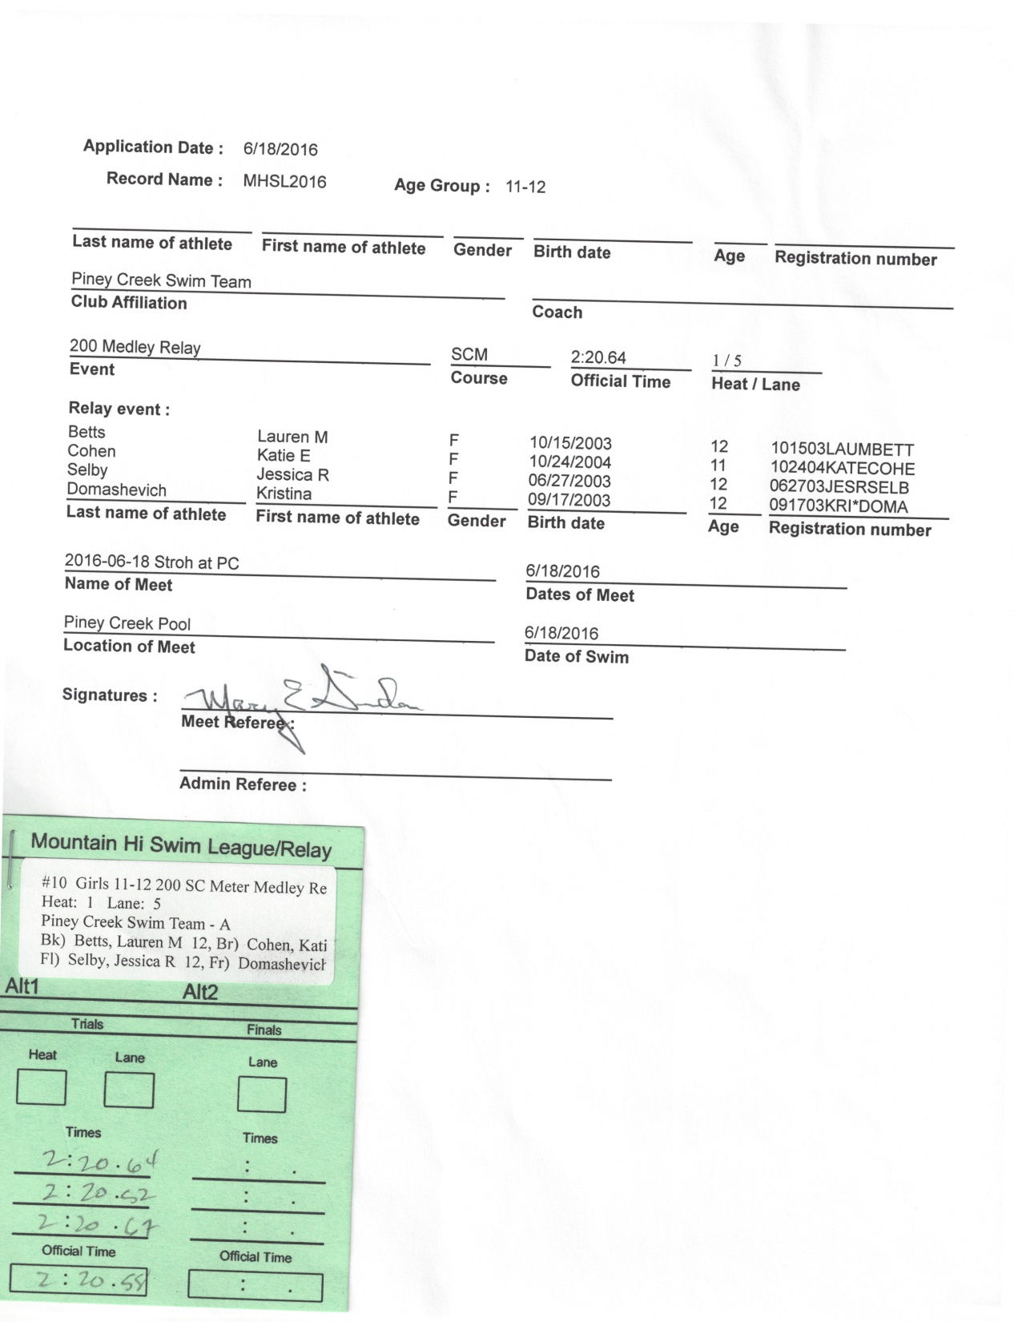

Slide 9
Championships
Swimmer Eligibility
Attended 10 Practices
Participated in 2 MHSL Dual Meets
One Meet, Multiple Sessions—Customized for each Division
Only Accept One Entries File per Team
Relays-only Entries for Finals OK
Deck Adds Day-Of Prelims for Un-entered Swimmers Only
Mandatory Exceptions Report
Over-Entered Swimmers
If found before heating meeting, let coach resolve
After heating meeting, take first 3 events
Swim-offs

Slide 11
The Big Picture
Team A |  |  | Team B |  |  |  | Set Run Preferences |  | During the Meet
TM Entry Files/Roster |  |  | TM Entry Files/Roster
 |  |  |  |  |  |  | Make scratches & Changes
 |  |  |  |  |  |  | Run the meet
 | Meet Manager
 | Seed the meet
 |  |  |  |  |  |  | Export & E-mail Meet Results
 |  | Print….
 |  | 1. Entry Card Labels |  |  |  |  | Print….
Before the meet |  | 2. Meet Programs |  |  |  |  | 1. Award Labels |  | After the Meet
 |  | 3. Timer sheets |  |  |  |  | 2. Meet Results
 |  | 4. Entry Reports |  |  |  |  | 3. Score Reports
 |  | 5. Meet Timelines
 |  |  |  |  |  |  | Manage Files
 |  |  |  |  |  |  | Submit any League Records
Enable Meet Mobile

Slide 12
Pre-Meet Preparation
Both teams will send you their entry files from whatever team management software they use by 5:00pm on Wednesday.
Host scoring person seeds the meet, sends seeded meet plus notes about combining heats back to visiting team by 9:00am Friday (the sooner you can do this the better).
Prior to Saturday you should create entry labels, meet programs, lane/timer sheets, entry lists for each team, and a meet timeline.
Coaches from both teams may e-mail corrections or changes to you during this process. Please make those changes & corrections when you get them.

Slide 13
Meet Day
During the course of the meet you will accept scratches and deck adds (un-entered swimmers!) Note: Make sure you look at the P&P’s and are familiar with the deck add rules.
As races and data come in you enter that data into meet manager (manual/timing system) and score the meet. DO NOT SCORE 6 & Under Events!!
Periodically print results and post around pool area to avoid parents crowding your table asking how fast their swimmers went.
Once the meet is over Host Scoring person sends results to visiting team and the score to the Division Scoring Rep by 6:00pm on Sunday.

Slide 14
Meet Manager Reports
Meet Program
Session Time Line (How long the meet will last?)
Entry Lists (By swimmer)
Lane/Timer Sheets (If at a cardless meet)
Results (Post every 10 events around the pool)
Score (Give to the announcer every 10 events)

Slide 15
Who do I make reports for?
Parent Delegates—2 copies of the meet program
Home & Visiting Coaches—6 meet programs, 1 timeline, 1 entry list for their team.
Officials—12 meet programs, 4 timelines
Clerk of Course—6 meet programs
Scoring Table—3 meet programs
Announcer—1 meet program
Concessions—1 meet program
Timers—lane/timer sheets
Extra Copies—at least 1 meet program (I usually have around 5 extra)

Slide 16
Equipment & Supplies
Computer w/ MM Software & Printer
WiFi Hotspot (Clubhouse or via Phone)
Surge protector & Extension cords
Flash Drive
Paper
MM Instruction Manual
Sectioned Dividers to organize deck cards
Pencils, Pens, Black Sharpies
Stapler, rubber bands, tape, paperclips or clothespins
Paperweight (rocks work well)
Boxes to put deck cards, lane/timer sheets, & other official papers in
Containers for each team's DQ slips

Slide 17
What does the scoring table look like?
Somewhere away from the action and DRY!!!
6-8 Volunteers (you want people from both teams).
Someone “in charge” who isn’t the computer person.
Timing Judges (1-2): Process deck cards by heat, determine correct time for each swimmer. Circle median time of the three times listed. If only 2 times, average them w/o rounding up, 1 time that is the official time.
Computer input (1-2): Enter time from cards or pull times from Dolphin system. Score the meet, print results.
Scoring Runner (1): Post results, get missing cards, delivers DQ slips to coaches.
Score Verifiers (1-2): Verify we are scoring correctly.

Slide 18
MHSL P&P’s Regarding Scoring
Swim Ups- A swimmer may compete in his/her legal age group AND an older age group provided:
He/She does not repeat the same event.
Once he/she advances to an older age group , he/she may NOT return to his/her legal age group for the remainder of the meet (except for the Medley Relay).
For relays at all meets, as long as at least one swimmer is in the correct age group, others may move up (not down) from any age group to swim in a relay. Swimmers may not swim on more than one medley relay or more than one free relay.
6 & Under can swim up to 8 & Under and come back down (because it is 8 & Under).

Slide 19
MHSL P&P’s Regarding Scoring
Relays – For DUAL meets, MHSL recommends only 3-4 relay entries are allowed per event. Actual number is agreed upon before seeding.
Relays – For CHAMPIONSHIPS, recommend only 2 relay entries allowed per event. Actual number is agreed upon by division.
Ties – For DUAL meets, ties stand. MM splits points between the two swimmers.
Ties – For PRELIMS, ties are broken using swim-offs. Swim-offs require their own event, and swimmers may qualify for All-Stars and Records.

Slide 20
MHSL P&P’s Regarding Scoring
Dual Meet Format – It is recommended that all deck changes and the swimmers' names for the medley relays are to be submitted to the scoring table a minimum of 30 minutes prior to the start of the meet. For the freestyle relays it is recommended that swimmers' names for the relays are submitted no later than event 71.
NOTE- This is a recommendation. The teams’ parent delegates should have agreed upon a deadline for changes and additions prior to the meet.

Slide 21
Look these up in the P&P’s
Officials and their duties
Scoring
Championship & All-Star Meets
8&Under Age group, Special considerations
Awards
Records
Must be submitted to Scoring Chair (Sandra Kelly) with proper documentation and a copy of the results and the event card or lane/timer sheet by TUESDAY after meet.

Slide 22
Questions????
If you have already done scoring before you are now free to leave. Thank you for coming!
If you are new to scoring we will be running through a mock meet from start to finish to show you how to do everything.

