Slide 1
asdfasdf
Mudrats Summer swim team
New FAMILY meeting - 2021

Slide 2
Agenda
Mudrat MiSSION
Mudrat parent board
Communication
Eligibility
Registration and fees
Covid safety protocols
Mudrat coaches
Practice
meets
PARENT Volunteer requirements
Spirit wear
Q&A

Slide 3
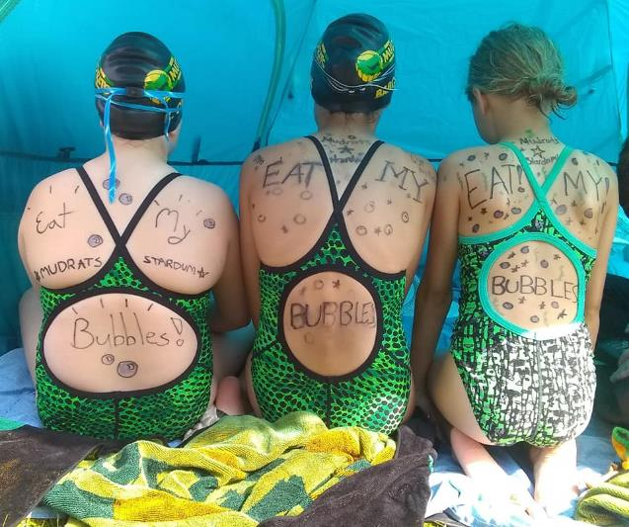
Mudrats have more fun!
Goals of the Mudrat swim team include:
Providing a healthy, safe, and enjoyable summer activity.
Improving individual swimming skills and abilities.
Experiencing a competitive team effort by supporting all teammates.
Experiencing an organized social environment.
Developing individual self-confidence.
Learning to compete, not by winning or losing, but by doing their personal best

Slide 4
2021 mudrat parent boArd
President – Carrie Smolinski
Webmaster – Tony Alberti
NSC Representatives – Jennifer Babcock and Larissa Bettenhausen
Treasurer – Dawn Blanton
Secretary – Liz Mares
Concessions – Heather Humikowski
Scoring – Karen Curran and Sherri Ventsam
Parent Participation – Stephanie Pittman and Heather Long
Social Events – Kristi Athas
Ribbons – Carrie Simkins
Spirit Wear – Jackie Ward
Naperville Park District – Jackie Gonzalez

Slide 5
Communication
Mudrat website (www.mudrats.org)
Primary source of information throughout the season
Up to date schedule: practice, meets, social events
Parent handbook, Code of Conduct
Email
Email blasts from website
Email addresses of Parent Board members listed on website
Facebook

Slide 6
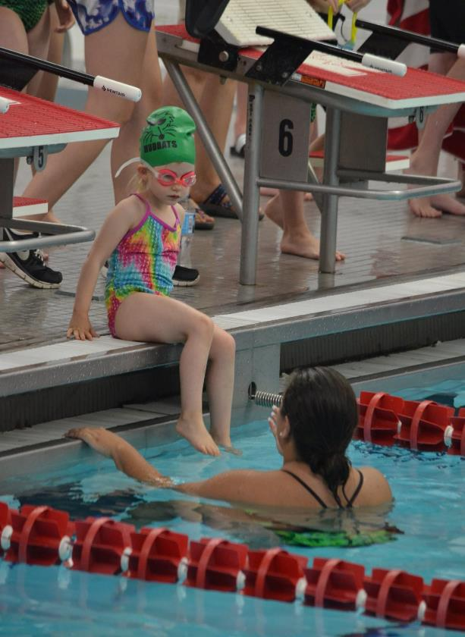
Eligibility requirements
Mudrats Swim Team is the only public swim team in the Naperville Swim Conference
Swimmers must be between the ages of 4 and 18
Swimmers should be able to complete a length of the pool (25 yards) unassisted
Older swimmers will be able to assist the youngest swimmers in the water during meets in June
Age groups are as follows:
6&U, 7-8, 9-10, 11-12, 13-14, 15-18

Slide 7
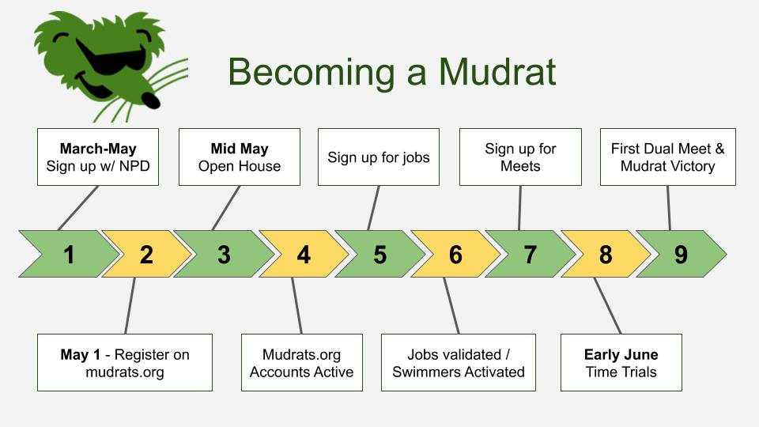
Registration and fees
Registration fee – payable to Naperville park district
Coach’s salaries
Pool rental fees (Indoor Pools)
Lifeguard salaries during Mudrat events
Activity fee – payable when registering on mudrats.org
2021 fee is $26 per family
Primary fundraiser for awards, social activities, program support

Slide 8
Covid protocols and safety
Based on IL Department of Commerce & Economic Opportunity (DCEO)
Guidelines are updated frequently and posted on the Park District website
https://www.napervilleparks.org/news/coronavirusinformation/participationguidelinesprogramsandfacilities
Refer to the Participation Guidelines for Youth and Adult Recreational Sports
Protocols at away meets to be set and communicated by host pools

Slide 9
2021 mudrat COACHING STAFF
Head Coach – Joe Talbot (headcoach@mudrats.org)
Assistant Coach – Jessica Sanders
Assistant Coach – Sonja Shirkevich
Assistant Coach – Ann Borow

Slide 10
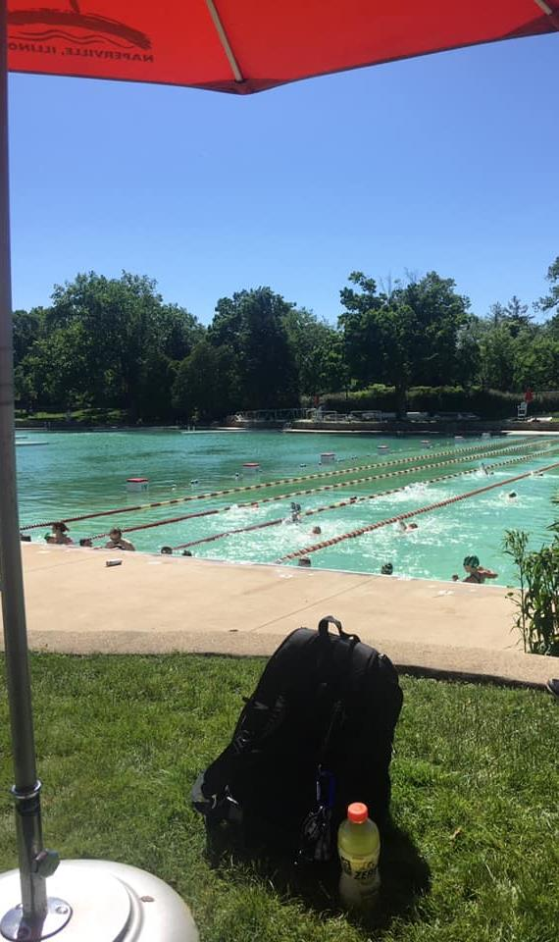
SWIM PRACTICE
Most up-to-date practice schedule can always be found on the website
First two weeks of the season, we practice in the evening
Typically indoors at Naperville North or Naperville Central HS
2021 schedule is TBD
Third week of the season onward, we practice in the mornings at the Beach

Slide 11
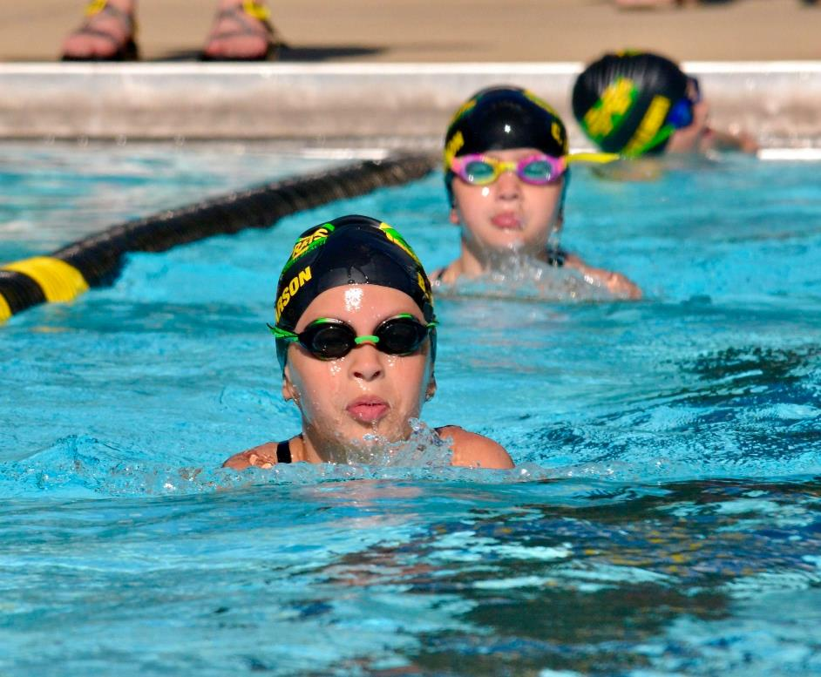
Required gear
Suit, cap, goggles, towel
Sneakers, shorts, and warm clothes for dryland workout if it is too chilly to swim
Optional team suit and cap

Slide 12
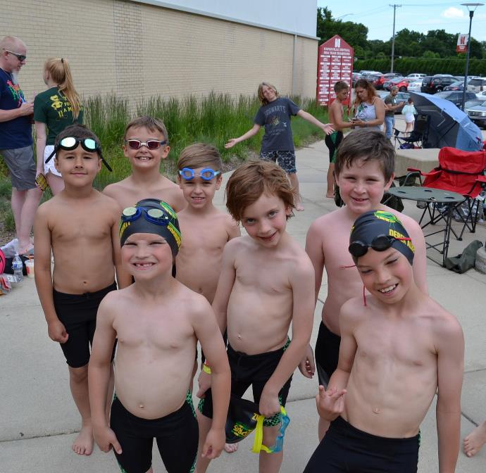
SWIM MEETS
Time Trials – Mudrats only, early June
Dual Meets - Against other teams in the Naperville Swim Conference
Typically 6-8 per season
Typically Tuesday, Thursday evenings and Saturday mornings; 3-4 hours long
Championship Meets – Classic and City – End of July
Swimmers are signed in/out of all meets on the website; deadline one week prior
Coaches make the final determination of events

Slide 13
2021 SEASON Meet schedule Subject to change, always refer to the website for the most up-to-date Schedule
Saturday, June 5: Time Trials
Bensenville Water’s Edge Aquatic Center, 11am
Saturday, June 12: Naperville Tennis Club
Tuesday, June 15: White Eagle
Saturday, June 19: Huntington
Tuesday, June 22: Steeple Run
Thursday, June 24: Huntington Estates Invite
Saturday, June 26: Breckenridge
Tuesday, June 29: Huntington Estates
Tuesday, July 6: Hobson West
Saturday, July 10: Stillwater
Thursday, July 15: Naper Carriage Hill Invite
Championship Meets – TENT.
Saturday, July 17: Classic
Friday & Saturday, July 23 & 24: City
Swimmer and Volunteer Check-in: 7:30 am Saturday Meets and 4:30 pm Tuesday/Thursday Meets
Warm-Ups Begin: 7:45 am Saturday Meets and 4:45 pm Tuesday/Thursday Meets
Meets Begin: 8:30 am Saturday and 5:30 pm Tuesday/Thursday

Slide 14
PARENT participation
Mudrats events and swim meets are driven by family participation
Each meet requires approximately 35 parents; home meets require more
Each family must work a minimum of 5-6 jobs over a normal season* plus Championship meets
Swimmers cannot register for meets until family has signed up for the required number of jobs
$50 fee for each missed job charged to credit card on file 3 days after missed job
*Season family job requirement is calculated after registration is complete
*2021 might not be a normal season!

Slide 15
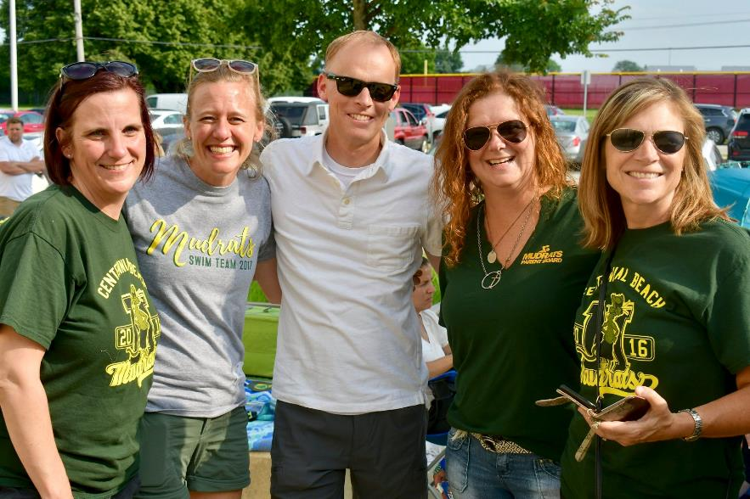
What is a “job”?
A “job” is a role that allows a swim meet or season social event to function
Majority of jobs are worked during meets
Mudrats cannot function without the tremendous support of our parents!

Slide 16
timer
Timers stand at the pool lanes and use a stopwatch to record swimmer’s times during the meet.
12 – 24 timers needed at every meet (3 timers per lane plus backup/relief timers)
Requires you to be on your feet throughout the meet
Excellent view of each event
Cannot closely supervise young children

Slide 17
Meet officials
Stroke and turn judge (first year meet official)
Starter and referee (experienced official)
Training clinic counts as a job
Dates of training clinics for 2021: May 10, 12 (evening events); May 15 (morning event)
USA Swimming or YMCA certified officials do not have to attend training clinic
Cannot closely supervise young children

Slide 18
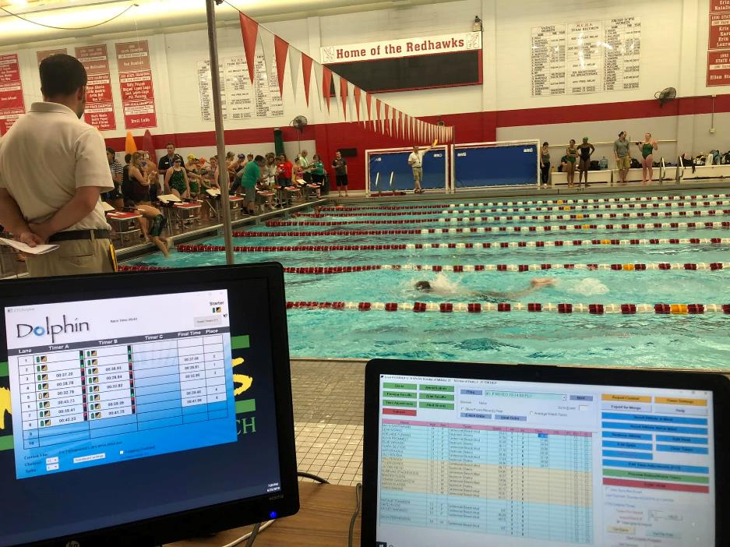
Scoring – time verification
Verifies the time and score of all swimmers
2 scorers are required at every meet
Able to sit through-out the meet
Can move to pool to watch your swimmers’ events
Cannot closely supervise young children

Slide 19
Concessions
Set-up, sell, replenish and clean-up food and beverage items during home meets
4 concession people are required at every home meet
Requires you to be on your feet throughout most of the meet
Can move to pool to watch your swimmers’ events

Slide 20
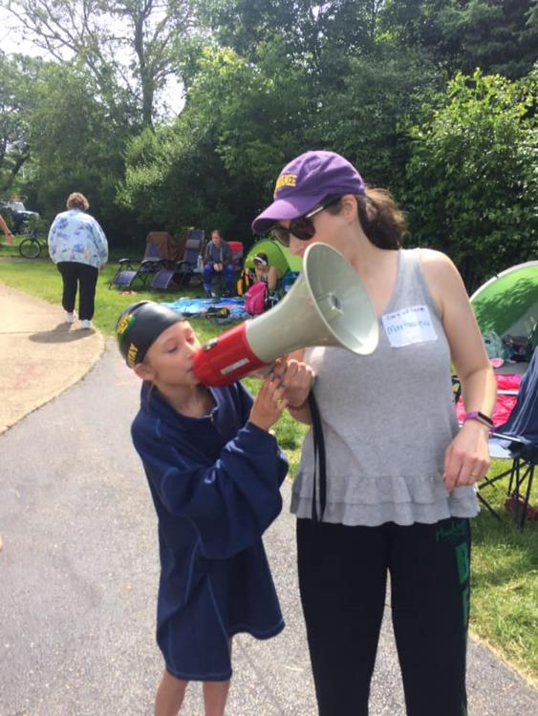
Clerk of course
Finds and helps line up each heat of swimmers by lane assignment
2 Clerks are required at every meet
Requires you to be on your feet throughout most of the meet
Occasionally requires some yelling!
Can move to pool to watch your swimmers’ events
Very good position if you need to supervise young children

Slide 21
Line-up assistants
Lines up each heat of swimmers by lane assignment, leads swimmer to pool area and correct lane.
2 Line-up assistants are required at every meet
Requires you to be on your feet throughout most of the meet
Occasionally requires some yelling!
Can move to pool to watch your swimmers’ events
Very good position if you need to supervise young children

Slide 22
Meet runner
Work on the pool deck, collecting timer and officials paperwork to submit to the scoring table
1 runner is required at every meet
Excellent view of each event
Cannot closely supervise young children

Slide 23
marshall
In charge of maintaining a safe environment at meets
2 – 3 Marshalls are required at every meet
Help supervise swimmers out of the water, watch for trash and unsafe play
Can move to pool to watch your swimmers’ events
Very good position if you need to supervise young children

Slide 24
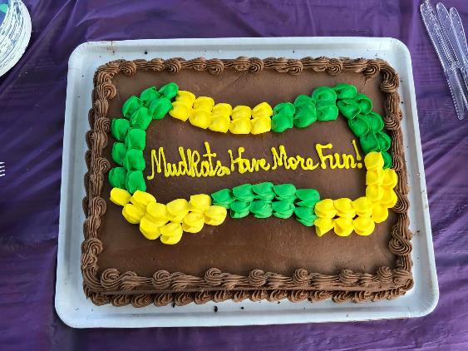
Additional participation opportunities
Social activities
Fulfills 1 or more job requirements
May require you to plan, organize and oversee the event
Pizza party
Luau
Mudrats play day (Raging Waves)
Ice cream social / pancake breakfast
Season end awards party

Slide 25
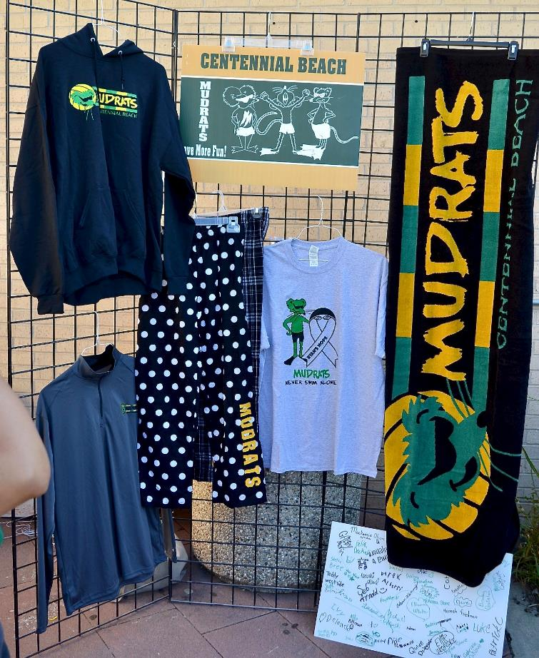
Spirit wear
Every swimmer will receive a Mudrats t-shirt as part of their NPD registration
Team suits are optional but encouraged
Optional spirit wear can be purchased at the open house, online, and at meets during the season
Questions regarding Spirit Wear – reach out to Jackie Ward (spiritwear@mudrats.org)

Slide 26
SEASON KICK-OFF Meeting
Sunday, May 16th, 3:00 – 5:00 pm
Fort Hill Recreation place, address
Open House Format
Purchase Spirit Wear
Questions Regarding the Mudrats Website
Team Suit Try-On and Purchase
Meet the Coaches and Parent Board

Slide 27
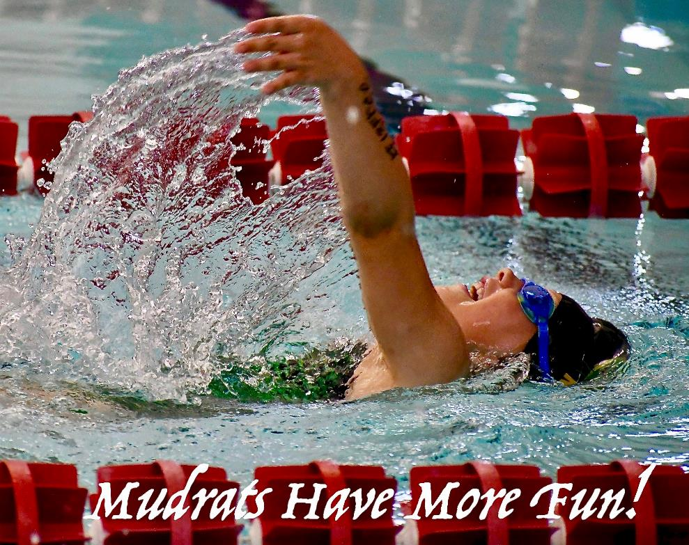
Q & A

