Slide 1
Old Dominion Swim League Stroke & Turn Clinic
Please Enter Your First Name, Last Name and Team Name
Into The Chat Box

Slide 2
Philosophy of Officiating
To establish, and ensure, an “arena” of competition whereby all competitors compete against each other on a fair and equitable basis
Swimmer always gets the “benefit of the doubt”!
Call what you see and see what you call
Penalty of “disqualification” is one of the most severe of any sport
Swim officials – all volunteers!
Why Do We Do It?
To contribute to that “arena” of fairness and equity
To contribute to our children’s development
To contribute to the sport’s development
It’s more exciting than sitting through 3 – 4 hour sessions in the sun!

Slide 3
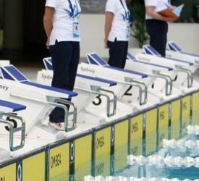
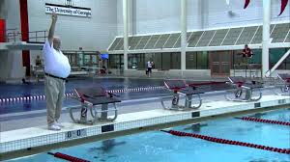
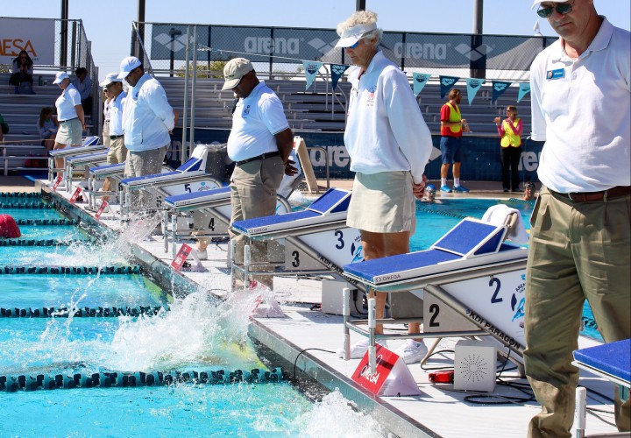
What Is A Stroke & Turn Judge?
One, in an official capacity, who judges the adherence to the rules of swimming, of the individual competitors within their jurisdiction

Slide 4
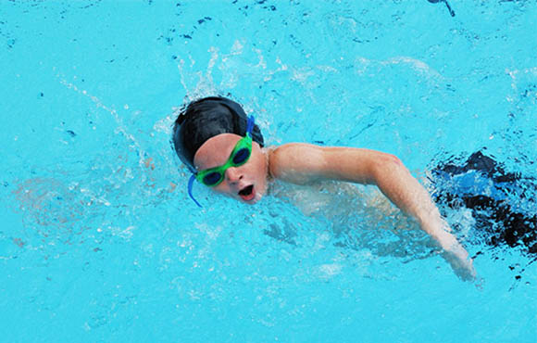
Expectations of a Stroke & Turn Judge
Be conscientious
Know the rules of swimming
Study the USA Swimming official rulebook
Know the current interpretations of these rules
Be fair, impartial, and consistent in the application of these rules
Call infractions when observed, and when there is no doubt as to your observation
“Benefit of the doubt” always goes to the swimmer!

Slide 5
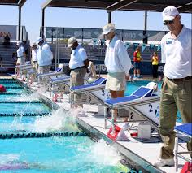
Expectations of a Stroke & Turn Judge
Be professional/Look professional
Wear white (polo) shirt over navy or black slacks, shorts, skirt
White footwear or appropriate sandals
No team logos on the shirt
Dress appropriate for the weather
Be punctual
You should plan on arriving at least 45-60 minutes before the start of the meet
S&T briefing is usually held 20-40 minutes before the start
Refrain from cheering
No smoking or eating on deck
Refrain from fraternizing with the swimmers unless it is in response to a direct question, or, as needed, to instruct the swimmers

Slide 6
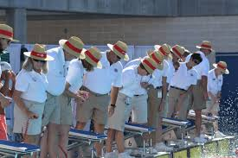
Expectations of a Stroke & Turn Judge
Be professional
Make calls quickly & decisively - raise you hand up high and hold for 5 secs. Be confident!!
Give a verbal explanation of calls clearly and succinctly to the Referee, (or Chief Judge-CJ), --- using the language of the rulebook. DO NOT USE HAND GESTURES!
Make calls only within your jurisdiction
Referee, (or CJ), will explain jurisdiction during the pre-meet officials briefing.
Remember, your professionalism, reflected by all of the above, will carry over and set the tone for both the swimmers and the spectators.

Slide 7
Position & Coverage
Step up immediately after the start (when at starting end). Be in the background prior to.
Be at the edge. You will get wet!
Know your jurisdiction. The Referee or Chief Judge should make that clear at the meeting. You will probably have multiple lanes to cover and half the pool length.
Be in position looking over the end of the edge of the pool for the turn.
At the end of the race, get to your best position to view the swimmer (over the edge of the pool), while leaving room for the timers to do their jobs.
If you have empty lanes, watch them as well --- to ensure equity from heat to heat.
Judge the outside lanes the same as the “fast” lanes.
Judge the early (slower) heats the same as the last (faster) heats.
Maintain the same degree of attentiveness all throughout the meet.
Judge the younger (8 & under) swimmers the same as the older swimmers.
You are to “observe” the swimmers, not to “scrutinize” them!

Slide 8
Know The Rules
Study them before every meet.
Stay up to date with any rule changes. Be willing to change your previously – held interpretation.
Write or verbally explain your DQs using the language of the rulebook.
It is your responsibility to explain what you saw and how it is a violation of the rule.
Remember, the Referee must be able to defend the call to the team rep and/or coach.
Be consistent in your calls and interpretations.
Put in your time on deck!
There is no substitute for experience!

Slide 9
Make The Call
All of the above is of no use if you are afraid to make the call!
(You can always rescind it.)
Raise your hand, (3-5 seconds), high. Raise your hand for every incident of violation, if more than once in a single swim.
Do not look at the swimmer’s eyes. Do not indicate to the swimmer, a fellow official, or the crowd, as to what lane you have called.
Should you make a call, mark your program discreetly as soon as the swimmers have left your jurisdiction, with the event/heat/lane #. Then go back to judging the race.
When explaining the call to the referee, do not “demonstrate” the violation (for all to see).
Take back the call if you are not sure, or think you may have been unduly influenced by “other” pressures, i.e.,
A string of similar calls,
Pressure to “make a call”
A situation from another swimmer.
Don’t make the call if you are not sure of what you saw.

Slide 10
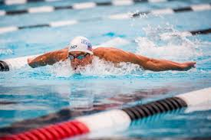
Butterfly
Start: Forward Start, Body must be kept on the breast
Stroke: Multiple kicks are permitted but the 1st arm pull must bring the swimmer to the surface.
Some part of the swimmer must break the surface throughout the race except after the start and each turn the swimmer may be submerged not more than 15-meters where the head must break the surface. The arms (shoulders to the wrist) must be brought over the water and pulled back simultaneously.
Kick: All up and down movements of the legs must be simultaneous (not on the same level). No alternating, scissors or breaststroke kick is allowed.
Turns: Body must be at or past vertical towards the breast when the swimmers’ feet leave the wall.
Finish: 2 hand touch→ separated & simultaneous, at above or below the water surface..

Slide 11
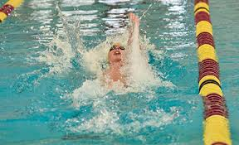
Backstroke
Start: Backward start - In water start from the edge of pool, toes not above over the edge
Stroke: Body must be kept on the back. Any stroke is allowed provided the swimmer remains on the back. Some part of the swimmer must break the surface throughout the race except after the start and each turn the swimmer may be submerged not more than 15-meters where the head must break the surface.
Kick: Any kicking movement is allowed provided the swimmer remains on the back
Turns: Swimmer may rotate onto their breast and utilize a continuous single or continuous simultaneous double arm pull to complete the turn. Some part of swimmer must touch the wall at the completion of each length. The swimmer must return to the back when the feet leave the wall.
Finish: Some part of the swimmer must touch the wall while on the back. The swimmer may resubmerge at the finish.

Slide 12
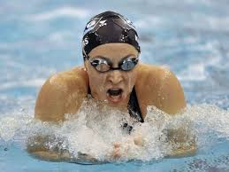
Breaststroke
Start: Forward Start
Stroke: Body must be kept on the breast. (Cyclical) One arm pull and one leg kick in that order. After the start and each turn 1 arm stroke may be pulled back to the legs. Recovery by the hands from the breast on, under or over the water. Elbows under water except the last stroke before the turn or finish. Head must breast the surface of the water during each cycle.
Kick: After the start and each turn a single butterfly kick is permitted prior to the 1st breaststroke kick. Movement of the legs shall be simultaneous. Feet turned out during the propulsive part of the kick. No alternating, scissors or butterfly kick except as stated.
Turns: Body must be at or past vertical towards the breast when the swimmers' feet leave the wall.
Finish: 2 hand touch→ separated & simultaneous at, above or below water surface

Slide 13
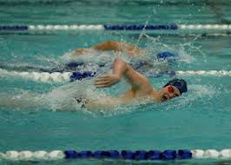
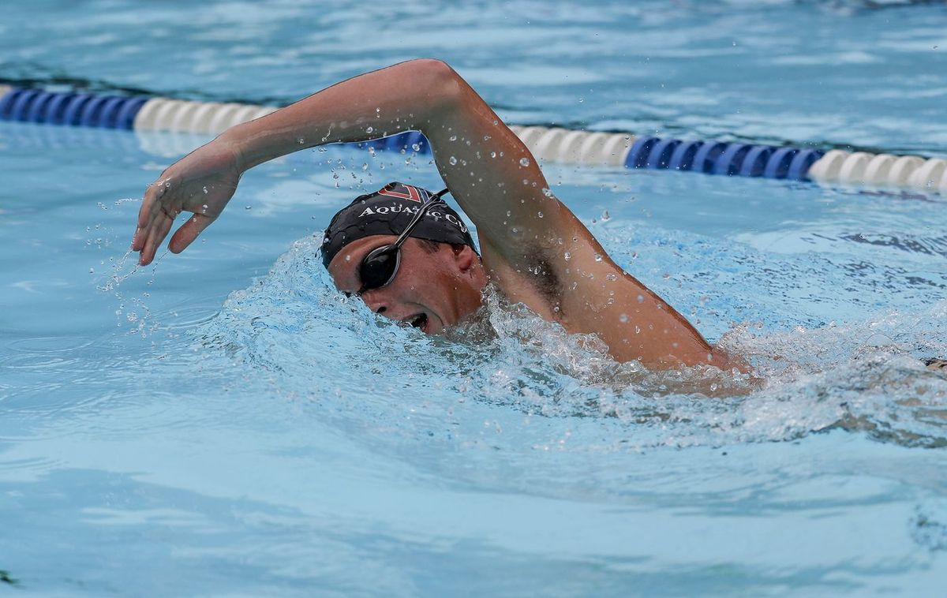
Freestyle
Start: Forward Start
Stroke/Kick: Any style (kick, stroke) may be used
Some part of the swimmer must break the surface throughout the race except after the start and each turn the swimmer may be submerged not more than 15-meters where the head must break the surface.
Turns and Finish: Some part of the swimmer must touch the wall at the completion of each length or at the finish
No assistance
No propelling forward off the bottom
No propelling off the lane line

Slide 14
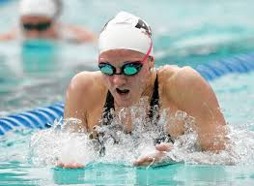
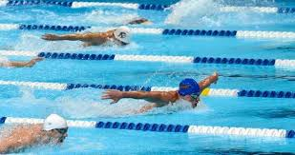
Individual Medley
Must swim ¼ of the distance in the following order
Butterfly
Backstroke
Breaststroke
Freestyle
May not swim in any of the other strokes during the freestyle portion of the IM and must remain on the breast.
Finish & Turn rules apply for each stroke

Slide 15
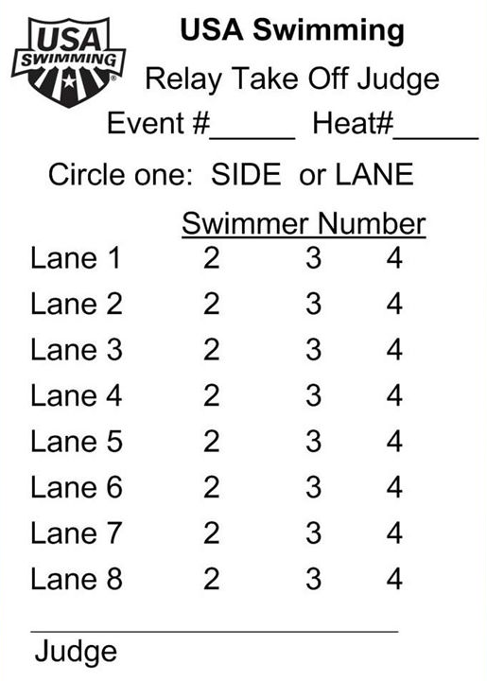
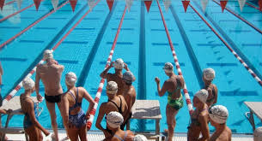
Relays
•Watch feet of swimmer leaving, then look down to see if incoming swimmer has touched
Circle=Good Take Off
“X”=Early Take Off
• Do not raise hand for early take-off violation.
• Early Take off’s must be dual confirmed
• Use pre-printed take-off slips to record your take-offs.

Slide 16
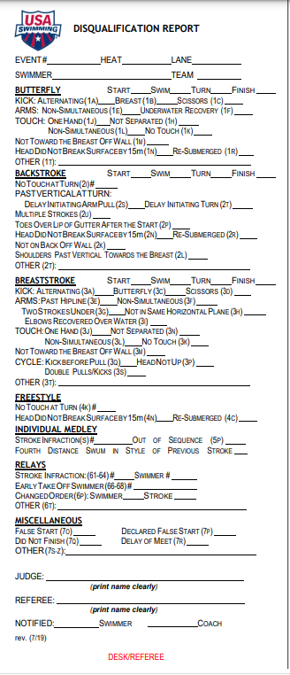
DQ Slips
Make sure Event, Heat, & Lane are filled out correctly.
Circle the stroke (optional, depending upon the Deck Referee)
Place “x” at the appropriately described violation, including whether at the Start, Swim, Turn, Finish.
Start is from the point the swimmer leaves the blocks until the swimmer's head is up.
Swim is from the point the head is up until the swimmer initiates the turning motion.
Turn is from the initiation of the turn, last stroke in/continuous turning action, until the head is up.
Finish is the last stroke in/finish move at the finish.
Print your name at the bottom.
Referee prints his/her name.

Slide 17
Next Steps
Complete On-Line Test by the deadline (include your name and team name)
Schedule your apprentice session
Arrive on time
Look professional (white collared shirt blue shorts, skirt)
Be Professional
Volunteer to support our swimmers
Thank-You

