Slide 1
ODSL Starter Clinic
Please Put Your Full Name &
Team Name Into The Chat Box

Slide 2
Philosophy
Significance of the position
This position is the only position with consistent interaction with the swimmers.
The Starter sets the tone and the tempo of the meet.
Starter is the second in command of the meet.
Should something happen to the Referee, the Starter must step in.
Also, the Starter may have to fill in as a Stroke & Turn official if short-handed.

Slide 3
Characteristics of a Good Starter
Outwardly calm
Even when things aren’t going your way
Project confidence
Confidence is infectious to swimmers (and the referee!)
Be professional at all times
The Starter’s job is no place for casualness, or sloppiness.
Be aware of tendency to get tired toward end of meet.
Dress professionally.
Be totally focused and alert during the whole meet, but especially at “the start”

Slide 4
Characteristics of a Good Starter
Be FAIR
Be consistent (call it the same throughout the entire meet).
Give the swimmer the benefit of the doubt
A “false start” may have been caused by some external cause.
Be PATIENIT
Particularly with the swimmers
Allow for goggles to be adjusted or toes up to the edge
Allow for swimmers with a disability
Stand up swimmers if they are too restless
Do not rush the swimmers
Your sole purpose is to ensure that all competitors get a crisp and fair start.
Give the swimmers adequate time after, “take your marks”, to settle down into their starting position.

Slide 5
Characteristics of a Good Starter
Need a calm, confident voice
Tone should be conversational, not strident: crisp and concise
“Invite” the swimmers to swim. Don’t “order” them to swim. If you get flustered easily, this job may not be for you.
Don’t be too wordy. Use the least amount of verbiage possible.
Use standard, consistent commands.
Remember, your voice is an audio queue to the swimmers that “it’s time to swim”. If they hear it too much, it loses its effect.
You are not the “announcer”. If an announcement needs to be made, let the Announcer, or the Referee make it.

Slide 6
Characteristics of a Good Starter
Develop the proper “inflection” to your commands.
Never, “Take your marks!!” Remember, it should be “conversational “.
Practice the commands:
“Take your marks”
“Step in”, or “step up”, or “step down”
“Place your feet”
“Stand”, or “stand, please”, or “stand down”
“Thank you, ladies/gentlemen” – to clear the pool
“Clear the pool, please”, (gentlemen/ladies”)
Don’t develop a pattern to your starting cadence (“take, your, mark, beep”).
This encourages the swimmers to anticipate the start. The swimmers will let you know when they are ready !

Slide 7
Deck Positioning
Make sure you are positioned where YOU want to be (the Referee will adjust).
Must be within approximately 5 meters of starting end.
Make sure that you can see the whole field.
Fair and equitable to all swimmers
Clear the starting area of lingering swimmers, or timers, that might be a distraction.
For backstroke starts, position yourself even with the swimmers so that you can see the swimmers’ toes (under/over the pool edge).
Don’t involve yourself with matters, concerns, controversies, etc., that do not involve you.

Slide 8
Pre-Meet Responsibilities
Arrive early (min 30 mins before warm-ups) to assist the referee.
Make sure starting system is, or has been, charged
Make sure starting system works including speakers
Set up & test the system if not previously done
Check for location and status of backup system in case it is needed
Check with the referee as to extent of coverage required (3-watches, 2-watches/1-button)
Conduct the Timer Briefing (approx. 20 minutes before the start)
Ensure that the timers are properly briefed and ready to collect accurate times
If short on Timers, let the Team Rep’s know – all timers must be in position before the meet begins.
All lanes must be covered before you start.

Slide 9
Pre-Meet Responsibilities
Coordination with the referee
You are an additional set of eyes on the pool→Safety
Know the warm-up procedures for the meet.
You will probably be in charge of the pool during warm- ups while referee is attending officials’ briefing
Are there any swimmers with special needs?
Review procedures for possible false start call

Slide 10
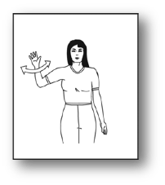
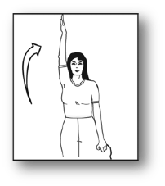
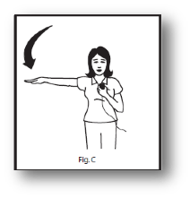
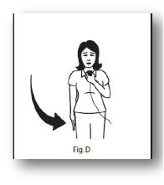
Starting Protocol for swimmers with a Hearing Disability
Chirps Long Whistle Take Your Mark Beep
Forward Start

Slide 11
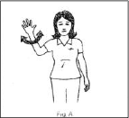
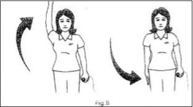
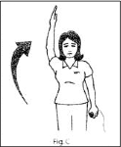
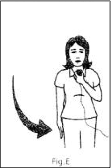
Starting Protocol for swimmers with a Hearing Disability
Twist hand at short whistles
Arm overhead-swimmer enters water: drop arm to side while swimmer enters water
1st Long Whistle
Arm overhead-swimmer returns to backstroke start position
(2nd long whistle)
Arm moves to shoulder level -Signal to
“Take your mark”.
Beep
Backstroke Start

Slide 12
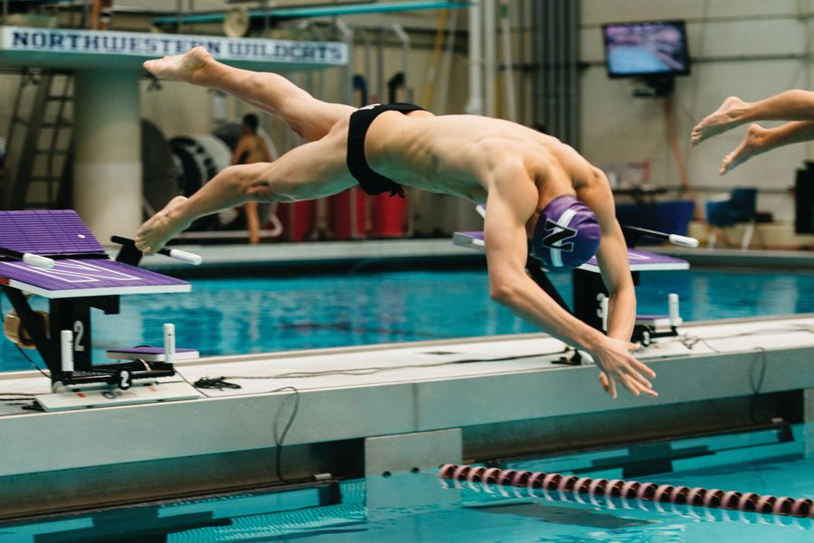
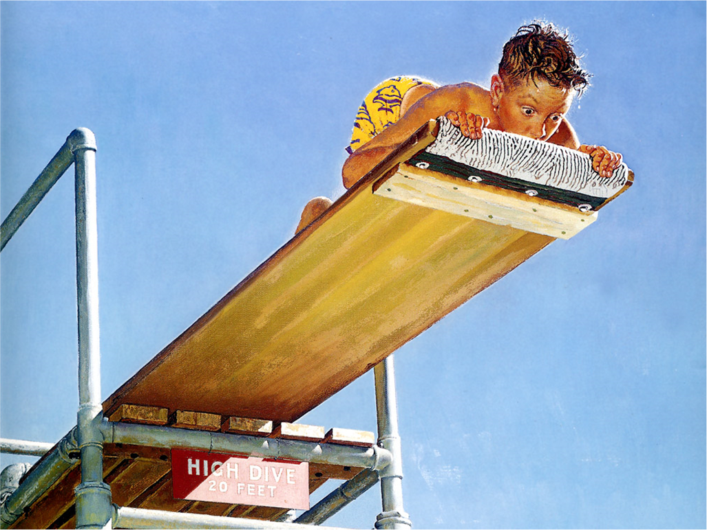
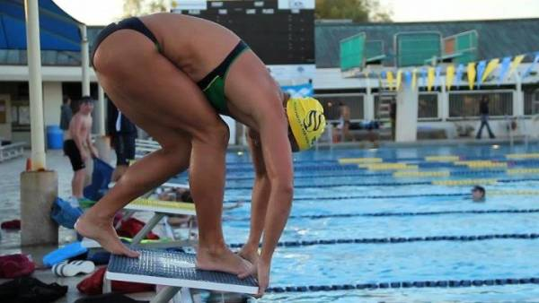
What Is A False Start?
“When all swimmers are stationary, the starter shall give the starting signal” (101.1.2.c) and “Any swimmer starting before the starting signal is given shall be disqualified if the Referee independently observes and confirms the Starter’s observation
This Photo by Unknown Author is licensed under CC BY-NC-ND

