Slide 1
ODSL
Referee Presentation
Updated 05/2019

Slide 2
Thank You

Slide 3

Notes:
When people ask what does the referee do at a swim meet…most people will say blow the whistle

Slide 4




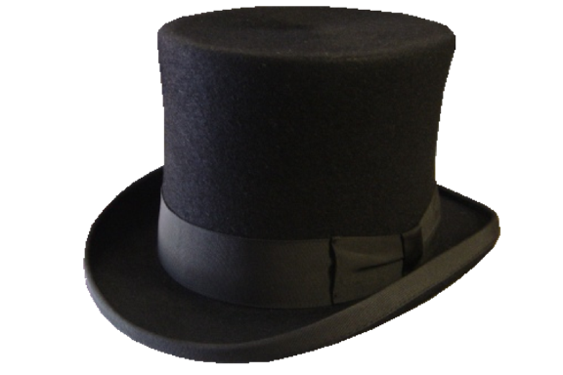

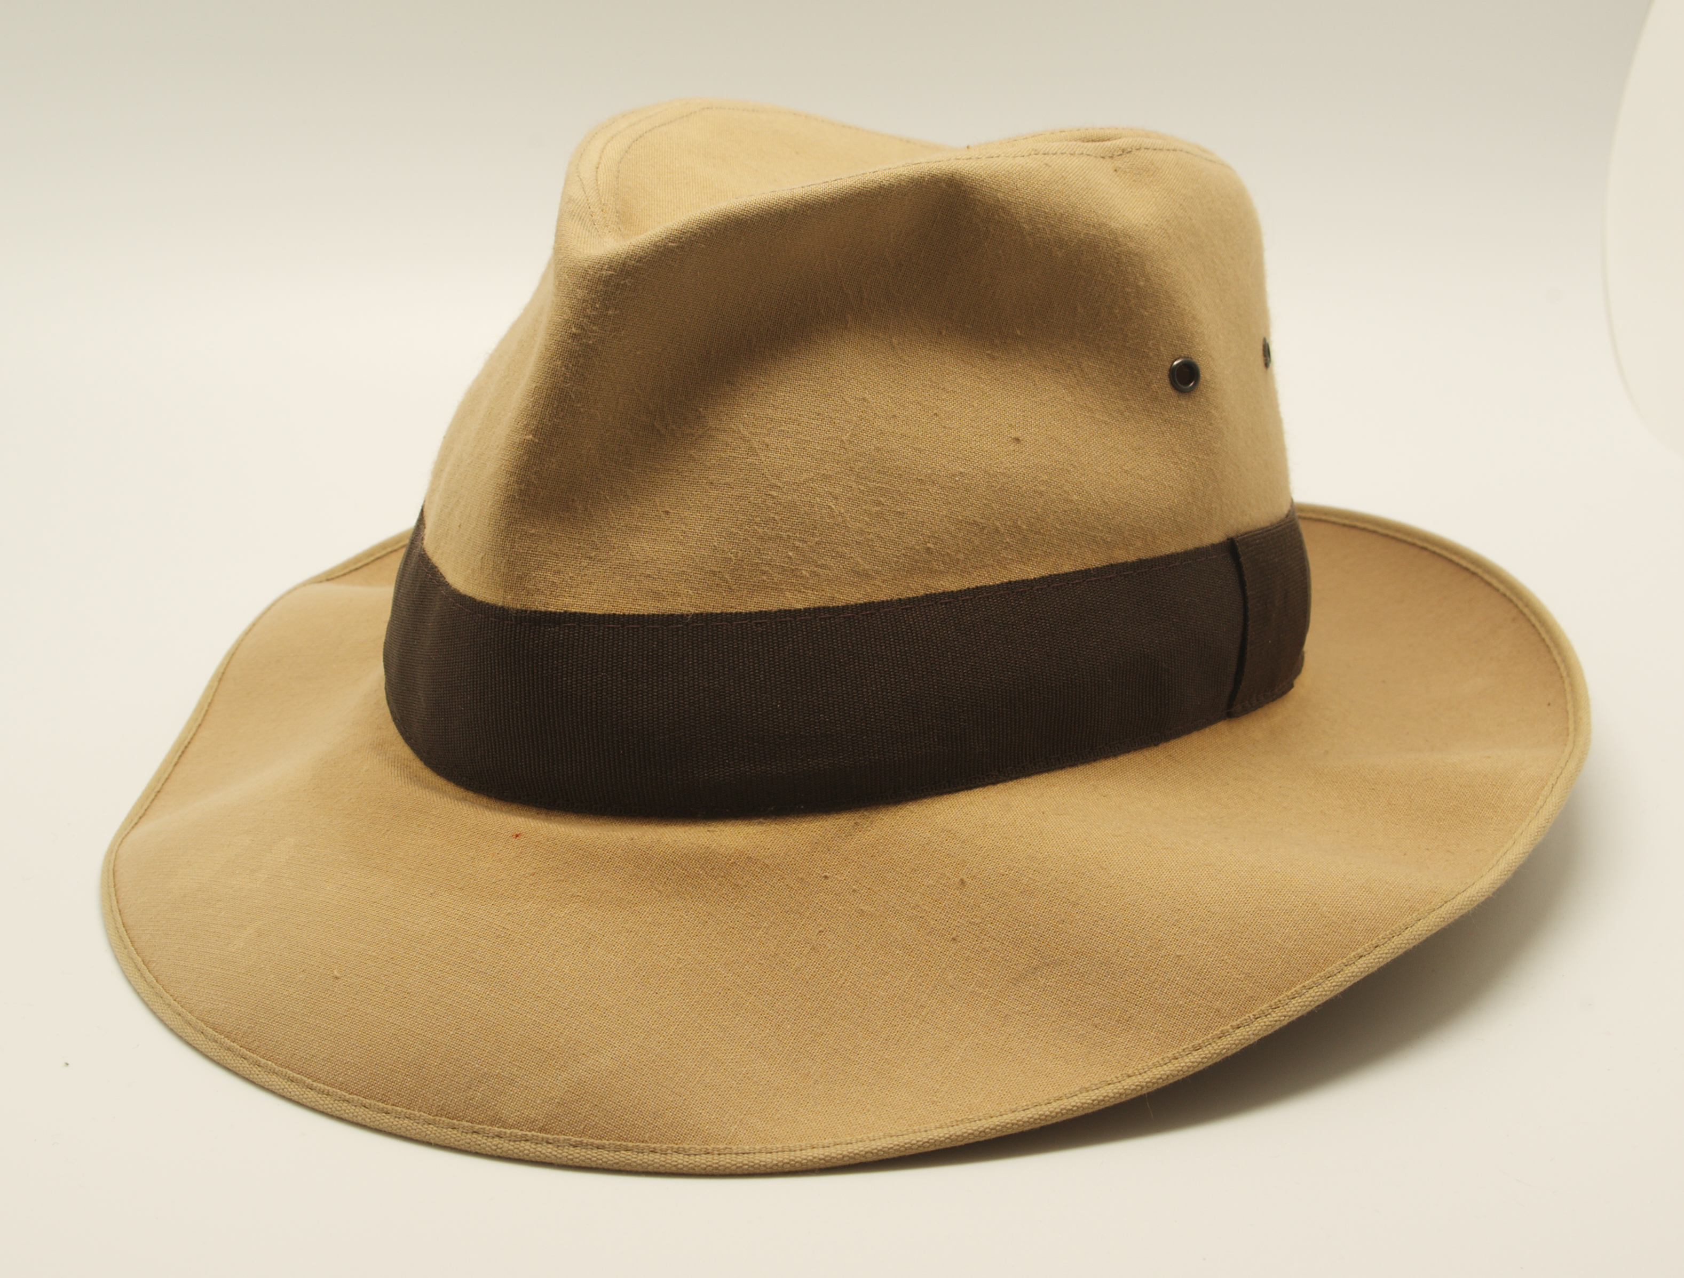

This Photo by Unknown Author is licensed under CC BY-SA
Notes:
KTA- A Referee has to wear many hats and wear them all WELL.
Meet Manager
Deck Referee
Stroke and Turn Mentor
Starter Mentor
Timer Mentor
Head Timer Mentor
Solver of the biggest problems in the world (when a small child misses a heat)
How you wear each of those hats before and during a meet will influence how smooth a meet runs and most importantly our kids expieience.

Slide 5
Pre-Meet Responsibilities
Communicate with your Team Rep
  Staffing for the upcoming meet
  Estimated #of Swimmers and Timeline
  HOA or Facility concerns
  Upcoming weather→Plan B
  Who is doing what for the meet
    STARTER
    CLERK OF COURSE
    RUNNERS
KNOW THE RULES
  USA SWIMMING
  ODSL

Slide 6
PRE-MEET RESPONSIBILITIES
GET ORGANIZED
  HEAT SHEET PREFERNCE
  PENS
  DQ SLIPS
Safety Check
  Pool
  Deck Area
Equipment Check

Slide 7
PRE-MEET RESPONSIBILITIES
DECK POSITIONING
  STARTER HAS THE PRIORITY
    ADJUST TO WHERE THEY WANT TO STAND. POSITION YOURSELF SO THAT THEY CAN SEE YOU HAND.
HANDICAPPED SWIMMERS?
  WORK WITH STARTER AND CLERK OF COURSE TO ENSURE THEY GET A FAIR AND EQUITABLE START.
    STARTER-HAND SIGNALS FOR THE ENTIRE EVENT
    CLERK OF COURSE-ENSURE THAT THE SWIMMER IS IN THE CLOSEST LANE TO THE STARTER AS POSSIBLE

Slide 8
Pre-Meet Check List
Officials Briefing
Stick to the script.
Relay Take Off Judges
Meeting time
Responsibilities
Timers Briefing
  Stick to the script
Officials in position?
Timers in position?
SWIMMERS

Slide 9
Meet Operations
Whistle Protocol
4-Short Chirps-Swimmers Get Ready
1-Long Blast-Swimmers Step Up
The whistle is a signal to the swimmers…not to the crowd or neighbors

Slide 10
Meet Procedure
Disqualification Slips
  Verify Name/Heat/Infraction
  Any questions talk to the Stroke & Turn Judge
    Talk to the rules
  Benefit of the doubt goes to the swimmer
Once you approve turn them into the computer operator

Slide 11
Meet Procedure
Whistle Protocol
Turn the course over to the starter
  Out stretched hand
  Watch the swimmers in the race (Safety #1)
  Whistle Protocol
  Dive over vs No Dive over?

Slide 12
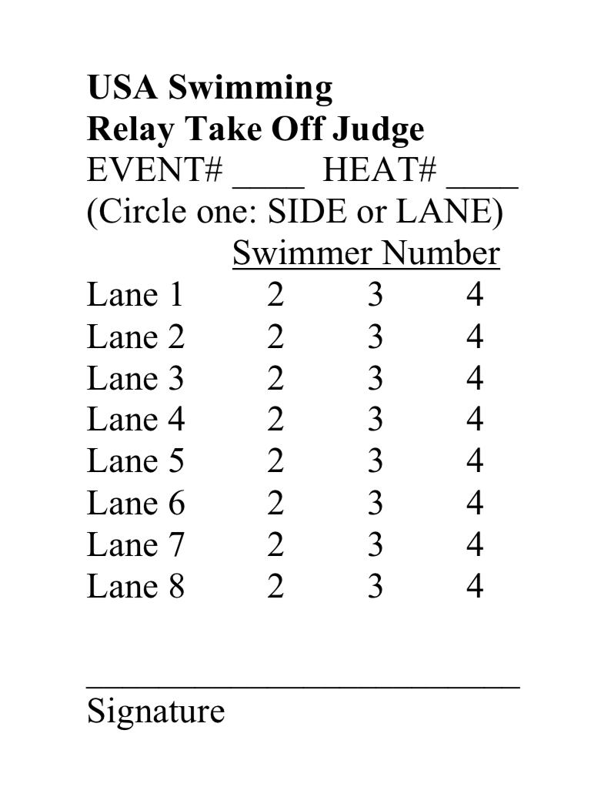
Relays
Stroke & Turn Judges-Stay in Position and observe the Stroke & Turns
X-Early Take-Off
0-Legal Take-Off
Toes Then Touch

Slide 13
Meet Procedure
Safety of the swimmer is the #1 Priority
No dive over starts for younger swimmers (under 10)
  At the end of each heat clear the pool and then start the next heat.
  Work with timers & stroke and turn judges to expeditiously complete this task

Slide 14
Meet Procedures-Protests
Protests
  Coaches have 30-minutes after the receipt of DQ Slips
  Stay organized
  Ensure that the slips are moving from
    Stroke & Turn Judge
    You
    Computer Operator
    Coach

Slide 15
Meet Procedures-Protests
Interact with Team Reps
Explain the rule and what the judge saw.
Benefit of the doubt goes to swimmer.
Referee decides whether to uphold or over turn the call

Slide 16
End of Meet
If all events are completed (no swim off’s no protests)
  Thank All Officials
  Thank All Timers
  Thank All Marshalls
Review Results
Make sure all equipment is put back and ready for the next meet

Slide 17
Execute
Be careful of setting precedents with early decisions
Don’t be afraid to ask questions or correct mistakes
Teach, provide constructive criticism
Say ‘THANK-YOU’ to everyone
Conduct Self-Evaluation

Slide 18
Thank You

