Slide 1
Castlewood Dragons
2021

Slide 2
Safety
Castlewood swim will follow safety guidelines from:
Cdc
Denton county
Usa swimming
Examples of Possible Modifications:
Limiting number of participants on deck
Modifications in lane assignments

Slide 3
Mission and Goals
Friendly, informal, fun summer swim league
Improve swimming comfort and skill
Encourage sportsmanship and teamwork
Have a fun summer Hanging out with old friends and make new ones

Slide 4
Requirements
resident of Castlewood, Highland Village, Double Oak, or Copper Canyon.
5 years old on June 1st and younger than 18 years of age.
Swimmers should able to swim the length of the pool (ages 11+, 2 laps)
Swimmers must be water safe
coaches realize that swimmers might be a bit rusty at the beginning of the summer
swimmers 8 years and under, have a responsible adult close to the pool area during all practices and team social events.
parent or family member (16 years or older) willing to volunteer.
Swim Team Registration: www.castlewoodswim.com.
Fees- $150 per swimmer (sibling discount- $25 per swimmer after 1st)
League fee of $20
Non-Castlewood residents-additional $25 per family for amenities/pool usage fee
Team swimsuit (recommended, not required)

Slide 5
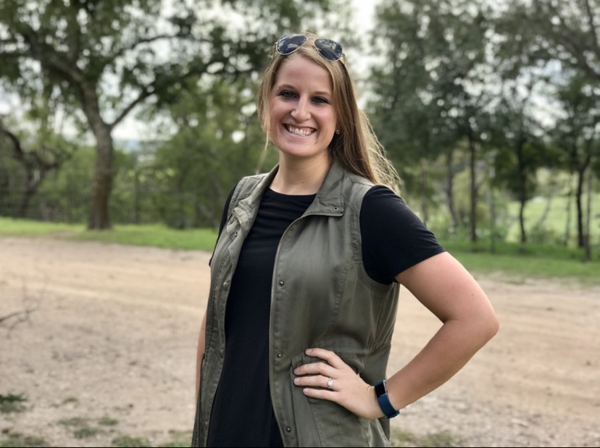
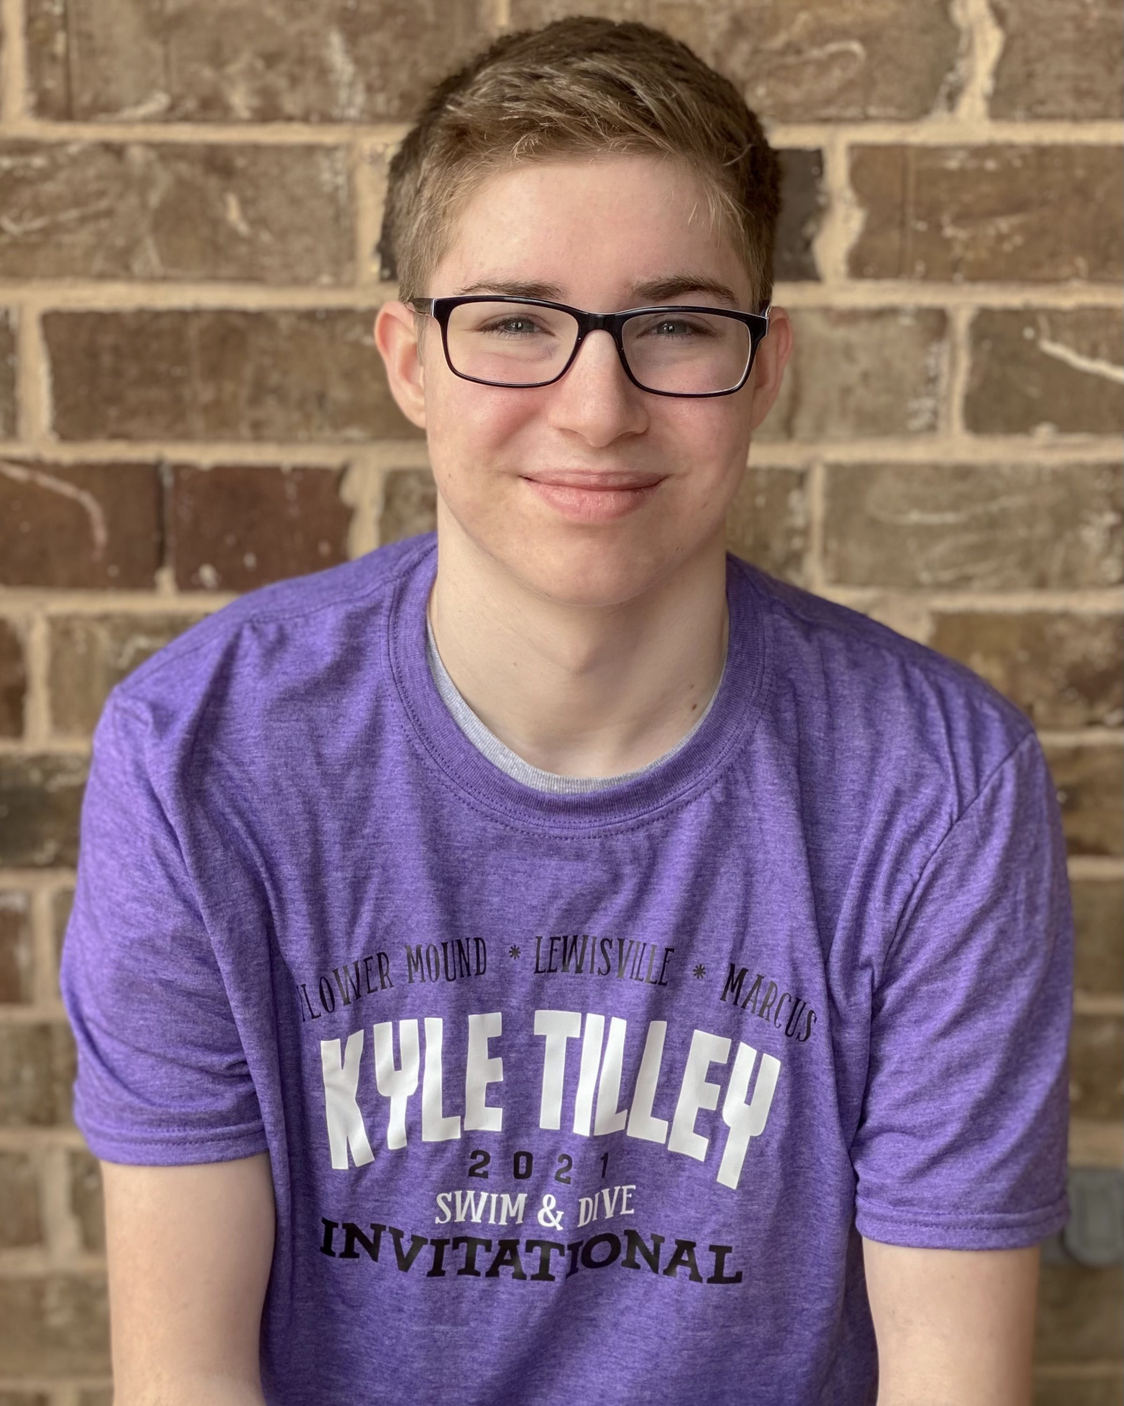
coaches
Head Coach: Melissa Box
LISD Kindergarten Teacher
Coaching for 10+years
4th year with the dragons!
Assistant Coach: Christopher Harvey
Former Dragons Swimmer and Jr Coach
Marcus Swim Team
10years swim experience
*Jr Coach Program: tbd

Slide 6
Schedule
3 components of summer swim
Practice
Swim meets (come to as many as you can)
Social events (nothing but fun!)

Slide 7
Practice
Evening practice (4 Days only)
Mon 5/17 and wed 5/19
tues 5/25 and thurs 5/27
20-40 minutes per age group 5:30-7:30pm
Morning Practices daily tues - fri starting June 1st
7-8:15AM Age 11+
8:15-9:15am ages 9&10
9:15am-10am ages 7&8
10-10:30am ages 5&6
* Schedule times may vary slightly depending on capacity restrictions

Slide 8
Meets
Local Competitions- exact # tBD
Tenetative: 4 regular meets
100% Volunteer run
Mondays (times tbd- morning or afternoon)
Championship meet- July (exact date tbd)

Slide 9
Social events
Every week- fun event at practice
Game
Treats
Activities
Special age specific social events
Afternoon ice cream social for younger
Late night pizza swim for older
Team wide events-TBD

Slide 10
Volunteering is a joy!! …and a requirement
Volunteer run swim team
We cannot have a swim team without you!
Examples: timers, bench coordinators
Exact volunteer needs- tbd based on guidelines and meet format

Slide 11
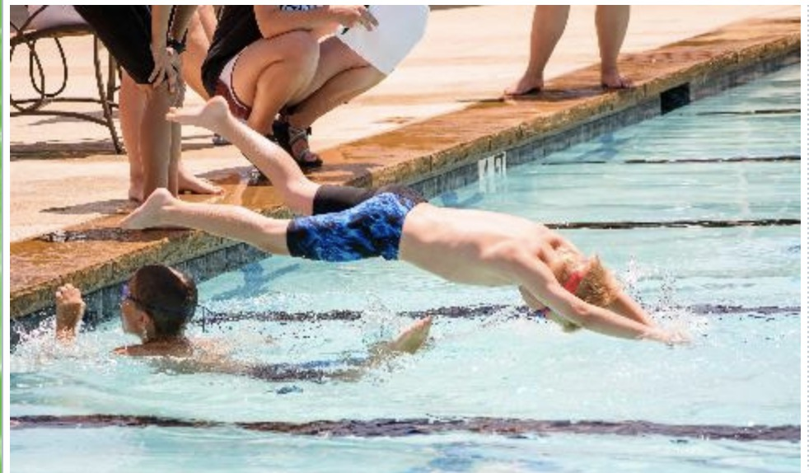
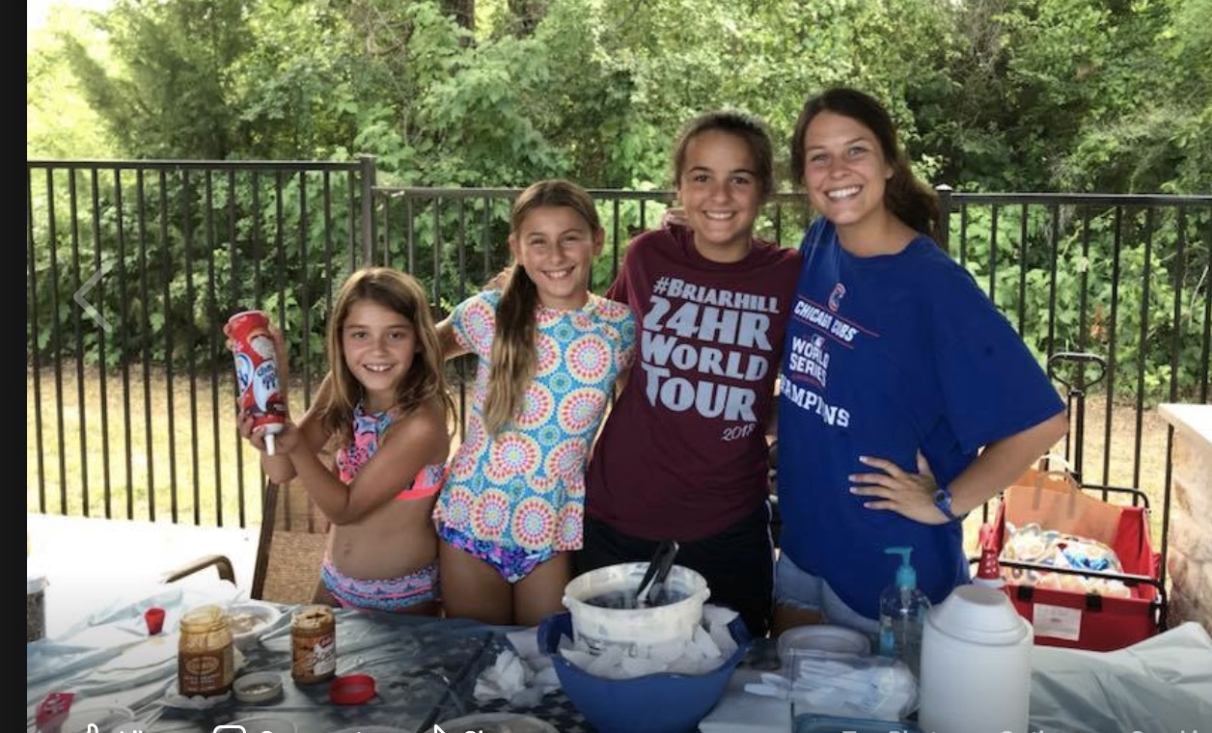
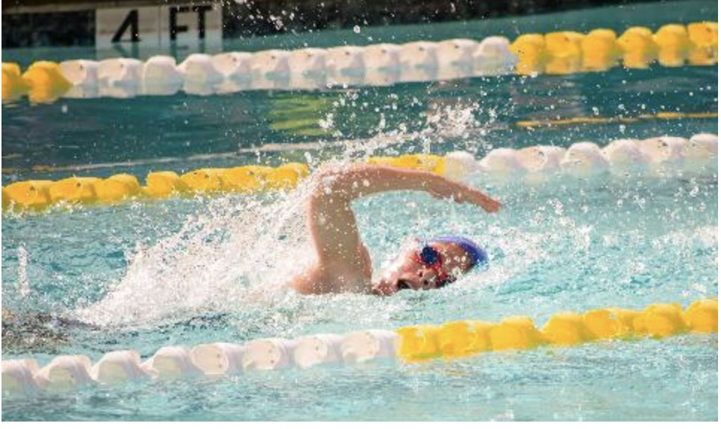
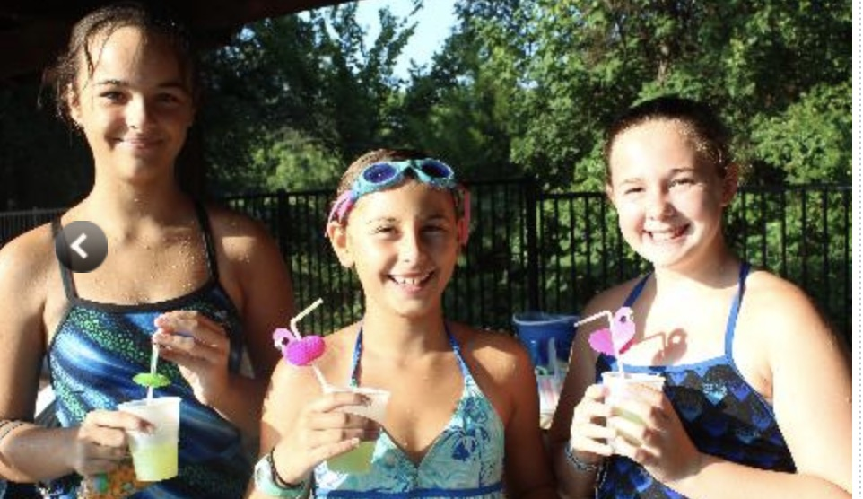
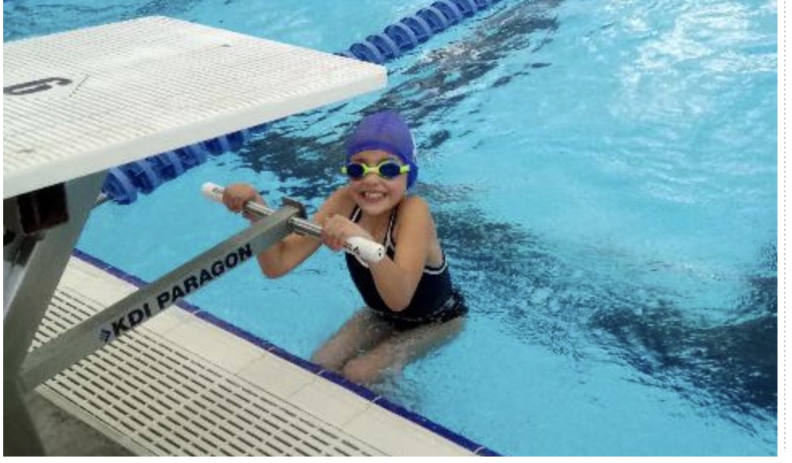
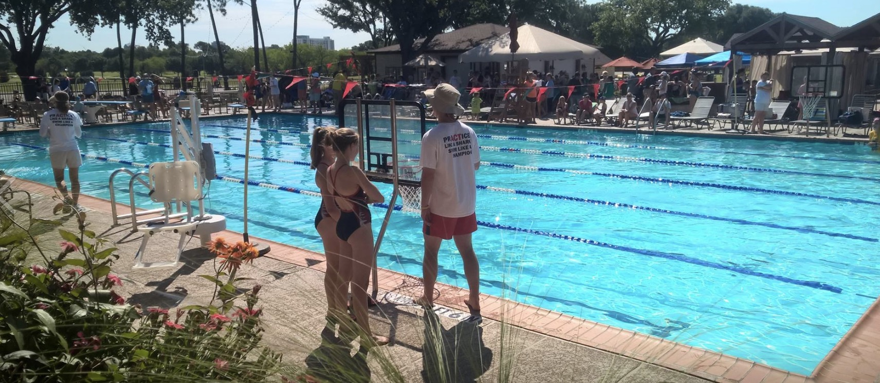
Questions?

