Slide 1
Fostering healthy competition, teamwork and sportsmanship
Swim Officials Administrative official certification
aq336I – V1.0
Optional slide deck
© 2014 YMCA of the USA

Slide 2
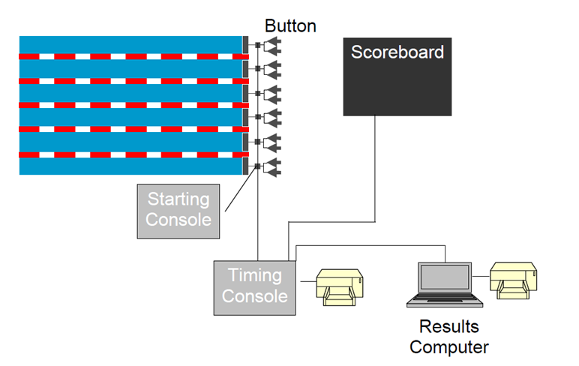
Electronic Timing System

Slide 3
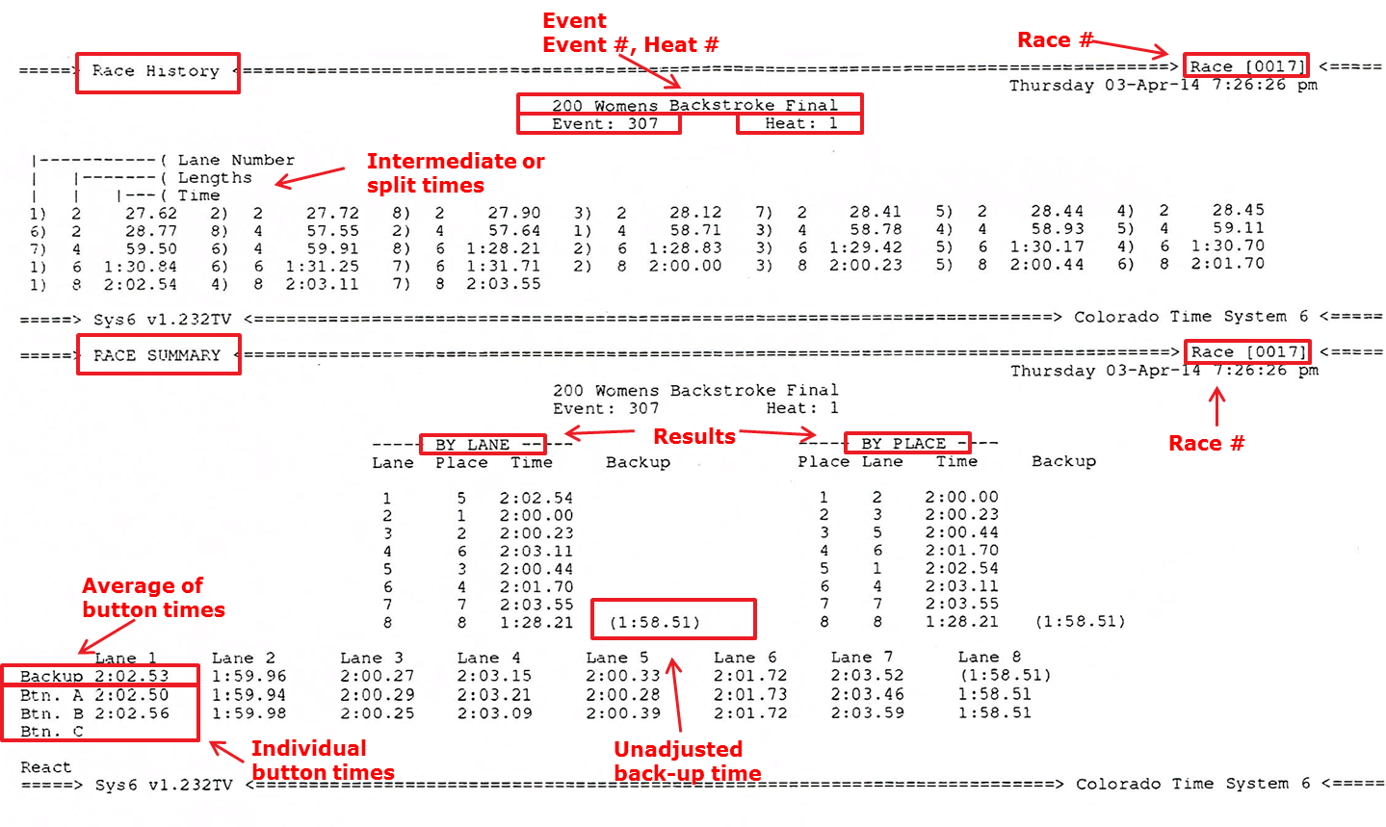
CTS Colorado Timing System Example

Slide 4
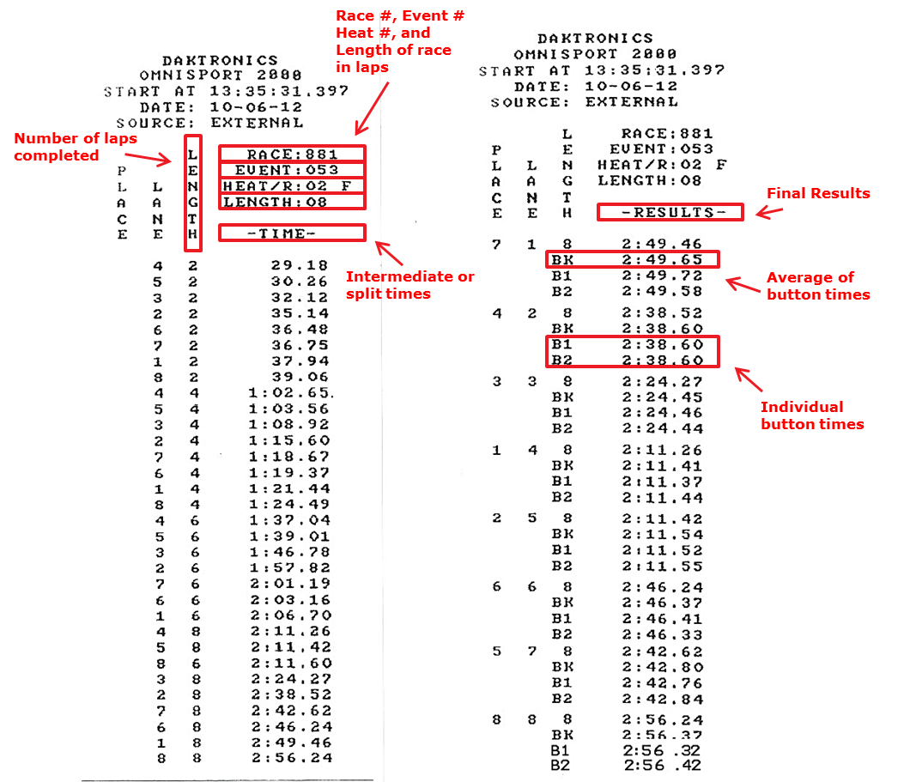
Daktronics timing system example

Slide 5
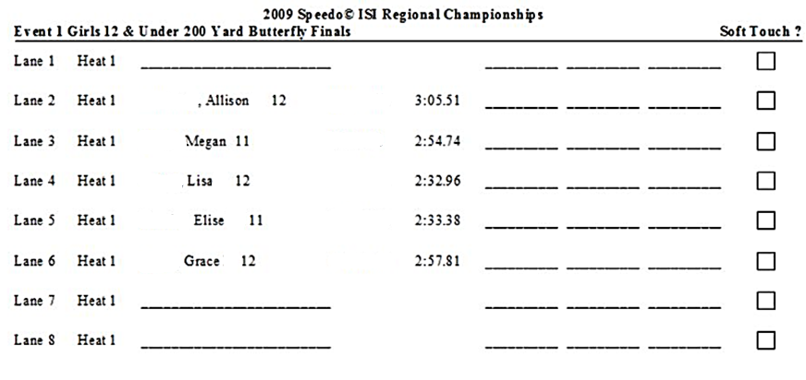
Timer Sheets example

Slide 6
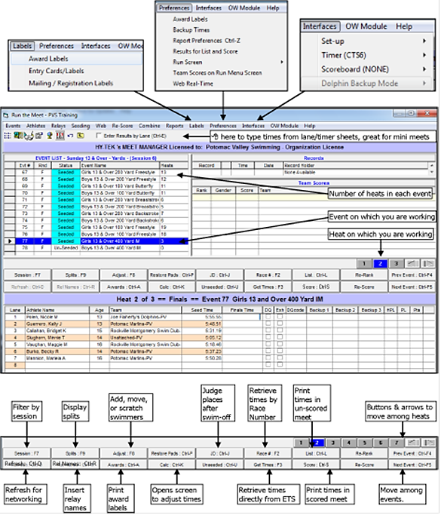
Meet management software – importing times

Slide 7
Meet management software – importing times part II

Slide 8
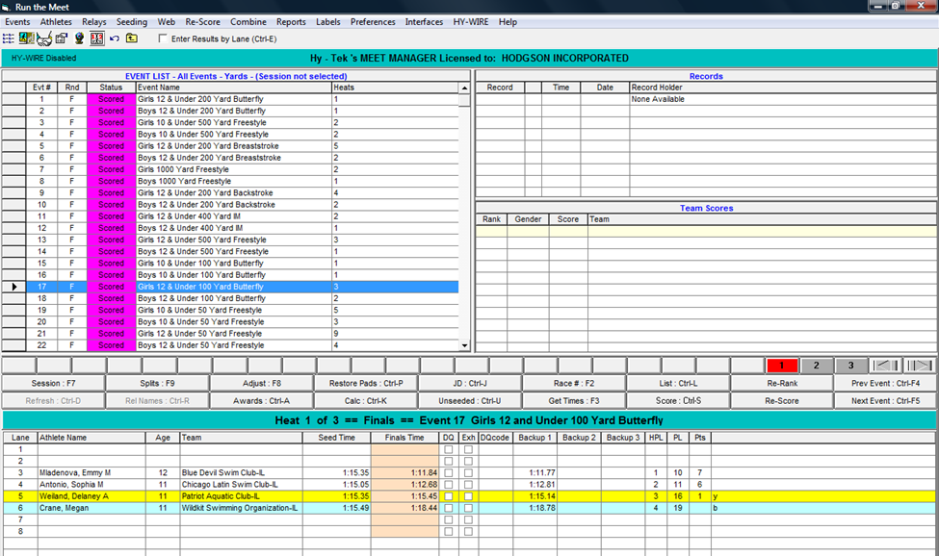
Run Screens – early button

Slide 9
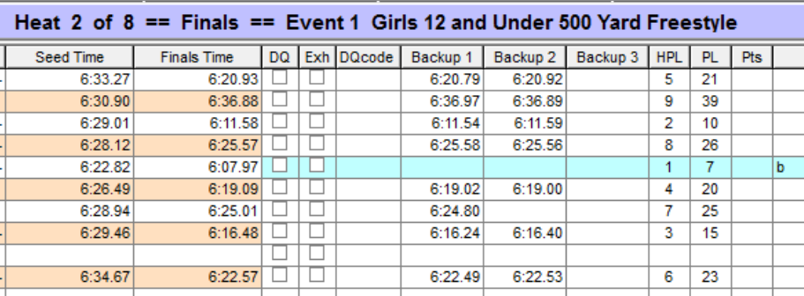
No backup button

Slide 10
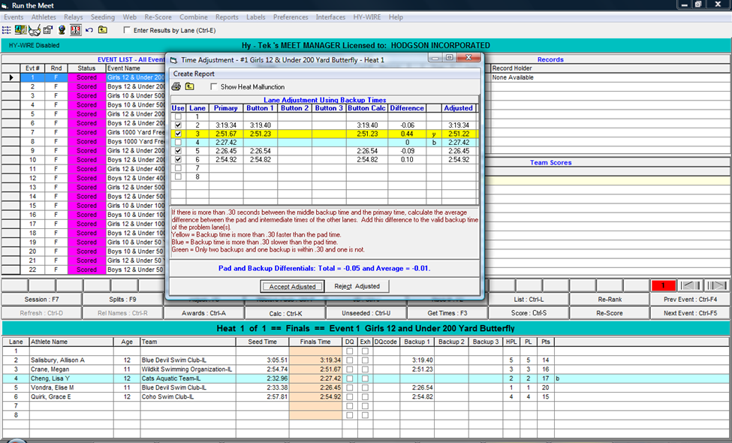
CALC screen – timing difference/no button

Slide 11
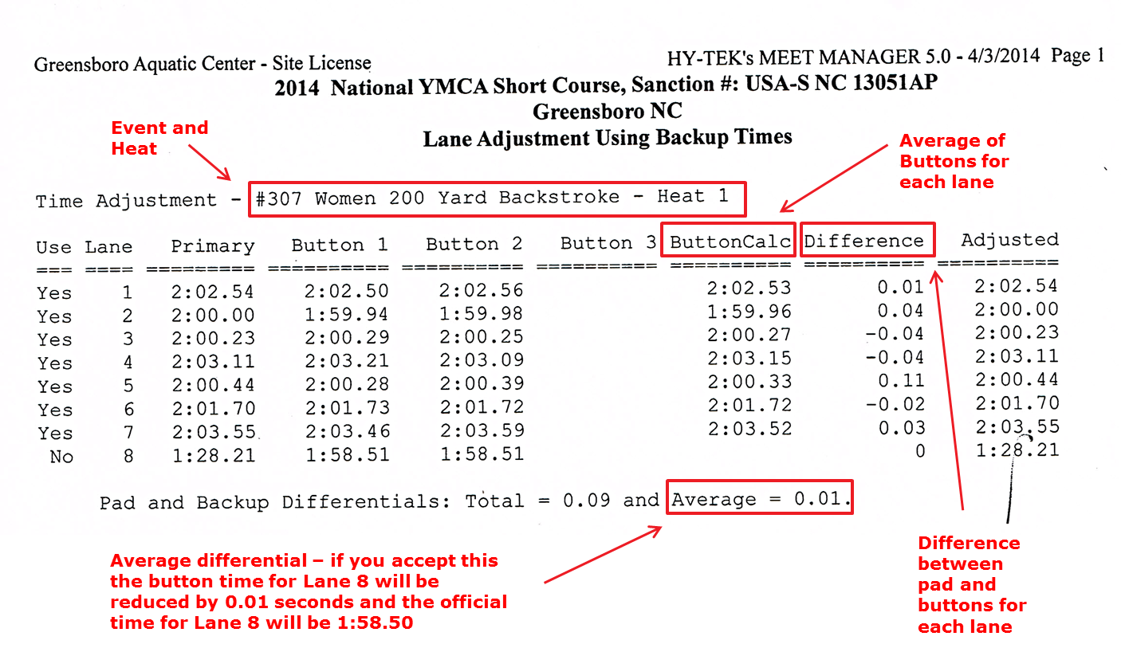
Printout of calc screen

Slide 12
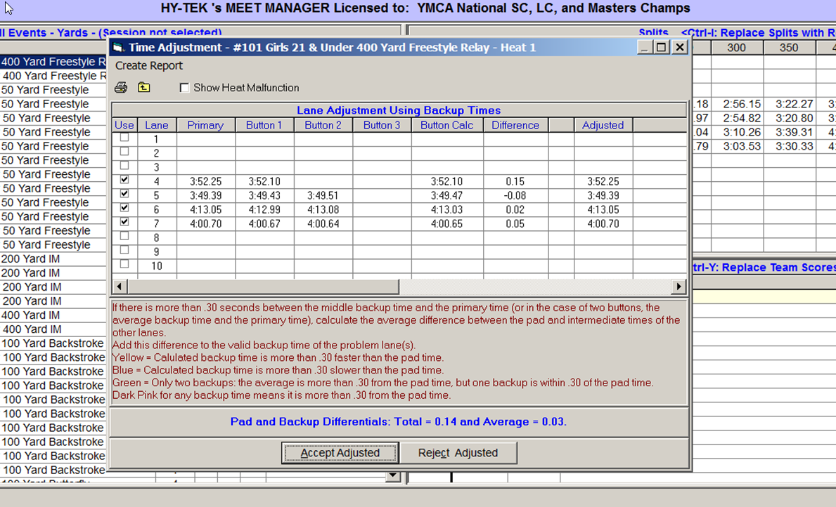
Lane Malfunction

Slide 13
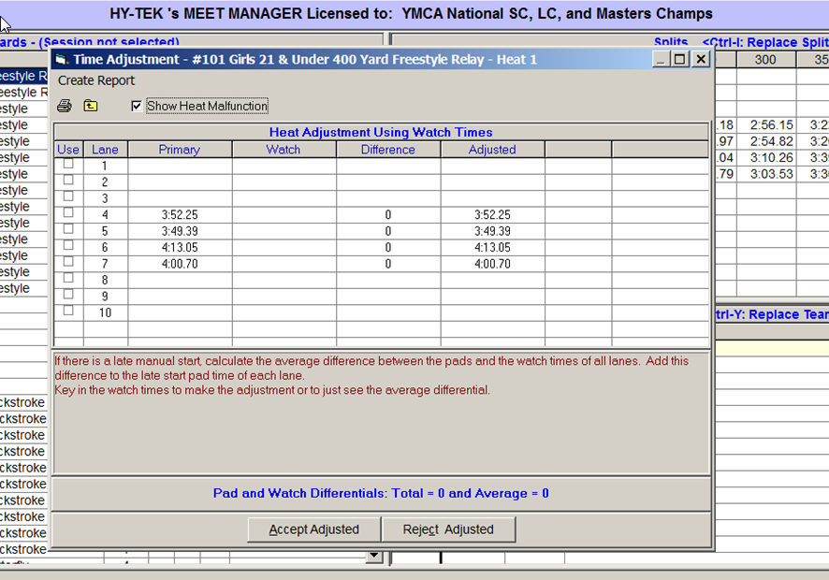
Heat malfunction

Slide 14
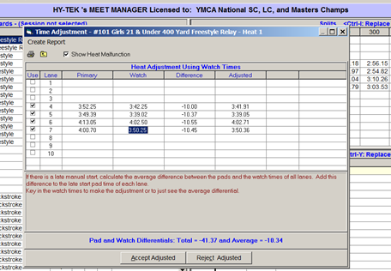
Entering Watch times

Slide 15
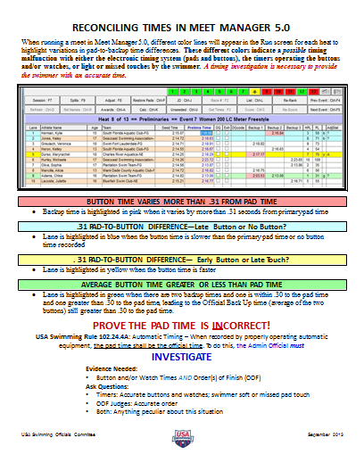
Quick guide for verifying times

Slide 16
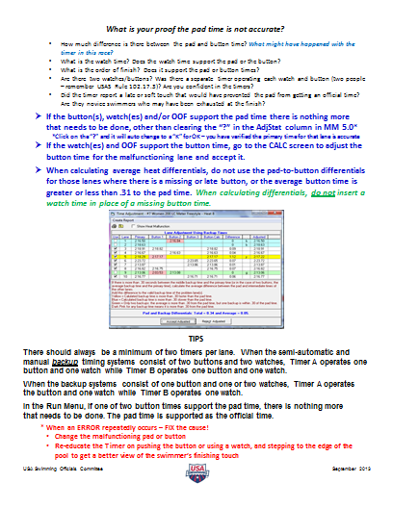
Quick guide for verifying times

Slide 17
Thank You
YMCA OF THE USA
V1.0

