Slide 1
Fall 2017
Parent information night

Slide 2
Agenda
Introductions
Rowing in Niskayuna
  Structure, Participation
Safety
  Rexford Bridge construction
Volunteers & Fundraising
  Yes, You!
Competitive Schedule
  Practices, Regatta travel
Team Breakout Meetings with Coaches

Slide 3
2017-2018 Board of Directors
President Chris Wolfe
1st Vice President Sean Ryan
2nd Vice President Dina McManus
Treasurer Matt Behar
Secretary Andy Bachert
Past President David Davenport
High School Parent Representative Larry Quinn
Modified Parent Representative Elissa Fromowitz
At-Large positions Bill Palmer
At-Large positions Marty Klepeis
At-Large positions Geoff Hall
At-Large positions Radu Neagu
At-Large positions Laura Mirkovic
At-Large positions John Conrad
At-Large positions Chris Liquori
At-Large positions Joan Rogers
At-Large positions Rob Lamoureux
Program Director (ex officio) Stacey Apfelbaum
NCSD Board of Education Representative Rosemarie Perez Jaquith
(ex officio, non-voting)

Slide 4
Rowing at Niskayuna
Niskayuna Rowing, Inc.
“NRI” d.b.a. Friends of Niskayuna Rowing
501(c)3 non-profit
  Board of Directors
  Annual budget
Program administration
  Program Director
  Most expenses (e.g. boats,
  coaches, travel, food, etc.)
Volunteers
Fundraising
  Equipment and operations
Niskayuna School District
“NCSD”
Code of conduct
  Student athletes, parents
  Coaches
Coach administration
  Appoints coaches each season
  Spring coach salaries (6)
Transportation for practice and local regattas
Strong partnership with specific roles & responsibilities
Relationship in the process of being updated

Slide 5

Rowing is a NCSD sport
NCSD Student Athlete Code of Conduct
  Parent and student sign Gray Cards
NCSD Coach handbook
  Parent/coach relationship page defines expected and acceptable communication with coaches
  Coach conference process
NRI Participation protocol
  Defines expectations for participation
www.niskyrowing.org
Clearly defined expectations

Slide 6
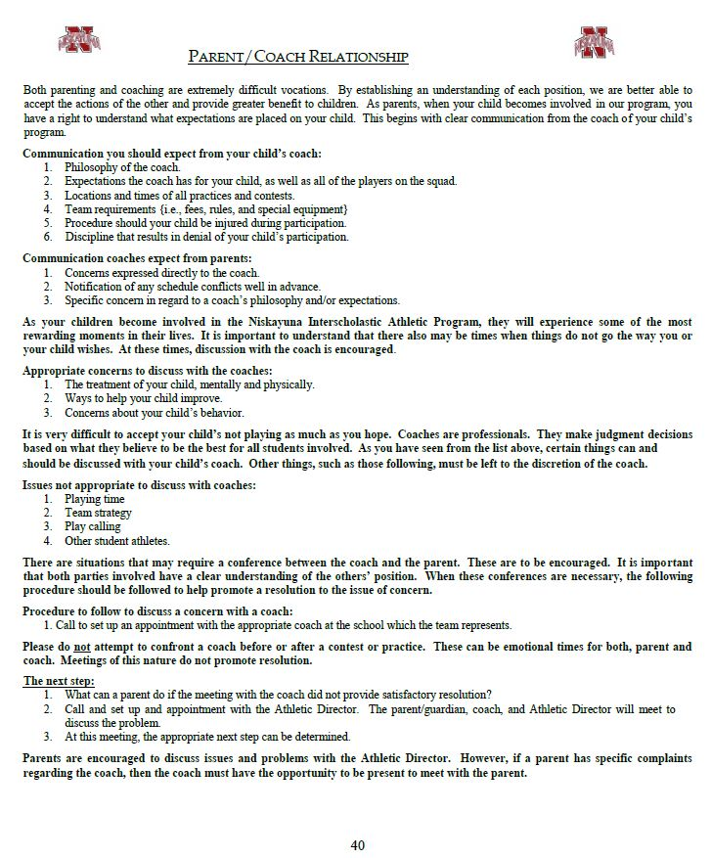
Resolution Process
Coach Handbook, Participation Protocol, AD Guidance
1. Rower meets with Coach
If not resolved…
2. Parent meets with Coach
If not resolved…
3. Athlete and/or parent meet with Program Director
If not resolved…
4. Athlete and/or parent meet with Athletic Director and Coach
www.niskyrowing.org

Slide 7
NRI’s participation protocol
Program philosophy and participation requirements
  NCSD Athletic gray card, physicals
  Swim test for all new rowers (swim, tread, life jacket)
Accept as many athletes as resources allow
  Prefer not to make cuts, but reserve the right if athletes > resources
  Training groups assigned based on skill, not age
Safety is paramount
  Athletes who pose a risk to themselves or jeopardize the safety of others, on land or on the water, may be asked to leave the program
Strive to get everyone a race, not every athlete will race at every regatta
Coaches reserve the right to place athletes at practice and/or events at the most appropriate skill level as determined by the coaches
Athletes may ride in coach launch during practice
  Affords learning, but should not occur on consecutive days unless due to injury
www.niskyrowing.org
\
& About Us → Policies Tab
Clarify expectations to join, practice and compete

Slide 8
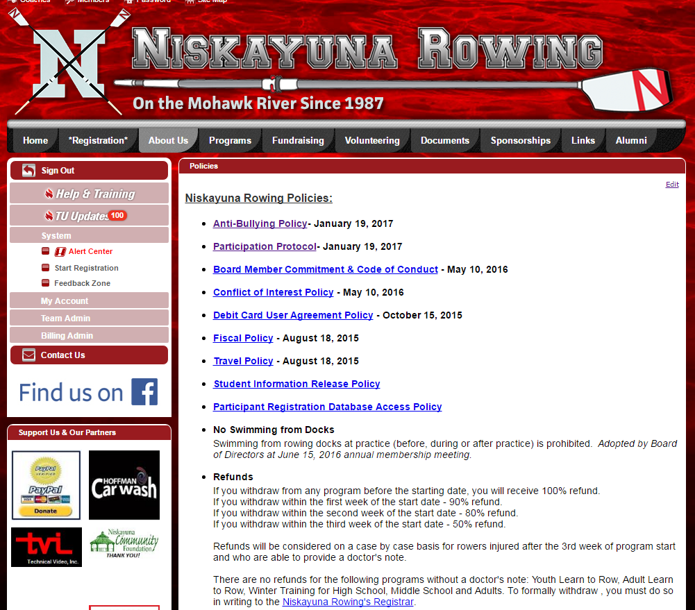
Policies at www.niskyrowing.org, “About Us” tab

Slide 9
Safety
Chris Wolfe

Slide 10
Safety is paramount
Everyone has a role to play on land and water
  Coaches, rowers, parents
Safety training meeting, video for all rowers at practice, start of season
Niskayuna Rowing Safety manual
Niskayuna Rowing prohibits swimming off our docks
10

Slide 11
Rexford Bridge construction
Construction of new bridge is substantially complete
However, demolition of old bridge will continue through October
Around the bridge is still an active construction site
  New Traffic Pattern working well – Cars moving much faster!!
  Be extra cautious entering and exiting the park
Safety! Key is maintaining physical separation
  Plans reviewed with NCSD, NYS DOT, Tioga Construction
  Navigation channel remains open for boats
  Water: alternate dock configuration still in effect
  Land: no construction in the park, safe driving
Niskayuna rowers and coaches will not pass under active bridge construction/destruction
  Close coordination with Tioga Construction drives upstream/downstream practice decisions
FNR safety manual updated for bridge and more

Slide 12
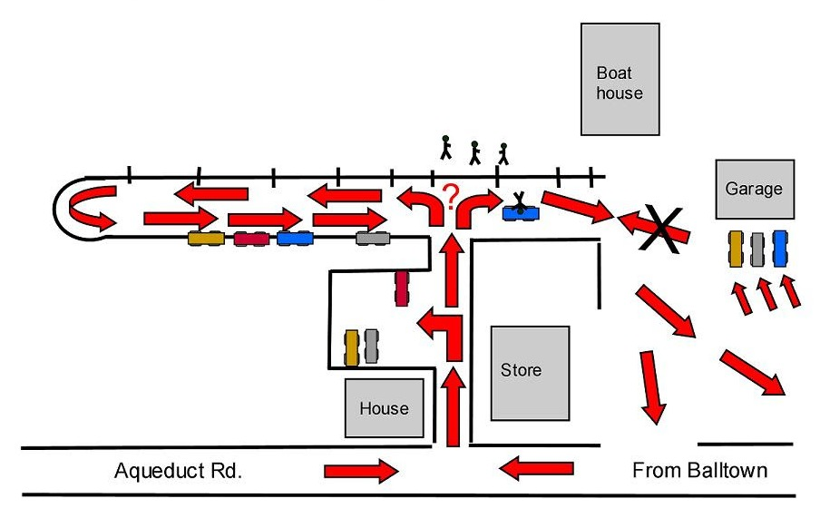
Boathouse Parking & Traffic
Watch for rowers
Exit only through store and garage lot
Do NOT park in garage lot
Consider alternate departure route – exit right
Mod Boat Racks
Car pooling is good!

Slide 13
Volunteer & Fundraising
Dina McManus

Slide 14
Committee membership
Executive (Board) Chris Wolfe, Sean Ryan, Dina McManus, Matt Behar, Andy Bachert
Finance & Audit (Board) Matt Behar, Julia Miller, Dave Davenport, Stacey Apfelbaum
Equipment, Health & Safety (Corp) Sean Ryan, Rich Bennett
Salvage Subcommittee Chris Wolfe, Andy Bachert, George Dalakos
Membership & Volunteer Mgt (Corp) Dina McManus, Ranya Palmer, Elissa Fromowitz
Fundraising & Development (Corp) Dina McManus, Larry Quinn, Rob Lamoureux
Travel (Corp) Chris & Ellen Wolfe, Dan McManus, Larry Quinn, Elissa Fromowitz, Stacey Apfelbaum, Marty Klepeis
New committees for 2017-2018
Publicity (Corp) Geoff Hall, Laura Mirkovic, Chris Liguori
30th Anniversary (Corp) Deb Bachert, Stacey Apfelbaum, Colleen Castle, Ranya Palmer, Kayla Bellaire-Sardos, Stephanie Lamoureux, Katie Singh, Cindy Chu

Slide 15
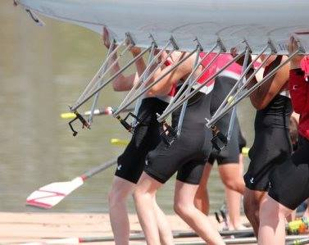
Rowing requires volunteers
Team Support
  Chuck Wagon at regattas
  Fall slide show Nov 2017
Necessary Fundraising
  30th year celebration Gala Nov 2017
Essential Operations
Dock Out (November 4th)
  Launch, engine, shell repair
  Board & Committees to plan tasks
  Major Efforts This Fall
Anniversary Gala
Execute Aqueduct Park Upgrades Using Grant Funds – Repair Timber Wall
Support our rowers… our coaches… our community!
Notes:
Three Concept II ergs $2,400
Safety launch engine repairs $2,500
36 Oars properly sized for our rowers: $4,500
A new Vespoli 8 Rowing Shell: $39,000
New trailer $9K+
Boathouse lights ~ $1.5K
Boathouse Port-a-potties, electrical, garbage, insurance: $1K
Accounting & QuickBooks ~ $3K
Website hosting, etc.

Slide 16
Volunteer Management Committee
Ensures parent volunteers are available in order to keep our rowers rowing and our Coaches coaching
To do that we need adults to manage
  Regattas
  Food
  Chaperones
  Fundraising
  Driving
  … and much, much more

Slide 17
Fundraising Committee:
We Are Dina McManus, Larry Quinn, Rob Lamoureux
  Bottle Drives: 3 –4 times, after holidays throughout the year
  Hoffman's Car Wash: Major Campaign between Thanksgiving and New Year's
  Tickets are available throughout the year.
  30th Anniversary Gala: November 11th
  Applebee's Flapjack Breakfast: December 3rd
  Amazon Smiles: Sign up on Team Unify
  "Donate Here" Always an option on Team Unify
  Annual Garage Sale: All hands on deck for volunteers
Dina slide
Committee needs more members and more ideas

Slide 18
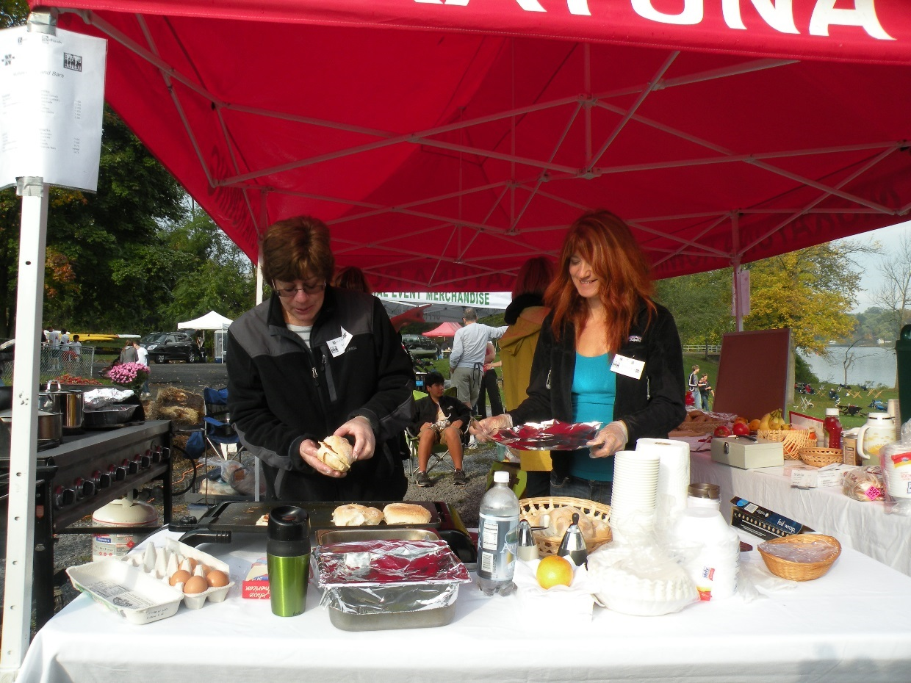
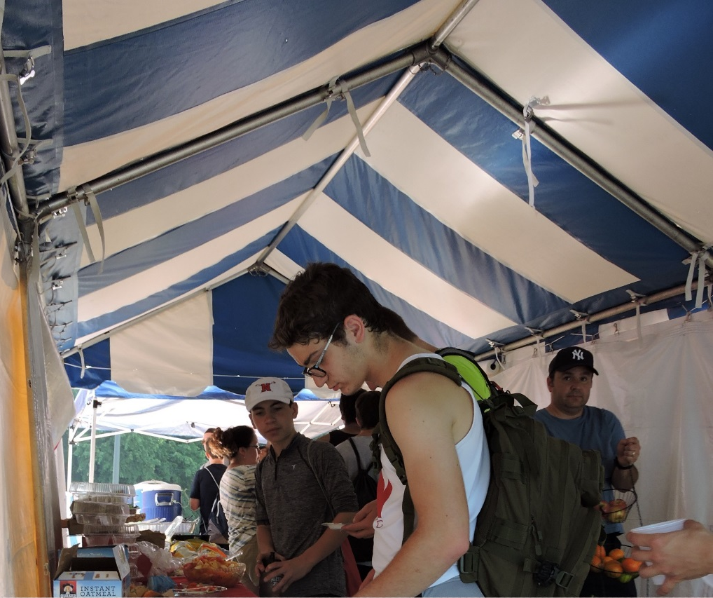
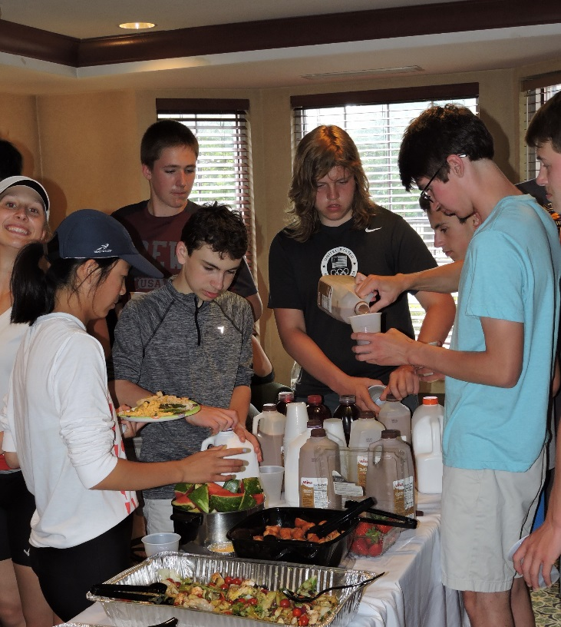
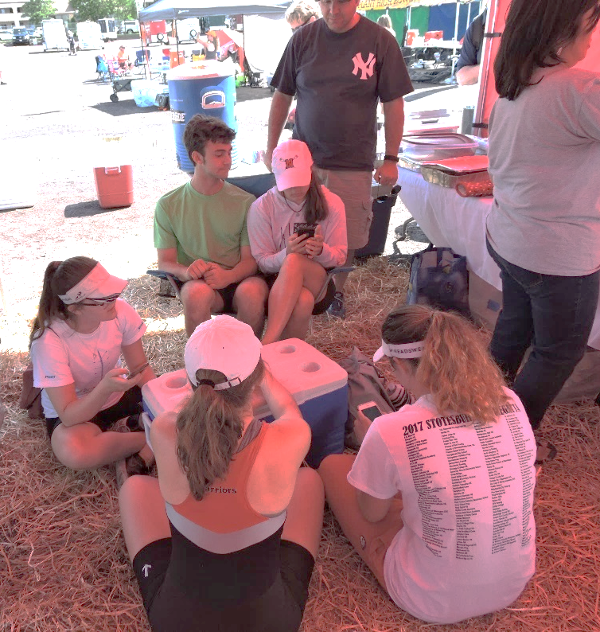
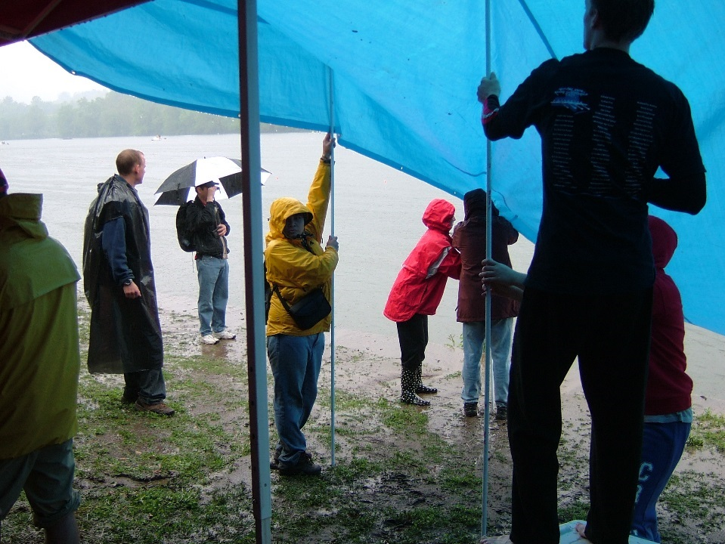
Travel committee
Stotesbury Cup, 2017
Head of the Mohawk, 2014
Stotesbury Cup, 2008
18
SRAA Nationals, 2017
SRAA Nationals, 2017

Slide 19
Travel committee
We are
Chris Wolfe, Ellen Lin, Dina McManus, Dan McManus, Larry Quinn, Elissa Fromowitz, Stacey Apfelbaum, Marty Klepeis
Our goals
Provide great race food in cost-effective manner
Involve every family in providing great food for our rowers
Make the tent a welcoming home base
- Food for all, with feeding rowers as the priority

Slide 20
The fall regattas
You will get an email soon with
Typical information:
e.g. Tail of the Fish
Racing 8am – 5pm
First bus leaves at 6am
Parking at Lee’s Park $15
You may take your child home after signing him/her out and the coach has dismissed him/her
Regatta costs included in registration fee
You will hear from Stacey a few days before the regatta
Boatings
Specific logistics like where the tent and trailer will be
Transport schedule

Slide 21
Food at the tent
Each family will work or provide food at least once in the season
Work at the tent
Bring baked goods to the tent
Bring fruit to the tent
Bring water to the tent
Tow chuck wagon
Shop
Sign up today with Elissa and Larry
or
Sign up on line – starting 9/13
or
Let us assign you a spot – after 9/20
You are responsible for your assignment!

Slide 22
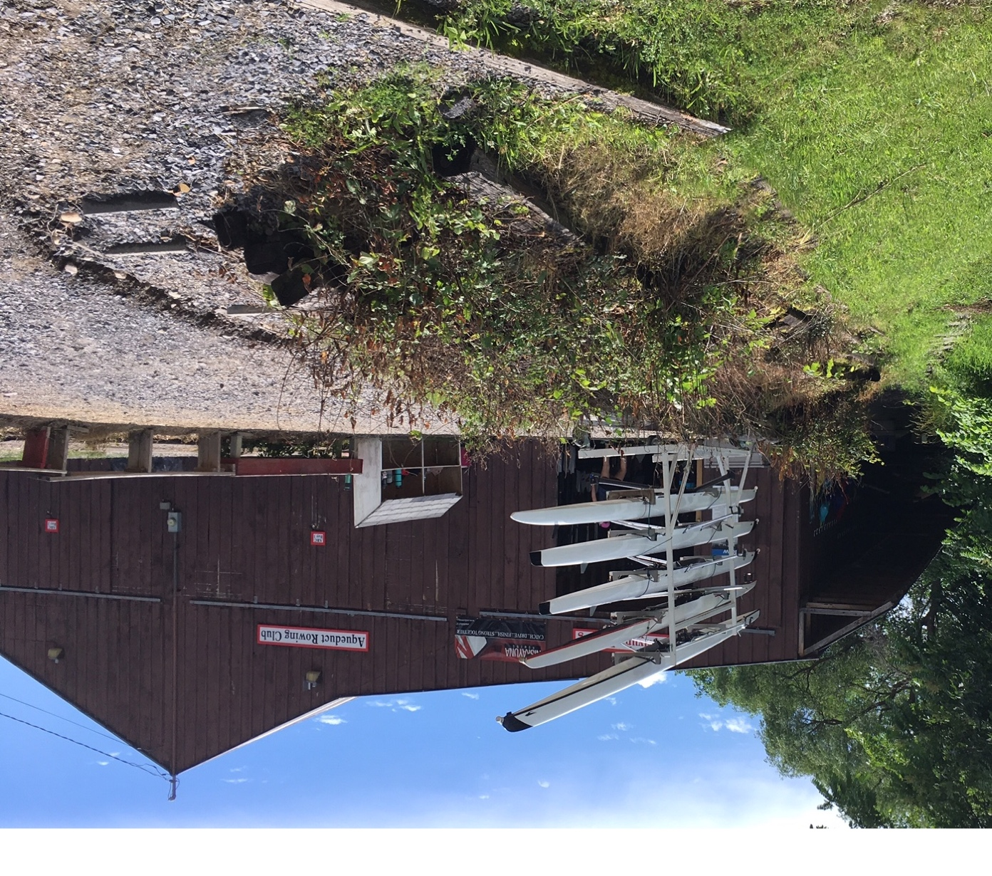
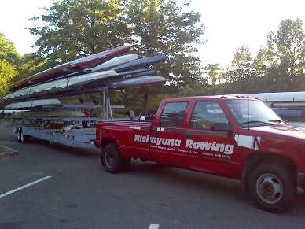
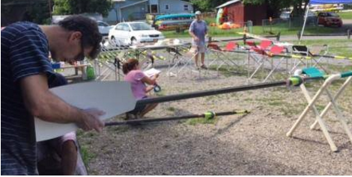
Equipment

Slide 23
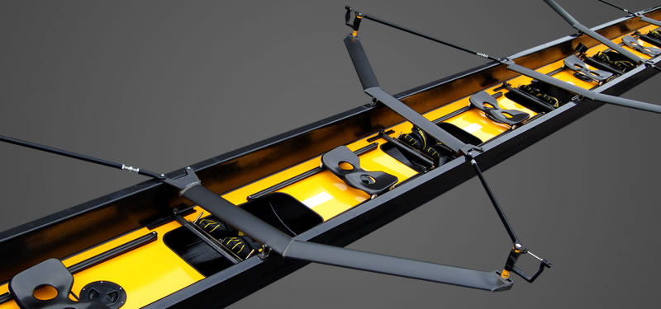

Fundraising driven by equipment needs
New Quad $15,000
New Eight $43,000+
New (to us) Truck
~$30,000 – 40,000!!
Set of Oars for Mods ~$1400
Set of Oars for Varsity ~$3200
23

Slide 24
Execute Aqueduct Park Upgrades Using Grant Funds
$150000 Canal Corp grant awarded to Town and FNR
New bathrooms handled by Town
Grant depends on matching through fundraising and volunteer labor.
Volunteers of all skill levels needed
  Replace Timber Walls
  Shore Up Boat House
  Refurbish Dock Ramps /Docks
  Boat House Maintenance
Retaining wall – this weekend!
  Stay tuned for details
  Sign up with Larry

Slide 25
How to stay informed
Our Website: www.niskyrowing.org
  Registration, policies, parent’s guide, other documents
  Subscribe to the calendar
Facebook: www.facebook.com/NiskyRowing
Attend Board meetings (next meeting: 9/19 at 7pm)
Socialize at the Boathouse and Regattas
Ask your Parent Reps
  Larry Quinn, High School
  Elissa Fromowitz, Modified
Our membership is our foundation for success

Slide 26
Fall 2017 Schedule
Stacey Apfelbaum

Slide 27
Fall 2017 practice schedule
Modified Team
September 5– November 4, 2017
High School Team
August 28 – October 30, 2017
At the boathouse on the water – all crews 3:30-6:00
Buses from high school and middle schools arrive 3:15 to 3:45
Practice Monday through Friday
Saturday practices for varsities, 8-10am on non-racing weekends
Weight room 6-7am for HS athletes.
  Boys: Mon/Wed Girls: Tues/ Thurs
  **Freshmen must produce an assignment with a grade of B or better to join the morning lifting group.

Slide 28
Fall 2017 competitive schedule
Sat September 30 Tail of the Fish Saratoga, NY Most HS, some Mods
Sun October 8 Mohawk Fall Classic Burnt Hills, NY All HS, most Mods
Sun October 22 Head of the Charles Boston, MA Qualifying HS crews
Sun October 29 Head of the Fish Saratoga, NY All HS, some Mods
Sat November 4 Mod Champs TBA All Mods
Notes:
Question: True that mods will practice during spring break? Required/optional?
Define “qualifying” means state finish + coach decision that semi finals is possible

Slide 29
Regatta Transportation- Everyone
Rowers must ride the bus to the regatta
Parents/Guardians may take their children home from regatta after the trailer is packed and loaded and they are dismissed by their coach
  Sign out your child with the coach;
  Bus will wait until we contact you to verify that you have your child
A written note by the parent/guardian to the coach shall be required before racing begins for another adult to transport a rower home from a regatta

Slide 30

Team Uniforms
Online JL Racing store to re-open for limited time for purchase of new unisuit and practice, weather gear
https://www.jlracing.com/page.NiskayunaRowing.html

Slide 31
Coaches
Stacey Apfelbaum

Slide 32
Fall 2017 Coaches
High School Crews |  | Modified Crews
Stacey Apfelbaum High School Girls Head Coach |  | Scott Meade Modified Coach, Girls
Burt Apfelbaum High School Boys Head Coach |  | Kate Meade Modified Coach, Girls
Sabrina Skotarczak High School Girls Coach |  | Julia Masson Modified Coach, Boys
Pat Grasso High School Boys Coach |  | Hannah Sive** Modified Coach, Boys ** Pending NCSD BoE Appointment
Aaron Prescott High School Boys Coach
Additional information at Coach Meetings
Notes:
Stacey – name of 9th coach?

Slide 33

THANK YOU
Additional Information at Coach Meetings

