Slide 1


LSC Non-Athlete Officials Membership Application
Background Check
Athlete Protection Training (Can only be done after you are a member, once registered in the system)
Concussion Training print and email certificate to office@sc-swimming.org

Slide 2
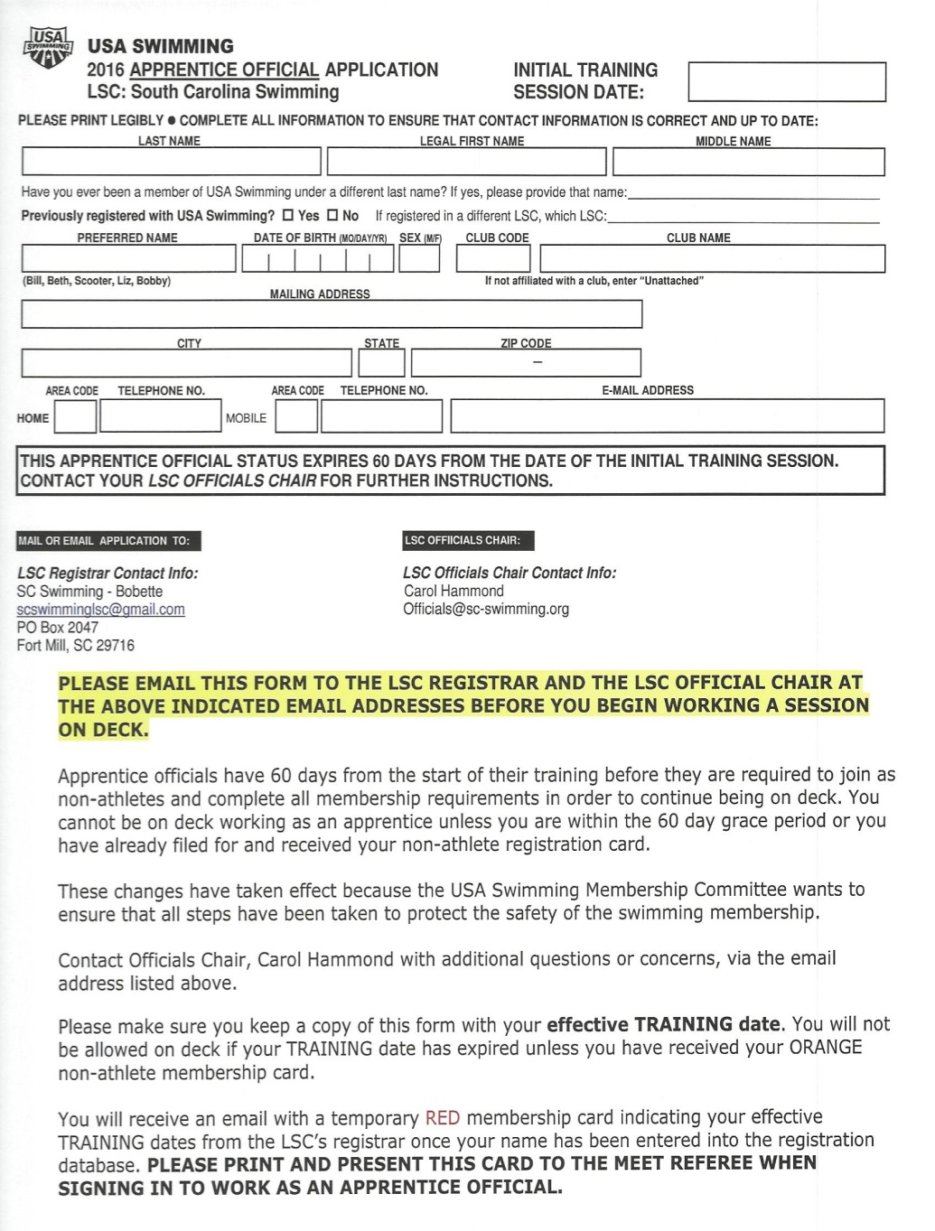
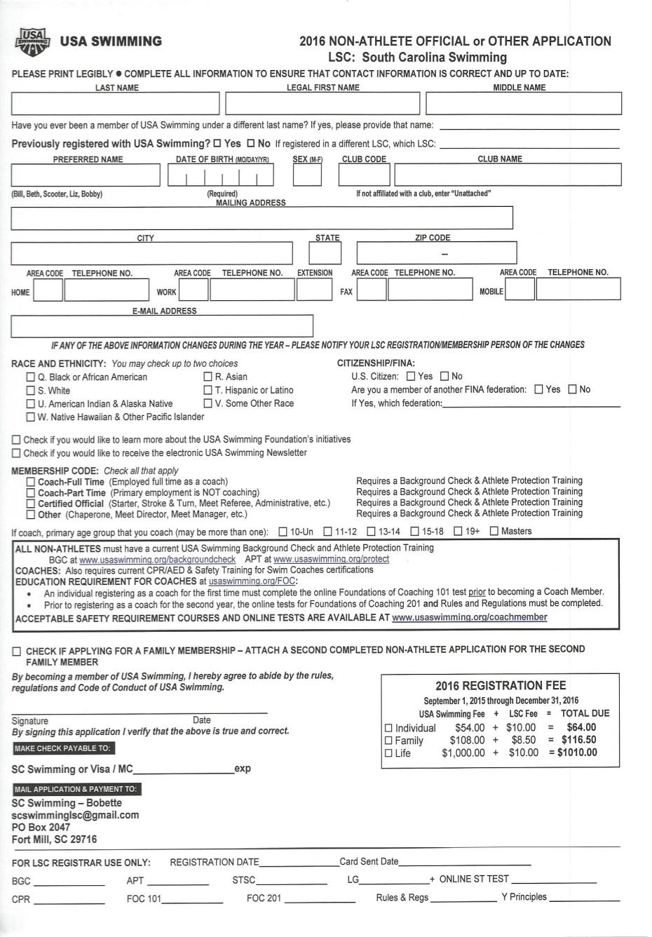
FORMS USED TO BECOME A MEMBER

Slide 3
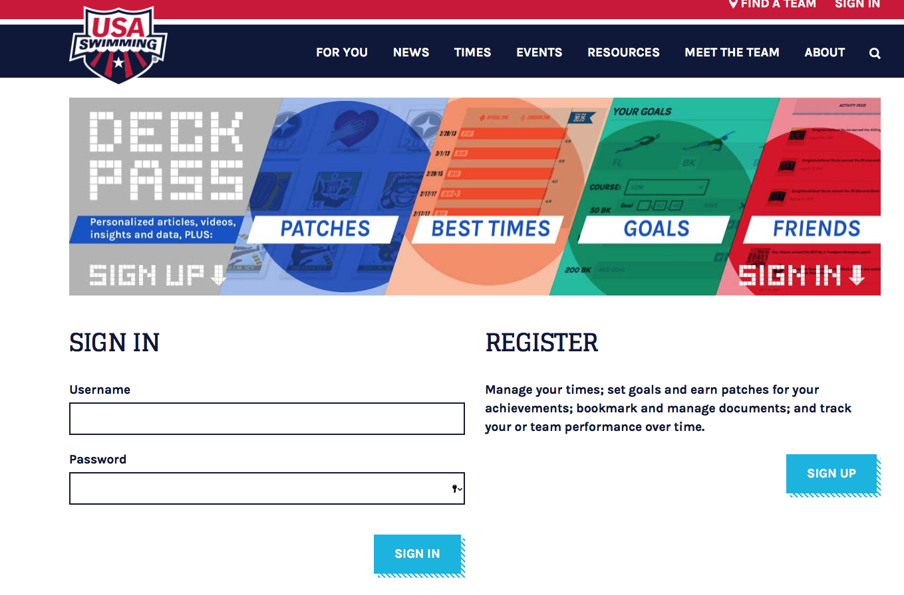
USASwimming.org
Click box to register

Slide 4
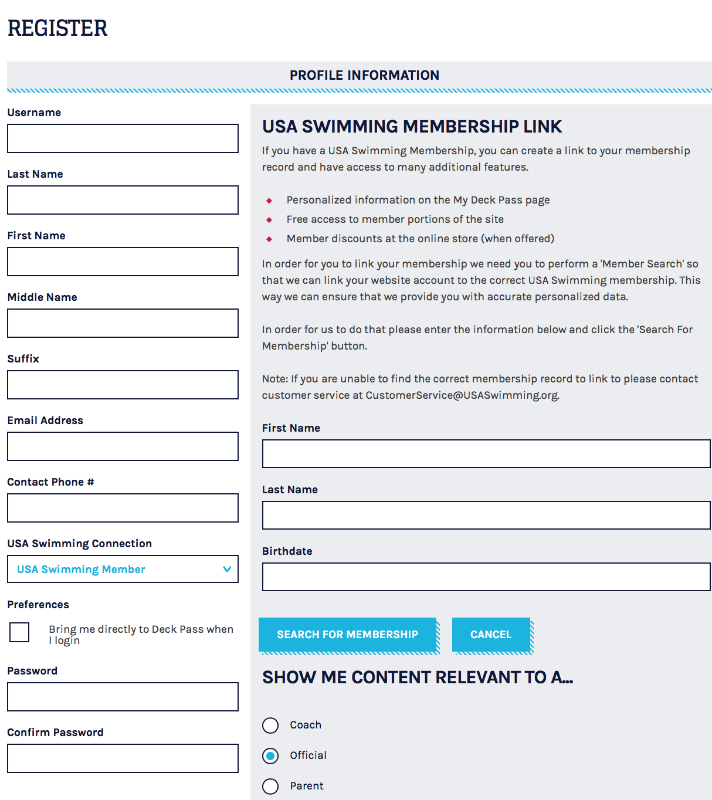
Registration
Complete form
Search for USA Swimming Membership
The username and password you create for your registration must be used for all officials related activities so that they are linked to your account.

Slide 5
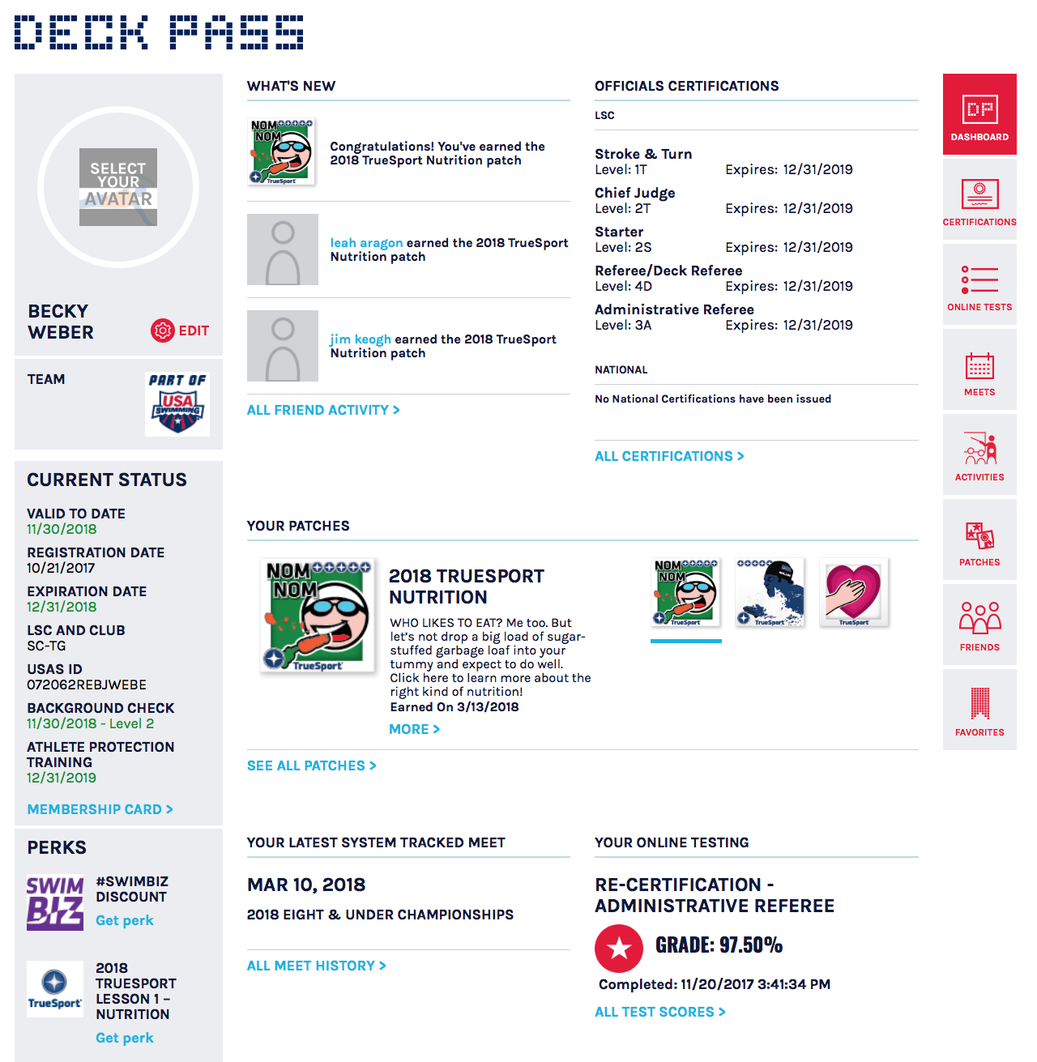
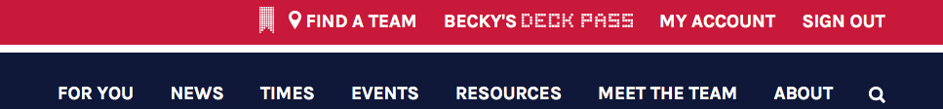
Deck Pass
Certifications
Sign in
Membership status
Certification test results
Click on Deck Pass

Slide 6
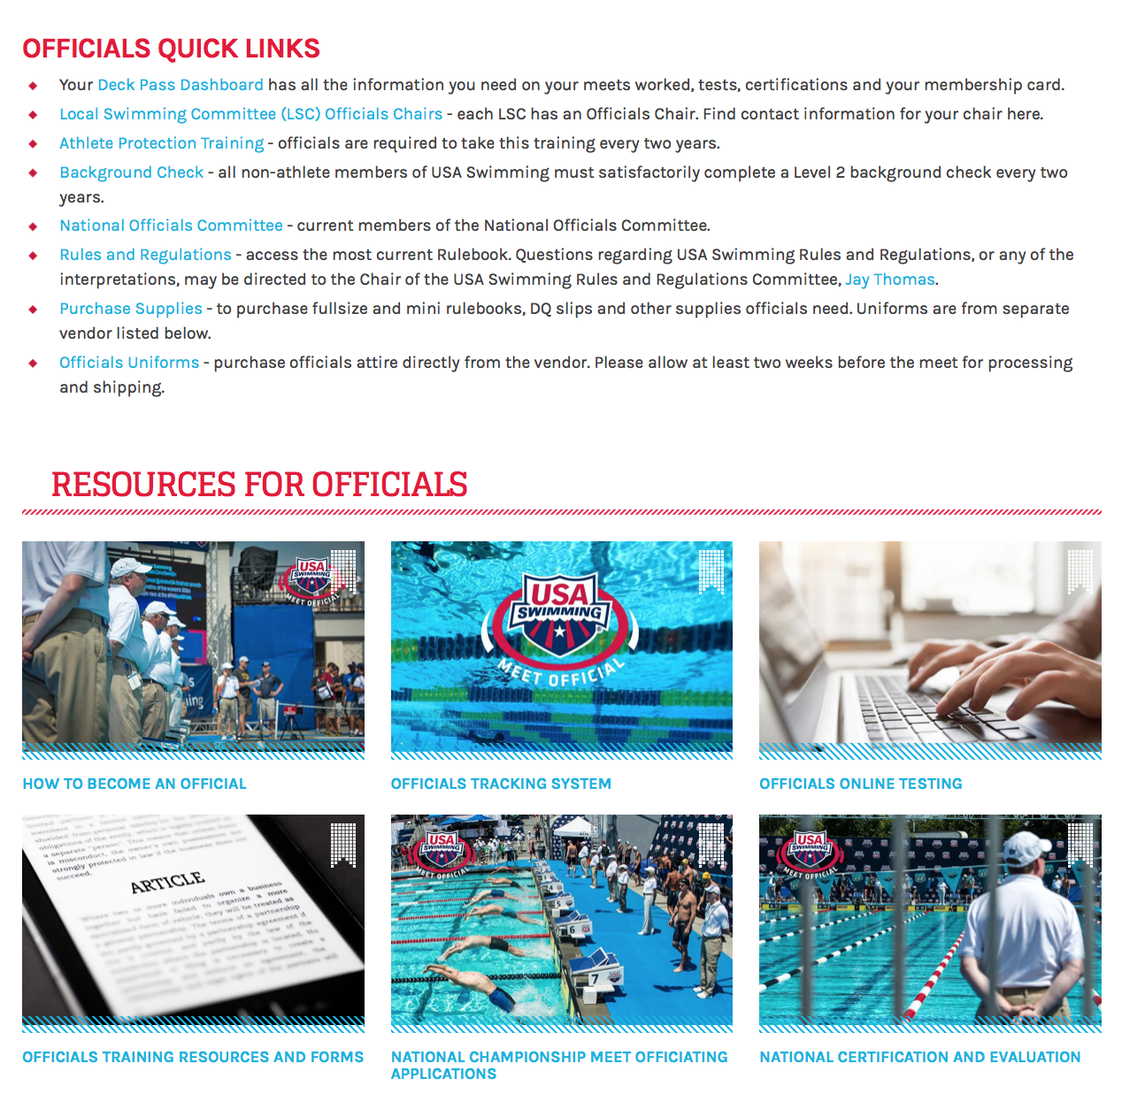
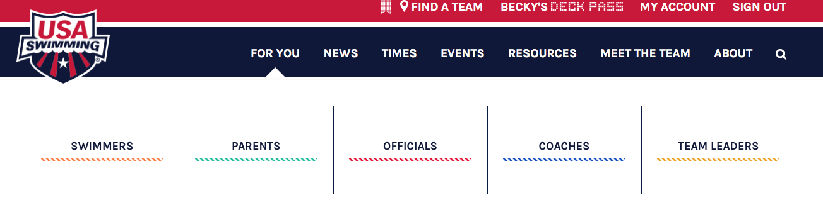
Officials Page
Click on FOR YOU
Click on OFFICIALS
Quick links to ATP & BGC can be found here
Links for OTS & Online Testing Pages

Slide 7
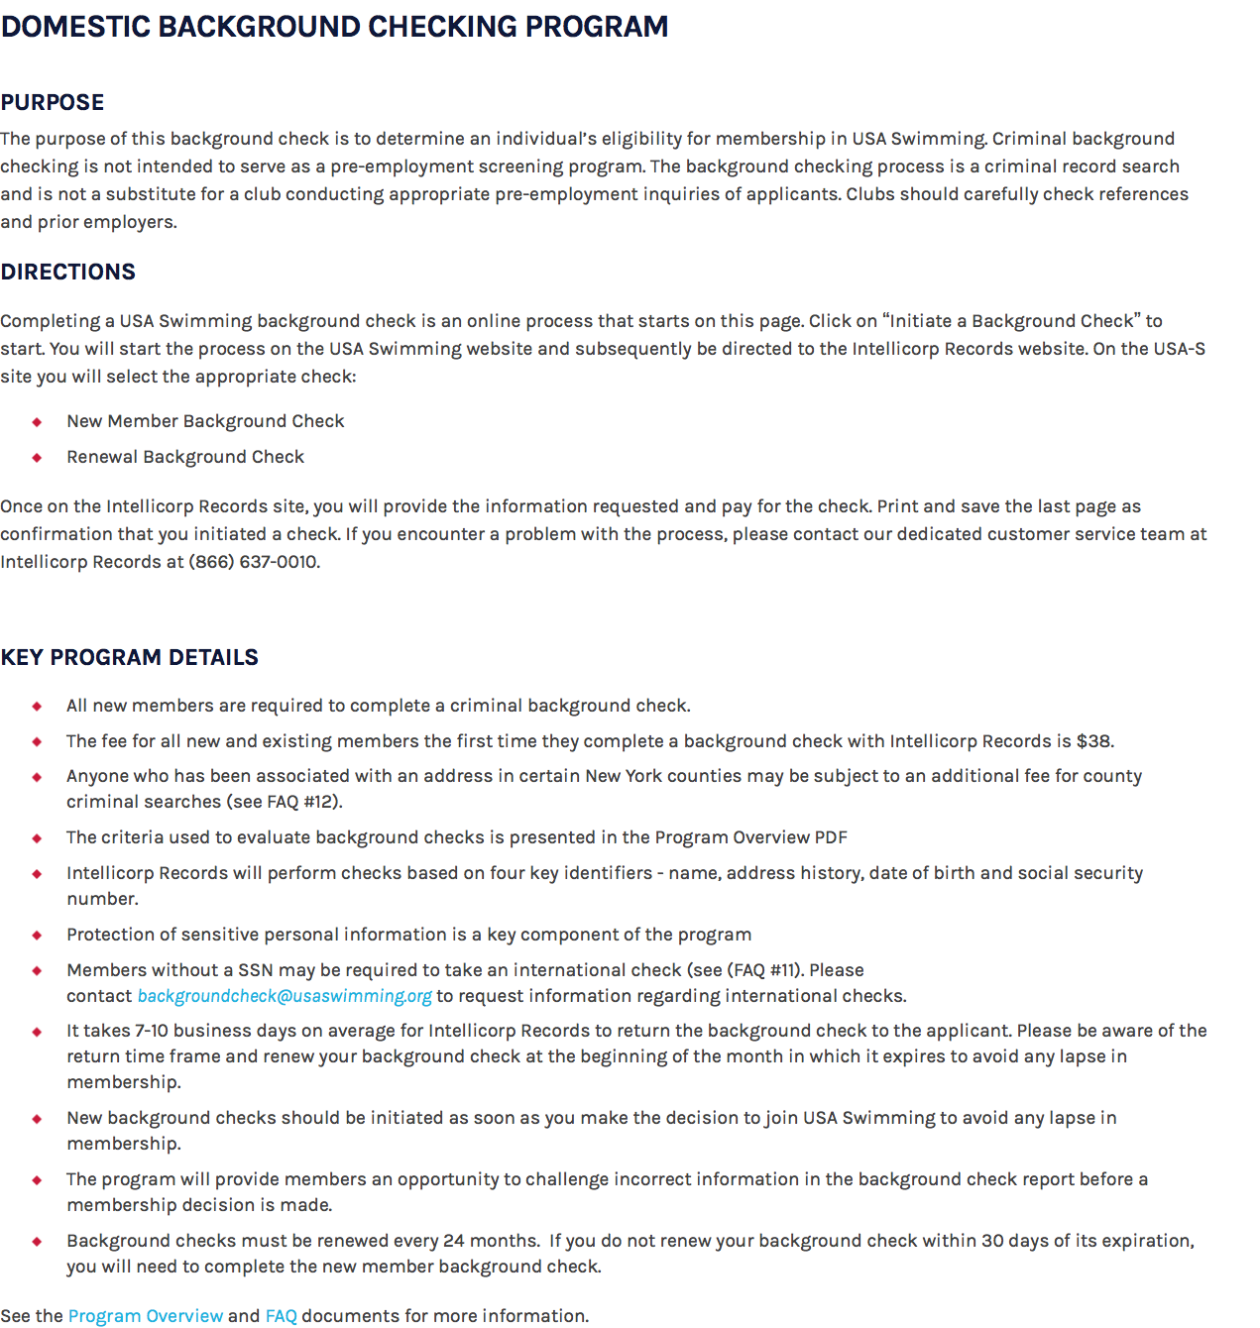
Background Check
BGCs are also mandatory for all USA Swimming Officials.

Slide 8
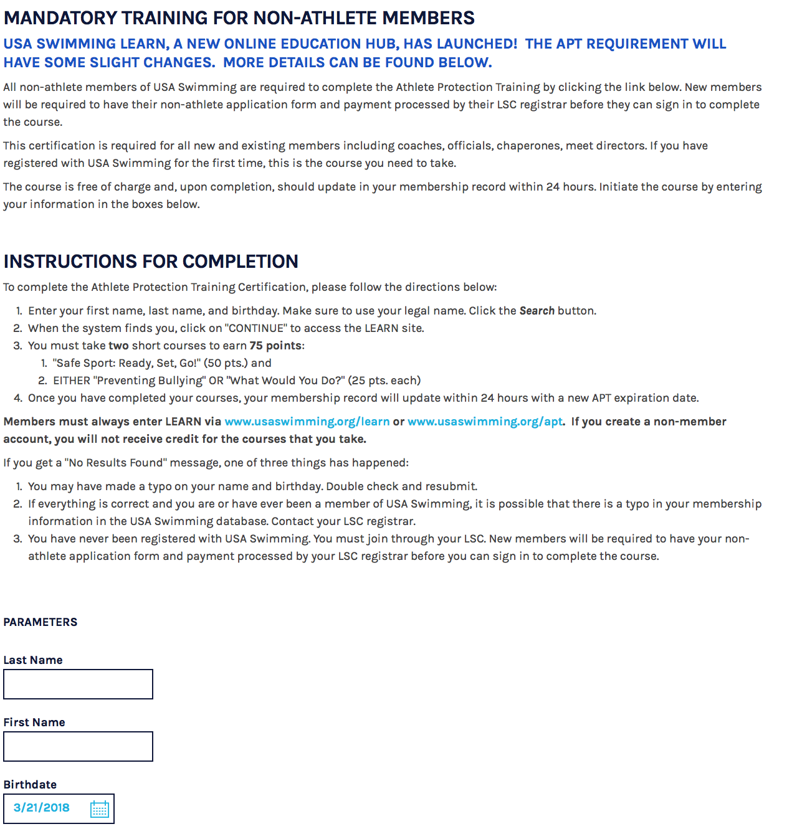
APT Requirement
USA Swimming mandates that all officials shall have completed the Athlete Protection Training to work on deck.

Slide 9
Concussion Training

Slide 10
Complete the Stroke and Turn or Administrative Official Apprenticeship.
Complete online Testing with a score of at least 80% prior to completing the apprenticeship.

Slide 11
Taking the Test
Log on to http://www.usaswimming.org/
Register if you have not done so.
Select “Stroke and Turn Certification Test”
  A hard copy of the test can be printed once you have registered and have selected the appropriate test.
  Results will be sent to the appropriate USA credentialing body, as well as the LSC Chair for Officials for South Carolina
80% passing grade –
Certification cards sent to your e-mail

Slide 12
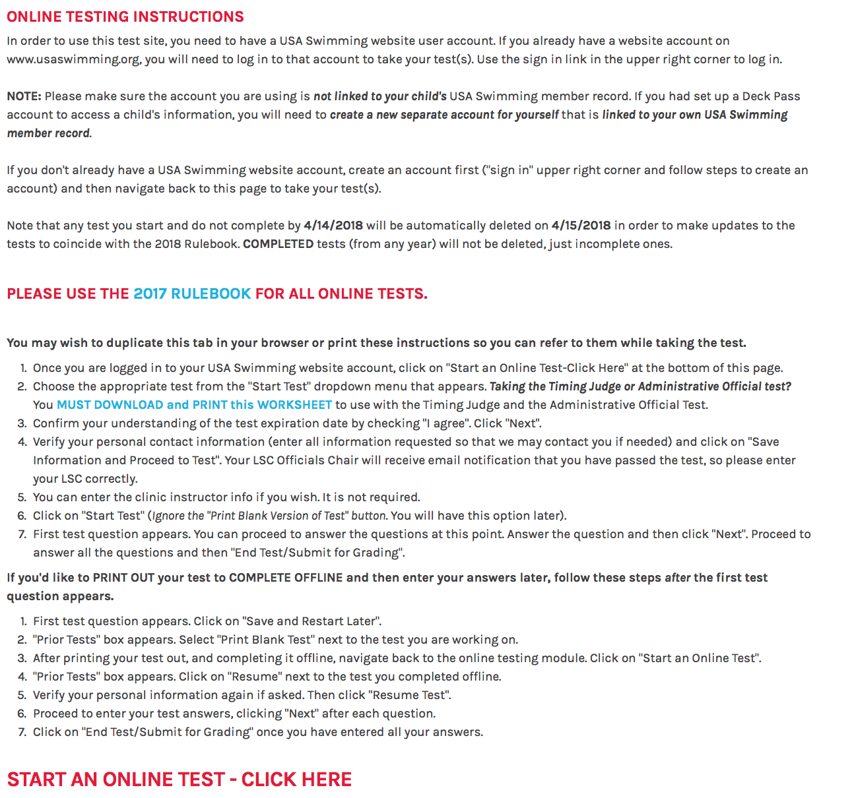
Online Testing
Changes to new year May 1st
Please follow these instructions found on the Online Testing Home Page!

Slide 13
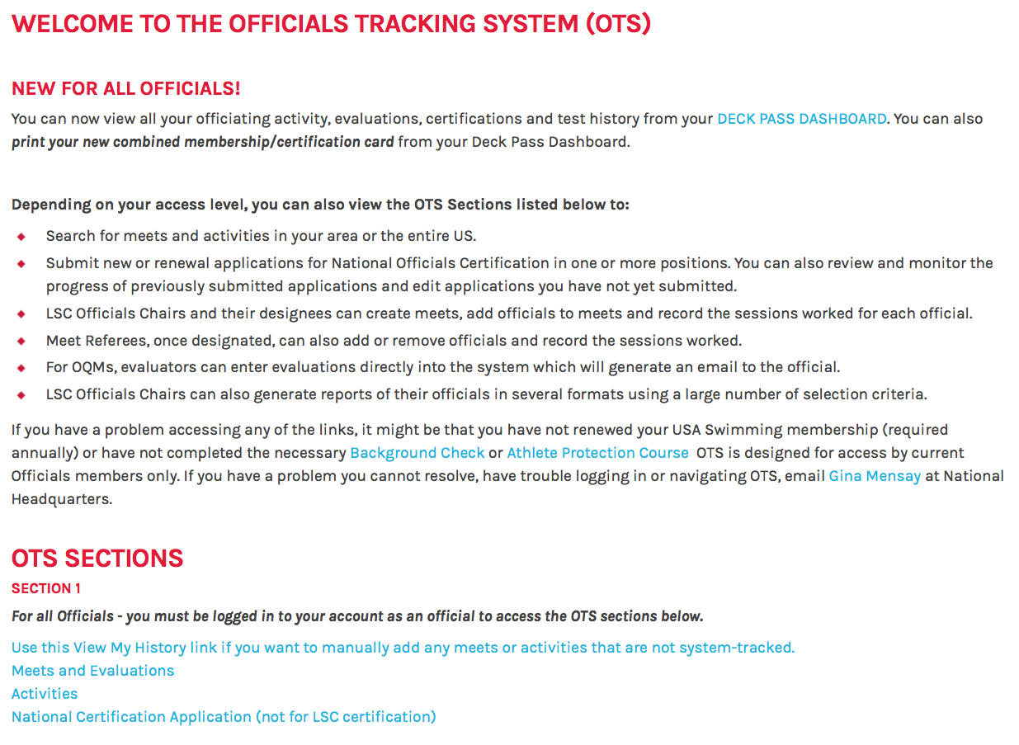
Officials Tracking System

Slide 14
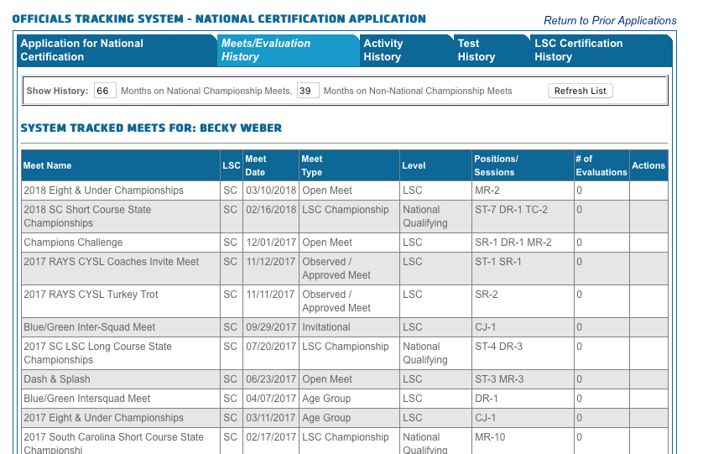
My History
All of your officiating history can be found here. Use the tabs at the top to verify

