Slide 1
Electronic Timing Official Training Clinic
Electronic Timing 4/2021

Slide 2
Agenda
Introductions
Role of an Official
Role of ET Official
Certification Process
ET Job Responsibilities
Timing Console (Station #1)
Time Verification/Paperwork (Station #2)
HyTek Meet Manager (Station #3)
Working Examples
Questions

Slide 3
Role of an Official
OSI Officiating Philosophy
Fair and equitable conditions of competition are maintained and uniformity in the sport is promoted so that no swimmer has an unfair advantage over another

Slide 4
Role of an Official
What does that mean?
Success of every meet depends on the official’s integrity, knowledge, concern and regard for the competitive interest of the swimmer
One set of rules applies to all swimmers
Swimmers get the benefit of the doubt
Demonstrate impartiality and professionalism on deck

Slide 5
Role of an Official
Professionalism on Deck
Wear standard uniform
Typically white polo over black shorts, black shoes
Long pants/skirts for championship finals
Sometimes khaki instead of black
No team logos or advertising
Wear credentials and name tag
Be in position on time. Do not vacate position until replacement in place

Slide 6
Role of ET Official
What does an ET Official do?
Operate electronic timing equipment (Timing Console-Station #1)
Determine official time (Time Verification/Paperwork-Station #2)
Record & post results and scores (Hy-Tek Meet Manager-Station #3)
Work as part of a larger officiating crew (ie: Referee, Starter, Stroke & Turn, Admin Official)
Assist AO (or Starter) with instructing timers in proper timing procedures or any other needed task

Slide 7
Certification Process
Certification Steps
Attend an introductory ET Clinic
Register through Oregon Swimming(OSI) as non-athlete member of USA Swimming
Pass a background check through USA Swimming
Complete USA Swimming online Athlete Protection Training
Complete USA Swimming online Concussion Training
Upon application approval; acquire uniform; begin volunteering at meets
Complete ET Training Record
Forward Training Record and Evaluations to OSI ET Chair and wait for confirmation to take online test
Take and pass on-line open-book test

Slide 8
Certification Process
ET Training Record
Attend ET Clinic
Complete a Deck Tour with Referee → should do at first meet
Work a minimum of 5 ET sessions
At least 2 of the first 6 hours must be with a designated ET Trainer
2 sessions at sanctioned 12&Under meet
1 session at a non-home meet
10 observed hours on Timing Console (become familiar with both Colorado and Daktronics)
10 observed hours on Time Verification/Paperwork
5 observed hours with the Hy-Tek operator
Successfully complete a heat malfunction calculation (by hand)
Receive 2 positive Evaluations from 2 different ET Trainers from 2 different sessions

Slide 9
Typical ET Setup
Pads
Scoreboard
Buttons
Starting
Console
Timing
Console
Time Verification (paperwork)
Hytek/Results
Computer

Slide 10
Typical ET Setup (Paperless)
Pads
**Advanced method of reconciliation.
Scoreboard
Buttons
Starting
Console
Timing
Console
Hytek/Results
Computer

Slide 11
Timing Console (1st Station):
Equipment:
Colorado Data Systems 6
Colorado Data Systems 5
Daktronics Omni-sport 2000 or 6000
Printer

Slide 12
Timing Console (1st Station):
Set Up Timing Equipment
Be familiar with Colorado and Daktronics systems
Help set up and know how to operate the equipment
Allow time before the meet to set up and diagnose problems
Home crew will often set up equipment, but you still need to check it over
Ensure starting unit connected
Ensure buttons and pads in place and connected
Verify meet file has been downloaded
Perform test start and then reset for first race

Slide 13
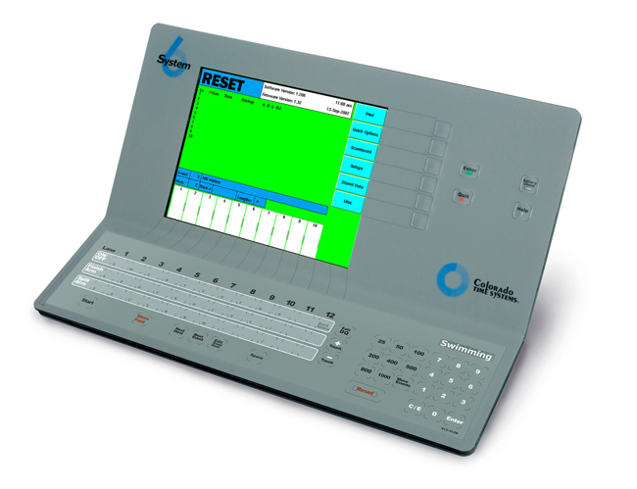
Timing Console (1st Station):
Colorado 6
Uses the softkeys on the right and bottom
Start Store Next Next Edit Reset
Print Heat Event

Slide 14
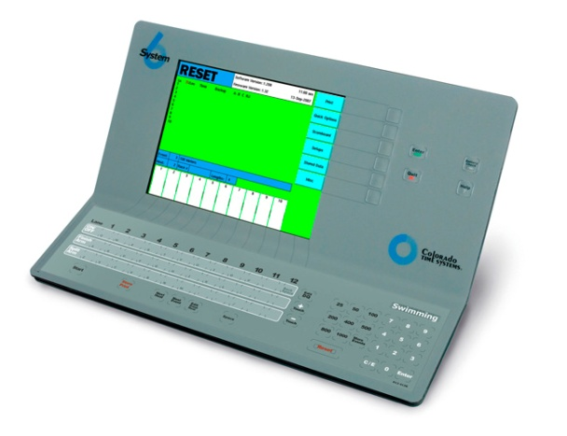
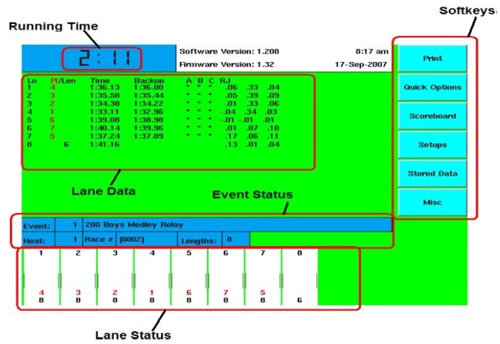
Timing Console (1st Station):
Colorado 6
Race screen shot

Slide 15
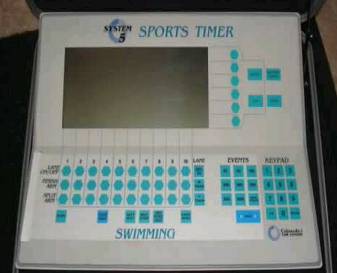
Timing Console (1st Station):
Colorado 5
Also uses softkeys to the right and bottom
Softkeys

Slide 16
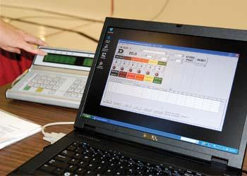
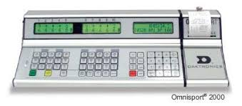
Timing Console (1st Station):
Daktronics (OmniSport)
OmniSport operates with buttons similar to Colorado
What is unique, is that it can be connected to a laptop by using an optional PC interface
Beware that button averages on the Daktronics printout may be rounded up instead of truncated (depending upon version)
OmniSport Console
PC Interface (laptop)

Slide 17
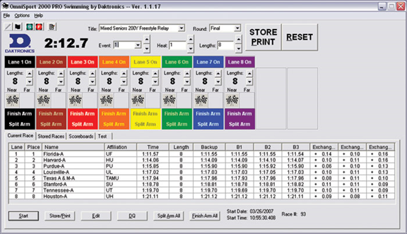
Timing Console (1st Station):
Daktronics (OmniSport)
Added features of PC interface:
1. Displays swimmer names & teams
2. Access to stored races→ contains unlimited race/meet memory (See Exhibit #1 for Race Log Instructions)
Race screen shot
Store
Print
& Reset
Running Time
Lane Status
Start

Slide 18
Timing Console (1st Station)
Operate Timing Equipment
Ensure ET Console set for correct event and heat and is “RESET”
Avoid making changes and beeps just prior to the start.
ET Console should start timing when Starter unit sounds
If ET Console fails to start, start it manually & write “manual start” on ET Console Heat Sheet
Check for No Shows and turn lanes on/off
Mark No Shows on ET Console Heat Sheet with “NS” and strike through the name (if all swimmers present mark heat with “F”)
Write race number on ET Console Heat Sheet
Watch for intermediate pad touches. Add/Delete touches as required
Finish arm lane(s) if necessary
Store-Print; Reset; Advance to Next Heat or Next Event
Get console ready for next heat in a timely manner
FOCUS ON DRIVING THE CONSOLE WHEN TASKED TO DO SO

Slide 19
Time Verification (2nd Station)
Timing System Designation (Rule 102.24.3)
Every race shall be timed with one or more of the following system; listed in their prefered order of use:
Primary
The most accurate system available
Could be automatic, semi-automatic, or manual
Normally automatic PADS
Secondary
Backup to primary system. Typically BUTTONS
Tertiary
At least one WATCH should be used as a back-up for a automatic or semi-automatic system

Slide 20
Time Verification (2nd Station)
Determining the Official Time
All timing systems, including manual watches, will be resolved and recorded to one one-hundredth of a second. (0.01 second). The digits representing thousandths shall be dropped with no rounding (102.24.1B)
For example: 57.347 → 57.34
When recorded by properly operating automatic timing equipment, the pad time shall be the official time (102.24.4A)
A (lane) malfunction may have occurred it the difference between the time obtained by the primary system and the backup system(s) is approximately .30 second or greater (102.24.4C(1))
Use the flowchart on the following slide to aid in determining the Official Time

Slide 21
Time Verification (Pad, Button & Watches) 5/1/16
At least one button confirms pad time
Y
102.24.4C
The difference between the time of the primary system and backup system must be 0.30 seconds or less
Use pad time
N
At least one watch confirms pad time
Y
(Tip: move to next step until you get watches)
N
Buttons confirm each other and faster than pad
Y
Use button average
N
Watches confirm one button time and faster than pad
Y
Use button
N
Watches confirm each other and faster than pad
Y
Use watch average
N
Collect order of finish and coach’s time. Compare with pad/watch/button times. Use best judgment.

Slide 22
Time Verification (3 Watches)
Two watches the same
Y
Use watch time
N
Middle watch within 0.30 seconds of the other two
Y
Use middle watch time
N
Only two valid watch times available (both within 0.30 seconds)
Y
Take the average of the two watches
N
One of the 3 watches more than ±0.30 seconds from either of the other two valid watches (both within 0.30 seconds)
Y
Discard the outlier and take the average of the two watches
N
Collect order of finish and coach’s time. Use best judgment. If no valid time, use the middle watch time. One time not validated is not ideal, benefit of doubt to swimmer
valid watch or button; def. having another time within approximately 0.30 seconds of that time

Slide 23
Time Verification (2nd Station)
Due diligence to provide the swimmer with the most accurate time available is extremely important
Keep these questions in mind:
Is the primary time invalid?
Is the use of the back-up time appropriate?
Should a button or watch time be used, and which is the most accurate?
Is there a heat malfunction and have proper calculations been applied?
Further investigation (watch times and OOF) is needed when:
Button times are slower than the pad time but button times confirm each other
Times validated “just barely” by approximately 0.30 seconds

Slide 24
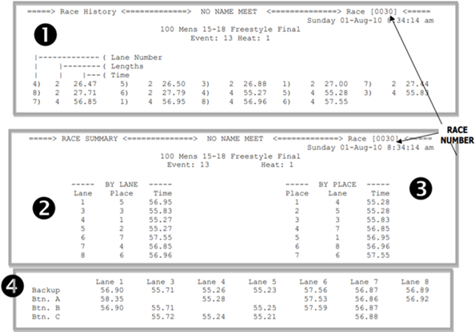
Time Verification (2nd Station)
Documenting Official Time (Paperwork)
Console Printout
1→ Race History-records each time a pad is touched, source of split times
2→ Race Results by lane
3→ Race Results by place (OOF is used instead)
4→ Backup Times recorded by pushing buttons connected to pad on each lane
*Note that no times are recorded for Lane 2 because there was no swimmer in Lane 2 in this heat, likely a “No Show” and should be confirmed with the console operator

Slide 25
Time Verification (2nd Station)
Documenting Official Time (Paperwork)continued...
Obtain heat printout from console operator
Check correct race#, event#, heat# and highlight printout
Confirm that each lane with a swimmer has a time
Document any no-shows
Document any DQ’s
Calculate official time. (Validate within .30 - use flowchart)
Clearly identify official time with check mark and strike out invalid times
Initial paperwork
Pass paperwork to Hy-Tek station

Slide 26
Time Verification (2nd Station)
Documenting Order of Finish (OOF)
OOF is an aid when no clear validation between pads, buttons, and watches is clear
Starters will provide the OOF, listing the lanes in the order that they arrived at the finish
Write OOF on paperwork: OOF 4-3-2-5-6-1
OOF also useful in validating times when 3 watches are used as the primary timing system
Do not confuse OOF with the finish place from console paperwork. It may not be accurate.
These Starter notations suggest unsure or too close to call for lanes 2,5,6:
43 - - - 1 ; 43 256 1 ; 43 256 1

Slide 27
Time Verification (2nd Station)
Documenting DQ Slips
Compare DQ slip for correctness with ET Console Heat Sheet
Swimmer/Team Name
Event/Heat/Lane
Signed by referee
If there any discrepancies, send DQ back to referee
Initial top corner of DQ Slip
On Console Sheet strikeout swimmer name
Denote “DQ” along left side of strikeout
Write the lane(s) and name(s) of those DQed on Time Verification paperwork; strikeout lane/time
Attach DQ slip to back of printout, facing backwards – enables easy review later if required
ET TIP:
RED IS NOT REQUIRED
DQ notations written in red are not overlooked BUT are harder to erase!

Slide 28
Time Verification(2nd Station)
Heat Malfunction (102.24.4E)
If the automatic system has had an early or late start (the manual start button is pushed), ALL times need to be adjusted
For each valid lane (pad validated by button), calculate the average WATCH - PAD difference
Discard any watch outliers that are more than 0.30
Adjust all automatic and semi-automatic times by average WATCH - PAD difference
Worksheet available

Slide 29
Hy-Tek Meet Manager(3rd Station)
Meet Manager software on the Hy-Tek/Results Computer
Set up meets
Manage entries
Seed races with swimmers
Prints heat sheets & psych sheets
Captures the times from the timing console
Assimilates the results
Scores the meet
Prints awards labels

Slide 30
Hy-Tek Meet Manager(3rd Station)
Before the meet starts, the following should be ready:
Download meet file from Hy-Tek to console
Print Console Heat Sheet - 1 event per page
Print and deliver Lane Timer sheets
Print Heat Sheets / Session Reports as needed
Hy-Tek operator “Get Times” to stay current with the meet
Paperwork is sent over by heat or in one event batch
Update official times after they are confirmed by Station #2
Update DQs as they come in
Confirm with Referee that events are closed before posting results
Keep console turned on until Hy-Tek operator confirms that ALL race information has been transferred

Slide 31
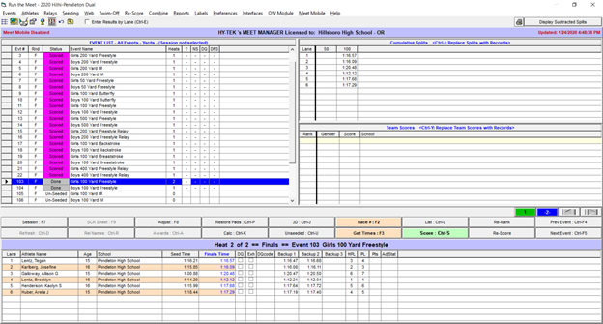
Hy-Tek Meet Manager(3rd Station)
Screen shot of typical “Run” Menu:
Buttons and arrows to move among heats
DQ’s
Get Times
Times recorded when swimmers touch pads
Button/Backup Times

Slide 32
Hy-Tek Meet Manager(3rd Station)
After “Get Times”, the Run Menu highlights timing anomalies in color. Don’t rely on colors, follow the Times Verification rules to determine Official Times.

Slide 33
Other Official Times
Rule 102.24.1A
Official times may be achieved in:
Any heat
A swim off
A lead-off leg in a relay
A split time recorded from the official start to the completion on an initial distance with a legal finish within a longer event, provided the swimmer completes the event or the lead-off portion of the relay in compliance with applicable rules
A time trial or a record attempt

Slide 34
Problem Solving
Communicate if something has gone wrong so that the problem can be fixed quickly. Examples:
Pad not working→ Swap out a backup pad
Button not working→ Swap out backup button
Printer not working
-Refill paper?
-Ink / Toner?
-Swap out different printer?
Console not working→ Check all connections; set up 3 watches in each lane
Hy-Tek not working→ Check all connections and cables; swap out cables or power cords
Race logs are a handy tool if you missed a race due to connection failure between console and Hy-Tek (see Exhibit #1)
ET TIP:
To swap pads & buttons, ask Ref to pause the meet between heats, even if unused lane

Slide 35
Worked Examples
Sample #1 (ET Training Material)
Sample #2 (ET Training Material)

Slide 36
Resources
Oregon Swimming, Inc (OSI) website:
www.oregonswimming.org
The following training material and quick reference guides are available on the OSI website (OSI>Officials>Training)
Time Reconciliation Flowchart
Heat Malfunction Worksheet
Exhibit #1 (Race log document under ET Training Material)
This presentation is available for printing individual slides
USA Swimming website: www.usaswimming.org

Slide 37
Questions ?

