Slide 1
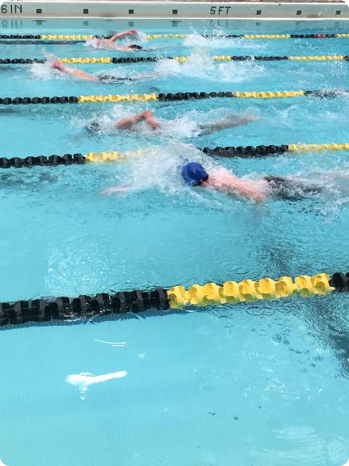
The YMCA of Greater Hartford
RETURN TO
PRACTICE PLAN

Slide 2
SAFETY FOR OUR SWIMMERS
Swimmers are NOT permitted to attend practices if…
They have a fever, cough, shortness of breath or difficulty breathing, chills, headache, sore throat, new loss of taste or smell, or other symptoms listed by the CDC.
Anyone in their household has symptoms or tested positive for COVID-19.
They have been exposed to anyone who has symptoms or tested positive for COVID-19.
There will be no penalty for swimmers missing practice due to Covid-19
Member Screening
All swimmers, parents, and coaches will be screened before they enter the YMCA
Any one with a temperature over 100.0 will not be allowed to enter the YMCA
All members will have to sign a new liability document when they enter the Y for the first time

Slide 3
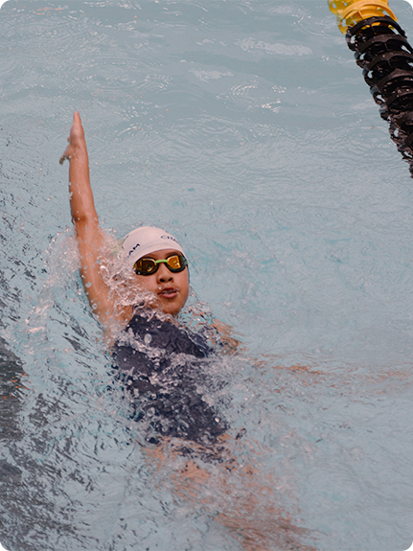
SAFETY FOR OUR SWIMMERS continued
Swimmers must come to practice…
Wearing a swimsuit
Wear Face Mask until you enter the pool
Pre-showered at home
With a full, clearly marked water bottle
We recommend using the restroom at home before coming to practice because practices are not long, but we will not turn away swimmers who ask to use the restroom. Prepared to follow all physical distancing requirements
Arrive as close as possible to when activity begins
We will start off with only 3 swimmers per lane

Slide 4
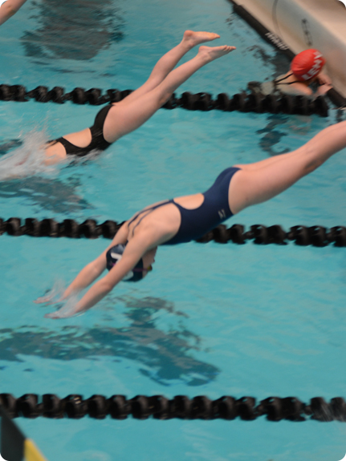
WHEN SWIMMING
Follow directions for spacing and stay at least six feet apart from others.
Do not make physical contact with others, such as shaking hands or giving a high five.
Avoid touching your face.
Avoid sharing food, drinks, or towels.
Maintain appropriate social distancing from other swimmers when taking a break.
Wear your suit to and from practice.
When swimming do not stop and stand to let swimmers pass. Slow down a little and let another swimmers pass.

Slide 5
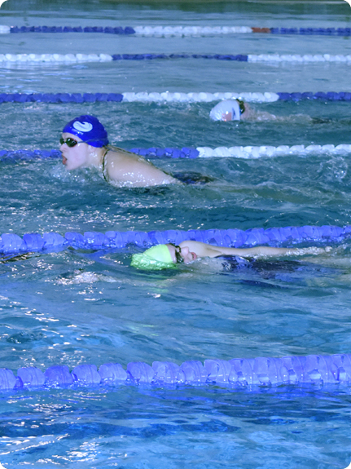
WHY RETURN
There is no evidence that COVID-19 can spread through the water. Proper operation, maintenance, and disinfectant (with Chlorine or bromine) of pools should kill covid-19. New practice process has been put in place to ensure the safety of our swimmers.
Physical distancing of 6’+ can be maintained both in and out of the water during organized swim practices.
Minimal touchable surfaces.
Coaches and all other YMCA staff have been trained in cleaning protocols and safety protocols to ensure the safety of our swimmers and members

Slide 6
CHOLRINE AND COVID-19
From the CDC…
Can the virus that causes COVID-19 spread through pools?
Proper operation, maintenance, and disinfection (with chlorine or bromine) of swimming pools should kill the virus that causes COVID-19.
Maintain proper disinfectant levels (1-10 parts per million free chlorine or 3-8 ppm bromine) and pH (7.2-8)
CDC’s Model Aquatic Health Code has more recommendations to prevent illness and injuries at public pools in parks.
From the WHO…
Virus type that causes COVID-19 is killed easily.
Enveloped viruses are easier to kill than non-enveloped viruses: “Sars-CoV-2, the virus responsible for the COVID-19 outbreak, is an enveloped virus and therefore the easiest to kill of the three types of viruses.”
The WHO recommended chlorination level of 15mg min/liter is sufficient to kill non-enveloped viruses, and an enveloped virus such as COVID-19 would be inactivated at even lower levels.
Research
CDC
World Health Organization
Articles
USA Swimming
Aquatics International
Swimswam Pt.1
Swimswam Pt.2

Slide 7
ROAD MAP TO GET BACK IN THE POOL
BEFORE PRACTICE
Park near front entrance Parents must park in the parking lot and NOT in front of the building to drop off swimmers. Swimmers will need to walk to the front door and wait for their temperature check while maintaining social distancing.
Enter through front door
Temperature check Swimmers will have their temperature taken by a thermometer upon entry. Swimmers will be asked if they have (1) specific symptoms such as fever, cough, or difficulty breathing, or (2) have been in contact with someone who has symptoms or has tested positive for COVID-19. Swimmers with a 100.0°F fever or answering “yes” to any of the questions will not be permitted to enter the facility.
Scan membership card at front desk All swimmers and parents must check in at the front desk. The Y must be able to track accurate numbers of members in the building
Go to designated Pool Doors Swimmers and parents will be required to go through designated doors to get to the pool. A coach will be waiting at the door to open it for everyone. This will help minimize the number of surfaces touched.

Slide 8
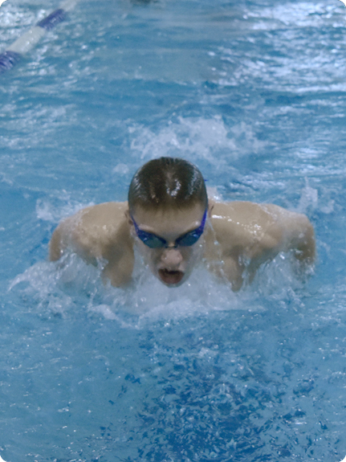
ROAD MAP continued
Pool Doors will be opened by coaching staff The pool doors will be opened by a coach to let swimmers and parents into the pool area
Once the deck is cleared swimmers will go to assigned lanes at both ends of the pool To help ensure social distancing and using recommendations from USA swimming we will only be allowing 3 swimmers per lane starting from opposite ends of the pool. Coaches will assign lanes based on swimmers.
Set items in assigned area on the deck Swimmers will leave all belongings behind there lanes and it is up to the swimmer to bring a container to put all of there stuff in. it is recommended that swimmers only bring essential things in to the Y.

Slide 9
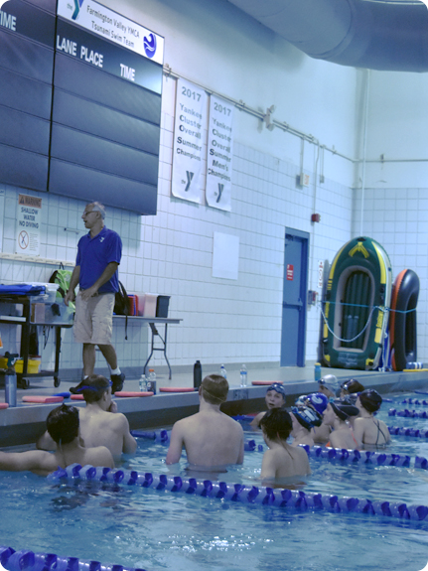
ROAD MAP continued
PRACTICE
Swimmers will utilize a 3-point entry to get into the water. Swimmers entering the pool must sit down and slide in to minimize splashing
3 Swimmers per lane, starting from opposite ends of the pool.
Swim workout With the modified swim practice schedule we will fit work outs to match the practice schedule. we will not be using equipment the first few steps of practice so leave your equipment bag at home!

Slide 10
ROAD MAP continued
DEPARTURE
Dry off and retrieve items from designated area Swimmer will not be allowed to use the locker rooms to change before/after practice They can only dry off . USA swimming does not allow for deck changing so swimmer must be prepared to come and go in their swimsuits. Swimmers must also have shoes on before reentering the lobby.
Following the approved flow of traffic swimmers will be dismissed in accordance with social distancing norms. Coaches will be directing the swimmer on how to exit the pool area using one-way access points.
Coach at pool doors will open the door and let swimmers out. Swimmers and parents will not be allowed to touch the doors. A coach will open them for you.
Swimmers will immediately proceed out the front doors and leave the YMCA. Swimmers will make their way out the front door of the YMCA and either head to their cars or wait on the sidewalk, maintaining physical distancing from other members. Parents, please wait in your cars for your swimmer(s) to come out.
Parents must park car in parking lot and swimmers will walk to car.

Slide 11
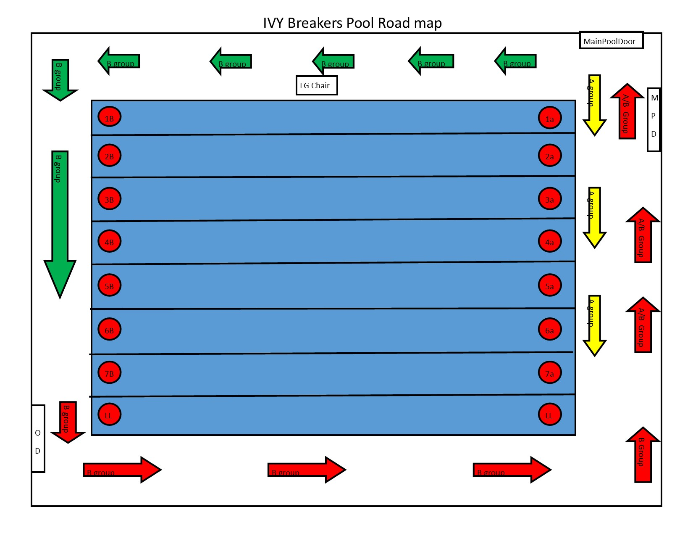
IVY POOL MAP

Slide 12
PRACTICE EXPECTATION
COVID-19 SYMPTOMS
What if my swimmer has symptoms or suspected exposure? Swimmers who are ill are not able to attend. Swimmers who have any members in their household who are ill may not attend for 14 days. Report any illness to Head swim coach so staff can trace and ensure the safety of all our swimmers.
What protective equipment is required? Swimmers, coaches, and parents are required to wear a mask in the YMCA. Swimmers will remove masks once they are allowed to enter the pool.
What precautions are coaches taking to keep swimmers safe? The coaching staff will wear masks during the all practices. Coaches will keep 6’ physical distancing except in emergency situations.
PRACTICE PREPAREDNESS
Can my swimmer participate if they are late to practice? Given the shorter timeframe for practice we would prefer that all swimmers arrive on time. However, if a swimmer is late, they will still be allowed to participate. They must still follow all of the steps outlined when arriving.
Can my swimmer borrow equipment? NO, in the first few steps of our return to swim plan Swimmers will not be using equipment during practice time.
Can my swimmer leave equipment at the pool? All personal items/equipment must be taken home at the end of practice each day. The Y will not have a “lost and found” anything left at the Y will be thrown away at the end of each day.

Slide 13
PRACTICE EXPECTATION
PARENTS AND SPECTATORS
Are parents or spectators allowed onto the pool deck? Per Safe Sport, parents and spectators are allowed on the pool deck, but there will be limited seating due to the new social distancing guidelines. Seating will be first come fist serve and bring your on chair.
CHANGING AND LOCKER ROOM ACCESS
Can my swimmer take a shower or use the locker room after practice? No. Out of an abundance of caution, the locker rooms will not be available for use by the swim team. Swimmers should show up to practice in their swimsuits.
Can my swimmer deck change? No. USA Swimming rules prohibit deck changing. Swimmers will be required to enter and leave the facility with their swimsuits on.
Where should my swimmer go to the bathroom? Swimmers should use the bathroom at home prior to coming to practice. In an emergency, swimmers will be able to use the designated bathrooms at the Y. With the abbreviated practices, swimmers should not plan to use the bathroom during practice time.

Slide 14
PRACTICE EXPECTATION
TRAINING GROUPS AND PRACTICES
Will all groups be back in the water right away? No, the GHYMCA swim teams will be returning to swimming in steps. We will be starting with our top groups, and then work down from there. This decision was made because we believe that the older groups can help demonstrate our social distancing protocols to the younger groups. ALL groups will be brought back in steps.
Will practice times be our normal practice schedule? Due to unprecedented time away from the pool and physical distancing measures, practices will be shorter, have a 10-minute interval between practice slots and limited Swimmers in the water at a time. Thus, we can’t run a normal practice schedule. Practice schedules will be adjusted week by week as we are able to add in more groups.
SAFE SPORT AND MAAPP
How is GHYMCA complying with Safe Sport MAAPP with the new parent/spectator restrictions? We will be allowing a limited number of parents on the pool deck during practice time. As well as having multiple coaches, lifeguard, and other aquatic staff on the pool deck, ensuring that all interactions are observable and interruptible
AFTER PRACTICES
What are swimmers advised to do after practices? Swimmers should dry off put on any clothes they came with and exit the building through the front doors, once at home swimmers should shower and rinse out their suits at home. Remember to clean off shoes and any items set down at the facility.

